Slide 1
A BIBLICAL RESPONSE TO TRIALS AND SUFFERING

Slide 2
A BIBLICAL RESPONSE TO TRIALS AND SUFFERING
2 Tim 3:16: All Scripture is breathed out by God and is profitable for teaching, for reproof, for correction, and for training in righteousness.
Scripture
Provides truth necessary for life and godliness.
Exposes sin, wrong behavior, or wrong beliefs, leading to confession and repentance
Directs us back to godly living and glorifying God
Discipleship to those who are suffering seems intimidating, but either we are in a storm, going out of one, or getting ready to head into one.
The questions aren’t: Will I suffer? Will I have hard times?”
The real questions are: How do I handle it? How do I respond?

Slide 3
A BIBLICAL RESPONSE TO TRIALS AND SUFFERING
The world sees suffering differently. We have hope and do not grieve as they do.
John 16:33: I have said these things that you may have peace. In the world you will have tribulation. But take heart; I have overcome the world.
Psalm 46:1-4,7: God is our refuge and strength, a very present help in time of trouble. Therefore, we will not fear though the earth gives way, though the mountains be thrown into the heart of the sea, though its waters roar and foam, though the mountains tremble at its swelling. There is a river whose streams make glad the city of God, the holy habitation of the Most High. The Lord of hosts is with us; the God of Jacob is our fortress.

Slide 4
WHAT DO YOU IDENTIFY AS TRIALS AND SUFFERINGS?
Finances
Marriage
Job
Disease
Relationship problems
Aging parents
Wayward children
Family
Physical
Mental
Accidents
Death
Life changes
Tornadoes, earthquakes, etc.
Persecution of believers
4

Slide 5
Wrong (typical) responses
Why me?
Why them?
Where was God?
Why is He punishing me?
What did I do to deserve this?
This always happens to me.
No one cares.
I can never win.
I have always tried to be a good person.
I was an innocent bystander
I always gave more than I took.
Life is unfair.
I deserve better.
I have lived a faithful life
5

Slide 6
Feelings consistent with thoughts
Fear
Pain
Worry
Depressed
Disappointed
Anger
Grief
Mistreated
Sorrow
Hurt
Revenge
Unappreciated
Abandoned
Paranoia
Helplessness
Self-pity
Cheated
Victimized
6

Slide 7
Behaviors consistent with thoughts and feelings
Isolate
Blame
Complain
Outbursts
Self-harm
Hurt others
Hypervigilant
7

Slide 8
Attempts to stop the trials and suffering
Denial – of a diagnosis or no money in the bank, so I refuse to acknowledge it
Leave a job after being passed over for a promotion
Leave a relationship because it is not easy
Moving away to avoid criticism of in-laws
Using alcohol or substances to avoid or numb feelings
Sleep all day to avoid it
Psalm 121:1-2:
I lift up my eyes to the hills. From where does my help come? My help comes from the LORD, who made heaven and earth.

Slide 9
truth: sin
We suffer and have trials because we are fallen creatures living in a fallen world
Secular counseling has no category for human sinfulness and none for Christ or His perspective on life and godliness.
Adam’s sin - Trials and suffering entered the world through Adam’s sin (Gen 3)
Creation suffers – natural disasters, terminal diseases, and death.
We wait to be renewed (Rom 8:19-22)
It is important to see the extent of sin in the world so we can communicate to those we are discipling.

Slide 10
Truth: sin
My sin - Trials and suffering can be a result of my sin (Rom 3:23; Gal 6:7-8; Psa 38:1-18)
Personal sin may lead to: Legal, marital, health, financial, and/or job problems, gossip, anger, lack of control
People may have blinders and may not see that they are the problem.
Sin affects our thinking. We suppress the truth and rationalize choices (good things seem wicked and bad things appear to be acceptable).

Slide 11
Truth: sin
My sin - Trials and suffering can be a result of my sin (Rom 3:23; Gal 6:7-8; Psa 38:1-18) - Continued
Sin affects our motivation – Noetic effects our inner man, will, choices, and desires. Sin distorts our motives in our hearts.
James 1:14-15: But each person is tempted when he is lured and enticed by his own desire. Then desire, when it has conceived, gives birth to sin and sin, when it is fully grown, brings forth death.
We were created to be motivated by the same things that motivate God.

Slide 12
Truth: sin
Dealing with Personal Sin
True godly sorrow: Grief over the reality that they have offended Almighty God; a desire to turn away from it with an emphasis on the relationship with the Person of God. The person is sorrowful because of offending God, not because of the punishment he will get, resulting in a change of mind.
(Psa 51:1-4; Matt 26:69-75; Acts 2:36-41; 1 Thess 1:6-9; Luke 19:8-10)
Worldly sorrow: Grief over the consequences of sin. This person has a sense of guilt but is unwilling to turn away from the sin. They are sorry they got caught and fear what will happen to them as a result. (Ex 9:27-35; Matt 27:3-5; Cain, Gen 4:1-14; James 4:1-2)
Worldly sorrow over the situation but unwilling to let go of the treasure that keeps one in sin and away from fellowship with God. (Rich Young Ruler, Mark 10:17-21)

Slide 13
Truth: sin
Other’s sin – Trials and suffering can be a result of other’s sin. (Psa 119:61; 1 Sam 19:1; Gen 50:20)
The sin of others may lead to: Being fired unjustly, getting your bank account hacked, being gossiped about, lied to, threatened, betrayed, a victim of crime
There can be complex trials and suffering. The same biblical principles apply.
We need to have our eyes and ears open to recognize trials happening simultaneously, i.e., abandonment in the midst of illness, being laid off during financial problems, problems with unhelpful attitudes from friends and family, which exacerbate the problem.

Slide 14
Truth: sin
Luke 13:1-5
It was the belief of many that disaster and sudden death always signified divine displeasure with sin.
However, God can cause calamity on evil as He did with the flood and Sodom and Gomorrah.
Christ challenged the people’s notion that they were morally superior to those who suffered in such catastrophes and called them to repent.
No one is guaranteed time to prepare for death; now is the time for repentance because judgment will come to all.

Slide 15
Truth: there is hope in god’s purpose
Produce endurance (James 12:4)
Result in glory and honor to Jesus (I Pet 1:6-7)
Disciplined to share in God’s holiness (Heb 12:10-11)
To be obedient to God’s Word (Psa 119:67, 71)
Jesus learned obedience through suffering (Heb 5:8)
Develop humility (2 Cor 12:5b-7)
To know Him, share in His sufferings (Phil 3:10)
Become like Jesus (1 Pet 2:20-21)
To strengthen us (1 Pet 5:10)

Slide 16
Truth: there is hope in god’s purpose
Reflections from the Psalms
He gives life (119:50)
Obey (119:67)
Learn God’s Word (119:71)
Delight in God’s Word (119:42, 143)
Purify us (66:10; 139:23-24)
Wean us from worldliness (73:25-28)
Teach us perseverance (88:13; 34:1, 19)
Suffering has been called the textbook that teaches us about ourselves. Don’t waste the trials. We can grow and help others. We are to bear fruit for His glory and our good.

Slide 17
Truth: there is hope in god’s provision
Sealed with the Holy Spirit (Eph 1:13)
Comfort in God’s Word (Psa 119:50)
We cannot be separated from the love of Christ (Rom 8)
God is faithful and will not let you be tempted beyond what you can bear (I Cor 10:13)
His divine power has given us everything we need for life and godliness (2 Pet 1:3)
Fear not, for I am with you; be not dismayed, for I am your God; I will strengthen you, I will help you, I will uphold you with My righteous hand (Isa 41:10)

Slide 18
Truth: there is hope in god’s provision
We will be with Him in heaven (Rev 21:3-4)
He will sustain us (2 Cor 4:8-9)
He can do more than we can ask or think (Eph 3:20)
He comforts us (2 Cor 1:3)
Christ defeated our last enemy; death is swallowed up in victory (1 Cor 15)

Slide 19
Right thoughts and responses
George Mueller: “I am satisfied with the will of my Father.”
Job: Through his suffering, he was better able to see and understand God (42:1-6)
Take-aways
Believe in the sovereignty of God
Believe everything He does is right and good
Repent and be humbled
Be satisfied and do not murmur
19

Slide 20
Right thoughts and responses
The problem is not the problem; it is my response to it.
Suffering is not arbitrary. It is individually and sovereignly designed to refine our faith and enlarge our holiness
There are times we must say with Job, “Though He slay me, yet will I trust Him” (13:15). God wants our trust more than our understanding.
20

Slide 21
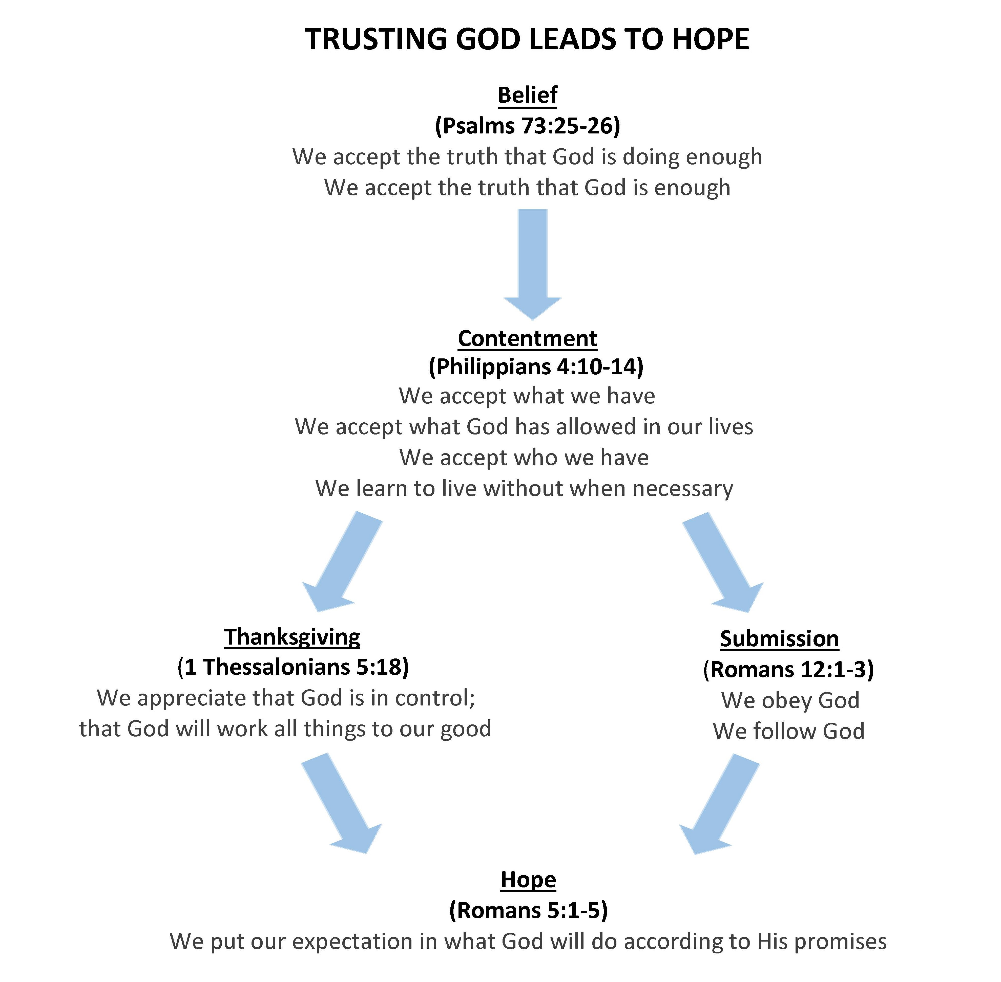
From Trusting God, Dr. Nicolas Ellen, www.mycounselingcorner.com, 5/17/2020

Slide 22
Right thoughts and responses
Bless God (Job 1:20-22)
Praise God (I Pet 2:21-23)
Please God (2 Cor 5:9)
Sing and Rejoice (1 Pet 4:12)
Rejoice in hope, be patient in tribulation, be constant in prayer (Rom 12:12)
Help others even in the midst of our affliction (2 Cor 1:4)
Delight in the Word when mistreated (Psa 119:69-70)
Open my eyes that I may behold wonderous things out of Your law (Psa 119:18)

Slide 23
Things not to say
It could be worse
God needed him
If you have enough faith, God will heal you (or your trial will go away)
I know the right person is out there for you somewhere; just be patient
When I finally stopped wanting _________, that’s when God gave it to me.
It’s not as bad as _________.
God is faithful; He won’t give you more than you can handle.
My brother-in-law’s cousin went to a clinic in ________ and got well. I’ll get the name of the clinic for you.
Even the truth can hurt if not applied to the right situation or right timing.

Slide 24
Things to say and do
1 Cor 12:25-26: If one member suffers, all suffer together.
Tell them you are sorry
Listen and ask how you can pray for them
Weep, mourn, and laugh with them
Encourage them in the Lord
Pour out hope on them
The Lord is able to do far more abundantly than we can ask or think (Eph 3:20)

Slide 25
What can we do to Help Others?
1 Corinthians 12:25-26 -
²⁵ so that there may be no division in the body, but that the members may have the same care for one another. ²⁶ And if one member suffers, all the members suffer with it; if one member is honored, all the members rejoice with it.
Check In and stay the course
“I’m so sorry…” (don’t lead with instruction and insight – there’s a time for that!
“How can I pray for you?” (allow them to articulate)
Enlist others if necessary

Slide 26
Ten Things to do During Suffering
Ed Welch
Don’t be surprised by suffering (1 Pet. 4:12). The Son suffered, so do His followers!
Live by faith, see the unseen (Heb. 2:2). Normal eyesight is not enough. Your eyes will tell you that God is far away and silent. The truth is that He is close—invisible—but close.
Suffering will reveal what is really in your heart. It will test you (Jam. 1:2).
God is God, you are not (Job 38-42). This is important. Humility and submission before the King can quiet some of your questions. Live by faith, see the unseen (Heb. 2:2).

Slide 27
Ten Things to do During Suffering
Ed Welch
5. Confess sin. There is nothing new here; it is a regular feature of daily life. Yet it always helps you to see the cross of Jesus more clearly. (Heb. 12).
6. Keep an eye out in Scripture for the Suffering Servant. He has entered into your suffering, and you can enter into his. (Isa 39-53, John 10-21)
7. Speak honestly and often to the Lord. Just speak, groan, have someone read you a psalm and say a weak, “Amen.”

Slide 28
Ten Things to do During Suffering
Ed Welch
8. Expect to get to know God better while in this wilderness. That is how he usually works with his people (Phil. 3:10-11).
9. Talk to those who have suffered, read their books, listen to them. You are not alone. Insist on being moved with compassion as you hear other stories of suffering.
10. Look ahead. We need spiritual vision for what is happening now and for where the universe is heading. We are on a pilgrimage that ends at the temple of God (Ps. 84).

Slide 29
Sources used and recommended reading
A Theology of Biblical Counseling by Heath Lambert
Suffering and the Sovereignty of God by John Piper and Justin Taylor
Walking with God Through Pain and Suffering by Tim Keller
Expository Counseling Training Center https://mycounselingcorner.com/
Association of Certified Biblical Counselors https://biblicalcounseling.com/resource-library/
Christian Counseling and Education Foundation https://www.ccef.org/resources/
Biblical Counseling Coalition https://www.biblicalcounselingcoalition.org/resources/

