Slide 1
Psychologized Culture and Drug Therapy
Discerning Myth from Reality in Biblical Counseling

Slide 2
Examples of Our Psychologized Culture
Common statements of self-identification.
  “I’m bipolar,” or “I’m OCD,” or “I’m ADD.”
Use of the words: “disease” or “disorder.”
  A disease is a concrete biological entity (like an infection or fracture).
  “Best available description of how mental disorders are expressed & recognized…” (DSM5, p.xli).
Unintended consequences.
  Belief that the underlying problem is organic with a known etiology.
  Results in a degree of hopelessness.

Slide 3
Yes, There is a Physical Component
Your Personal Data Inventory (PDI) should include physical assessment questions.
  Diagnoses, medications, physicians, etc.
Do not hesitate to recommend a physical examination.
  Should have a current exam.
  May need to recommend one in the discovery process.
Examples of physical diagnoses that impact mood and behavior:
  Hypothyroidism, hyperthyroidism, Addison’s disease (adrenal gland), Acromegaly (pituitary gland), Parkinson’s disease, etc.

Slide 4
DSM5 – The Diagnostic & Statistical Manual for Mental Illness – Fifth Edition
History of the “psychiatrist’s bible.”
  1st edition – 106 diagnoses, DSM 5 well over 400 diagnoses.
DSM III (3rd edition) - 1980
  Change to a medical model.
  Introduction of SSRIs (Prozac).
Saving Normal.
  What the insiders are saying about trends in mental health.
Is there help in the DSM5 for biblical counselors?

Slide 5
Medical Diagnosis vs. Psychiatric Diagnosis
Medical diagnoses have objective data that points to a known etiology (e.g., Streptococcal infection, diabetes, hypertension, etc.)
Psychiatric diagnoses are without objective data. The diagnosis is based on observational data with an unknown etiology.
  Diagnostic criteria also change with new or different hypothetical explanations or guesses as to supposed cause.
  There simply are no examples in traditional psychiatry – outside of the organic mental or brain diseases – where a distinct, measurable, observable alteration in brain structure or function has been discovered such that the concept of disease can be fully and honestly applied.

Slide 6
Chemical imbalance theory
Definition – The chemical imbalance theory is a hypothesis suggesting that mental disorders, such as eating disorders and depression, may result from imbalances or dysregulation of neurotransmitters in the brain. (originally published as a scientific fact).
Often this theory is linked to lower levels of serotonin, a neurotransmitter associated with wellbeing and satiation.
According to the theory the dysregulation occurs because there is not enough of the neurotransmitters in the synapses. Since these neurotransmitters are in a class called monoamines, the theory is often referred to as the monoamine hypothesis.

Slide 7
Chemical imbalance theory
History – In 1951 Germany, a drug know as iproniazid was being used to treat tuberculosis. Some patients reported in increased sense of vitality and well-being. This resulted in some medical professionals using it for treating depression as the effect was assumed to be a biological response to the drug. In less than one year over 400,000 depressed people were treated with iproniazid. Often, this theory is linked to lower levels of serotonin, a neurotransmitter associated with wellbeing and satiation.
Similarly, impramine was observed to affect the mood of patients who were receiving the drug for psychosis.
Key Point: correlation does not equal causation. Interestingly enough, impramine does not inhibit the destruction of neurotransmitters in the synaptic cleft (thus it IS NOT a MOAI monoamine oxidase inhibitor).

Slide 8
Chemical imbalance theory
Implications:
Multiple studies have been conducted that were aimed at reducing serotonin in healthy individuals. None of these studies show the patients became depressed because their serotonin levels were dramatically reduced.
Continued studies show the MAO theory to be so week that it has been abandoned by clinicians in the field.
The effects between SSRIs and placebo show similar results. The difference between SSRI and placebo is considered by many scientist to be clinically insignificant.

Slide 9
Psychotropic Drug Info / Nomenclature
It should be recognized that the NBN (Neuroscience-Based Nomenclature) classifies agents based on their pharmacological mechanisms of action and not the pathopsychological mechanism for psychiatric symptoms or their root causes (which are largely unknown).
The link between neurochemical changes in the brain and the distortions individuals display in perceiving the world or shaping their behavioral responses remain an unproven hypothesis.

Slide 10
Do Antidepressants work?
It depends on what you mean by “work.”
There is some agreement that antidepressant medication can make some people feel better. In fact, there are times when the reduction in depressive symptoms can be dramatic.
But there is much we still don’t know.
  We don’t know why medications that are chemically different have similar effects.
  We don’t know why it helps some and does not help others.
  We don’t know why antidepressants seem to be equally effective with seemingly unrelated problems, such as obsessive thoughts and compulsive behavior.
  We don’t know why it can take up to a month before people notice a difference.
  We don’t know why antidepressants often lose their effectiveness over time.
The idea of working is subjective and resides with the person receiving the medication and not in any clear objective change if their physical makeup.

Slide 11
Science Fictions
Fraud.
  Intentional falsification of data in scientific studies.
Bias.
  Any process at any state which tends to produce results or conclusions that differ systematically from the truth.
Negligence.
  Either 1) unforced errors that come from inattention, oversight, and carelessness, or 2) from a design error due to poor training apathy, etc.
Hype.
  Exaggerated advice, exaggerated causal claims, and exaggerated inferences to humans from animal research.

Slide 12
Psychology
Questions that should be asked about psychology and their findings.
  Are the findings Subjective or Objective evaluations?
    There are no objective findings to validate psychiatric diagnoses.
  Are the findings reproducible?
    Findings vary significantly and undermine their reproducibility.
  Should we think of psychology as a science, a philosophy or a myth?
    Science deals with what can be consistently quantified and findings that can consistently be reproduced.
    Unproven findings (observations) should not be presented as proven fact.
    Philosophy is the exposition and defense of a worldview.
    “Mental Illness is still a myth” – Thomas Szasz*
* Professor Emeritus of Psychiatry at the State University of New York in Syracuse, New York. He is author of The Myth of Mental Illness. (1995).

Slide 13
Drugs and Their Use in Treating Mental Health Issues
Monoamine hypothesis / chemical imbalance theory.
  Neurotransmitters are attributed as being deficient.
Commonly used medications presenting in counseling:
  Antidepressants.
  Anxiolytics.
  ADHD medication.
  Others.
Side effects and psychotropic medications.

Slide 14
Changing the Vocabulary with Counselees
Understanding the use of psychologized labels.
  How does your counselee use the labels for his problem?
    Realize this is how the counselee has come to define his problem.
    Clarify what the counselee means by use of these labels.
    Begin to transition the conversation.

Slide 15

Transitioning the Conversation
See to it that no one takes you captive through philosophy and empty deception, according to the tradition of men, according to the elementary principles of the world, rather than according to Christ. – Colossians 2:8

Slide 16
Untangling the Use of Psychologized Labels.
How does the Bible define the current psychological term?
  The Bible speaks to all of our life (2 Peter 1:3).
  Begin grounding the counselee in the framework of Scripture.
  From disorder to issues of the heart.
  Remember 2 Tim 3:16 To reprove is to… “So rebuke another, with such effectual wielding of the victorious arm of the truth, as to bring him, if not always to a confession, yet at least to a conviction, of his sin.” – Richard Trench from “Synonyms in the New Testament.” (cf. Titus 1:9). Scripture has that effect on us as we study it and feel its convicting power, or on others as we point them to it.

Slide 17
Addressing Questions – Psychotropic Medication
Questions presented before your counselee is placed on medications.
  Start with biblical counseling.
Questions presented after placed on medication.
  Do not recommend discontinuation of medication.
  Know the use of the medication.
  Know the side effects of the medication.

Slide 18
Counseling with Compassion and Humility
Compassion.
  Aided by the Holy Spirit, biblical counselors seek to reflect the love, concern, and compassion of Jesus our Shepherd and Counselor (Matthew 9:36).
  Biblical counseling is a caring process marked by Christlike love (1 Corinthians 13:4–8), the fruit of his Spirit (Galatians 5:22–23), and “compassion, kindness, humility, gentleness and patience” (Colossians 3:12).
  Christlike compassion extends to those who suffer not only from the sins of others but also from the consequences of their own sins (e.g., Nehemiah 9:16–21).
  True compassion involves taking the time to learn what God has to say about human difficulties and how He expects us to confront them. It means working long and hard with counselees—some of whom are not always too cooperative.
  The biblical counselor should “rejoice with those who rejoice and weep with those who weep” (Romans 12:15). He should become compassionately involved!
  Have mercy on some, who are doubting – Jude 22-23.

Slide 19
Counseling with Compassion and Humility
Humility
  Scripture does not give us exhaustive understanding of our bodies. Even the best medical researchers cannot explain many of the body’s complex functions. For instance, while science has made great strides, there is much we do not understand about the way the brain works. – See Ecc 11:5.
  Ultimately, while we can affirm the presence of the body, we cannot feign to understand all of its complexities. We are indeed “remarkably and wondrously made” (Ps 139:14).
  Counselors should remember that while there might be a biological factor at play in any counselee’s situation, there is always a spiritual component.
  2 Timothy 2:24 - The Lord’s bond-servant must not be quarrelsome, but be kind to all, able to teach, patient when wronged,
  Matthew 10:16 — 16 “Behold, I send you out as sheep in the midst of wolves; so be shrewd as serpents and innocent as doves.”
  Here is the basic idea of saying the right thing at the right time and place, of having a sense of propriety and appropriateness, and of trying to discover the best means to achieve the highest goal. It is neither wise nor loving to be needlessly accusatory or inflammatory.

Slide 20
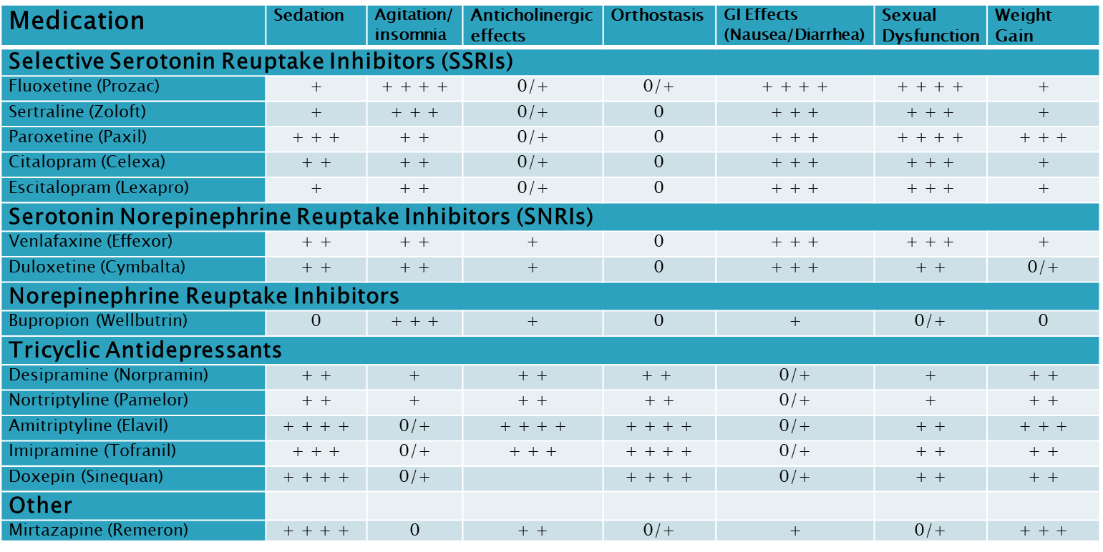
Adverse Effects of Antidepressant Medication
0, Negligible; + very low, + + low, + + + moderate, + + + + high

Slide 21
Working with a Counselee and Their DSM Diagnosis
Assessment: Questions that reveal what is behind the label he is using.
The counselor should use biblical terminology as he understands the issue.
Use the narratives of Scripture which speak to the heart issue.
  Moses – anxiety and fear (Exodus 3-4).
  Elijah – overwhelming sadness (1 Kings 19).
  Psalmist – grief (Psalm 42, 43 and others).
  The desolate or abased ones – humiliation and fear (Isa 54).

Slide 22
Conclusions
  Not everything is physical, but everything is spiritual i.e., how the counselee will respond to his current situation.
  The sufficiency of Scripture – the backbone of biblical counseling.
  Unlike secular psychologists, biblical counselors view the consideration of God as critical in developing a proper view of human nature, and they recognize that the source from which to draw an understanding of God is made possible primarily through the sacred Scriptures. The Bible, therefore, is the ultimate source of knowledge (not pseudoscience, as is the case in secular psychology). Succinctly stated, the Bible is the epistemological basis from which biblical counselors develop their presuppositions regarding all that is counseling.

Slide 23
Conclusions
  Paul is saying (Col 2:4) – Wake up! Pay attention! Danger! These things are empty deceptions (designed to trick or entice through a pleasant illusion). Paul expresses it this way, “according to the tradition of men, according to the elementary principles of the world RATHER THAN according to Christ.”
  Do not be taken captive by philosophy and empty deception (Col 2:8).
  Follow Scripture’s admonition.
    Let the word of Christ richly dwell within you (Col 3:16).
    Do all for the glory of the Lord (Col 3:17).
    Know how you are to respond (Col 4:6).

Slide 24
Thank You
Questions?

