Slide 1

Biblical Counseling Basics - Sanctification and Heart Change
September 18, 2024

Slide 2
INTENT AND PURPOSE
Sanctification: Our’s and One Another’s
To understand our sanctification
To learn what the Bible teaches about the issues and challenges of life.
To learn how to use the Bible to address the issues and challenges of life.
To develop confidence in accurately handling the Word of Truth
To learn how to examine yourself through the lens of Scripture.
To help Christian men and women learn how to minister the Word to other brothers and sisters in Christ in discipleship and counseling.
Develop and enhance biblical skills in addressing and solving problems biblically, as a disciple-maker, a shepherd, mentor or as a trained lay counselor.
To understand the conflict between secular counseling reasoning and a biblical worldview and how to recognize the difference and address it through a biblical lens.
To work towards and achieve certification as a Biblical Counselor

Slide 3

Psychological Questions
All people in every society and culture asks these questions:
Who are we?
What happened?
Why do we do the things we do?
What motivates people?
What are the causes of our psychological ills?
How do we change?
How do we heal?
What is the goal of change?
We propose to answer these questions from a biblical worldview!

Slide 4
Biblical Counseling: Defined
Biblical counseling is the personal discipleship ministry of God’s people to others under the oversight of God’s church, dependent upon the authority and sufficiency of God’s Word through the work of the Holy Spirit.
Biblical counseling seeks to reorient disordered desires, affections, thoughts, behaviors, and worship toward a God-designed anthropology, in an effort to restore people to a right fellowship with God and others.
This is accomplished by speaking the truth in love and applying Scripture to the need of the moment by comforting the suffering and calling sinners to repentance, thus working to make them mature as they abide in Jesus Christ.
Dale Johnson and Samuel Stephens:
The Association of Certified Biblical Counselors (ACBC)

Slide 5
Sanctification
“Sanctify” is to set apart to God, for His use. God works in those whom He claims as His own to conform them “to the image of his Son” (Rom. 8:29).
We are increasingly being changed from what we once were through the agency of the indwelling Holy Spirit .
Progressive Sanctification is spiritual growth/maturity/being complete (Colossians 1:28).
The Holy Spirit “works in you, both to will and to work” according to God’s purpose (Rom. 8:28).
Working out our salvation with fear and trembling (Phil. 2:12, 13). Christians become increasingly Christlike, as the profile of Jesus is progressively formed in them (Gal. 5:22–25; 2 Cor. 3:18).

Slide 6
SANCTIFICATION

John 6:44
Eph. 1:4-6
Eph. 2:4-6
Preparatory – all God does in bringing a person to Christ.

Slide 7
SANCTIFICATION
Positional – the moment a person is saved, justified.
John 1:12-13
Romans 3:24-28
1 Cor. 6:11
Eph. 1:7
Eph. 2:6-9
Titus 3:4-7

Preparatory – all God does in bringing a person to Christ.

Slide 8
SANCTIFICATION
Positional – the moment a person is saved, justified.
Eph. 2:10
Phil. 2:12-13; 3:13-14
1 Thess. 4:1-8
Titus 3:7-8
This is you!

Progressive – the process of changing/growing over time.
Preparatory – all God does in bringing a person to Christ.

Slide 9
SANCTIFICATION
Prospective –
Ultimate: Heaven, glory.
Positional – the moment a person is saved, justified.
This is you!
ROM. 8:30
2 Tim. 4:8
2 Cor. 5:5-10

Progressive – the process of changing/growing over time.
Preparatory – all God does in bringing a person to Christ.

Slide 10
Heart of Man
Heart change = Behavior change
Change of behavior without heart change is temporary and hypocritical
The Christian life is a dynamic life!
The Christian life is about change – healthy, maturing, spiritual growth to become complete in Christ – Christ-likeness (Col. 1:28)

Slide 11
Heart of Man
Proverbs 4:23
Watch over your heart with all diligence,
For from it flow the springs of life.

Slide 12
Heart of Man
Jeremiah 17:9-10
The heart is deceitful above all things
and beyond cure.
Who can understand it?
10 “I the Lord search the heart
and examine the mind,
to reward each person according to their conduct,
according to what their deeds deserve.”

Slide 13
Heart of Man
Mark 7:14-23
¹⁴ After He called the crowd to Him again, He began saying to them, “Listen to Me, all of you, and understand: ¹⁵ there is nothing outside the man which can defile him if it goes into him; but the things which proceed out of the man are what defile the man. ¹⁶ If anyone has ears to hear, let him hear.”
¹⁷ When he had left the crowd and entered the house, His disciples questioned Him about the parable. ¹⁸ And He *said to them, “Are you so lacking in understanding also? Do you not understand that whatever goes into the man from outside cannot defile him, ¹⁹ because it does not go into his heart, but into his stomach, and is eliminated?” (Thus He declared all foods clean.) ²⁰ And He was saying, “That which proceeds out of the man, that is what defiles the man. ²¹ For from within, out of the heart of men, proceed the evil thoughts, fornications, thefts, murders, adulteries, ²² deeds of coveting and wickedness, as well as deceit, sensuality, envy, slander, pride and foolishness. ²³ All these evil things proceed from within and defile the man.”

Slide 14
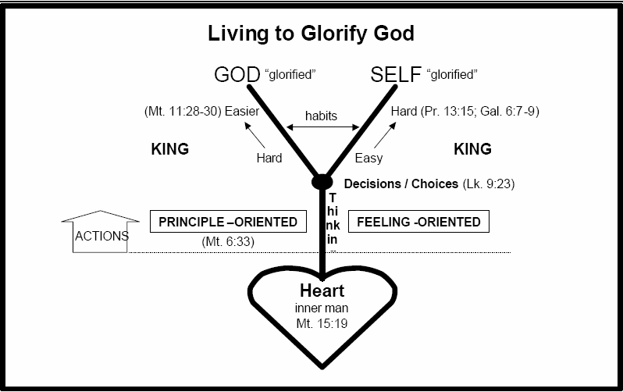
Lk 6:45

Slide 15
Inner self
Heart
Matthew 12,15
Luke 6:45

Slide 16
Actions
Thinking
Inner self
Heart
Matthew 12,15
Luke 6:45

Slide 17
Thinking
Matthew 6:33
Actions
Principles Oriented
Feelings Oriented
Inner self
Heart
Matthew 12,15
Luke 6:45

Slide 18
God Glorified
Self “glorified”
Decisions/Choices Luke 9:23
Thinking
Matthew 6:33
Actions
Principles Oriented
Feelings Oriented
Inner self
Heart
Matthew 12,15
Luke 6:45

Slide 19
God Glorified
Self “glorified”
Hard
Prov. 13:15
Gal. 6:7-9
Easy
KING
Decisions/Choices Luke 9:23
Thinking
Matthew 6:33
Actions
Principles Oriented
Feelings Oriented
Inner self
Heart
Matthew 12,15
Luke 6:45

Slide 20
God Glorified
Self “glorified”
Easier
Hard
Matt. 11:28-30
Prov. 13:15
Gal. 6:7-9
Hard
Easy
KING
KING
Decisions/Choices Luke 9:23
Thinking
Matthew 6:33
Actions
Principles Oriented
Feelings Oriented
Inner self
Heart
Matthew 12,15
Luke 6:45

Slide 21
Lk 6:45

Slide 22
Hopeful Counseling
Goal, method, focus, target, and tools of intensive discipleship and biblical counseling:
1. The goal is heart transformation and relational restoration (2 Corinthians 5:12-21).
2. The method is truth in the context of grace (John 1:14).
3. The focus is mind, will, emotions, and right behavior—renewed mind, submitted will, informed emotions, and godly behavior.
4. The target is beyond behavior to the desire and motivations of the inner man. (For example: Is it possible that there are cases where mania and depression that have resulted in a bi-polar diagnosis, are a long-standing pattern of foolish behavior and despairing thoughts?)
5. The tools are the Word of God, Spirit of God, community of God (2 Peter 1:3).

Slide 23
THE PROCESS OF CHANGE THAT BRINGS HOPE
I. Conception Of Sin (James 1:12-15)
A. Tempted by my desires, I am lured and sin is conceived in my mind (Jer 17:5-8).
B. What do I desire more than glorifying God, so much that I am willing to sin to get it?
C. Sin is my responsibility, not something I can blame on Satan or the situation.
2. Conviction (John 16:8-11)
A. What is the sin I have done in unbelief? Unbelief is going anywhere other than God and His Word to deal with a situation—Jeremiah 17:5-8.
B. What is the righteousness I have not reflected?
C. What is the judgment? What is the price to pay?

Slide 24
THE PROCESS OF CHANGE THAT BRINGS HOPE
3. Confession (1 John 1:9, Proverbs 28:13, Proverbs 13:15)
A. I agree with God. I surrender my mind, will, and emotions to God’s mind, will and emotions (according to His Word).
B. I confess to God in contrite humility. He cleanses me through the blood of Jesus Christ, and restores the relationship with Him.
C. I confess to the person I have sinned against in contrite humility. Through being forgiven by Christ—merciful, gracious forgiveness is granted, and the relationship is restored (Ps 66:18, Pro 15:29, Matt 5:23-24).
4. Change (2 Corinthians 7:8-10, Romans 12:1-2, Ephesians 4:17-32, Colossians 3:1-17)
A. Godly sorrow - I put off. I verbalize to those I have sinned against how I hate my sin.
B. Repentance - I renew my mind. I verbalize how my mind has been renewed by the Word of God to think differently (new mind).
C. Deliverance - I put on. I explain how my thoughts and actions are different (new man).

Slide 25
THE PROCESS OF CHANGE THAT BRINGS HOPE
5. Convincing Evidence (2 Corinthians 7:11)
A. I prove repentance by manifesting change in my life rather than simply talking about change – diligence through the power and leading of the Holy Spirit, clearing the old, indignation toward the sin, fear of doing it again, desire and zeal in the new actions. I am vindicated.
1. Diligence—we will eagerly and aggressively pursue righteousness (Matthew 5:6).
2. Clearing yourself—A desire to clear your name from any form of the sin (Romans 13:14, 1 Thessalonians 5:22).
3. Indignation—means we will have anger over our sin and displeasure because the shame it brought our Lord (Matthew 5:4, James 4:7-10)
4. Fear—we will have a healthy fear and reverence towards the God who disciplines and judges sin (Deuteronomy 13:4-11, Psalm 9:20, Revelation 14:7).

Slide 26
THE PROCESS OF CHANGE THAT BRINGS HOPE
5. Vehement desire—this refers to the strong desire to restore the relationship with the person who you sinned against.
6. Zeal—this refers to loving someone so much that one hates anything that harms the object of this love.
7. Vindication- means the repentant sinner no longer tries to protect himself. He wants to see his sin avenged.
B. By repentance, I prove (show, speak) myself to be changed (2 Corinthians 7:11).

Slide 27

Conclusion
“We proclaim Him, admonishing every man
and teaching every man with all wisdom,
so that we may present every man
complete in Christ.”
Colossians 1:28
And concerning you, my brethren, I myself also am convinced that you yourselves are full of goodness, filled with all knowledge and able also to admonish one another.
Romans 15:14

