Slide 1
Biblical Marriage – Part 2
BIBLICAL
Roles and Responsibilities
of a
HUSBAND and WIFE

Slide 2
Basic Marriage Principles
1. Both of You: Put Jesus First; Love Jesus Most: Matthew 22:35-38
2. Both of You: Be Empowered, Changed, and Comforted by the Trinity—Be Filled by the Spirit, Empowered by the Son, and Comforted by the Father: Eph. 5:18; 6:10-18; 2 Cor. 1:3-8
3. Both of You: Remember Who Your Enemy Is—Satan!: Eph. 6:11-12
4. Both of You: Take Personal Responsibility: Joshua 1:6-9; Philippians 4:9
5. Both of You: Take the Log Out of Your Own Eye, Confess, Repent: Matthew 7:3-5; James 4:1-4

Slide 3
Basic Marriage Principles
6. Both of You: Forgive Each Other, Reaffirm Your Love, Comfort Each Other: 2 Corinthians 2:5-11
7. Both of You: Speak Life Words, Not Death Words to Your Spouse: Ephesians 4:29; Proverbs 18:21
8. Both of You: Put the Interests of Your Spouse First in the Power of Christ: Philippians 2:1-5
9. Husband: Lead, love, and shepherd Your Wife with Christ’s Sacrificial, Other-Centered Love: Ephesians 5:22-33; 1 Peter 3:7
10. Wife: Respectfully love and submit to your Husband like the Church loves and submits to Christ: Ephesians 5:22-33; 1 Peter 3:1-6

Slide 4
Biblical Basis for Role Differences
The Bible teaches complementarianism
Equality in spirituality and personhood (Genesis 1:26-28, Galatians 3:25-29,
1 Peter 3:7)
Functional role differences in the home and in the church. (Proverbs 31:10-31, Ephesians 5:22-33, 1 Peter 3:1-7).

Slide 5
Biblical Basis for Role Differences
Complementarian relationship - “gender roles ordained by God; men and women created to complement one another. God’s roles for husbands and wives are distinct and part of God’s creative order.
Gender roles are Christ-honoring as men/husbands love and provide leadership to their wives and family;
women/wives submit to their husbands and his leadership as the most suitable helper.
Gender roles established by God are given to the church as men assume leadership over the church and women submit to male leadership.

Slide 6
Biblical Basis for Role Differences
God-ordained and Christ-honoring male headship is not dominating or oppressive, but is sacrificial, loving, and servant leadership.
Female submission is willing, voluntary, and not forced subjugation and is done as a picture of the church submitting to Christ.
Equality in spirituality and personhood. 1 Peter 3:7 - spouses are joint heirs. Galatians 3:28: “There is neither Jew nor Greek, there is neither slave nor free, there is neither male nor female; for you are all one in Christ Jesus.”

Slide 7
Biblical Basis for Role Differences
Worldly culture (sadly, in many churches now) hold to the position of “EGALITARIANISM”.
Egalitarianism holds that there are no gender distinctions as to marriage or gender roles or functions in the family or church.
No one is the designated leader and all share in the leadership, or even more confusing no one leads at all as the couple claim both are equal at leading and both are equal in every way.

Slide 8
Biblical Basis for Role Differences
Where there is no fixed leadership in the family (or any institution ) conflict and misdirection will eventually arise.
Biblical marriage is not a 50/50 relationship. The closest is a 51/49 with the husband at 51% of leadership responsibility. This is not demeaning to the wife as it is God’s design and intention.

Slide 9
Biblical Basis for Role Differences
Genesis 2: 18-24 – “a helper suitable for him”.
1 Corinthians 11:3 – “Headship”
Ephesians 5:22-33 – “Headship and Submission”

Slide 10
Biblical Basis for Role Differences
Headship and Submission (Ephesians 5.
HUSBAND LOVES AND LEADS HIS WIFE
WIFE SUBMITS TO AND RESPECTS HER HUSBAND

Slide 11
BIBLICAL ROLE/RESPONSIBILITIES OF A HUSBAND
A. God calls men to leadership - God’s plan since creation
God gave man the responsibility to lead, provide, protect, and defend and the woman was created to help him in his role (Gen. 2:16-18).
Genesis 2:16-18 –
And the LORD God commanded the man, saying, "You may surely eat of every tree of the garden, but of the tree of the knowledge of good and evil you shall not eat, for in the day that you eat of it you shall surely die.“ Then the LORD God said, "It is not good that the man should be alone; I will make him a helper fit for him."

Slide 12
God Calls Men to Leadership
A. God’s plan since creation
Though Adam has been established as the head, the adversary comes after the woman (Genesis 3:1).
Roles are important to God. When men just try to make everyone happy instead of leading biblically, children oppress and women rule, and the result is destruction (Isaiah 3:12).

Slide 13
God Calls Men to Leadership
What is leadership?
Biblical Leadership is not being a dictator, nor is it all the decision making. It is servant, sacrificial leadership (John 13:1-17).
Spiritual leadership begins with respect for the authority of the church (Hebrews 13:17).

Slide 14
God Calls Men to Leadership
What is leadership?
Leadership is solution based and goal-oriented (Ephesians 5:26-28; 6:4).

Slide 15
Ephesians 5:26-28 –
that he might sanctify her, having cleansed her by the washing of water with the word, so that he might present the church to himself in splendor, without spot or wrinkle or any such thing, that she might be holy and without blemish. In the same way husbands should love their wives as their own bodies. He who loves his wife loves himself.

Slide 16
Ephesians 6:4 –
Fathers, do not provoke your children to anger, but bring them up in the discipline and instruction of the Lord.

Slide 17
God Calls Men to Leadership
What is leadership?
Leadership sets the example of practice (Philippians 4:9).
Lead by living joyfully and setting an emotional tone of joy in the home
(Proverbs 5:18).

Slide 18
God Calls Men to Leadership
What is leadership?
A leader solves problems biblically (Ephesians 4:29, rules of communication).
7. It is man’s God-assigned responsibility to be the spiritual leader.

Slide 19
A Husband is to Love His Wife
A. The Command: Love your wife sacrificially (Ephesians 5:25).
Ephesians 5:25 –
Husbands, love your wives, as Christ loved the church and gave himself up for her

Slide 20
A Husband is to Love His Wife
Love her sacrificially as Christ loved the church.
Make every decision based on what’s best for her.
Love her in spite of her failures and without bitterness (Col. 3:19).
Colossians 3:19 –
Husbands, love your wives, and do not be harsh with them.

Slide 21
A Husband is to Love His Wife
B. The Method:
The husband sanctifies his wife (Ephesians 5:26).
so that He might sanctify her, having cleansed her by the washing of water with the word,
2. The husband is the protector and defender of his wife (2 Timothy 3:1-7).

Slide 22
A Husband is to Love His Wife
The Goal: (Ephesians 5:27)
The husband presents his wife as a pure, spotless bride as Christ does the church!
Ephesians 5:27 –
so that he might present the church to himself in splendor, without spot or wrinkle or any such thing, that she might be holy and without blemish.

Slide 23
A Husband is to Love His Wife
D. A husband loves his wife - Constantly assures his wife that he loves her (Ephesians 5:28-33a).
Love her first—no friendships with anyone stronger than with wife.
Love her most—more than job, children, mother.
Love her unmistakably—constantly in process of convincing her of his love for her.
Loves her as his own body (Ephesians 5:28).

Slide 24
E. SUMMARY
Husbands are to love their wives with a love that is unconditional, sacrificial, purifying, nurturing, cherishing, and understanding.
This calling to love our wives as Christ has loved us can be overwhelming.
Who is sufficient for these things? Who can live up to such a standard?
Brings humility before God and wives. Much grace needed. We have hope that as we better know and experience Christ’s love for us, we will better be able to express His love to our wives.

Slide 25
—QUESTIONS FOR REFLECTION:
Regarding a Husband’s Love for His Wife—
In what ways is the love of a husband to
resemble the love of Christ?
2. How can a husband’s love purify his wife?
3. Does the responsibility of a husband to nourish his wife mean that he is to be the primary provider?
4. What would you say to a husband who claims that his wife is too hard to love?

Slide 26
IV. Husbands are Learners
A husband learns to understand and honor his wife (1 Peter 3:7).
1 Peter 3:7 –
Likewise, husbands, live with your wives in an understanding way, showing honor to the woman as the weaker vessel, since they are heirs with you of the grace of life, so that your prayers may not be hindered.

Slide 27
Husbands are Learners
He learns about and focuses on her true needs (Philippians 2:3-4).
3 Do nothing from selfishness or empty conceit, but with humility of mind regard one another as more important than yourselves; 4 do not merely look out for your own personal interests, but also for the interests of others.

Slide 28
Husbands are Learners
The world says: “You can’t understand a woman.”
The Bible says: “Live with her in understanding.”
This command takes time.
This command takes study—to learn strengths, weaknesses, annoyances.

Slide 29
Husbands are Learners
This command takes sensitivity—learn to be compassionate.
This command includes recognizing my selfishness and honoring her need for affection.
Learning affects a husband’s spiritual life. Without it his prayers are hindered
(Psalm 66:18).

Slide 30
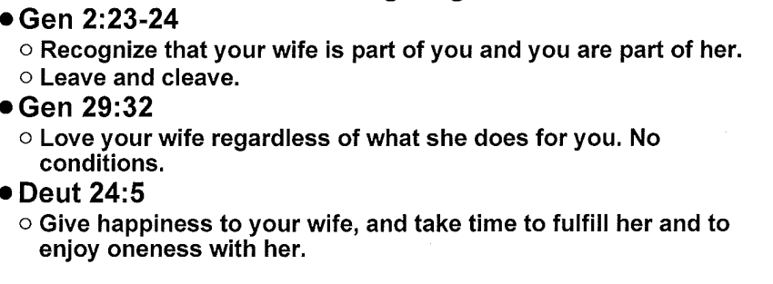
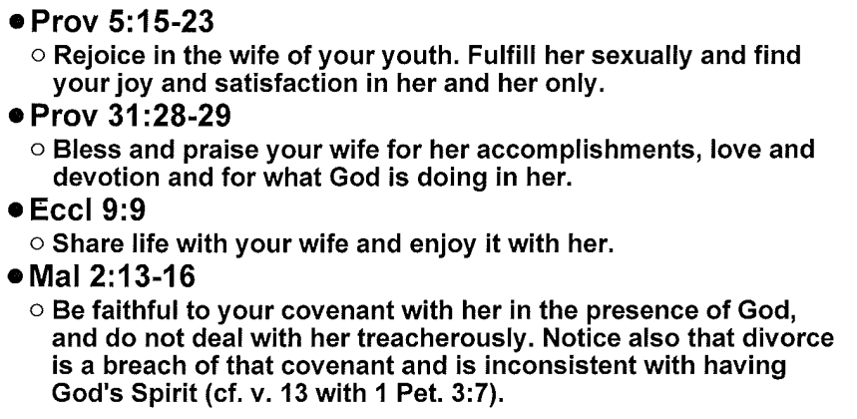
Husbands – A Summary

Slide 31
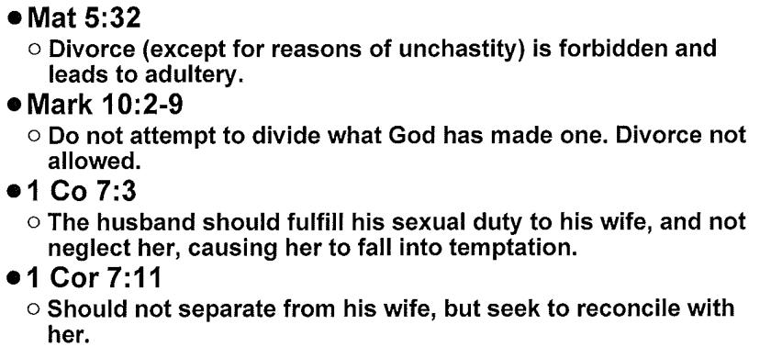
Husbands – A Summary

Slide 32
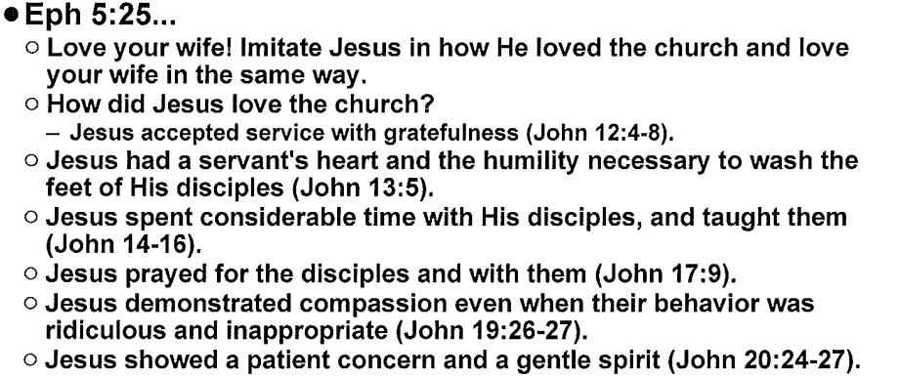
Husbands – A Summary

Slide 33
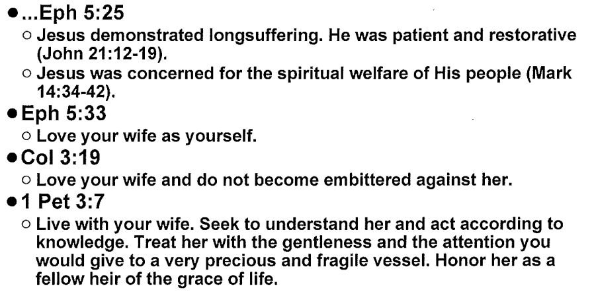
Husbands – A Summary

Slide 34
Biblical Roles and Responsibilities of a Wife

Slide 35
A Wife Submits to Her Husband: Submission is a Military Term Meaning “To Voluntarily Arrange Yourself In Rank Under”
The history of mankind’s response to submission:
Started with Satan (Isaiah 14:13)
Continued in the Garden of Eden (Genesis 3:5)
Extended to all mankind (Isaiah 53:6)

Slide 36
A Wife Submits to Her Husband: Submission is a Military Term Meaning “To Voluntarily Arrange Yourself In Rank Under”
Mankind’s rebellion to authority is intensified in the last days
(2 Timothy 3:1-2).
As a result, submission is misrepresented and misunderstood (Romans 6:16)

Slide 37
A Wife Submits to Her Husband: Submission is a Military Term Meaning “To Voluntarily Arrange Yourself In Rank Under”
Wrong ideas about submission:
1. That the wife is inferior
2. That the husband is infallible
3. That a wife cannot think and should not speak
4. That a wife has no influence

Slide 38
A Wife Submits to Her Husband: Submission is a Military Term Meaning “To Voluntarily Arrange Yourself In Rank Under”
Biblical teaching about submission:
Demonstrated perfectly by Jesus
(1 Corinthians 11:3)
It is a way of life for all believers. (Ephesians 5:22 explains how husbands and wives do vs. 21, just as 6:1 explains how children and parents do vs. 21, and 6:5 explains how slaves and masters do vs. 21).

Slide 39
A Wife Submits to Her Husband: Submission is a Military Term Meaning “To Voluntarily Arrange Yourself In Rank Under”
3. Submission is the mode for the most suitable helper
4. Submission is an attitude toward God (Romans 13:1-2)
5. Submission is proof of a wife’s love for her husband. Limited only by the Bible—a husband has no authority to ask his wife to sin.

Slide 40
A Wife Respects Her Husband
A. Respect includes:
Expressing acceptance of his authority
Showing confidence in his decisions
Flexibility of schedule to make room for his priorities.
Choosing not to remember his past failures.

Slide 41
A Wife Respects Her Husband
A. Respect includes:
Being grateful to him, adjusting your lifestyle to fit under family income.
Not publicly criticizing and not making statements that do not build him up.

Slide 42
A Wife Respects Her Husband
B. Results of disobeying God and not reverencing/respecting husbands:
Jealousy, criticism, and resentment
Anger, arguing or silence, and tension
Unforgiveness, bitterness, contempt

Slide 43
A Wife Respects Her Husband
B. Results of disobeying God and not reverencing/respecting our husbands:
Depression, discouragement, despair, stonewalling
In the case of a believing wife with an unbelieving husband, she refuses to do her part in winning him to Christ
(1 Peter 3:1-2).

Slide 44
A Wife Helps Her Husband
Suitable Helper – “completing, complementing, corresponding to, fitted perfectly to, and adapted to meet needs.”
B. Literally, the Hebrew word means that the wife makes up what is lacking in her husband’s life (Genesis 2:18, 1 Cor. 11:8-9).

Slide 45
A Wife Helps Her Husband
C. Helper is not a demeaning term, nor does it mean somehow “second class.” In fact, the same word for “helper” is used 14 other times in Scripture to describe God as our help (Psalm 27:9, 30:10, 40:17, 63:7, 70:5).

Slide 46
A Wife Helps Her Husband
D. No one can complement a husband like his wife can. Here just a few of the ways she can be his fitting helper/helpmate:
Provide companionship – emotional fulfillment
Provide sexual fulfillment – pleasure and protection

Slide 47
A Wife Helps Her Husband
Spiritually – pray for, encourage
Ministry – serve together
Parentally – authority over the children in unity with her husband
Domestically – add color and depth

Slide 48
A Wife Helps Her Husband
Attitudinally – promote joyful submission to authority
Financially – watchful and protective while cheerfully generous
Preparation – discerning of possible future needs

Slide 49
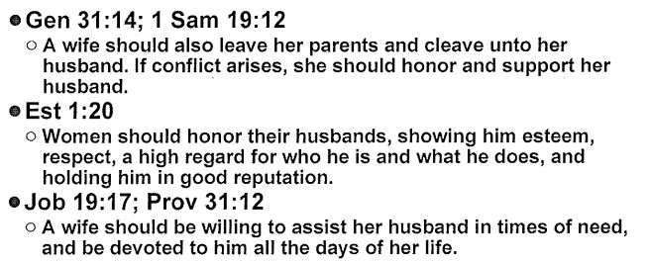
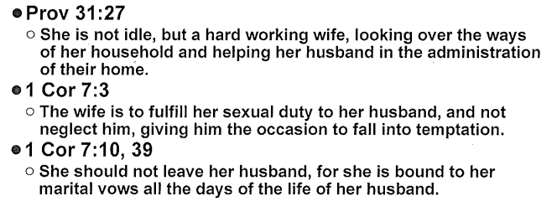
Wives – A Summary

Slide 50
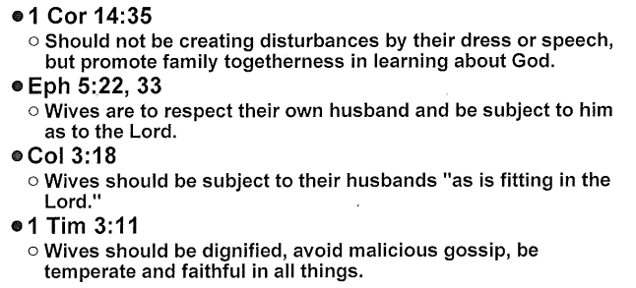
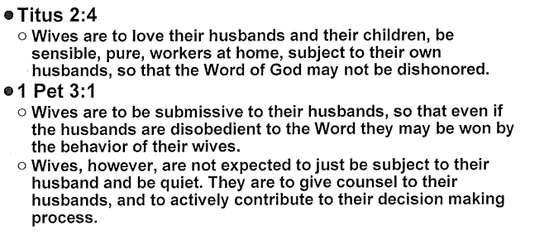
Wives - A Summary

Slide 51
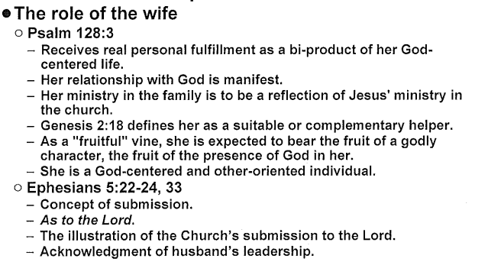
Wives - A Summary

Slide 52
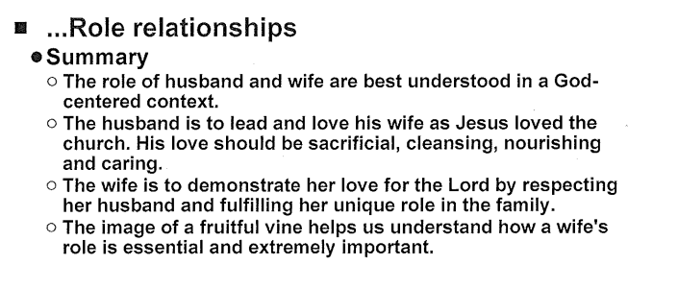
Wives - A Summary

Slide 53
Biblical Basis for Role Differences
Ephesians 5:33
HUSBAND LOVES AND LEADS HIS WIFE
WIFE SUBMITS TO AND RESPECTS HER HUSBAND

