Slide 1
KEY ELEMENTS IN THE BIBLICAL COUNSELING RELATIONSHIP
3 Blessed be the God and Father of our Lord Jesus Christ, the Father of mercies and God of all comfort, 4 who comforts us in all our affliction so that we will be able to comfort those who are in any affliction with the comfort with which we ourselves are comforted by God. 5 For just as the sufferings of Christ are ours in abundance, so also our comfort is abundant through Christ. 6 But if we are afflicted, it is for your comfort and salvation; or if we are comforted, it is for your comfort, which is effective in the patient enduring of the same sufferings which we also suffer; 7 and our hope for you is firmly grounded, knowing that as you are sharers of our sufferings, so also you are sharers of our comfort. 2 Cor. 1:3-7
15 but speaking the truth in love, we are to grow up in all aspects into Him who is the head, even Christ, 16 from whom the whole body, being fitted and held together by what every joint supplies, according to the proper working of each individual part, causes the growth of the body for the building up of itself in love. Ephesians 4:15-16
This presentation includes a general overview of the counseling process from building involvement, gathering data, speaking the truth in love, identifying and discerning problems biblically, loving confrontation, biblical instruction through counseling, assigning homework, and reviewing homework.

Slide 2
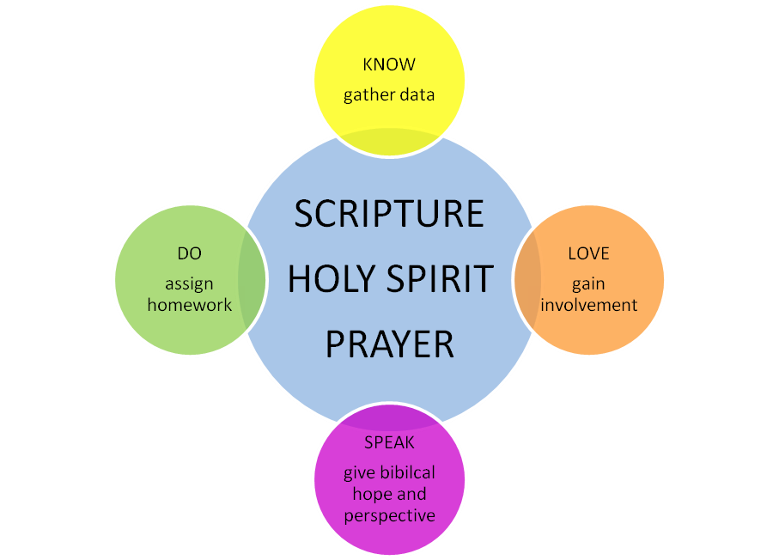
Biblical counseling process in action:

Slide 3
KEY ELEMENTS IN THE BIBLICAL COUNSELING RELATIONSHIP
KNOW

Slide 4
KNOW: Gather Information (Prov. 18:13, 15, 17; 23:7)
Building Involvement/Personal Data Inventory (PDI)
Use a PDI for each counselee to begin to know more about them and their problems before the first visit.
Must know about them to help/minister to them.
You have to be willing to dig deep to get to the heart.
Something like this may be helpful even in informal settings.
Even if a form is not completed, the information from a PDI is helpful to guide you and help you to specifically pray.

Slide 5
KNOW: Gather Information (Prov. 18:13, 15, 17; 23:7)
Extensive/intensive probing (Proverbs 18:17).
¹⁷ The first to plead his case seems right,
Until another comes and examines him.
Extensive questions are more shallow but you ask a lot of them. They regard a broad spectrum of aspects of life, covering a wide range. Then when you discern an area that may need help, you ask good, intensive questions that probe deeply into that area.
Intensive questions – many questions about one area to reveal heart motivation.

Slide 6
KNOW: Gather Information (Proverbs 18:13, 15, 17; 23:7)
Verbal/non-verbal communication:
Content data = what is said (actual verbs, phrases).
Halo data = how it is said (body language, tone of voice, eyes).
Listening is a requirement for information gathering – listen well (Proverbs 18:13)
  Listen actively for these things:
Blame-shifting.
Words like can’t, unable, too much.
Sin being called disorder/disease.
Reliance on feelings over facts.

Slide 7
KNOW: P-R-E-A-C-H Proverbs 18:2
Physical information
Resources: What resources are available to the person that can help the process of counseling?
Emotions (Genesis 4:1-8).
Actions (Ps. 1:1-3, Ps. 34:12-14, Lk. 6:46-49, Js. 1:22, 25). Are the actions of the person in line with God’s Word
CONCEPTS (Mark 7:18-23, Romans 12:1-2, Galatians 5:16-21, Ephesians 4:22-24).
Historical information (Proverbs 5:22-23, Colossians 3:21, 1 Peter 1:18).

Slide 8
KNOW: Levels of Information Gathering
Trials: Circumstances, situations, problems.
Fruit: You will be considering observable manifestations, evidences, emotional affect, responses, feelings (objective presentation and performance levels).
Root: Don’t ignore desires, motivations, beliefs, obsessions, values, inner man heart issues (subjective preconditioning level).
Cross: What does the person know about God, and where does He fit into the person’s fruit and root?

Slide 9
KEY ELEMENTS IN THE BIBLICAL COUNSELING RELATIONSHIP
LOVE

Slide 10
LOVE: Biblically Defining The Establishing Of Involvement
How does the Bible define compassionate involvement?
JESUS—Mark 1:41, Mark 3:5, Mark 3:14, Mark 6:34
PAUL—Acts 20:31, 2 Corinthians 11:29, Ephesians 4:15, 29, 1 Thessalonians 2:7-9, Philippians 1:7
JOHN—3 John 4

Slide 11
LOVE: Involvement Includes Compassion, Respect, and Sincerity
B. Practical ways to show compassion:
Tell the person that you care for him/her (Philippians 1:8).
Pray for and with him/her (Colossians 4:12-13)
Rejoice and grieve with him/her (Romans 12:15).
Deal with them gently and tenderly (Matt. 12:20).
Be tactful (Proverbs 15:23).
Speak graciously (Colossians 4:6).
Continue to love and accept them even after they have refused your counsel (Mark 10:21).

Slide 12
LOVE: Involvement Includes Compassion, Respect, and Sincerity
Defend the person against those who mistreat and accuse (Matthew 18:21-22).
Be willing to assist in meeting physical needs if necessary (1 John 3:17). (i.e. In counseling a live-in partner who desires to live in a godly fashion prior to the marriage covenant, it may become necessary to help find alternate housing.)
C. How to show respect to someone.
1. Proper verbal communication – 2 Timothy 2:24-25;
Proverbs 16: 21, 24

Slide 13
LOVE: Involvement Includes Compassion, Respect, and Sincerity
Proper non -verbal communication (S-O-L-V-E-R):
S – Squared shoulders.
O – Open stance.
L – Lean forward slightly.
V – Vocal quality (volume and intensity that reflects tenderness and compassion).
E – Eye contact (w/o staring to make them uncomfortable).
R – Relational posture (not stiff or robotic, but not so totally relaxed that you appear to be bored).

Slide 14
LOVE: Involvement Includes Compassion, Respect, and Sincerity
Taking the person’s problems seriously communicates respect. Never minimize problems presented by the person.
Love believes all things (1 Corinthians 13:7).
1 Corinthians 13:7 –
Love bears all things, believes all things, hopes all things, endures all things.
It is never helpful to have a cynical attitude. If the person is insincere, you will use that as information to find out what he thinks it will accomplish.
Don’t be fooled or put off by the person’s manipulations (i.e. tears, changing the subject).

Slide 15
LOVE: Involvement Includes Compassion, Respect, and Sincerity
Express confidence in the person.
Paul rejoices in the work that God was doing in the Corinthians, although that church had more problems than any other church (2 Cor. 7:16; Phil. 2:13).
Welcome the person’s input. Ask for evaluation of sessions and suggestions regarding improvements.
Maintain confidentiality. Guard the person’s reputation as much as possible without disobeying God (Matthew 18:16-17).
8. Be honest about your goals and agendas.
Let the person know right from the start what you are trying to do and how you intend to do it.
It must be clear that God’s Word is the source of authority.

Slide 16
LOVE: Involvement Includes Compassion, Respect, and Sincerity
9. Be honest about your limitations as a counselor.
If you don’t know how to proceed, admit it and seek help (Galatians 4:20, 2 Cor. 4:8).
But never let the person lose hope that God’s Word does not have the answers he needs.
c. Be honest about your weaknesses. Wise openness about your own struggles will demonstrate sincerity (1 Corinthians 2:1-3, 2 Corinthians 1:8, Romans 7:14-25).
10. Model, don’t ramble (Ephesians 4:29).

Slide 17
D. Give Hope
God is the source of all hope and the Bible is a textbook on counseling.
(Romans 15:13, 1 Peter 1:3, Psalm 25:4-5, Psalm 42:5,
2 Corinthians 4:7, 1 Thessalonians 1:3, 2 Timothy 3:16-17; 1 Peter 1:21).
Christ is the Great Counselor (John 14:16), and the Holy Spirit is at work in the counseling room (Philippians 2:20-21).
Always give hope that problems can be overcome, even if the circumstances do not change.
Biblical counseling is not about the counselor or the counselee; it is about the Word and Spirit of God.

Slide 18
Give Hope
The person can, by the grace of God and the power of the Holy Spirit, become God’s kind of person for God’s glory.
Should nothing else change, the person still can gain a sense of hope as they embrace God’s sovereignty, grace, and glory.

Slide 19
KEY ELEMENTS IN THE BIBLICAL COUNSELING RELATIONSHIP
SPEAK
Proverbs 25:11-13
¹¹ Like apples of gold in settings of silver
Is a word spoken in right circumstances.
¹² Like an earring of gold and an ornament of fine gold
Is a wise reprover to a listening ear.
¹³ Like the cold of snow in the time of harvest
Is a faithful messenger to those who send him,
For he refreshes the soul of his masters.

Slide 20
I. SPEAK:
Prior to speaking relevant truth into the situation, problems must be discerned thorough and ongoing information gathering.
At the foundational level, problems must be defined biblically (divine definitions vs. demonic distortions).
When a problem is defined differently than God’s Word defines it, it has been distorted. A wrong definition leads to destructiveness.
As you gather information, determine areas to cover and categories within that area. You must know your Bible. A biblical counselor must be constantly growing as a theologian.
People seek help because their life is hard (Proverbs 13:15).
Do a personal study so that you are familiar with all the NT lists of transgressions that make life hard (including Romans 1:29-31, Colossians 3:5-9, Ephesians 4:25-32, 2 Timothy 3:2-5).

Slide 21
II. SPEAK: Give Proper Instruction
Instruction must be biblical.
Since the Bible is our Creator’s instruction manual for how to live life, it is foolishness to look elsewhere (2 Timothy 3:16-17, Psalm 19:7-11).
We must not confuse our people by combining the wisdom of God with man’s wisdom (Colossians 2:8, 1 Corinthians 12:20).

Slide 22
II. SPEAK: Give Proper Instruction
Instruction must be ACCURATE.
Know the meaning of biblical words (hope, love, rejoice, joy, justification, sanctification, repentance, temptation, consider, confess, grace, forgiveness, sorrow, fornication, adultery, faith, idolatry, guilt, humility, pride, sin, wisdom, etc.) and use them.
Properly interpret passages in their context (use good hermeneutics).
Immediate context and larger context of the Bible.
Scripture interprets Scripture (i.e. Matt. 18:20 – church discipline)

Slide 23
II. SPEAK: Give Proper Instruction
Be specific —Know and apply your own life to the three-part biblical paradigm for change before teaching it.
Put off, renew mind, put on (Romans 12:1-2, Ephesians 4:22-25, Colossians 3:5-11).
Clearly differentiate between God’s directives and man’s suggestions.
Instruction must be appropriate.
Don’t just use your favorite passages. Instruction must be individualized according to their problems.

Slide 24
II. SPEAK: Give Proper Instruction
1. Instruction must be appropriate to the person’s spiritual condition.
Saved or unsaved? Does he need to be introduced to the Gospel (John 20:31)?
A babe or mature in Christ (Hebrews 5:12-14)?
Rebellious, faint-hearted, or weak
(1 Thessalonians 5:14)?

Slide 25
II. SPEAK: Give Proper Instruction
2. Instruction must be appropriate to the person’s learning style.
Visuals, pictures, simple charts, role-playing may be appropriate.
Jesus used stories to make a point.
Reading can reinforce what has been taught, but not everyone reads with comprehension or can read at all.
In teaching and discussion, be alert to what the person actually hears.

Slide 26
KEY ELEMENTS IN THE BIBLICAL COUNSELING RELATIONSHIP
DO
Luke 6: 46-49
James 1:22-25

Slide 27
DO: Assign Homework. What Is Homework?
Definition of homework in biblical counseling:
Effective homework leads to working hard in the areas where change is needed, training in the direction that God’s Word gives, and practicing biblical thinking and behavior
(2 Timothy 3:17, Philippians 3:13-14).

Slide 28
DO: Assign Homework. What Is Homework?
Biblical examples include:
Matthew 19:21-22 — Rich young ruler
(Go – sell – give – follow Me)
2 Kings 5:10 — Naaman
(Go – wash)
3. Luke 3:7-18 – John the Baptist
(Repent – produce fruit)
4. Matthew 7: 17-20; 24-27 – Jesus
(Produce good fruit – Build on the Rock)

Slide 29
DO: Why Give Homework?
Homework is vital to turn the talk of the session into action. Talk alone is only therapy.
When homework is given, counseling goes faster
Work is not stopped at the end of the session, but is continued through the week.
Counselees are not dependent on the counselor.
Our people learn to take personal responsibility.
People see the changing power of God’s Word.
People learn the value of prayer.
Our people can readily gauge their own progress.

Slide 30
IV. DO: Why Give Homework?
Homework gives hope as it says you believe things can be different today.
C. Other reasons:
    Teach them the knowledge necessary to rightly respond and how to biblically handle their challenges.
    Train them how to respond to their challenges, conflicts, and obstacles.
    Homework helps to learn Scripture imperatives – what, how, and why of putting off the old man, being renewed in the spirit of the mind, and putting on the new man (Eph. 4:22-24).

Slide 31
DO: What Does Homework Look Like?
Learning Scriptural teaching formulates a pathway in the mind; then an applicable, hands-on methodology brings about a paradigm for change.
God says His Word must be hidden in hearts in order for sin not to take place (Psalm 119:11).
Speaking of and meditating on God’s Word is necessary for success (Joshua 1:8).
As God works in us, obedience to His Word is how we work out salvation (Philippians 2:12-13). Homework puts theology on the street. Homework is where the rubber hits the road.

Slide 32
DO: What Does Homework Look Like?
Concrete, not abstract. Concrete homework is vital to change. To be concrete, homework must be:
Specific
Practical: It must involve knowing and doing. Connect Bible study to daily life.
Robust with practice.
Personally tailored for each situation based on data gathered.
Written – both in instruction and implementation (records).

Slide 33
DO: What Does Homework Look Like?
Clear expectations – otherwise the results will be vague and subject to the whim of the person.
Tailored to the ability of the person (be sure he understands it and is physically able to do it). Have homework repeated back to you to be sure it’s understood.

Slide 34
DO: What Does Homework Look Like?
Abstract homework does not help the person change. Abstract homework:
Is about lofty ideas.
Lacks relevance.
Lacks application.
People don’t sin in the abstract. Be sure homework is specific, not abstract.

Slide 35
DO: How Is Homework Used In A Biblical Counseling Session?
Review previous homework at the beginning of the session (gather further data).
Neglected homework can lead to an understanding of the cause of problems. Gain commitment prior to assigning homework.
Assign new homework at end of each counseling session, that applies to the person’s life and problems to the biblical principles that have been learned.

Slide 36
DO: Specifics Of Homework
Prepare tentative homework that includes:
BIBLE READING =
SCRIPTURE MEMORIZATION =
EXTRA-BIBLICAL READING MATERIAL =
DOING =
PREACHING = Sitting under biblical preaching reinforces biblical counsel.
PRAYER

Slide 37
DO: Specifics Of Homework
Recording when the scriptural concept you have taught is disobeyed and when it is obeyed.
Homework may include radical amputation (Matthew 6:29-30). This requires the terminating of influences that feed the failure and replacing them with godly influences.
Conflict lists.
Thankfulness lists.

Slide 38
DO: Specifics Of Homework
Beware of the dangers of assigning behavioral change without scriptural conviction and convincing regarding what Scripture says.
Lack of commitment.
Not being convinced or convicted by the Holy Spirit – God’s Word is the power for change.
Behavioral change alone fosters dependence on counselor. If the person is not convinced regarding what God teaches, and you ask him to make a change, if he does it he is pleasing you over God.
The greater likelihood is that he won’t be persuaded to do it and may fall away from continuing in counseling.

Slide 39
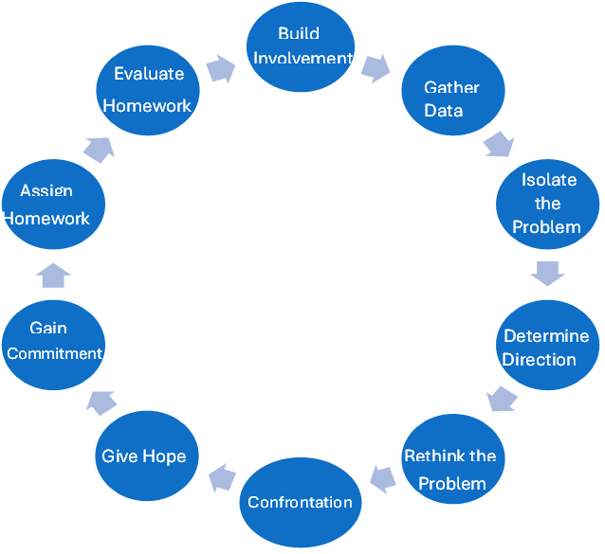
Biblical Counseling Process. Below is the biblical counseling process in action incorporating the key element in the counseling process.

