Slide 1
GOD, TECHNOLOGY, AND THE CHRISTIAN LIFE

Slide 2
Conference Schedule
9:00 || Session 1: Anatomy of Tech-Fueled Distorted Desires
10:30 || Session 2: Technology & the Purposes of God & Man
11:30 || Panel 1: The Dangers of Technology
12:00 || Lunch
1:00 || Session 3: The Creation Mandate & Technology
2:30 || Session 4: Tech's Telos
3:30 || Panel 2: The Benefits of Technology

Slide 3
GOD, TECHNOLOGY, AND THE CHRISTIAN LIFE

Slide 4
SESSION 1: The Anatomy of Tech-Fueled Distorted Desires
Nolan Games

Slide 5
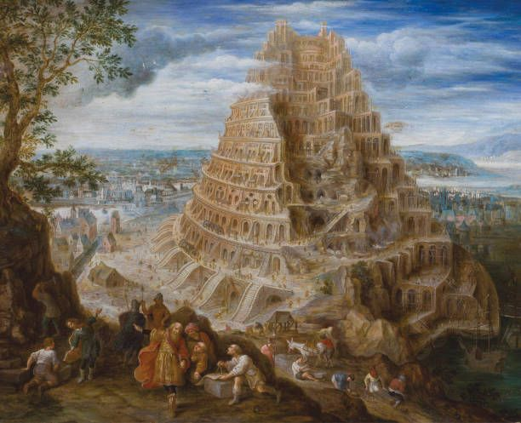
Technology Reveals Man's Heart
Genesis 11:1-8

Slide 6
Technology Reveals Man's Heart
The Motivations
The Anatomy of Technologically Fueled Distorted Desires
The Ideology
Fear of Technology | Hope In Technology | Ignorance | Abuse
The Practice
Minimalism | Maximalism | Ambivalence | Abuse
The Consequence
Physical, Social, Emotional

Slide 7
Technology Reveals Man's Heart
The Motivations
Technologically Fueled Distorted Desires
The Ideology
Worship of Technology | Ignorance | Abuse
The Practice
Control the Ideology, Practice, Consequences
The Consequence
New Technologically Fueled Distorted Desires

Slide 8
GOD, TECHNOLOGY, AND THE CHRISTIAN LIFE

Slide 9
SESSION 2: Technology and the Purposes of God and Man
Garrett Plunkett

Slide 10
Technology & the Purposes of God and Man
BIG IDEA: Technology Accomplishes God's Purposes for Man, Bringing Him from Eden to Eternity
OUTLINE:
Technology, Biblically Defined
Technology is a Good Gift of God but is Tainted by Sin
Technology Accomplishes God's Sovereign Purposes for Creation
God Uses Technology to Prepare the Eternal City of God and Judge the Fallen City of Man

Slide 11
What is Technology, Biblically Defined?
Key Takeaways:
Jesus of Nazareth was a τέκτων (tekton)
τέκτων (tekton) = "a skilled carpenter or stone mason"
Uses: Matthew 13:55, Mark 6:3
Τέχνη (techne) = "A skilled art, practical craft, or professional trade"
Uses: Acts 17:29, Acts 18:3, Revelation 18:22

Slide 12
Point 1: A Biblical Theology of Genesis
KEY TAKEAWAYS:
God Creates Mankind to Reflect His "Making" Nature
(Genesis 1:1-2:3)
God Tasks Mankind to Accomplish His Will for Creation
(Genesis 2:15-17)
God Uses Technology to Advance Human Culture
(Genesis 4:17-22)
God Uses Technology to Preserve a Remnant of Mankind
(Genesis 6:13-16)
God Sovereignly Repurposes Effort to Build a City to Glorify Man
(Genesis 11:1-9)

Slide 13
Technology's Origins: Genesis 1:1-2:3
1In the beginning, God created (bara) the heavens and the earth. 2The earth was without form (tohu) and void, and darkness was over the face of the deep.
26Then God said, “Let us make (asah) man in our image (tselem), after our likeness. 27So God created (bara) man in his own image (tselem), in the image (tselem) of God he created (bara) him; male and female he created (bara) them.

Slide 14
Technology's Task: Genesis 2:15-17
15The Lord God took the man and put him in the garden of Eden to work (abad) it and keep (shamar) it. 16And the Lord God commanded the man, saying, “You may surely eat of every tree of the garden, 17but of the tree of the knowledge of good and evil you shall not eat, for in the day that you eat of it you shall surely die.”

Slide 15
Technology's Revolution: Genesis 4:17-22
17Cain knew his wife, and she conceived and bore Enoch. When he built a city, he called the name of the city after the name of his son, Enoch… 19And Lamech took two wives…20Adah bore Jabal; he was the father of those who dwell in tents and have livestock. 21His brother’s name was Jubal; he was the father of all those who play the lyre and pipe. 22Zillah also bore Tubal-cain; he was the forger of all instruments of bronze and iron.

Slide 16
Technology's Inspiration: Genesis 6:13-16
13And God said to Noah, “I have determined to make an end of all flesh, for the earth is filled with violence through them. Behold, I will destroy them with the earth. 14Make (asah) yourself an ark of gopher wood. Make (asah) rooms in the ark, and cover it inside and out with pitch. 15This is how you are to make (asah) it: the length of the ark 300 cubits, its breadth 50 cubits, and its height 30 cubits. 16Make (asah) a roof for the ark, and finish it to a cubit above, and set the door of the ark in its side.

Slide 17
Technology's Glory: Genesis 11:1-9
1Now the whole earth had one language and the same words…
3And they said to one another, “Come, let us make bricks, and burn them thoroughly.” And they had brick for stone, and bitumen for mortar. 4Then they said, “Come, let us build ourselves a city and a tower with its top in the heavens, and let us make a name for ourselves, lest we be dispersed over the face of the whole earth.”…
...And from there the Lord dispersed them over the face of all the earth.

Slide 18
Point 2: A Biblical Theology of Isaiah
KEY TAKEAWAYS:
God Teaches Mankind Technology so He May Flourish in the Fall
(Isaiah 28:23-29)
Technology Used for Idolatry and Rebellion Distorts God's Image
(Isaiah 44:9-20)
The Cross is a Technology of Death, Turned into a Means of Life
(Isaiah 54:16-17)
The Cross is a Technology of Death, Turned into a Means of Life
(Isaiah 53:1-6)
Technology is Transformed Under the Reign of Jesus Christ
(Isaiah 2:2-5)

Slide 19
Technology's Teacher: Isaiah 28:23-29
26For he is rightly instructed; his God teaches him.
27Dill is not threshed with a threshing sledge, nor is a cart wheel rolled over cumin, but dill is beaten out with a stick, and cumin with a rod.
28Does one crush grain for bread? No, he does not thresh it forever; when he drives his cart wheel over it with his horses, he does not crush it.
29This also comes from the Lord of hosts; he is wonderful in counsel and excellent in wisdom.

Slide 20
Technology's Worship: Isaiah 44:9-20
9All who fashion (yatsar) idols are nothing (tohu), and the things they delight in do not profit…12The ironsmith takes a cutting tool and works it over the coals. He fashions (yatsar) it with hammers...He shapes (asah) it into the figure of a man, with the beauty of a man, to dwell in a house… 20He feeds on ashes; a deluded heart has led him astray, and he cannot deliver himself or say, “Is there not a lie in my right hand?”

Slide 21
Technology's Limits: Isaiah 54:16-17
16Behold, I have created (bara) the smith who blows the fire of coals and produces a weapon for its purpose. I have also created (bara) the ravager to destroy;
no weapon that is fashioned (yatsar) against you shall succeed, and you shall refute every tongue that rises against you in judgment.

Slide 22
Technology's Turn: Isaiah 53:1-6
4Surely he has borne our griefs and carried our sorrows; yet we esteemed him stricken, smitten by God, and afflicted. 5But he was pierced for our transgressions; he was crushed for our iniquities; upon him was the chastisement that brought us peace, and with his wounds we are healed. 6All we like sheep have gone astray; we have turned —every one—to his own way; and the Lord has laid on him the iniquity of us all...
...by his knowledge shall the righteous one, my servant, make many to be accounted righteous, and he shall bear their iniquities.

Slide 23
Technology's Redemption: Isaiah 2:2-5
2It shall come to pass in the latter days that the mountain of the house of the Lord shall be established as the highest of the mountains, …3and many peoples shall come, and say: “Come, let us go up to the mountain of the Lord, …that he may teach us his ways and that we may walk in his paths.” …and they shall beat their swords into plowshares, and their spears into pruning hooks;

Slide 24
Point 3: A Biblical Theology of Revelation
KEY TAKEAWAYS:
God Judges the Fallen City of Man, Destroying Those Who Use Technology to Glorify Man
(Revelation 18:1-24)
God Prepares the Eternal City of God, Dwelling with Those Who Use Technology to Glorify God
(Revelation 21-22)

Slide 25
Technology's Telos: Revelation 18:1-24
“Fallen, fallen is Babylon the great!...
…7As she glorified herself and lived in luxury, so give her a like measure of torment and mourning, …“Alas! Alas! You great city, you mighty city, Babylon! For in a single hour your judgment has come.”
…for mighty is the Lord God who has judged her.”
…and a craftsman (technites) of any craft (techne) will be found in you no more,
…for your merchants were the great ones of the earth, and all nations were deceived by your sorcery. 24And in her was found the blood of prophets and of saints, and of all who have been slain on earth.”

Slide 26
Technology's Telos: Revelation 21:1-27
1Then I saw a new heaven and a new earth, for the first heaven and the first earth had passed away, and the sea was no more. 2And I saw the holy city, new Jerusalem, coming down out of heaven from God, prepared (hetoimazó) as a bride adorned for her husband. 3And I heard a loud voice from the throne saying, “Behold, the dwelling place of God is with man.

Slide 27
Summary: The Biblical Theology of Tech
BIG IDEA: Technology Accomplishes God's Purposes for Man, Bringing Him from Eden to Eternity
Main Points:
Technology is a Good Gift of God but is Tainted by Sin
Technology Accomplishes God's Sovereign Purposes for Creation
God Uses Technology to Prepare the Eternal City of God and Judge the Fallen City of Man
Talk Definition of Technology
Technology is Man's Means for Transforming God's Creation for a Specific End

Slide 28
GOD, TECHNOLOGY, AND THE CHRISTIAN LIFE

Slide 29
PANEL 1
The Dangers of Technology Text Questions: 501.687.4515

Slide 30
GOD, TECHNOLOGY, AND THE CHRISTIAN LIFE

Slide 31
SESSION 3: The Creation Mandate and Technology
Lawson Hembree

Slide 32
The Creation Mandate and Technology
Big Idea: The Creation Mandate informs our view of technology
The Call to Dominion (Gen 1:26-28; 2:15)
Be fruitful and multiply
Fill the earth
Subdue the earth
Have dominion over created things

Slide 33
The Creation Mandate and Technology
Big Idea: The Creation Mandate informs our view of technology
The Call to Dominion (Gen 1:26-28; 2:15)
The Difficulty of Dominion (Gen 3:16-19)
Spiritual
Physical
Relational
Vocational

Slide 34
The Creation Mandate and Technology
Big Idea: The Creation Mandate informs our view of technology
The Call to Dominion (Gen 1:26-28; 2:15)
The Difficulty of Dominion (Gen 3:16-19)
The Tools of Dominion (Gen 4:20-22)
Technology is God's gift to us to fulfill our calling in a fallen world

Slide 35
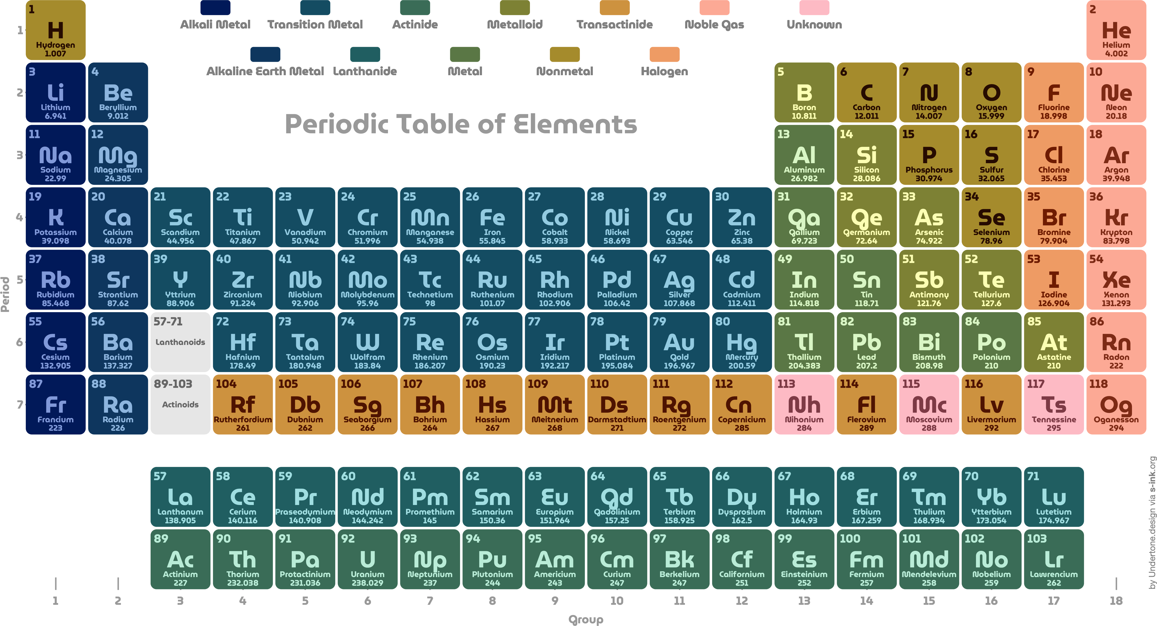

Slide 36
The Creation Mandate and Technology
Big Idea: The Creation Mandate informs our view of technology
The Call to Dominion (Gen 1:26-28; 2:15)
The Difficulty of Dominion (Gen 3:16-19)
The Tools of Dominion (Gen 4:20-22)
Technology is God's gift to us to fulfill our calling in a fallen world
Physical
Relational
Vocational
Spiritual

Slide 37
Wisdom for Tech Adoption
Ethical:
Is the use of this technology in this way sinful or foolish?
Does the use of this technology honor and value my body, the temple of the Holy Spirit?
Spiritual Formation:
In what ways might I be tempted to put my faith and hope in this technology rather than in God?
How might it seek to fulfill me in ways only Christ can?
How might it lessen my reliance on God?
Am I embracing it solely for the comfort or control it provides or as a gift granted by the Giver?
How might this technology seek to shape my identity in an unhealthy way?
What has my use of it up to this point revealed about my desires?
Self-Control:
How could it potentially exercise dominion over me? What guards can I put in place to prevent that?
What does it look like to use this in moderation? What boundaries do I need to put in place to avoid overuse?
Stewardship:
How can I use it for a beneficial, God-honoring purpose?
How does this technology affect my time, attention, and ability to focus on what matters most?
How does the manufacturing and use of this technology affect God’s creation?
Relational:
How does this technology affect my ability to love my neighbor?
Does my use of this technology help or hinder my witness to others?
What example am I setting for others through my use of this technology?

Slide 38
The Creation Mandate and Technology
Big Idea: The Creation Mandate informs our view of technology
The Call to Dominion (Gen 1:26-28; 2:15)
The Difficulty of Dominion (Gen 3:16-19)
The Tools of Dominion (Gen 4:20-22)
Wisdom for Tech Adoption

Slide 39
GOD, TECHNOLOGY, AND THE CHRISTIAN LIFE

Slide 40
SESSION 4: Tech's Telos
Douglas Allison

Slide 41
Tech’s Telos
Big Idea: Future Glory Will Shape Future Technology
Text: Revelation 21:1-22:5
Outline
21:1-8: Future Glory Makes Current Things Former Things
21:9-21: Future Glory Begins with Divine Technology
21:22-22:5: Future Glory Will Only Grow Goodness

Slide 42
Tech’s Telos

Slide 43
Tech’s Telos

Slide 44
Tech’s Telos
…heaven does not consist in idleness, and a cessation of all action, but only a cessation from all the trouble and toil and tediousness of action. The most perfect rest is consistent with being continually employed. So it is in heaven. Though the saints are exceedingly full of action, yet their activity is perfectly free from all labour, or weariness, or unpleasantness. They shall rest from their work, that is, from all work of labour and self-denial, and grief, care, and watchfulness, but they will not cease from action. The saints in glory are represented as employed in serving God, as well as the saints on earth, though it be without any difficulty or opposition.
– Jonathan Edwards, Sermon, “Praise: One of the Chief Employments of Heaven.”

Slide 45
GOD, TECHNOLOGY, AND THE CHRISTIAN LIFE

Slide 46
PANEL 2
The Benefits of Technology

Slide 47
GOD, TECHNOLOGY, AND THE CHRISTIAN LIFE

Slide 48
Conference Audio
Session 1: ​Anatomy of Tech-Fueled Distorted Desires
Session 2: ​Technology & the Purposes of God & Man
Panel 1​: The Dangers of Technology
Session 3: The Creation Mandate & Technology
Session 4: ​Tech's Telos
Panel 2: The Benefits of Technology

