Slide 1

A Service of the Peoples
Welcome to Worship

Slide 2
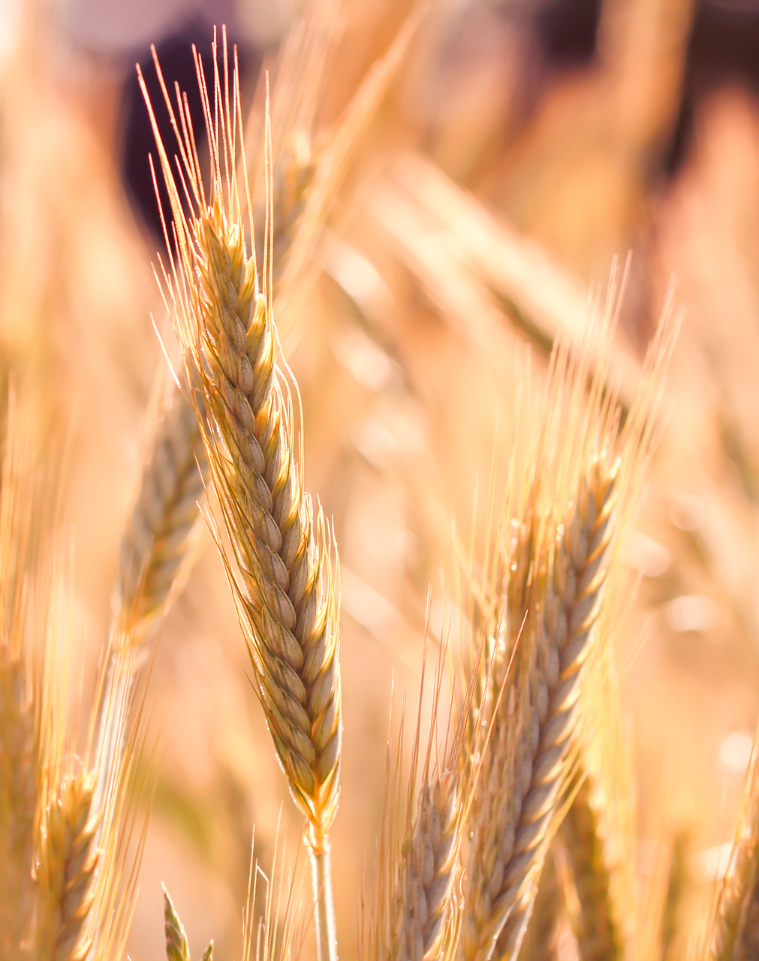
Call to Worship
L: We gather in the name of God, Creator, Christ, and Holy Spirit
C: We gather on the traditional lands of the___(see resources pg.8)______peoples
L: We acknowledge the breath prayer of Mitakuye Oyasin – that we are all related

Slide 3
Call to Worship
C: The roads that brought us here today were a place where indigenous people walked and lived on this sacred land, and still do today.
L: We gather to honor the Creator and all creation-human, animal, plant, water, wind, earth, and sky- that belong to God.

Slide 4

Gathering Song
All Are Welcome
ELW #641

Slide 5
Let us build a house where love can dwell
And all can safely live
A place where saints and children tell
How hearts learn to forgive.
Built of hope and dreams and visions
Rock of faith and vault of grace;
Here the love of Christ shall end divisions
All are welcome, all are welcome
All are welcome in this place.

Slide 6
Let us build a house where prophets speak
And words are strong and true
Where all God’s children dare to seek
To dream God’s reign anew.
Here the cross shall stand as witness
And as symbol of God’s grace;
Here as one we claim the faith of Jesus
All are welcome, all are welcome
All are welcome in this place.

Slide 7
Let us build a house where love is found
In water, wine, and wheat
A banquet hall on holy ground
Where peace and justice meet.
Here the love of God through Jesus
Is revealed in time and space
As we share in Christ the feast that frees us
All are welcome, all are welcome
All are welcome in this place.

Slide 8
Let us build a house where hands will reach
Beyond the word and stone
To heal and strengthen, serve and teach,
And live the Word they’ve known.
Here the outcast and the stranger
Bear the image of God’s face
Let us bring an end to fear and danger
All are welcome, all are welcome
All are welcome in this place.

Slide 9
Let us build a house where all are named
Their songs and visions heard
And loved and treasured, taught and claimed
As words within the Word.
Built of tears and cries and laughter,
Prayers of faith and songs of grace
Let this house proclaim from floor to rafter
All are welcome, all are welcome
All are welcome in this place.

Slide 10

Confessing Racism:
A lament for the church
As church, we confess the sin of racism and condemn racist rhetoric and the ideology of white supremacy. God, have mercy.
God, have mercy.
As church, we confess, repent, and repudiate the times when this church has been silent in the face of racial injustice. God, have mercy.
God, have mercy.

Slide 11
Confessing Racism:
A lament for the church
Racism is deeply ingrained within the ELCA, a predominantly white church. It is deeply embedded within the individual congregations whose members continue to foster stereotypes and support policies that actively hurt people of color. God, have mercy.
God, have mercy.
As church, we declare that the enslavement of black bodies and the removal of indigenous peoples established racism in the United States, a truth this nation and this church have yet to fully embrace. God, have mercy.
God, have mercy.

Slide 12
Confessing Racism:
A lament for the church
Rooted in slavery, racism is manifested through the history of Jim Crow policies, racial segregation, the terror of lynching, extrajudicial killings by law enforcement, and the disproportionate incarceration of people of color. God, have mercy.
God, have mercy.

Slide 13
Confessing Racism:
A lament for the church
As church we lament the institutional racism of discriminatory treatment within the call process; inequitable compensation of clergy of color; racial segregation; divestment from black communities and congregations; systemic policies and organizational practices; and a failure to fully include the gifts of leadership and worship styles of black people, indigenous people, and people of color. God, have mercy.
God, have mercy.

Slide 14
Confessing Racism:
A lament for the church
Confessions are empty promises without meaningful actions—actions that are grounded in prayer, education, and soul-searching repentance. The sin of racism separates us from one another. Though we trust that we are reconciled to God through Christ’s death and resurrection, we seek such life-giving reconciliation with one another. As we repent, let us not turn back to ideologies that promote white supremacy. We trust that God can make all things new.
Amen.

Slide 15

Greeting
The grace of our Lord Jesus Christ, the love of God, and the communion of the holy Spirit be with you all.
And also with you.

Slide 16
Kyrie
ELW #157

Slide 17
In peace, in peace, let us pray to the Lord
Lord, have mercy, Christ have mercy,
Lord have mercy.
For the reign of God and for peace throughout the world
For the unity of the all, let us pray to the Lord
Lord have mercy, Christ, have mercy,
Lord have mercy.

Slide 18
For your people here who have come to give you praise
For the strength to live your Word
Let us pray to the world.
Lord, have mercy, Christ have mercy,
Lord have mercy.
Help, save and defend us, O God.
Amen.

Slide 19
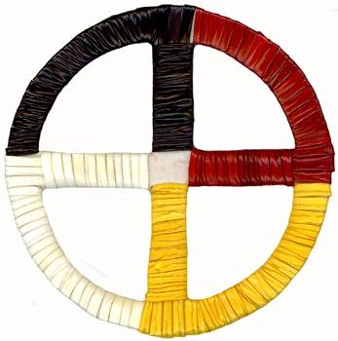
Prayer to the Four Directions
READER: Creator, the strength of the people, we honor you. Listen to the thoughts of your people.
We respect the truth of your spirit world and care for your Creations to the east, to the south, to the west and to the north. We honor you by deeds and not words.
We live by the ways you have entrusted to us within the circle of life.
Come Great Spirit as we gather in your name.
This Photo by Unknown Author is licensed under CC BY-NC-ND

Slide 20
READER: We face East: To your symbol color gold, the place of dawning, there is beauty in the morning, there the Seeker finds new visions as each sacred day is born. All who honor life around them, all who honor life within, shall shine with light and glory when the morning comes again. And we pray,
ALL: Come Holy Creator’s Spirit, Come
This Photo by Unknown Author is licensed under CC BY-NC-ND

Slide 21
READER: We turn to the South: To your symbol color red, in the south, the place of growing there is wisdom in the earth, Both the painful song of dying and joyful song of birth. As the earth gives up her lifeblood so her children’s hearts may beat. We give back to her our reverence for the holy ground beneath our feet. And we pray,
ALL: Come Holy Creator’s Spirit, Come
This Photo by Unknown Author is licensed under CC BY-NC-ND

Slide 22
READER: We turn to the West: To your symbol color black, the place of seeing, there is born a vision of the servant of the servants, who proclaimed the gospel to us. Guide us at the end of each day and fill us with your peace. And we pray,
ALL: Come Holy Creator’s Spirit, Come
This Photo by Unknown Author is licensed under CC BY-NC-ND

Slide 23
READER: We turn to the North: To your symbol color white, we look to God our Creator who cleanses our earth with snow, wind, and rain. To Jesus who fills us with the wideness of mercy and grace and lovingly embraces all the people. And the Holy Spirit who comes to inspire us. And we pray,
ALL: Come Holy Creator’s Spirit, Come
This Photo by Unknown Author is licensed under CC BY-NC-ND

Slide 24
PRESIDER: (Remain Standing…)
Creator, you bent the earth like a bow until it was one, round, shining planet. At your word the land was drawn into mountains and deserts, forests and plains; The waters were gathered together into rivers, lakes and seas. Many times, when people crossed these seas from other lands, they broke the circle of your creation by their greed and violence and they shattered the lives of others. Creator, renew the circle of the earth, and turn the hearts of all people to one another, that they and all the earth may live and be drawn toward you, through the power of your Son, who lives with you and the Holy Spirit, in the circle of the Trinity, forever One.
AMEN
This Photo by Unknown Author is licensed under CC BY-NC-ND

Slide 25
Reading
Isaiah 40:25-31
The Word of the Lord.
Thanks be to God.

Slide 26
Gospel
The Holy Gospel of our Lord Jesus Christ, according to John 17:20-23
Glory to you, Lord Christ.
The Gospel of the Lord.
Praise to you, Lord Christ.

Slide 27
Gospel Acclamation
ELW #171

Slide 28
Hallelujah, hallelujah; Halle, hallelujah.
Hallelujah, hallelujah; Halle, hallelujah.
Heleluyan, Heleluyan; hele, heleluyan.
Heleluyan, Heleluyan; hele, heleluyan.

Slide 29


Slide 30

Creed Statement
ALL: We believe in Creator, Father-Mother Spirit, who called the world and all that is in it, into being, who spoke the creative-forming word, and all came forth who created women and men and set them free to live in love, in obedience to the will of supreme love and in community with all.

Slide 31
We believe in Creator, Son and Brother, who, because of love beyond our understanding, love for creation, entered the world to share our humanity, to rejoice and to despair; to set before us the paths of life and death, and walk them with us; to be rejected and die, but finally to conquer death and bind the world to himself for all time.

Slide 32
We believe in Creator, whose word teaches us that all things grow together, the Circle of Life; that the paths of life and death, good and evil, too often come together, that choices are not clearly defined; but that we confidently and responsibly tread the path we choose and only the true One can be our judge.
We believe in Creator, who is present and working in this world through all creation. AMEN.

Slide 33
We believe in Creator, In-Dwelling Spirit, who invites us into community, that we may through faith and that community of oneness, experience uplifting and sustaining grace; that we may fulfill our human responsibility to reach out to our neighbor, whoever that may be; that we may rejoice in the constant nature of creation and the wondrous joy of life itself.

Slide 34
We believe in Creator, In-Dwelling Spirit, who invites us into community, that we may through faith and that community of oneness, experience uplifting and sustaining grace; that we may fulfill our human responsibility to reach out to our neighbor, whoever that may be; that we may rejoice in the constant nature of creation and the wondrous joy of life itself.

Slide 35
Song

Slide 36
Offering Prayer
Creator, we give you thanks for all that you are and all that you bring to us within your creation. In Jesus, you placed the Gospel in the Center of the Sacred Circle through which all creation is related. Amen.

Slide 37
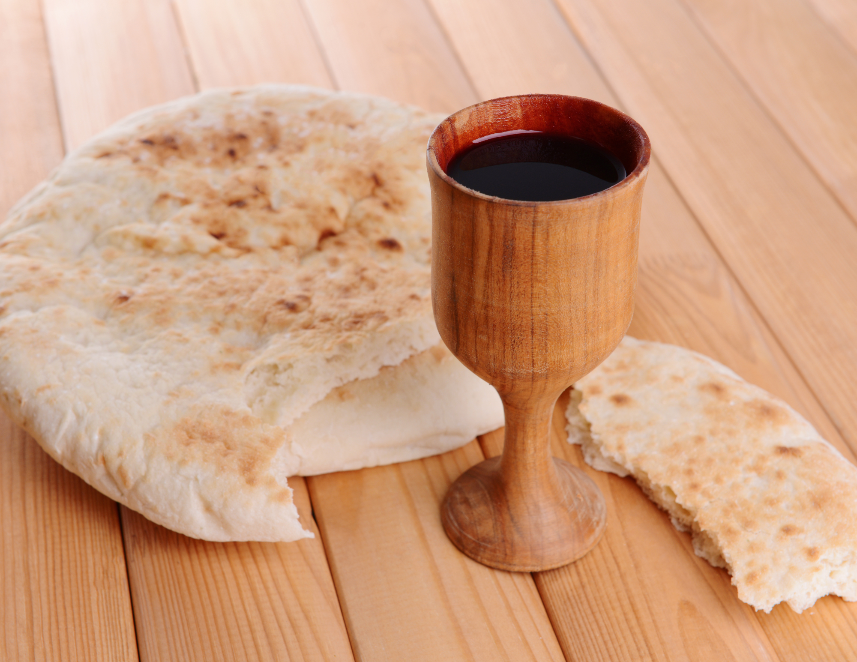
Communion
The Lord be with you.
And also with you.
Lift up your hearts.
We lift them to the Lord.
Let us give thanks to the Lord our God.
It is right to give our thanks and praise.

Slide 38
Words of institution

Slide 39
Distribution

Slide 40
Prayers of intercession
Lord, our God, creator of heaven and earth, of all things visible and invisible, the source and sustainer of life, you who holds in unity and harmony the multiple parts of the entire cosmos, we thank you and praise you for your love, for your wisdom, for your kindness and mercy. Give us courage and strength to follow your way and to be your witnesses to the end of the earth so that the world may know your love.
Lord, hear our prayer.

Slide 41
Prayers of intercession
Lord Jesus Christ, you are our way to life, justice, and peace. In you we are called to find our unity. Come into the brokenness of our lives and our land with your healing love. Help us to be willing to bow before you in true repentance and to bow to one another in real forgiveness. By the fire of your Holy Spirit, melt our hard hearts and consume the prejudice and pride which separate us. Fill us, O Lord, with your perfect love that casts out fear and bind us together in the unity that you share with the Father and the Holy Spirit.
Lord, hear our prayer.

Slide 42
Prayers of intercession
Make us instruments of your love, O God, agents of your justice and peace. Strengthen us to work for unity and harmony between people of every race, color and creed. Enable us to respect all of your creation and to love one another as ourselves, that we may serve one another in humility, simplicity and joy; through Jesus Christ, our Lord.
Amen.

Slide 43
The Lord’s Prayer
L: And now we say the Nez Perce version of the Lord’s Prayer:
ALL: Oh Great Spirit, You are our Shepherd Chief, In the most high place whose home is everywhere, Even beyond the stars and moon. Whatever You want done let it be done everywhere. Give us Your gift of bread day by day. Forgive our wrongs as we forgive those who wrong us. Take us away from wrong doings. Free us from all evil, for everything belongs to You. Let your power and glory shine forever. Amen

Slide 44
Blessing
Que el Dios de justicia nos conduzca en medio de la furia de los mares.
Que el Cristo solidario renueve la fuerza de nuestros sueños.
Que el Espíritu Santo nos guíe a aguas tranquilas donde reina la justicia, la solidaridad y la paz. Amén.
REC – Red Crearte, a liturgical network of Latin American Christians)

Slide 45
Blessing
May the God of justice lead us through the tumultuous seas.
May the Christ who came to dwell among us renew the strength of our dreams.
May the Holy Spirit guide us to still waters where justice, solidarity, and peace reign. Amen.
(Book of Common Worship, Blessing, Spanish and English adaptation, pp. 625-626)

Slide 46
Sending Prayer
Go out into the world in peace; have courage; hold onto what is good; return no one evil for evil; strengthen the faint hearted; support the weak, and help the suffering; honor all people; love and serve the Lord, rejoicing in the power of the Holy Spirit. Amen
Thanks be to God.

Slide 47
Sending Song
Thuma mina, Nkosi yam
(Send me, Jesus)
ELW #549

Slide 48
Thuma mina; thuma mina;
thuma mina, Nkosiyam
Send me, Jesus; send me Jesus;
Send me, Jesus; send me, Lord.

Slide 49
Ndiya vuma, ndiya vuma;
Ndiya vuma, Nkosiyam.
I am willing; I am willing;
I am willing, willing, Lord.

