Slide 1

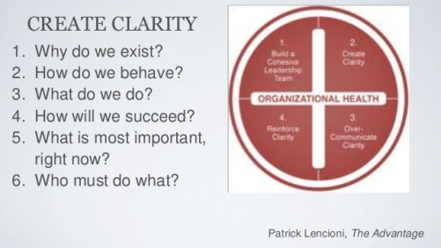
Six questions that will help

Slide 2
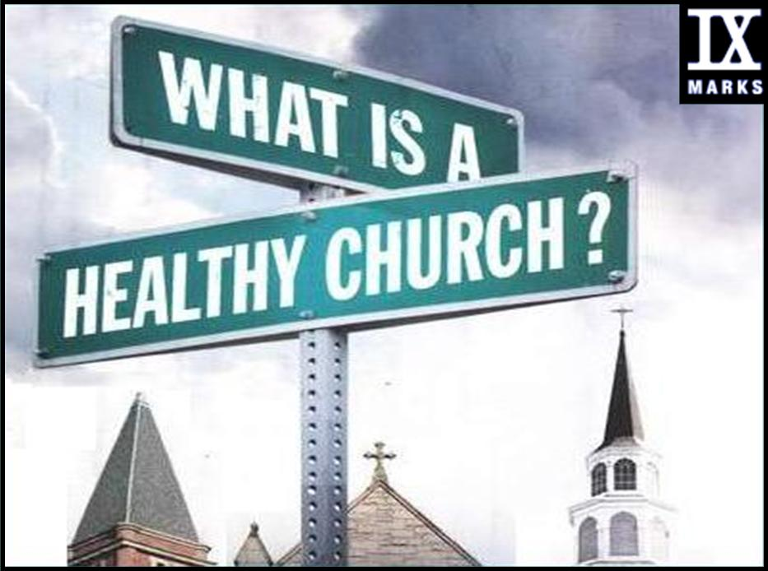

Slide 4

6 ?????? Questions
1. Why do we exist? Why does our church exist?
2. How do we behave? As members of this church? Church council members?
3. What do we do?
Council President, VP, Sec, Treasurer?
Church council members-ministry descriptions?
Each committees, teams, groups?
Pastor? Members?
4. How will we succeed? What does “success” look like?
5. What is most important, right now?
What is our ONE THING?
6. Who must do what? Clarity of roles and expectations

Slide 5
6 Simple Questions that HELP.
1. Why do we exist as a synod ministers?
The synod ministers are spiritual leaders. Together we resource, encourage, challenge, and accompany congregational leaders, so that we can better love God and neighbor, and the next generation comes to know and love Jesus.
2. How do we behave as a synod ministers? We are partners on a team that respect and trust one another in the spirit of Ujamaa.

Slide 6
6 Simple Questions that HELP.
3. What do we do? (individually and as a team)
We share our individual and collective gifts generously for the common good of the synod.
4. How will we succeed? What does “success” look like?
At the end of each day, we feel we have been faithful to our call, creating healthy and vital congregations, and have actively sought ways to support one another in our ministry, celebrating every bright spot that comes our way.

Slide 7
6 Simple Questions that HELP.
5. What is most important, right now?
Communicate our vision as a synod staff with leaders and congregations of the synod
6. Who must do what? (clarity of roles)
Liz – Administration, Financials, Event Planning, Constitutions, Synod Council, Call Process
Greg – Call Process, Resource Center, Lay School
Laurie – synod assembly, council, ecumenical relationships, administration, COB, CWA, spiritual leadership, mission and unity of the church, ordinations, word and sacrament, rostered ministers
Laura – Communication, Faith Formation, Malawi, Youth Board
Randy – Call Process, First Call, Bridgebuilders, Candidacy
Erin – DEM, Stewardship, Walking Together, EPIC, FIN

Slide 8
