Slide 1
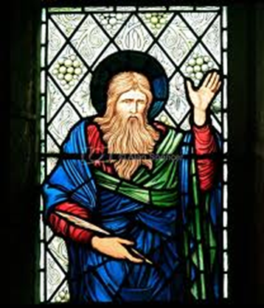
Isaiah

Slide 2
A Tale of three cities
& three isaiahs!
Jerusalem – capital of Judah
Ninevah – capital of Assyria
Babylon – capital of Babylonia
1st Isaiah (1-39)
  Active 742-700 BCE
2nd Isaiah (40-55)
  Active 550-540 BCE
3rd Isaiah (56-66)
  Active post exile 538 BCE - ?

Slide 3
1st Isaiah (1-39) Active 742 – 700 BCE
  “Isaiah of Jerusalem”
  Contemporary of Amos and Hosea
  Deeply involved in the political life of Judah
  Two crises play a central role in his oracles:
    War against Israel and Damascus – 734 BCE
    Assyria’s invasion in 701 BCE
  Jerusalem won’t fall. Why?
    People were convinced Yahweh loved Jerusalem and its temple so much that it could never fall – Isaiah’s proclamation to trust solely in the God of Zion seemed to support this!
    Isaiah warned against this false sense of security and focused on God’s demand that justice be done, and foreign alliances be avoided.

Slide 4
1st Isaiah - Introduction
Isaiah emphasized that God is holy and since God chooses to dwell with his people, they should imitate God by living justly.
Isaiah railed against the rich and powerful for their unjust treatment of the poor.
Isaiah announced God’s judgement against his people, and predicted their downfall, but held out hope that God would save a remnant who would live the way God wants God’s chosen people to live, under a king who will obey Yahweh, unlike Ahaz.
Focus is on the David Covenant, rather than the Sinai Covenant.

Slide 5
1st Isaiah - Outline
Isaiah 1-12: Prophecies aimed at Judah prior to Israel going into exile.
Isaiah 13-23: Prophecies against foreign nations
Isaiah 24-27: “Little Apocalypse” of Isaiah, probably added much later
Isaiah 28-33: Judgement messages against Judah during the time of Hezekiah
Isaiah 34-35: Vision of Jerusalem, probably added later
Isaiah 36-39: Stories of Isaiah’s later life, some of which matches 2Kings 18-20

Slide 6
2nd Isaiah – Active 550-540BCE
The image in the following slide of the Ishtar Gates of Babylon set the stage for the message of 2nd Isaiah.
Unlike 1st Isaiah, who worked in Jerusalem during the 8th century, 2nd Isaiah did his work in Babylon in the mid 6th century.
He offers a radical vision of a Persian messiah named Cyrus who will allow God’s covenant people to return home to Jerusalem.
God will lead them out the same Ishtar Gates that they straggled through as exiles almost 50 years earlier!

Slide 7
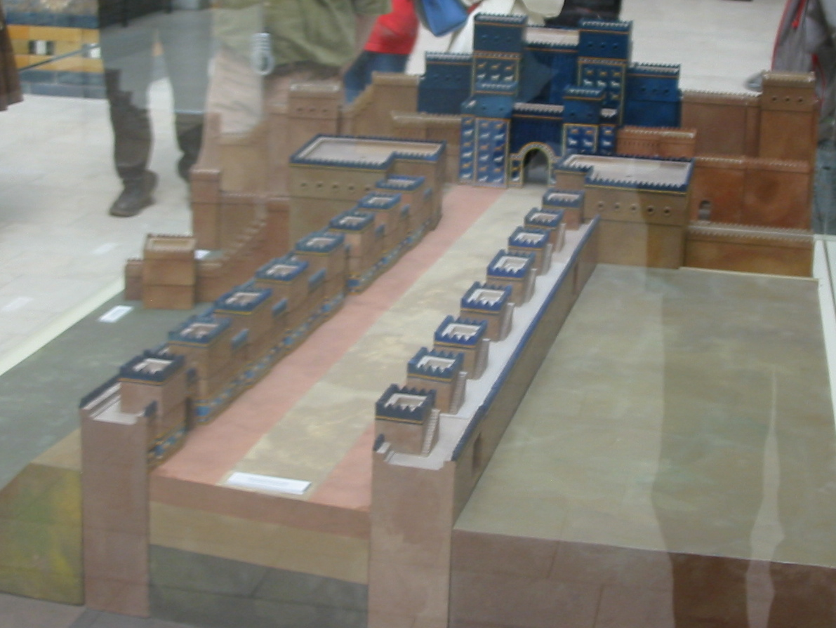
Notes:
Justification leads to Vocation!
These same Ishtar Gates, can symbolize God’s vocational call to all of us. Think about the trajectory of the three parts of Isaiah.
First Isaiah – you are going into exile because you’ve broken the covenant.
Second Isaiah – you are going home on a new Exodus and will experience a new creation – because God is merciful and God will abundantly pardon. It isn’t about you or what you’ve done to deserve this pardon!
Third Isaiah – how to deal with the realities of trying to live as saved people with a vocation to serve God by serving the neighbor.
Isaiah 55:5 paints a grand vision of the vocation of the returning Israelites. They will fulfill the covenant made with Abraham in Genesis 12! They will call nations they do not know, and nations that do not know them shall run to them!
What does it mean that this little group of refugees are given the vocation to call the nations? What does it mean that the same vocation has been given to you?

Slide 8
2nd Isaiah - Outline
Isaiah 40: Wonderful news is proclaimed. God is coming to free his people and bring them home.
Isaiah 41-48: God remains faithful to his covenant people, and will bring them home through a new Exodus.
Isaiah 49-55: God calls his people to become what they were created to be – a light to the nations. They should listen to God’s teachings and practice them in their lives.

Slide 9
3rd Isaiah – Active 538 – 500?BCE
These chapters (56-66) are set once again back in Jerusalem. Cyrus the Persian now rules Babylon, and has set them free.
They are busy trying to figure out how to live as free people once again but are opposed by those who had remained behind 50 years ago.
Should they rebuild the temple, and reinstate all of its sacrifices, or is synagogue worship adequate?
Should we try to have a Davidic King again?
What role if any should the Torah play in our public and private lives?

Slide 10
3rd Isaiah - Outline
Isaiah 56-59: Isaiah calls on them to reform their worship and turn away from idols. He also returns to the prophetic call for ethical lives. Unlike 2nd Isaiah, 3rd Isaiah condemns Israel’s sinfulness repeatedly! He holds out hope that a righteous few will heed his warnings.
Isaiah 60-62: Reminiscent of 2nd Isaiah, he proclaims God’s promise to comfort Israel, restore it, and through them to draw all nations to worship God.
Isaiah 63-66: A recap of the entire prophetic book of Isaiah. God will bless his people and reject those nations that refuse to worship God. God reminds his people that the promise of a new creation is contingent upon their living according to God’s law.

