Slide 1
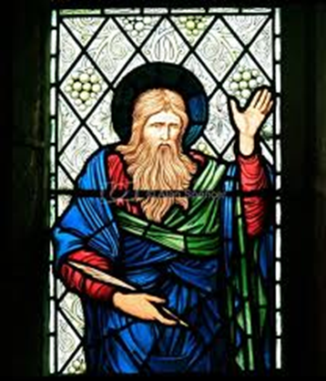
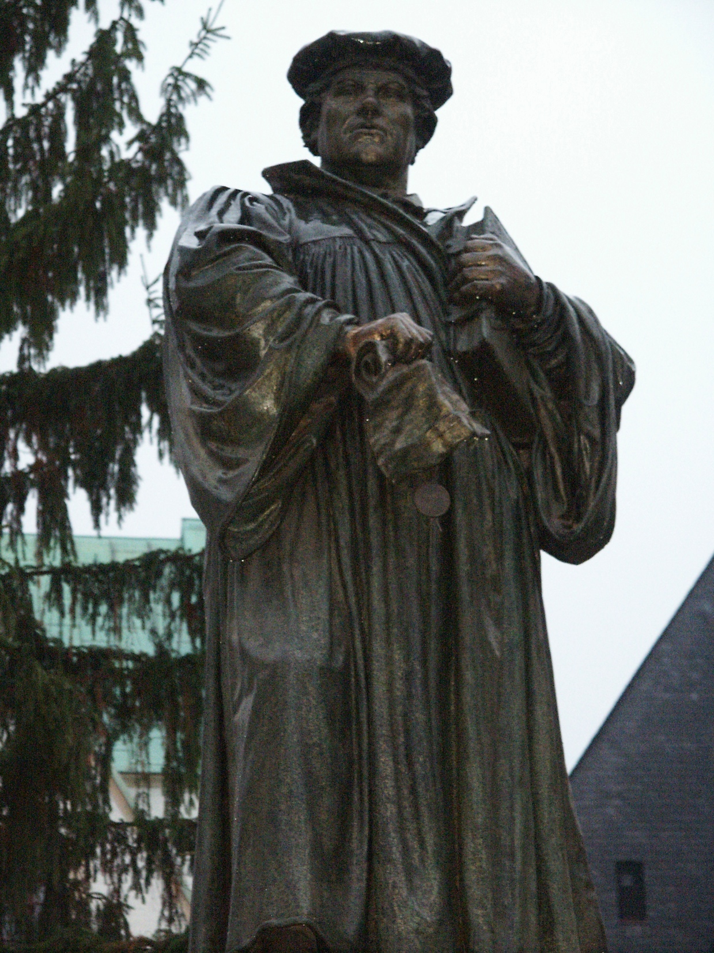
Isaiah
Isaiah 55
Lutheran Lens
Notes:
Before hearing this chapter read, what would Isaiah’s first auditors know that we don’t? What do we need to know in order to hear these words as Good News for us?
Possible exercise to help people realize how important context is for meaning:
(Read a small piece of Martin Luther King Jr.s famous “I have a Dream” speech to make the point. “So we have come to cash this check – a check that will give us upon demand the riches of freedom and the security of justice. We have also come to this hallowed spot to remind America of the fierce urgency of now. This is no time to engage in the luxury of cooling off or to take the tranquilizing drug of gradualism…Now is the time to lift our nation from the quicksands of racial injustice to the solid rock of brotherhood.” While we are all familiar with the famous last page of this speech, almost no one will know that these words precede that famous ending.)

Slide 2
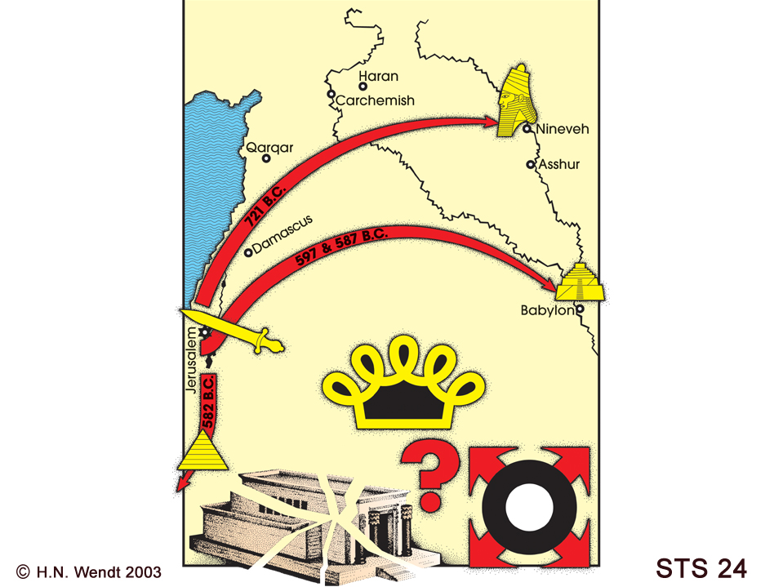
STS 24
Notes:
Two generations ago the parents and grandparents of the people who now sit in Babylon, listening to Second Isaiah, went through an experience that caused them to question everything about their faith.
Explain Nebuchadnezzer’s conquest. (The handout titled “A Tale of Four Cities” covers the history of Assyria and Babylon.)
Three things they had put their trust in – all were now gone as they headed to Babylon and exile.
Temple
King from the line of David
Promised Land
Can you blame them if they began to question God?
What things did you put your trust in prior to the COVID pandemic? Individually, and as a congregation?

Slide 3
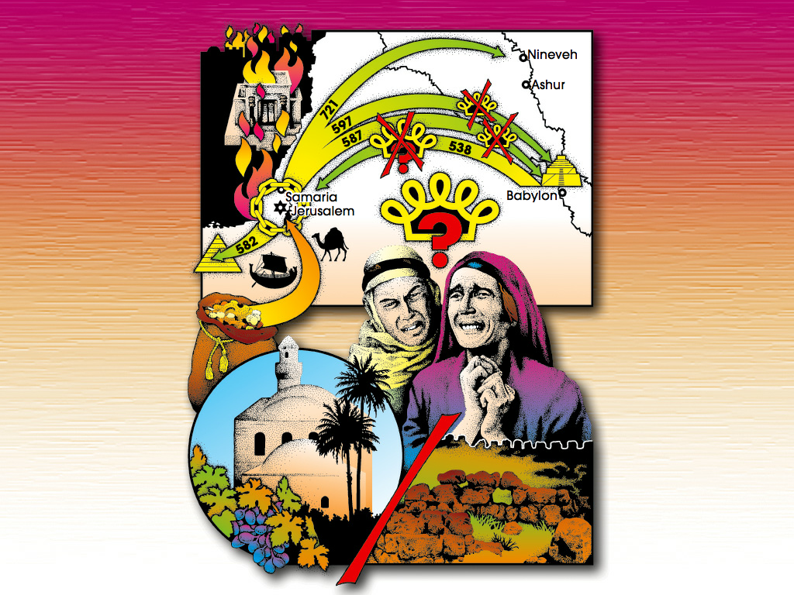

11C
© H. N. Wendt 2004 11C
Notes:
Second Isaiah had to convince those who had grown accustomed to living in Babylon that God had a future for them. God’s promises can be trusted. God’s faithful people still have a vocation.
But for many the pain had been too great, and they chose not to listen to Second Isaiah. They didn’t believe God’s promises were any good, and they chose to remain in Babylon rather than going back to Jerusalem as Second Isaiah prophesied they should. Only a fraction of those in exile chose to heed 2nd Isaiah’s call and return.
What new thing is God calling you and your congregation to now? How many are willing to let go of their cherished past in order to experience God’s new future?

Slide 4
Isaiah
Isaiah 55
Lutheran Lens
Notes:
We’ve heard the background to Isaiah 55.
These words are Second Isaiah’s final words. Last chapter of his portion of the prophetic book we call Isaiah. Isaiah is the longest Prophetic book and the prophetic book most quoted by the NT writers.
A third Isaiah will update the message one more time, once those few who follow Second Isaiah’s advice return to Jerusalem and need more words from the Lord.
Now let’s hear the final words of Second Isaiah read. You might choose to use the choral reading I’ve included in this session. One person reads the text that is italicized. The other would read the majority of the text.

Slide 5
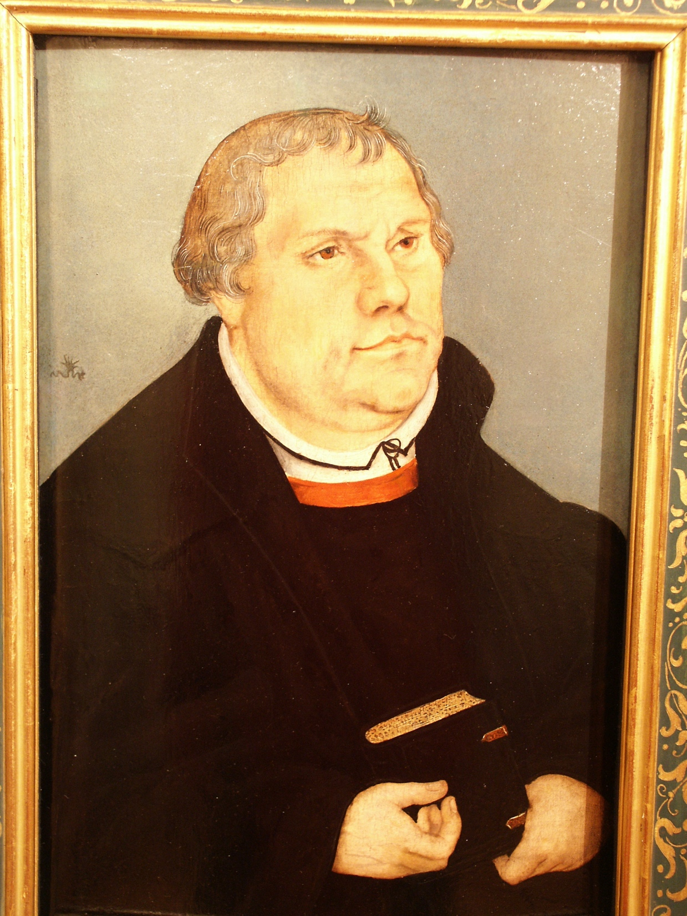
Lucas Cranach’s
Martin Luther
1541
Notes:
OK, the picture is a bit askew. Fits our theology – ELCA Lutherans don’t claim to have it all figured out. We just claim to have some insights that the whole Christian community needs to hear…just as we need to listen to what others have to add to our understanding of the text.
So, here are a few ideas which I pray will provide a useful perspective for your congregation as you engage in this four-session study of Isaiah.

Slide 6
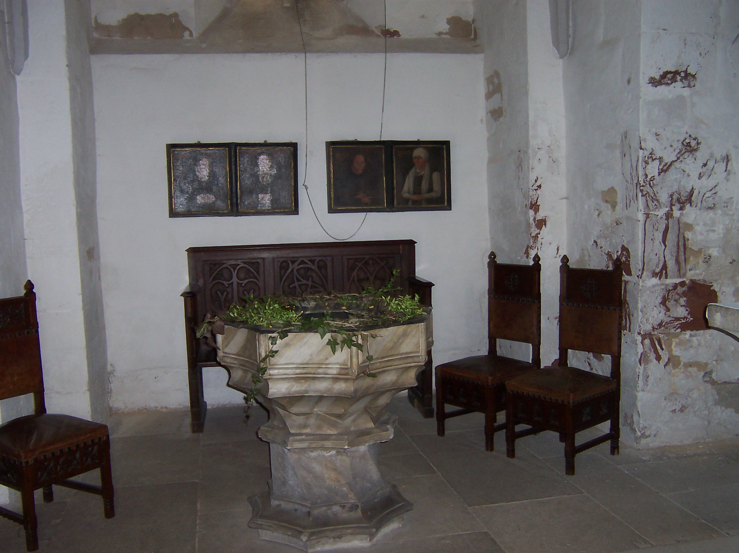
Is. 55:1-2
Notes:
“Ho, everyone who thirsts, come to the waters; and you that have no money, come, buy and eat!
Come, buy wine and milk without money and without price.”
“Why do you spend your money for that which is not bread, and your labor for that which does not satisfy?
Listen carefully to me, and eat what is good, and delight yourselves in rich food.”
Remember, Second Isaiah was inviting them to leave a land surrounded by rivers, and head back to dry and dusty Jerusalem – which was about as opposite of this image as one can get.
Isaiah certainly wasn’t thinking about Baptism, but the image of all who are thirsty coming to receive the free gift of God’s life-giving water, wasn’t lost on the writer of the Gospel of John. A quick read of John’s account of Jesus’ conversation with the Samaritan woman at the well is helpful. Read John 4:10-14.
Baptismal font in Eisleben, Germany. Paintings on the back wall are Luther’s parents, Hans and Margarethe Luder, painted by Lucas Cranach.
The font stands in the baptistry of the church of St. Peter and St. Paul (but it is not the font that Luther was baptized with – that font is gone). He was baptized Nov. 11, 1483.
Luther’s understanding of God’s radical grace poured out in the waters of baptism and yet our ongoing sinfulness led to his famous declaration that we are at the same time sinners and saints. While we are invited to feast on God’s free gift of grace, we consistently chose to try to buy our way at least part way to heaven. The list of what we use for money is endless, as is our attempt.
Yet God chooses to see us through the lens of the cross!
Congregations, just like yours, are no different. We are made up of a collection of sinner/saints. We struggle to have things go our way, while at the same time, we pray that God will open our eyes to the future God has in store for us.

Slide 7
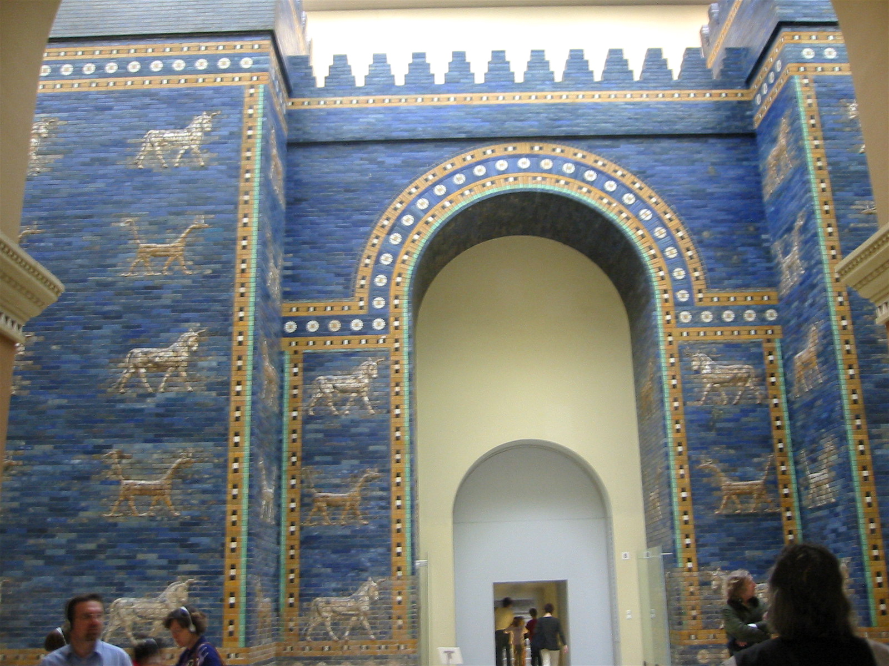
Is. 55:2-3
Notes:
These gates symbolizes both Law and Gospel in 2nd Isaiah and in particular Isaiah 55.
Two generations ago they walked through the Ishtar Gates as defeated, captive people. Most followed Jeremiah’s advice (Jeremiah 29: 1-14) and settled down and made Babylon their home. Now 2nd Isaiah is inviting them to follow Cyrus the Messiah’s decree and pass through these same gates as part of a new Exodus. These gates had symbolized LAW – exile for breaking the Covenant, but now they are a symbol of God’s radical grace. God is making a new, everlasting covenant with all the people.
The same gates – but two different ways to experience God’s involvement in their lives as people of Israel.
Martin Luther used this imagery when he wrote the “Babylonian Captivity of the Church.” That topic is for another time, but what might it have been like to experience that first Babylonian exile. To pass through these gates and to sense that everything you had placed your trust in had been destroyed – or let you down! No more city of Jerusalem, no more temple, no more Davidic king, no more Davidic throne, no more promised land… might you have been tempted to think…no more Yahweh????
God reminds them that their natural inclination is to spend money for that which is not bread, and labor for that which does not satisfy! Their experience of exile in Babylon was evidence enough of that. But rather than more pronouncements of Law and punishment like 1st Isaiah declared, 2nd Isaiah announces God’s radical grace. You are going home! You are going home because God is faithful to God’s covenant promises. You are going home with a purpose.
What might the list look like in your congregation? You’ve experienced several years of COVID. In response to this pandemic, families in some cases have been divided. Maybe some members have left, others have stayed. What is our future? What is our purpose? More questions than answers?
Leader note: Mention where the Ishtar Gates are currently located. Museum Island, Pergamum Museum, Berlin, Germany.

Slide 8
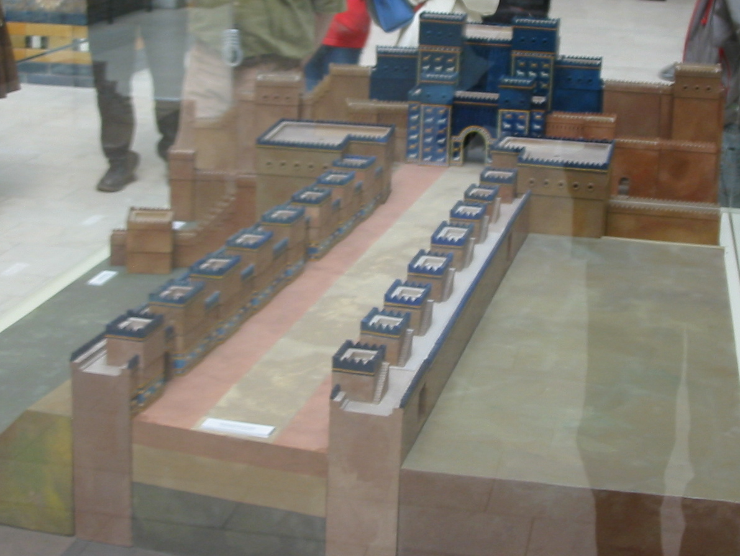
Isaiah 55:3-5
Notes:
Justification leads to Vocation!
These same Ishtar Gates, can symbolize God’s vocational call to all of us. Think about the trajectory of the three parts of Isaiah.
First Isaiah – you are going into exile because you’ve broken the covenant.
Second Isaiah – you are going home on a new Exodus and will experience a new creation – because God is merciful and God will abundantly pardon. It isn’t about you or what you’ve done to deserve this pardon!
Third Isaiah – how to deal with the realities of trying to live as saved people with a vocation to serve God by serving the neighbor, often when it is counter cultural.
Isaiah 55:5 paints a grand vision of the vocation of the returning Israelites. They will fulfill the covenant made with Abraham in Genesis 12! They will call nations they do not know, and nations that do not know them shall run to them!
What does it mean that this little group of refugees are given the vocation to call the nations? What does it mean that the same vocation has been given to you?
What will that look like in your community? Done by you, members of __________? A good deal of your pastor’s role with you is to help you struggle with the answers to these vocational questions.
It is helpful to remember that Second Isaiah didn’t have a better crystal ball than you do! He knew God’s promise to God’s people. He knew the purpose God’s people were being called to. But he missed the HOW entirely! (There was no super-highway through the desert. There was no welcoming throng when they returned. It remained a rubble heap, inhabited by others who weren’t at all willing to give up this land to the returning exiles.) I think most of us are in the same boat as Second Isaiah. We know whose we are – as Luther regularly reminds us – we are Baptized Children of God. We know our vocation – to live amongst each other and to serve others so that others will be drawn to experience God’s loving community too. But how exactly that plays out is often surprising and/or unclear.

Slide 9
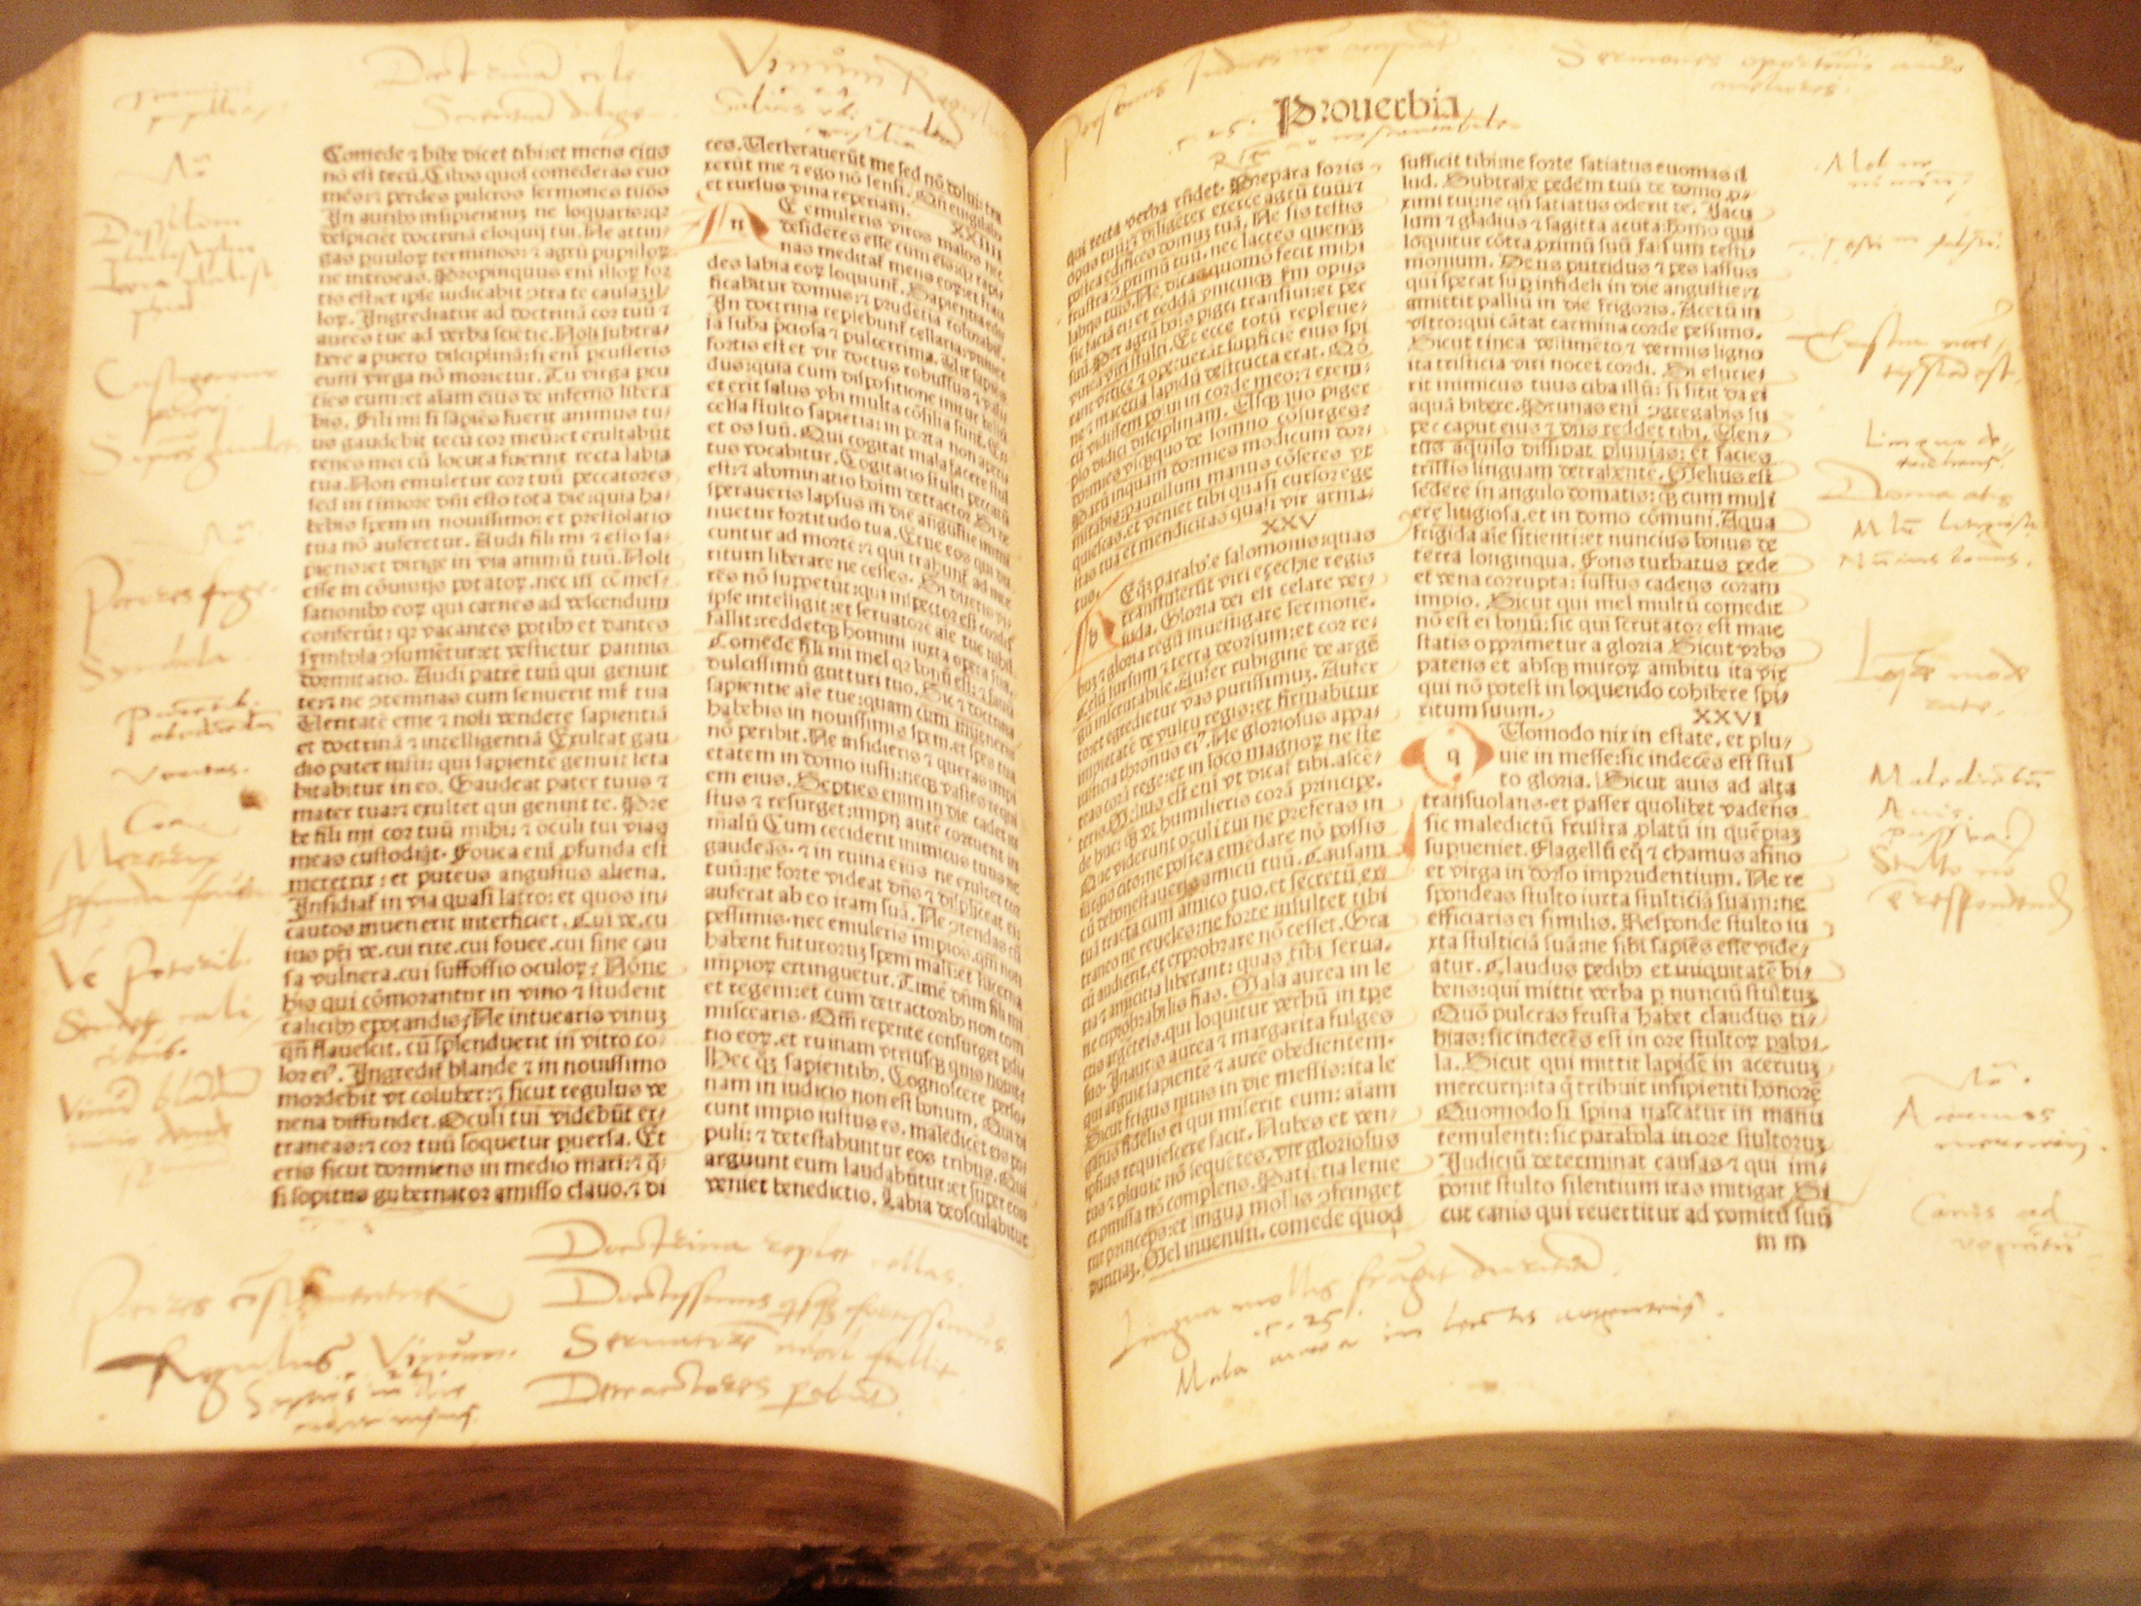
John 1:14-15
John 20:30-31
Is. 55: 6-9
Notes:
George Spalatin’s 1498 Latin Bible, borrowed by Luther. On display in Altenburg.(I took this photo on a 2003 visit) He was the go-between with Luther and his protector Elector Frederick the Wise. The two never met face to face!
How a book begins and ends matters. We call that: Bookends.
Is. 40:8 “The grass withers, the flower fades; but the word of our God will stand forever.”
Is. 55: 11 “…so shall my word be that goes out from my mouth; it shall not return to me empty, but it shall accomplish that which I purpose, and succeed in the thing for which I sent it.”
How does this strong word work in us? How does it accomplish its purpose?
When one remembers that both the Priestly writer/editor that gave shape to the Torah (first 5 books of our OT) and 2nd Isaiah were contemporaries in Babylon, one can’t help but compare Genesis 1 and the way the Word of God brings order out of chaos with Isaiah 40 where the Word of God brings order out of political, social and religious chaos!
A good deal of misunderstanding is tied to this idea in the ELCA today.
What is its purpose? We’ve already seen what Second Isaiah thinks God’s Word will do.
But two NT passages are very helpful as well.
John 1:14-15 and John 20:30-31 give us a NT perspective on God’s purpose!
That incarnational Word is encountered 4 different ways:
Christ’s presence – as the Word made flesh, dwelling within us, through the power of the Holy Spirit, given in baptism.
Written Word – Like Isaiah 55, with its strong words of promise and purpose
Spoken Word – whether it is this Bible study, or your faithful conversations with each other and the neighbor
Splashed/Tasted Word – Sacraments that you make available to all who worship with you are means of God’s grace.

Slide 10
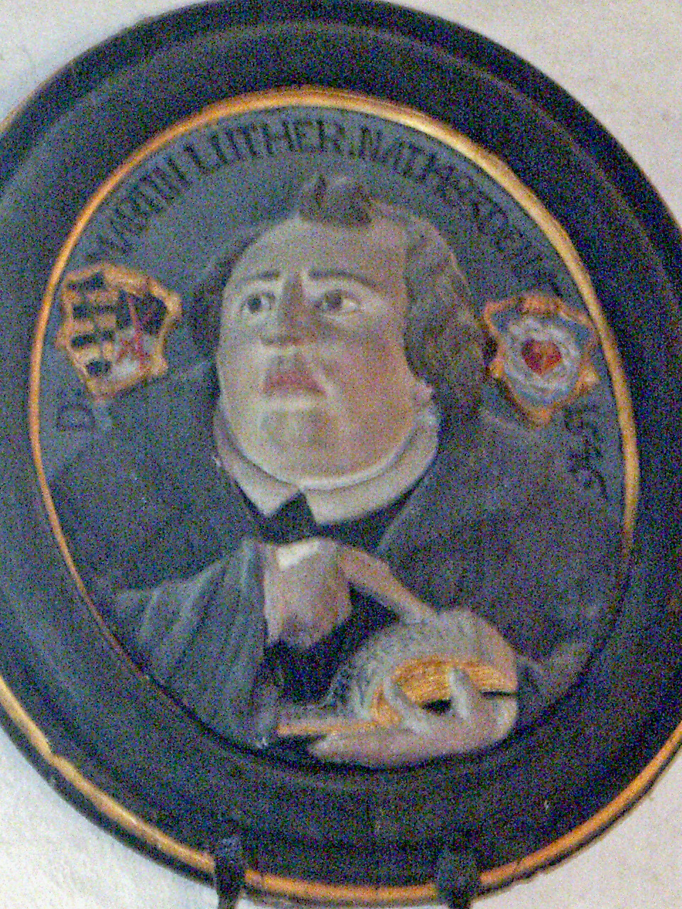
Isaiah 55:10-13
“it shall accomplish that which I purpose,”
Notes:
Power of the word. Incarnational word. Accommodated word.
What does it mean that the vision/promise/hope of Second Isaiah didn’t materialize? The second Exodus and the promised New Creation didn’t turn out the way he had prophesied! A quick read of Third Isaiah or Ezra/Nehemiah tells how the people had to adjust.
How does God’s powerful word work through real human people – then and now?
Luther believed that the Biblical writers were fully human and had no better insights into the world than anyone else. He often commented that the smart Germans of his day understood how the world worked far better than those old Jewish writers. But he did believe that they never erred when they spoke/wrote about God’s gracious mercy and God’s intent to keep God’s promises, most fully shown in God’s coming all the way down in a cradle and a cross.
2 Isaiah, while his vision of the future didn’t pan out, was spot on in his announcement of God’s gracious intent to use God’s people to bring others to know about God’s love for them and the creation.
The closing words of Chapter 55, and thus the final words we have from 2 Isaiah say it best;
“it shall be to the Lord for a memorial, for an everlasting sign that shall not be cut off.”
In what ways, will God’s Word accomplish its purpose through you, members of ___________?
How will your lives in your homes, and your life together as a congregation, be a witness to Christ, the living word in your midst?
How can God’s unconditional love guide everything that you do here?

Slide 11
Isaiah 55
Lutheran Lens
How might Second Isaiah’s first audience have heard these words as both Law and Gospel? How do they serve as Law and Gospel for you?
How does this chapter move from Justification to Vocation for the Israelites who first heard it? How does it do the same for you?
What other passages help you to understand this one?
How might those around you from another culture, or your companion synod/s understanding of Second Isaiah, help you to experience the text differently?
Notes:
Invite the group for one last time to gather with their neighbors and take the questions in any order they choose.

