Slide 1

Holy Conversations
Options for Congregations Living Into A Vital and Sustainable Future

Slide 2

Exodus 16
Then the Lord said to Moses, “I will rain down bread from heaven for you. The people are to go out each day and gather enough for that day. In this way I will test them and see whether they will follow my instructions. That evening quail came and covered the camp, and in the morning there was a layer of dew around the camp. When the dew was gone, thin flakes like frost on the ground appeared on the desert floor. When the Israelites saw it, they said to each other, “What is it?” For they did not know what it was.
Moses said to them, “It is the bread the Lord has given you to eat.

Slide 3
Exodus 16
This is what the Lord has commanded: ‘Everyone is to gather as much as they need. Take an omer for each person you have in your tent.’”
The Israelites did as they were told; some gathered much, some little. And when they measured it by the omer, the one who gathered much did not have too much, and the one who gathered little did not have too little. Everyone had gathered just as much as they needed.
Then Moses said to them, “No one is to keep any of it until morning.”
However, some of them paid no attention to Moses; they kept part of it until morning, but it was full of maggots and began to smell. So Moses was angry with them.

Slide 4

Exodus 16
What is a word or phrase that comes to mind when you read this passage?
What do you think God is saying to you or your congregation as you read this passage?

Slide 5
What is your Moldy, Maggoty Manna?
How do we let go of that moldy manna to have open hands to receive the daily break that God has promised?
What is the new daily bread being offered to you today?

Slide 6
What Is Going On Here?
What are the major challenges you are facing?
What are the bright spots of your ministry?
What are your hopes for the future?

Slide 7
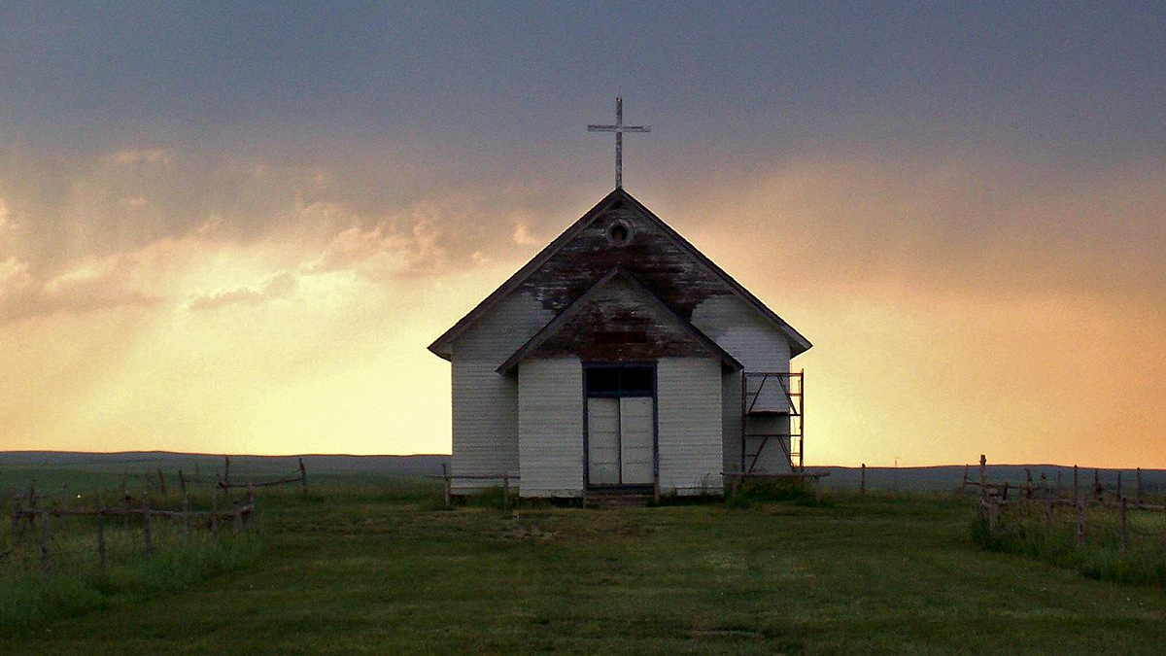
Challenges to Smaller Congregations
As congregations shrink and struggle financially, they may need to find alternatives to a “conventional” ministry model—one that pre-supposes that each congregation will have it’s own separate facility and be served by a full-time, salaried, seminary trained pastor.
This Photo by Unknown Author is licensed under CC BY-SA

Slide 8
Three Choices for Congregations Living Into a Vital and Sustainable Future
Choosing Transformation
Choosing Partnerships
Choosing Resurrection

Slide 9
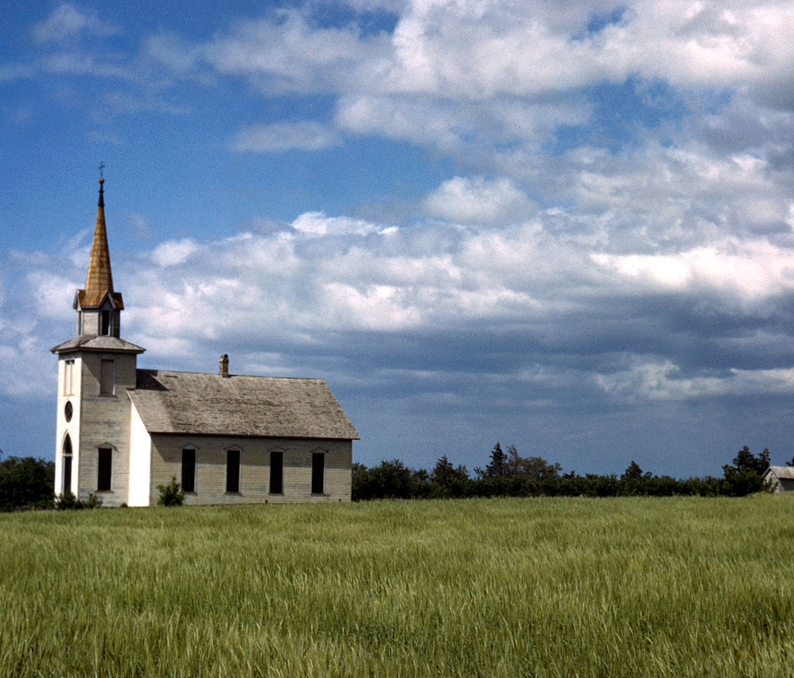
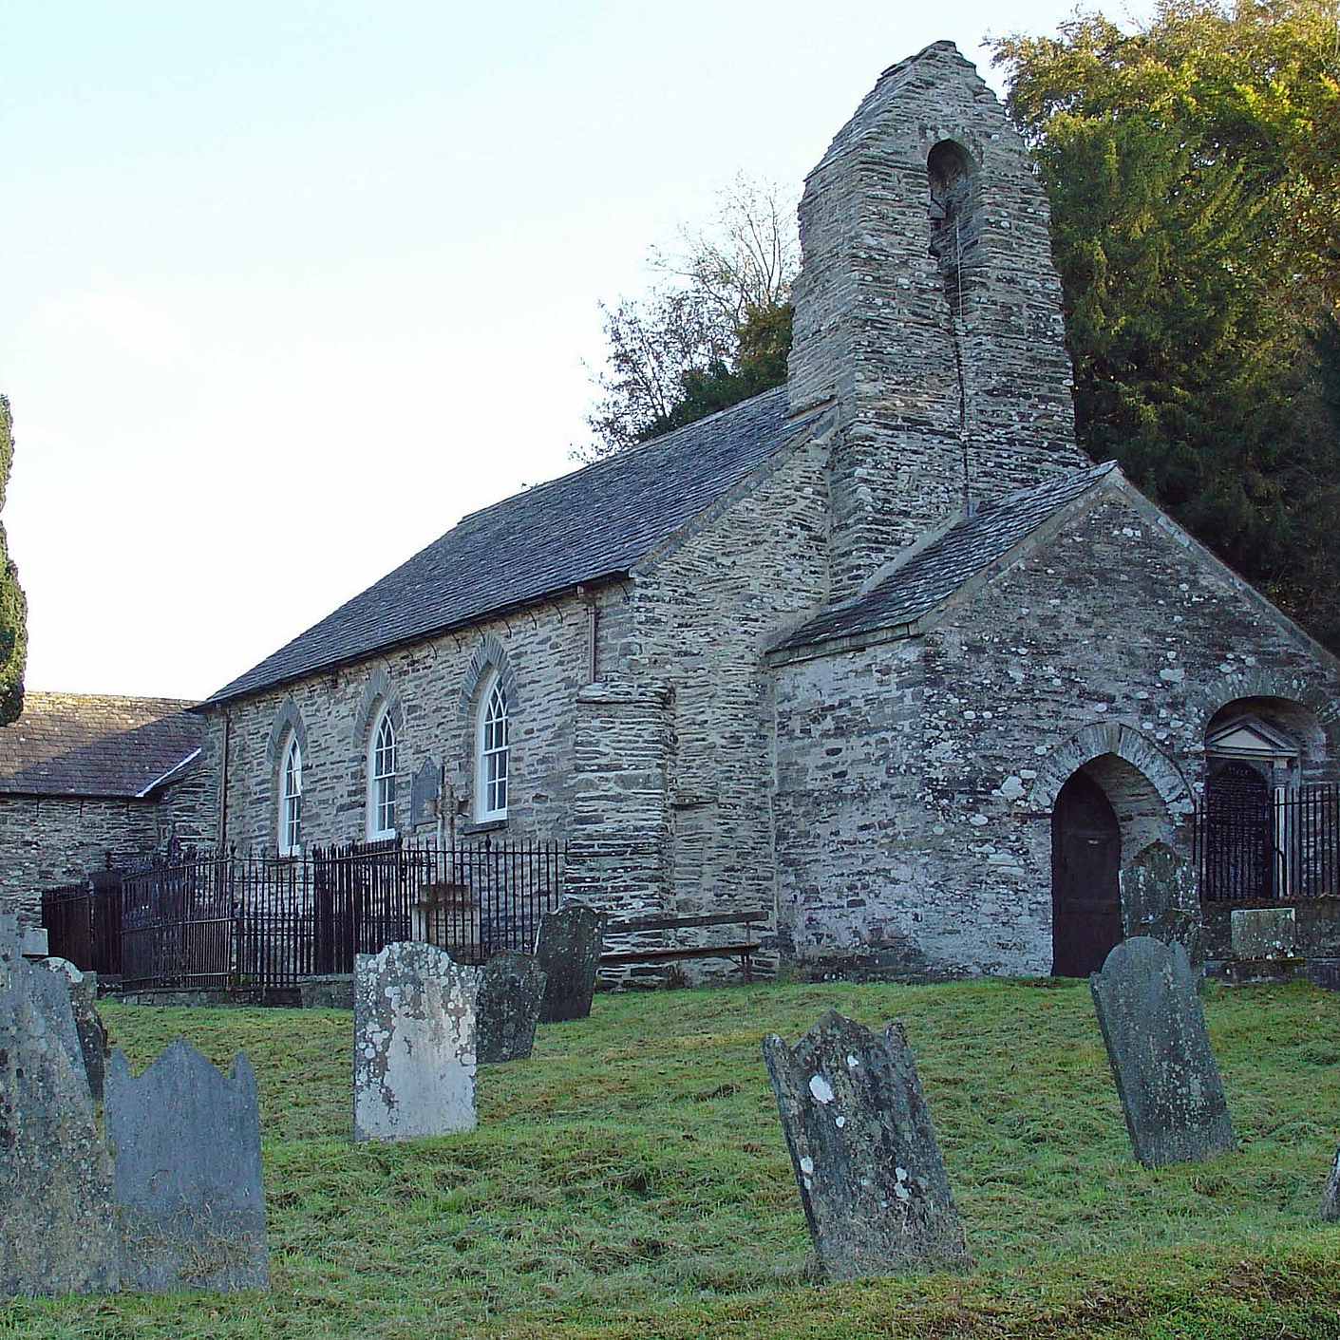
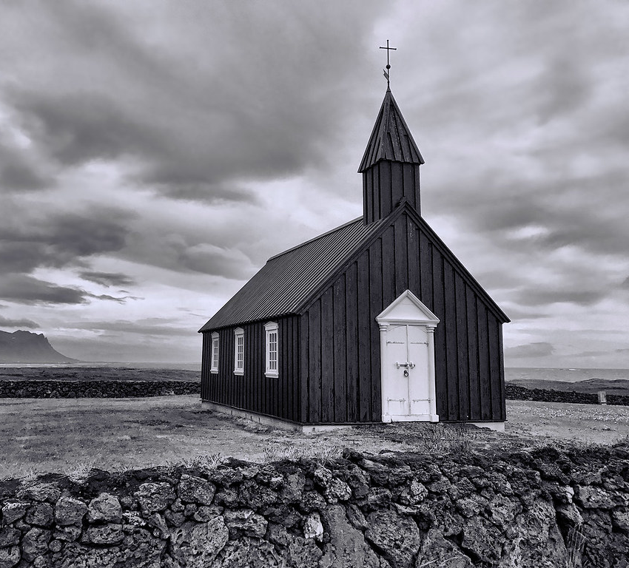
Choosing Transformation
Revitalization Process
Renewal Process
Redevelopment Process
Staffing in a New Way
This Photo by Unknown Author is licensed under CC BY-SA
This Photo by Unknown Author is licensed under CC BY
This Photo by Unknown Author is licensed under CC BY-SA

Slide 10
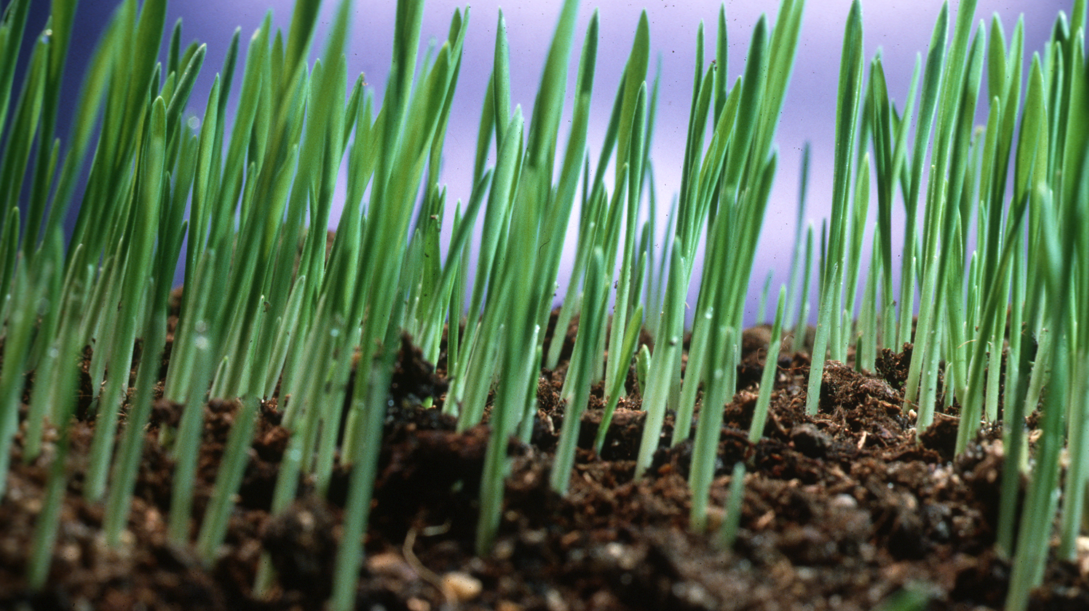
Revitalization Process
  Process with the purpose to raise vitality and mission in a congregation
  Faithful Innovation
  Cultivating Generous Givers
This Photo by Unknown Author is licensed under CC BY-SA

Slide 11


Renewal Process
Process of more in depth work over a period of time to renew, turn around ministry.
Often starts with the CAT Survey and then a Synod Authorized Renewal Plan that is worked on for a period of time by the interim and congregation

Slide 12
Redevelopment Process
A Process where an ELCA trained Redevelopment Pastor is put in the congregation for a term call (often for 3 years) to completely redevelop ministry.
Need approval by the ELCA and DEM
Need openness to becoming something new

Slide 13

Staffing in a New Way
Synodically Authorized Minister
Part Time Clergy
This Photo by Unknown Author is licensed under CC BY-NC-ND

Slide 14

Choosing Partnership
Merger/Consolidation
Multi Point Parish
Anchor Church
Co Op Ministry
This Photo by Unknown Author is licensed under CC BY-SA-NC

Slide 15
Join an Area Parish or Cluster
A Parish or Cluster is two or more congregations who share a pastor (or a pastoral team). This structure is also called a “Multi Point Ministry Site”.

Slide 16
Anchor Church Relationship
An Anchor Church is when a larger, established congregation partners with smaller congregations. This can look like a few different things:
Accompanying Model (A short term relationship with coaching, some shared staff and shared programs)
Adoption Model (A permanent multi point relationship with coaching, shared staff and shared programs)
Poly-site Model (The smaller congregation become a mission outpost)
Franchise Model (The smaller congregation becomes a second version of the larger)

Slide 17
Merge or Consolidate with other congregations
A Merger is when two or more congregations come together (Congregation A and B) but only one exist afterwards (Congregation A).
A Consolidation is when two or more congregations come together (Congregation A and B), both disband and then form a brand new congregation together (Congregation C).

Slide 18
Form a Ministry Co-op With Neighboring Churches
A Co-op is a relationship where area pastors partner of ministry and structure for financial and missional gain:
1. Shared building or shared office space
2. Shared employees or support staff
3. Shared youth or family programs
4. Shared committees or missions

Slide 19

Choosing Rebirth
Ending Well
Becoming a Mission Point

Slide 20

End Well
Questions:
  What is our Purpose? Are we clearly living out our purpose?
  Do we only exist to continue our beloved community and traditions?
  What is the meaningful work God has given us to do now?
  What gifts do we have to offer the community?

Slide 21

Next Steps to Consider
MOST IMPORTANT: Listen to God, each other and the neighborhood. Pray continually!
Take a breath before making any decisions. Have conversations to see what options you would like to consider
Work through the Bible Studies in the Workbook to aid in discernment
Ask DEM Erin Nelson to assist you as you move forward.

