Slide 1

Go Big or Go Home:
Caring for God’s Creation
How to supercharge
your green team

Slide 2
If not now, then when?
If not us, then who?
Matthew West’s Do Something https://www.youtube.com/watch?v=b_RjndG0IX8

Slide 3
Eau Claire Interfaith Green Team
Sue Wagner- First Presbyterian Church- swagner@chipvalley.com
Pat Mertens- Trinity Lutheran Church- pmertens@charter.net
Lynn Fering- Spirit Lutheran Church lafering@aol.com
Kathy Stockton-Behnke- Spirit Lutheran Church- kasbehnke@gmail.com
We are members of a coalition of green teams of multiple faith communities in and around the Chippewa Valley sharing a common concern for the health of Earth. We are a part of the Environmental Task Force of JONAH (Joining Our Neighbors Advancing Hope)

Slide 4
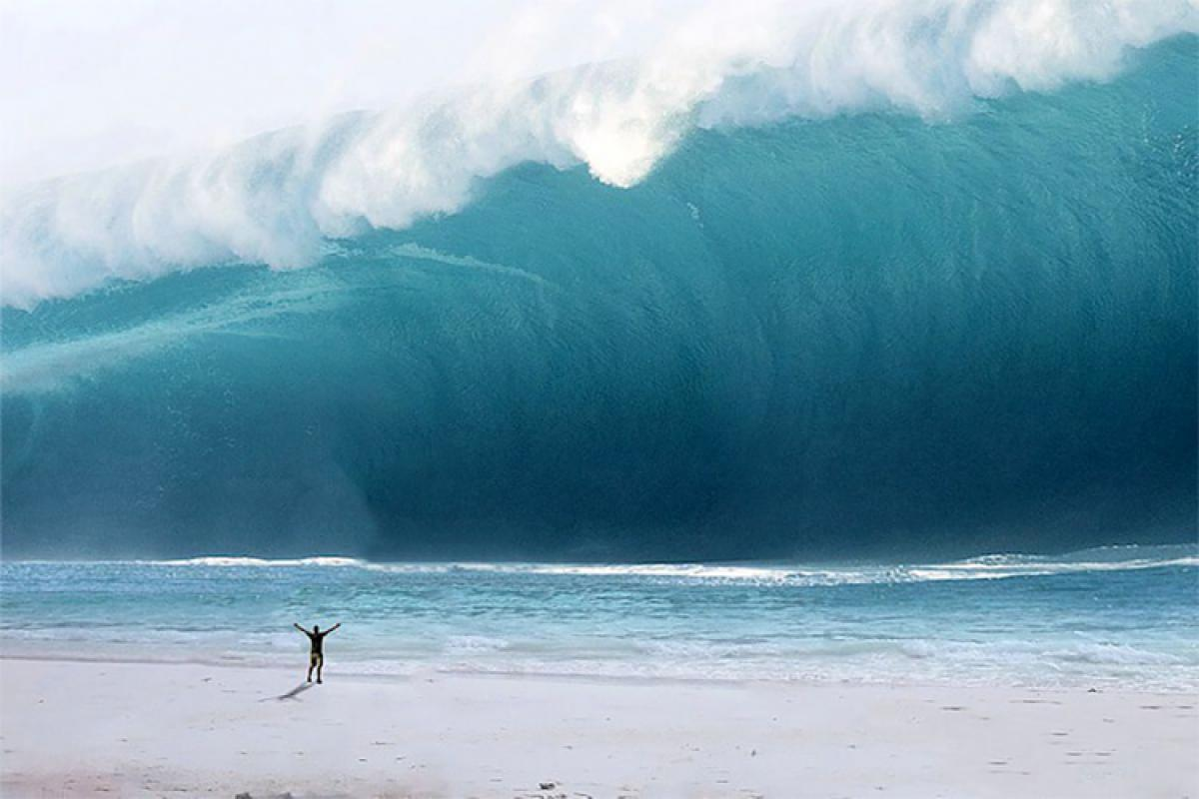
The task of educating yourselves about the climate change, Earthcare, recycling, environmental justice, etc. may seem overwhelming!

Slide 5
Caring for Creation is a very big topic.
Preserving nature
Environmental justice- who will suffer the impacts of climate change
Looking at our personal and corporate impact on the world around us
Social Justice- overconsumption, food deserts, affordable housing
Pollution- what is our individual contribution?
Many others
We are focusing on one aspect of this topic- how to create a team in your church that will focus on one of the miriad of choices of ways to affect change in our congregational and personal lives…
A GREEN TEAM

Slide 6
How to get started- Talk about it!
Find your person(s) “on fire”- HOW?
  Preach about creation care/temple talks
  Bring in a speaker about climate change
  Do a book club on the topic
  Invite others to join the team every time you talk about it
  Make it personal- what will happen to your kids or grandkids or family?
  Make it easy to join the green team- it’s the whole congregation!
  Put information in the church newsletter
  Keep it positive- “ we can make a difference”

Slide 7
Find your natural partners:
Inside the church
THE CHILDREN- they are who all this is for: Sunday School, Bible School, Youth groups, confirmation
Pastor(s)/church council
Synod resources- Caring for Creation team
Church custodian
Church secretary (knows everything and everyone)
Mission teams already in place
Men and women’s groups in the church

Slide 8
Outside the Church…
Local and county recycling – what are the local recycling guidelines; talk with them about compliance
County sustainability department/office
County Extension agent
Parishioners with similar interests and concerns
Garden Club/other community organizations
FFA/4H/High school groups
Local composting service
State and Federal congressional representatives
US Department of Energy
Wisconsin Department of Energy
Wisconsin DNR
Neighborhood associations

Slide 9
Educate yourself – people will expect you to be the experts
Online resources
Books on climate change, recycling, caring for creation
Local and county office on recycling and sustainability education materials
Technical schools or University resources
Find out what is going on locally/who else is being active in this?
Find out what is going on in the church regionally and nationally
Lutherans Restoring Creation
NW Synod Caring for Creation (Lutherans) group
Check out other resources from other denominations and secular organizations
Other national and international efforts- Greta Thunberg

Slide 10
Ideas for First Steps
Once you find your seed team members, find out their “burning” issues.
Develop your mission statement- your guide, your roadmap, your reminder of why you are doing this (examples found in the resources section)
Consider a questionnaire for the recycling habits of the team members and the congregation
Do a review of the church: How is your church green health?
  recycling
  energy management- heating and cooling and water use
  office use of paper, printing, ink cartridges,
  Reusable/recyclable/compostable items in the kitchen- plastic dinnerware, plates, cups
  plastic bags
  batteries from the microphones
  food waste- left over food, coffee grounds, etc.

Slide 11
Some suggestions for a successful team:
Meet regularly and use an agenda
Keep minutes of the meeting
Have good communication with team members and the congregation and other leaders
Make a one or two year plan
Engage or partner with other congregations in your community (interfaith)
Keep recruiting and partnering
Keep going!

Slide 12
You many need to be a “leader” for the congregation but be sure to partner, partner, partner with other groups in the church, community groups, pastor(s), church council, custodian, women/mens groups, and the CHILDREN.
The green team may be the leader but share the work and the glory!

Slide 13
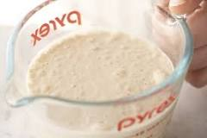

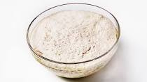
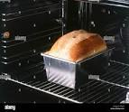
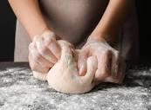
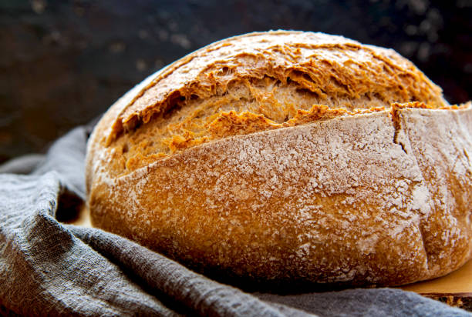
Starting a green team is like making bread… you start by proofing the yeast(add warm water and sugar and let it grow), mix it in with the rest of the ingredients, give it time to rise then knead it, bake it, then, VOILA, a beautiful loaf of bread.
The green team is the yeast, the starter, for a green congregation.

Slide 14
Ready, Set, Go
Once you have:
  A mission statement
  Educated yourselves – very important!
  Reviewed the current status of things in the church
  Looked at your resources
  Considered the team members’ areas of interest
  Then, plan your first project.

Slide 15
To give you a jump start, here are three projects our teams have started in our different congregations.

Slide 16
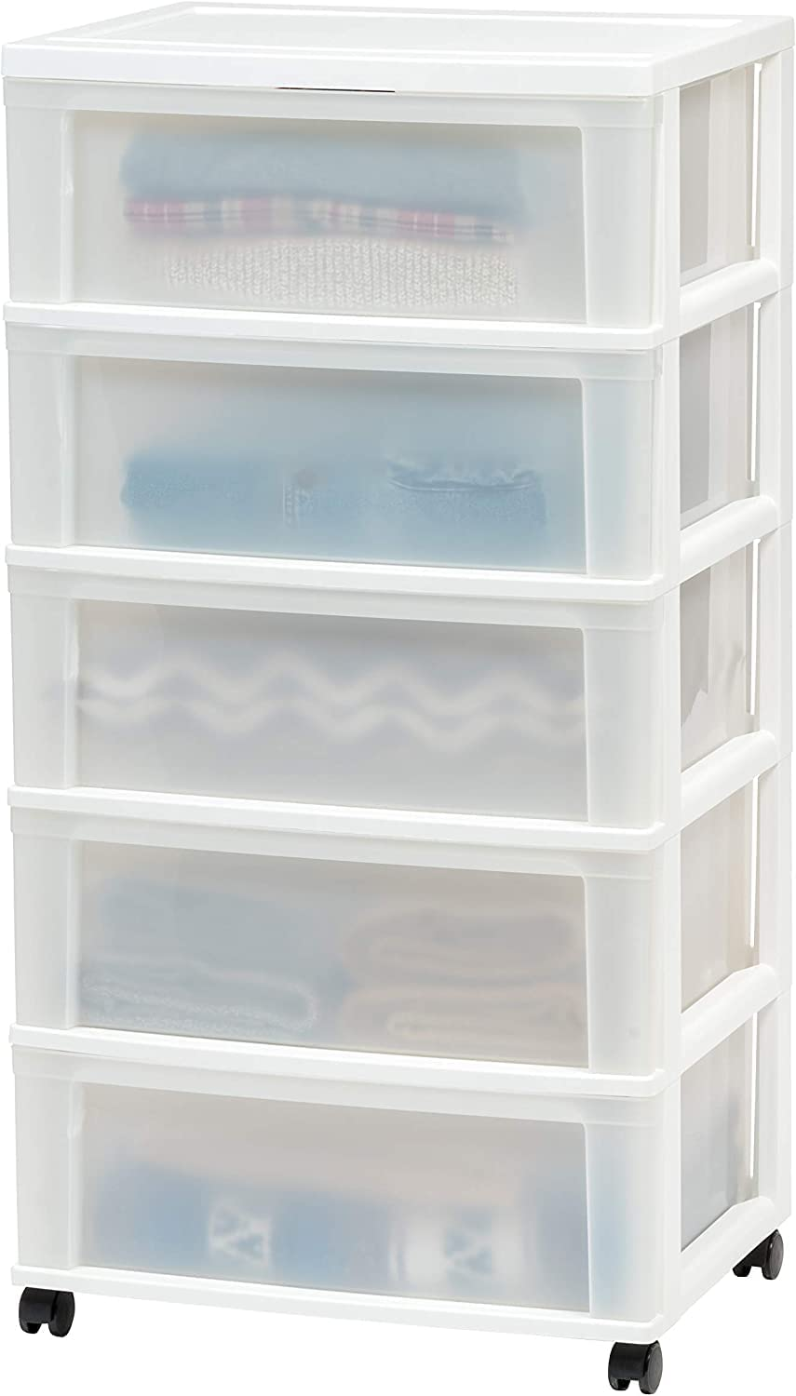
Project #1 – Lynn
Spirit Lutheran Recycling Kiosk
Household batteries
Electric cords/wire
Christmas tree lights
Metal jar lids
Eyeglasses
Computers/cell phones/electronics
Cart can be purchased: https://www.amazon.com/dp/B082VJV7NP?ref_=cm_sw_r_cp_ud_dp_WF75Q6XX141ENPZMPZW1

Slide 17
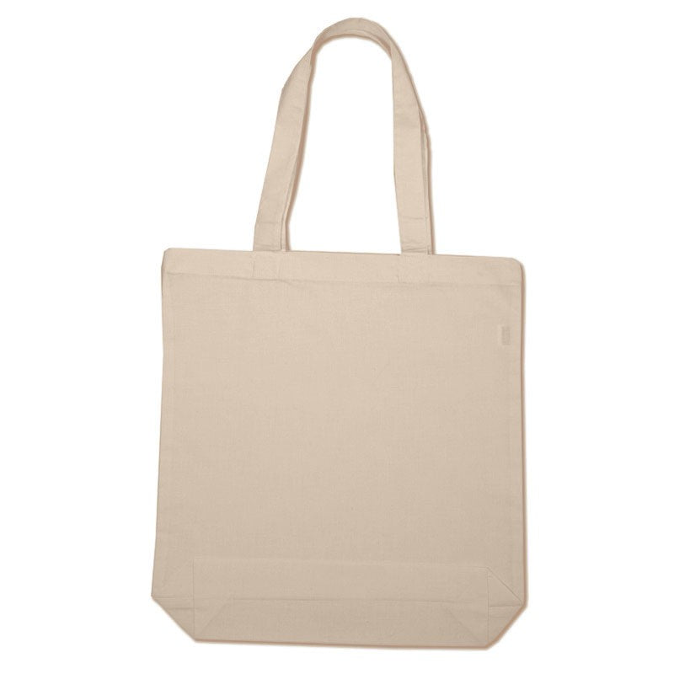

Project #2- Pat
Trinity Lutheran - Reducing Single Use
Plastic Shopping Bags

Slide 18
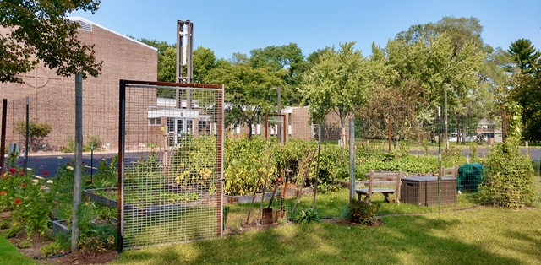
Project #3-Sue
First Presbyterian- Community Garden

Slide 19
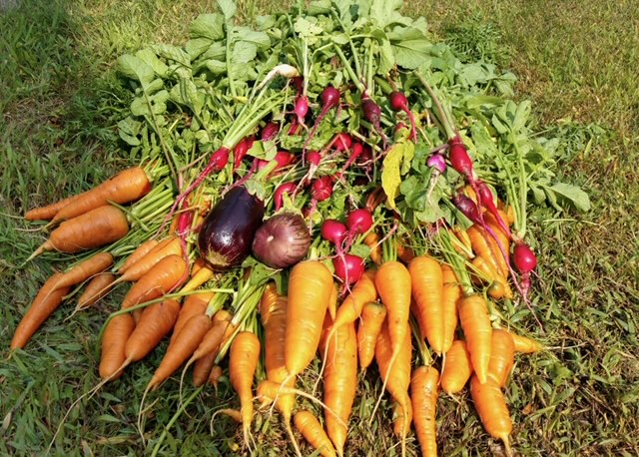

Slide 20
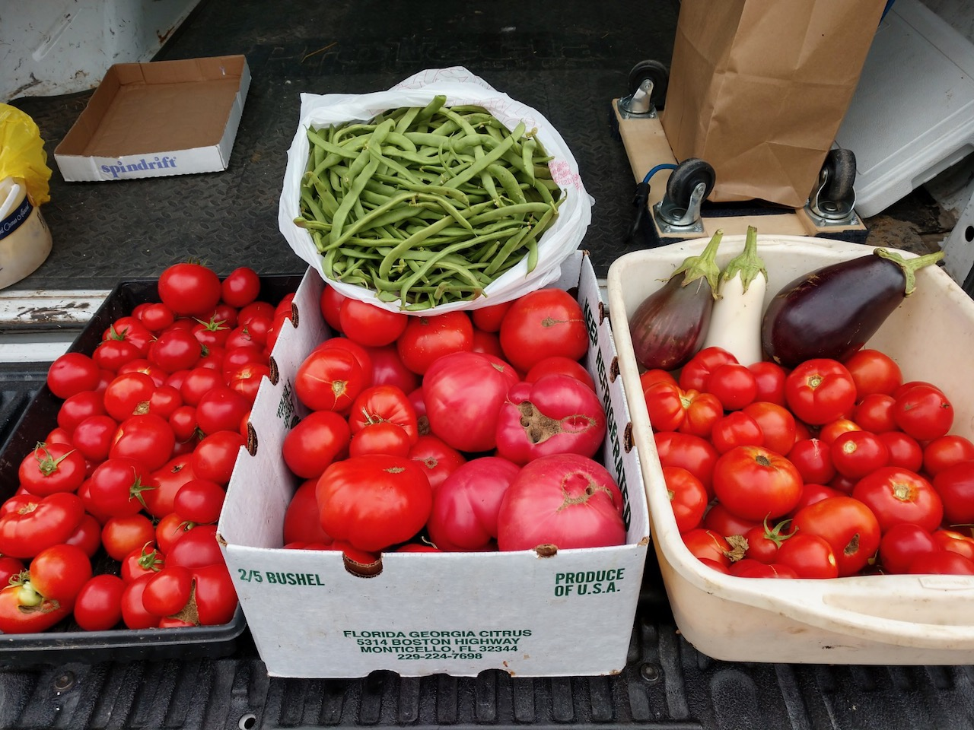

Slide 21
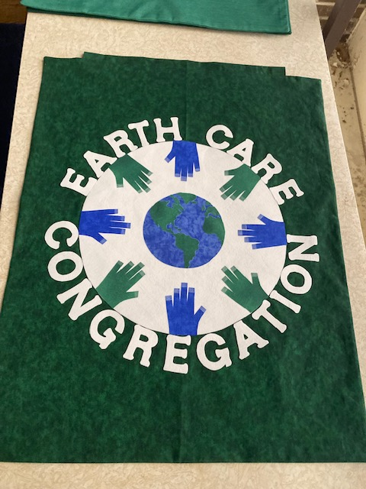

Slide 22
Nothing succeeds like success!
Do One Thing and Do it very well!

Slide 23
Every church has their own way of being.
Adapt your plans to include everyone that needs to be part of the planning.
Be prepared to answer questions, present a plan, and work towards “YES”.

Slide 24
You don’t need a lot of money to start a green team. What you do need is a lot of enthusiasm.
We are running short on time to turn this climate crisis around.
If you ask God, why don’t you do something about this mess,
God will answer, I did….

Slide 25
I created
YOU!

Slide 26
QUESTIONS?
Powerpoint with additional resources available on the Synod Website.

Slide 27
Other project possibilities
Write a regular green information item(s) for the newsletter or bulletin
Community garden
Solar panels for the church
Shop locally promotion
Display of sustainable products
Green techniques for church lawn care- delayed mowing for pollinators
Displays of locally recyclable items- what to recycle and how
Reduce use of plastic single use plastic bags/use of reusable shopping bags

Slide 28
Resources:
Books:
“Cathedral on Fire: a church handbook for the climate crisis” by Brooks Berndt - order from www.ucc.org – cost $6.95 plus shipping- $14.45 total
Internet sites:
  Lutherans Restoring Creation ( a grassroots organization to fight climate change)- https://lutheransrestoringcreation.org/
  NW Synod ELCS- Caring for Creation- https://nwswi.org/social-justice-advocacy/creation-care
  Soles4Souls(collecting shoes for homeless and micro loans)- https://soles4souls.org/?utm_term=soles4souls&utm_campaign=Branded%20-%20MXC&utm_source=adwords&utm_medium=ppc&hsa_acc=4331453876&hsa_cam=12315872629&hsa_grp=120646427267&hsa_ad=498040665557&hsa_src=g&hsa_tgt=kwd-4681319325&hsa_kw=soles4souls&hsa_mt=b&hsa_net=adwords&hsa_ver=3&gclid=CjwKCAiAjPyfBhBMEiwAB2CCIiyofLeZtOauVRvAu7kkd4notqnJaf1vNKR4OVinYqNpaaE-V828BxoCKs8QAvD_BwE
  US Department of Energy- https://www.energy.gov/energysaver/energy-saver
  Interfaith Power and Light (IPL inspires and mobilizes people of faith and conscience to take bold and just action on climate change.) - https://www.interfaithpowerandlight.org/

Slide 29
More Resources
Cool Congregations (The Cool Congregations program is designed to support faith communities as they “walk the talk” by reducing their own carbon footprint, thus helping to cool the planet.)- coolcongregations.org
Lutherans Restoring Creating Congregational Self-Organizing Kit; becoming a Creation Care Congregation- https://lutheransrestoringcreation.org/how-to-become-a-creation-care-congregation/
Thrivent Action Team grant $250 (for Thrivent product owners)- thrivent.com
Citizen’s Climate Lobby cclusa.org
Rewiring America IRA (InflationReduction Act of 2022) info /calculator rewiringamerica.org
Investing in Our Planet Earth Day 2023 http://www.earthday.org
EN-ROADS climate simulator enroads.org

Slide 30
Movies for kids/youth with a green theme:
  https://www.smithsonianmag.com/science-nature/top-ten-kids-movies- with-a-green-theme-19409104/
  https://www.commonsensemedia.org/lists/movies-that-teach-kids-about-climate-change

Slide 31
Green Products
Grove Collaborative- Grove Collaborative, a creator and curator of 150+ healthy, effective, ethically produced, and cruelty-free personal care and household cleaning brands sold primarily online, has just three short years to meet its goal of being plastic-free by 2025.- https://www.grove.co
Misfits Market (It has a two-pronged mission to provide affordable access to healthy food and to fight the food waste crisis.- https://www.misfitsmarket.com/
Good Start Packaging: All products on this page were MADE IN the USA! Lots of great American-made compostable food packaging & bag options with more and more coming in regularly. Wholesale Pricing & Fast Shipping! https://www.goodstartpackaging.com/

Slide 32
Mission Statement- Trinity
Lutheran Church
To serve in Christ’s love and to promote justice for creation.
Encourage through worship, music, forums, and educational resources an awareness of the urgent need to care for God’s Creation
Support and encourage church life activities that work toward earth stewardship
Encourage and support environmental activities that protect the earth and connect faith with sustainable living through energy efficiency, conservation, decreased consumption and waste, and use of clean and renewable energy.
Work with the interfaith community to share ideas and work together to support environmental actions that advocate sustainability. The interfaith community could join sustainability actions at the city, state, and local levels.

Slide 33
Mission Statement- Spirit Lutheran
The Spirit green team can help our congregation identify the ways in which our own human activity is negatively affecting the earth. Once we see what we are doing, we can learn new ways. We can, then, each share that information with others and promote the care of our world through our words and actions. Learning to live in ways that support the earth allows humans and all aspects of nature to live in harmony. The earth is God’s beautiful creation. It is up to us to take care of it.

Slide 34
PRESBYTERIANS FOR EARTH CARE (PEC)
is an eco-justice network that cares for God’s creation by connecting, equipping an inspiring Presbyterians to make creation care a central concern of the church.
WWW.presbyearthcare.org
Our Earth Care Pledge
1. Our worship and discipleship will celebrate God’s grace and glory in creation and declare that God calls us to cherish, protect and restore this earth.
2. In education, we will seek learning and teaching opportunities to know and understand the threats to God’s creation and the damage already inflicted. We will encourage and support each other in finding ways of keeping and healing the creation in response to God’s call to earth-keeping, justice and community.
3. Our facilities will be managed, maintained and upgraded in a manner that respects and cherishes all creation human and non-human, while meeting equitably the needs of all people. In our buildings and on our grounds we will use energy efficiently, conserve resources, and share what we have in abundance so that God’s holy creation will be sustainable for all life and future generations.
4. Our outreach will encourage public policy and community involvement that protects and restores the vulnerable and degraded earth as well as oppressed and neglected people. We will be mindful that our personal and collective actions can positively affect our neighborhood, region, nation and world. We will seek to achieve environmental justice through coalitions and ecumenical partnership.

