Slide 1

A conversation about the right time to have a conversation about closing a congregation.
Finished not Failed
“Very truly, I tell you, unless a grain of wheat falls into the earth and dies, it remains just a single grain; but if it dies, it bears much fruit.” (John 12:24)

Slide 2
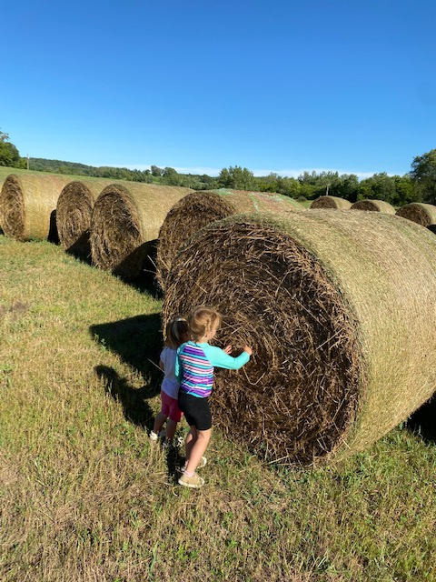
summary
Finished Not Failed
How and when to have the conversation with your leaders about the completion of ministry and closing congregation’s building.

Slide 3
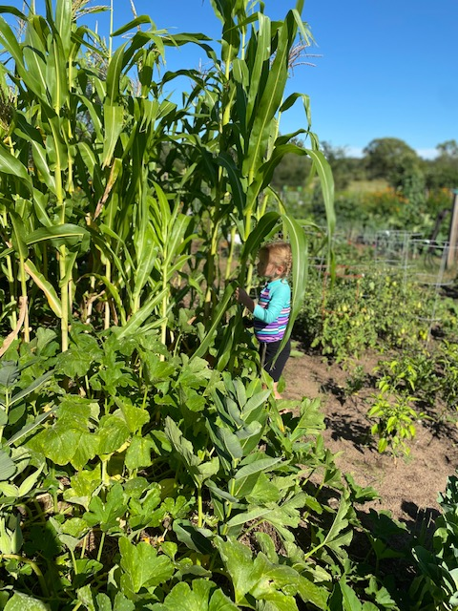
ὅτε οὖν ἔλαβεν τὸ ὄξος ὁ Ἰησοῦς εἶπεν· Τετέλεσται, καὶ κλίνας τὴν κεφαλὴν παρέδωκεν τὸ πνεῦμα John 19:30

Slide 4
John 19:28-30
²⁸ After this, when Jesus knew that all was now finished, he said (in order to fulfill the scripture), “I am thirsty.” ²⁹ A jar full of sour wine was standing there. So they put a sponge full of the wine on a branch of hyssop and held it to his mouth. ³⁰ When Jesus had received the wine, he said, “It is finished.” Then he bowed his head and gave up his spirit.
³⁰ ὅτε οὖν ἔλαβεν τὸ ὄξος
ὁ Ἰησοῦς εἶπεν·
Τετέλεσται,
καὶ κλίνας τὴν κεφαλὴν
παρέδωκεν τὸ πνεῦμα.

Slide 5
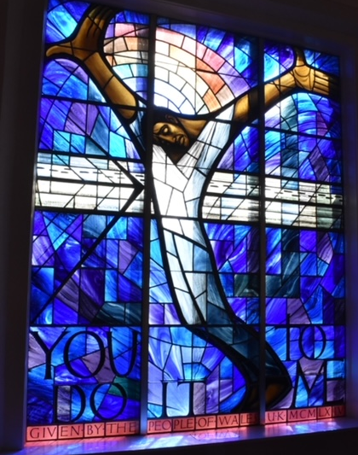
Τετέλεσται
Tetelestai-it is finished
john 19:30
When Jesus had received the wine, he said, “It is finished.” Then he bowed his head and gave up his spirit.
the perfect indicative passive tense of the word telos,
Koine Greek, It is translated to “It is Finished”.

Slide 6

τέλος
Teleos-τέλος an end, purpose, completion, fulfilment, finished, accomplished, to bring to conclusion, to fulfill, maturity or perfection, death, border, result, product, highest power, consummation, .
Tetelestai-It is finished. John 19:30 the perfect indicative passive tense of the word telos, completed, purpose fulfilled, job done,
paid in full, turning point as one period ends and another begins

Slide 7
Τετέλεσται
Tetelestai-it is finished
john 19:30
When Jesus had received the wine, he said, “It is finished.” Then he bowed his head and gave up his spirit.
No one on this side of the resurrection looks at an image of Jesus hanging on the cross and says that Jesus failed his mission or ministry. It is clear that he completed the work that God had given him. He completed it and commissioned us to carrying it on, to “Go and make disciples of all nations, baptizing and teaching and to remember that he is with us until the end.”

Slide 8
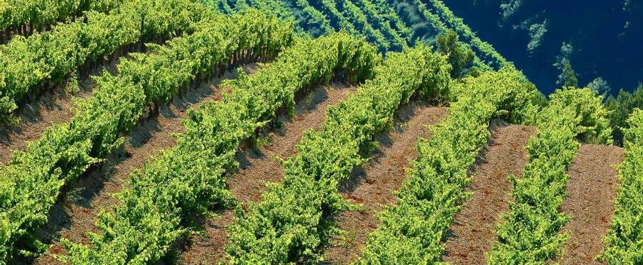
summary
Finished Not Failed
How and when to have the conversation with your leaders about the completion of ministry and closing congregation’s building.
Have this conversation before…

Slide 9
summary
Finished Not Failed
You can have this conversation before…
1. You hit bottom and
three of your council members are in the nursing home and you no longer worship in the winter because the members don’t drive on snow and/or they go south or
You can no longer hold a legal congregational meeting and will then
need to go under synod administration

Slide 10
Teleos-τέλος
Gardening-end of the season-the harvest is completed-everything is done-just the compost and leaves intentionally left to fertilize next year’s produce.
Teleos-an end, fulfilled purpose
No one says that leaving the garden after the good harvest was collected that it is a failure now that the season is over, only that it is finished, it is completed, fulfilled its purpose, accomplished, came to its logical conclusion, fully matured, perfect, death, end of the road, at the border, final results, product, reached its highest power, consummation.

Slide 11
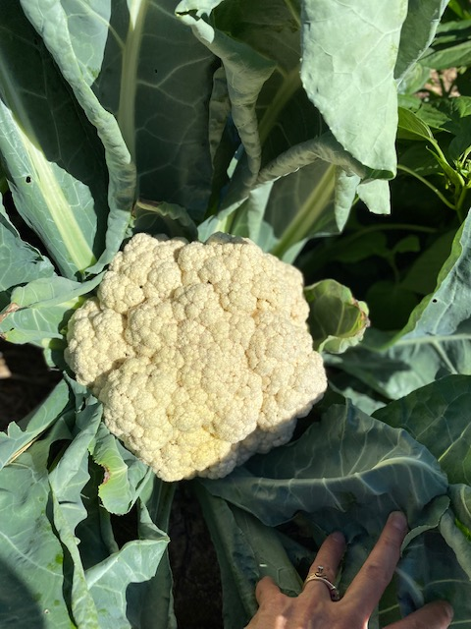
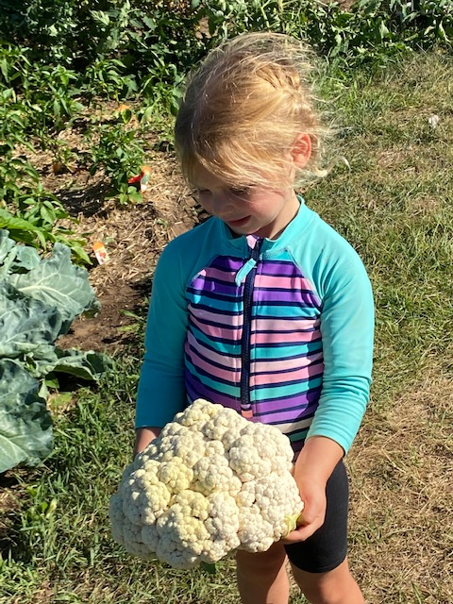
Harvest Time
Ecclesiastes 3
For everything there is a season and a time for every purpose under heaven. A time to be born and a time to die. A time to plant and a time to harvest.
A time to START and a time to FINISH ministry.

Slide 12

To be clear, no one wants your congregation to close. The Synod does not want your congregation to close.

Slide 13
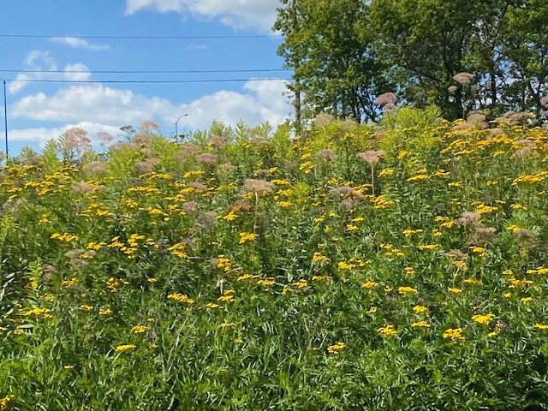
To be clear, no one wants your congregation to close. Just to be crystal clear-The Synod does not want your congregation to close.

Slide 14
Is that clear? no one wants your congregation to close.

Slide 15

HOWEVER
If you are wondering what the future looks like for your congregation then let’s talk.

Slide 16
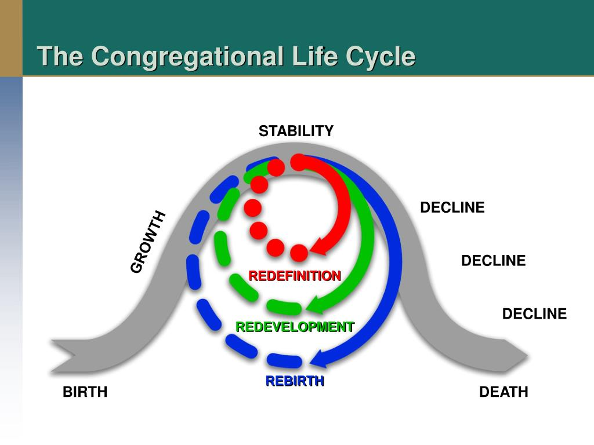
problem
Market gap
Customers
Organic agriculture continues to be consumer driven, but we're seeing a lapse of availability in the market for organic products
6.6% increase of retail sales of organic food proves that there's consumer interest for more organic produce
Costs
Usability
Loss of sales by not offering organic produce selection
Retail organic food sales were up by $112 billion in 2019
Financials
Customers want something that's healthy and available to pick up at their local supermarket or area

Slide 17
problem
Market gap
Customers
Organic agriculture continues to be consumer driven, but we're seeing a lapse of availability in the market for organic products
6.6% increase of retail sales of organic food proves that there's consumer interest for more organic produce
Costs
Usability
Loss of sales by not offering organic produce selection
Retail organic food sales were up by $112 billion in 2019
Financials
Customers want something that's healthy and available to pick up at their local supermarket or area
Finished

Slide 18
Where is you congregation on the lifecycle chart? Discuss:
1. Where are you now?
2. What would it take to move to growth? Stability?
3. Do you have the energy to do it?

Slide 19
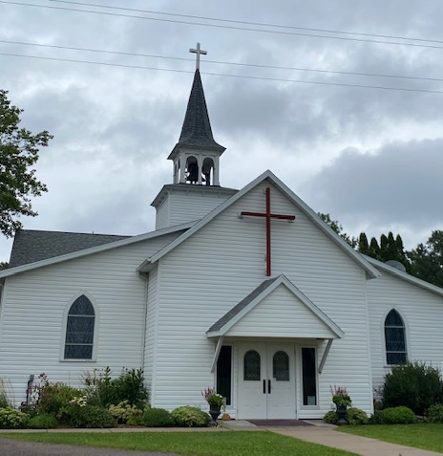
Are your best days ahead of you or behind you?
Read Luke 10:1-12 Reflect
Is the harvest complete in your geographic place?
Do the laborers have energy to do bring in the rest of the harvest?
Could you share your resources with others with more energy to continue the harvest?

Slide 20
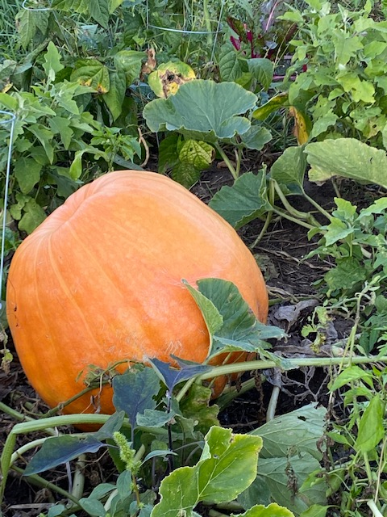
After this the Lord appointed seventy-two others and sent them on ahead of him in pairs to every town and place where he himself intended to go. ² He said to them, “The harvest is plentiful, but the laborers are few; therefore ask the Lord of the harvest to send out laborers into his harvest. ³ Go on your way; I am sending you out like lambs into the midst of wolves… ⁸ Whenever you enter a town and its people welcome you, eat what is set before you; ⁹ cure the sick who are there, and say to them, ‘The kingdom of God has come near to you.’ ¹⁰ But whenever you enter a town and they do not welcome you, go out into its streets and say, ¹¹ ‘Even the dust of your town that clings to our feet, we wipe off in protest against you. Yet know this: the kingdom of God has come near.

Slide 21
How to have this Conversation
If you are wondering what the future looks like for your congregation then let’s talk.

Slide 22
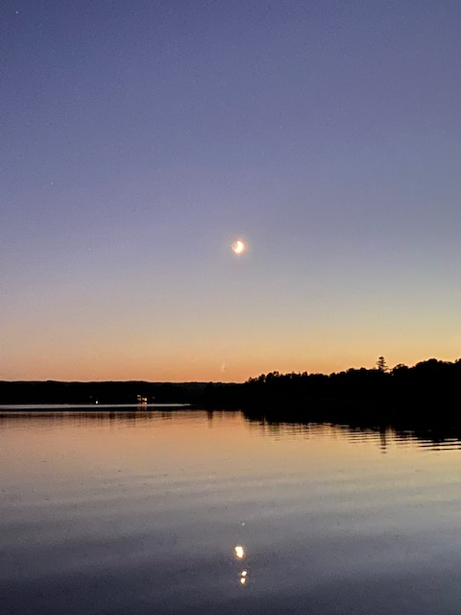
Spiritual Energy
How would you describe the spiritual passion of members to continue to bring in the harvest for Jesus’ sake?
How many active members do you have between the ages of 35-64?
How many members of any age are active in ministry beyond worship? How many are active in adult Bible Study?
Is the energy level for ministry beyond worship very high, high average, low, very low?
Does your congregation have a full council? How difficult is it to find members to serve on the council? How many of your current council members have served more than two terms?

Slide 23
MISSIONAL ENERGY
Does your congregation have a clear sense of purpose? Will this purpose propel it forward into God’s mission to redeem the world?
When you think about your congregation do you believe there is a possibility for redevelopment/rebirth/ revitalization? What would it take for that to happen?
What is the best possible future you can imagine for your congregation in the next 5 years/10 years? Does your congregation have the energy to make that happen?

Slide 24
    FINANCIAL ENERGY
    What percentage of your income is used for…
    building maintenance
    building debt
    staff salary
    programs
    mission beyond the congregation
    How much do you have in reserves? Saving, endowment, cash? How would you describe your cash flow pattern?

Slide 25
DEMOGRAPHICS REALITIES
How has the population of your context for ministry changed in the last 10 years?
How many ELCA congregations are within 5 miles/10 miles/15 miles of your building? How would you describe the health/vitality/sustainability of the three congregations closest to your building?
How many students do you have engaged in Sunday/Wednesday School or confirmation?
Describe the enrollment trends of your closest schools.
Does your congregation have an established ministry to a special group in your community? (12 step recovery worship, ministry with intellectually challenged…)

Slide 26
τέλος
Teleos-τέλος
Gardening-in the fall, the end of the season-the harvest is completed-everything is done-just the compost and leaves intentionally left to fertilize next year’s produce.
Teleos-finished, completed, mission accomplished, fulfilled
No one says that leaving the garden in the fall after the good harvest was collected that it is a failure now that the season is over, only that it is finished.
How can you use what is left after you complete your mission to compost or fertilize to encourage and stimulate growth in a new or existing ministry? How can you combine your resources with another ministry to give growth for another season in a new field or garden? How can you leave a legacy?

Slide 27
What if the doctor told you that you had less than a year left to live? What would you do differently? How would you choose to live your last days? What would you do to leave a legacy?
What if you knew that you had three years left? What if your church knew that it was closing in three years? How would you do ministry differently? How would you refocus your energy, values, resources? How would you prioritize your time? What would you do to leave a legacy?

Slide 28
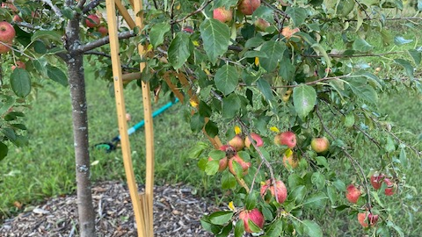
What do you see
in this photo?
Does it
relate to
your church?

Slide 29
Does your congregation have assets that need to be prop it up? Is the branch weak? Do you still have produce enough to share?
Is your congregation currently in “hospice?” Are you making the members comfortable while the congregation slowly dies?

Slide 30
Do you know what your constitution says about closing your building and finishing your ministry? Do you know what happens if the congregation gets so small or old it no longer has a functioning council and can no longer hold legal congregational meetings?

Slide 31
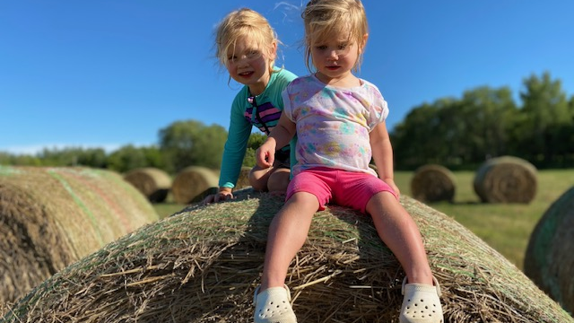
Legacy Planning

Slide 32
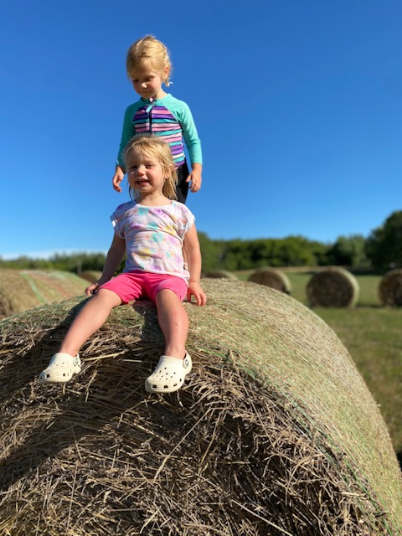
What are you
willing to do
so that the next
generation
comes to know
and love Jesus?

