Slide 1

EPIC
Effective Practices in Church Councils
How to run a good meeting
Pastor Laurie Skow-Anderson & Leslie Frost

Slide 2
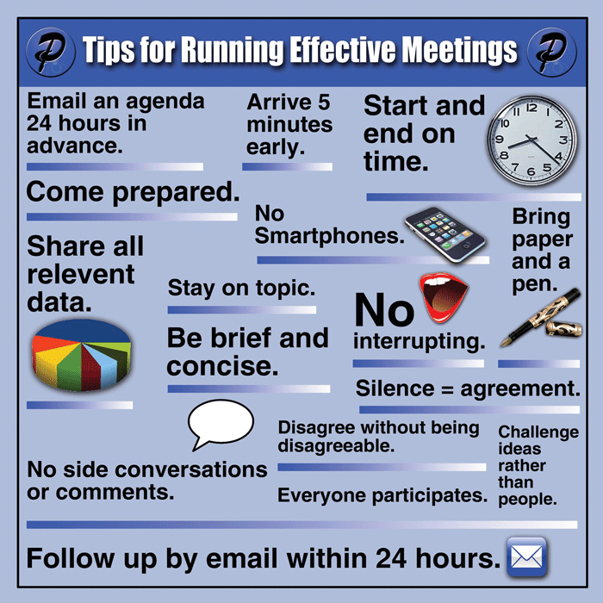

Slide 3

Running a Good Meeting

Slide 4

Running a Good Meeting
1. Create an agenda: Executive committee: president, vice president, secretary, treasurer, pastor. Email it out a week before the meeting. Also functions as a reminder of the next meeting.
2. Written agenda with times
3. Approve agenda and stick to agenda.

Slide 5

7:00 Call the meeting to order
7:00-7:20 Dwelling in the Word/Bible Study/Prayer
7:20 Approve the agenda
7:20-7:35 New Business Neighborhood Outreach
Discussion about the Outreach Team’s new proposed outreach ministry to the elementary school across the street
What did you hear from conversations with the school administrator, teachers and neighbors? Is this part of our congregation’s mission and purpose? Is this how God is calling us to love our neighbors?
Action Item: Decision to move forward with new ministry. If approved:
Action Item needing a vote: funding for snacks, supplies, background checks for volunteers
7:35-7:50 Old Business-Christmas Eve Service in the Barn
a. Evaluate the Service: barn, hay, animals, heater, musicians, actors for the nativity, hot apple cider, mailings and invitations on promotions through social media.
b. Does this worship reach out to the unchurched in our community? Is this how God is calling us to love our neighbors?
Action Items needing a vote---approve the worship’s committee request for additional funding for apple cider for 200.
c. Request from property committee to remove the historical display from the narthex and put it in the fellowship hall to make the space more open and welcoming to visitors.
7:50-7:55 Secretary’s report-approve minutes
7:55-8:05 Treasurer’s report-accept the report
8:05-8:30 Committee reports
Pastor’s report
Education/Youth Team
Generosity Team
Worship Team
Property Team
Social Justice Team
Outreach and Evangelism Team
Finance/Endowment Team
8:30 Adjourn the meeting with prayer

Slide 6

Running a Good Meeting
4. Spiritual leaders begin with Dwelling in the Word/Bible Study and prayer
5. Church councils care for and pray for each other. Spiritual conversation
“How do YOU need God’s help this week? How have you seen God at work in your life this week?”
6. Spiritual leaders learn together:
Read a book together, watch a video series together…discuss it.

Slide 7

Running a Good Meeting
7. Keep God in the conversation. Take a pen and draw a cross on top of the financial
report.
Ask: “Did Jesus have to die for this budget?”
Ask: What is God’s will for our congregation? Will this help us love our neighbors better?
Ask: How is the Holy Spirit calling us to move forward in God’s mission?
Ask: Will this help us accomplish
our purpose in God’s mission?

Slide 8

Running a Good Meeting
8. Create an ACTION PLAN at the end of each meeting. Everyone knows what they are expected to do between meetings and come to the next meeting prepared.
An Action Plan answers the questions: What/When/Where/Who/How
9. Communicate: Send out the minutes of
the meeting immediately
after the meeting.

Slide 9
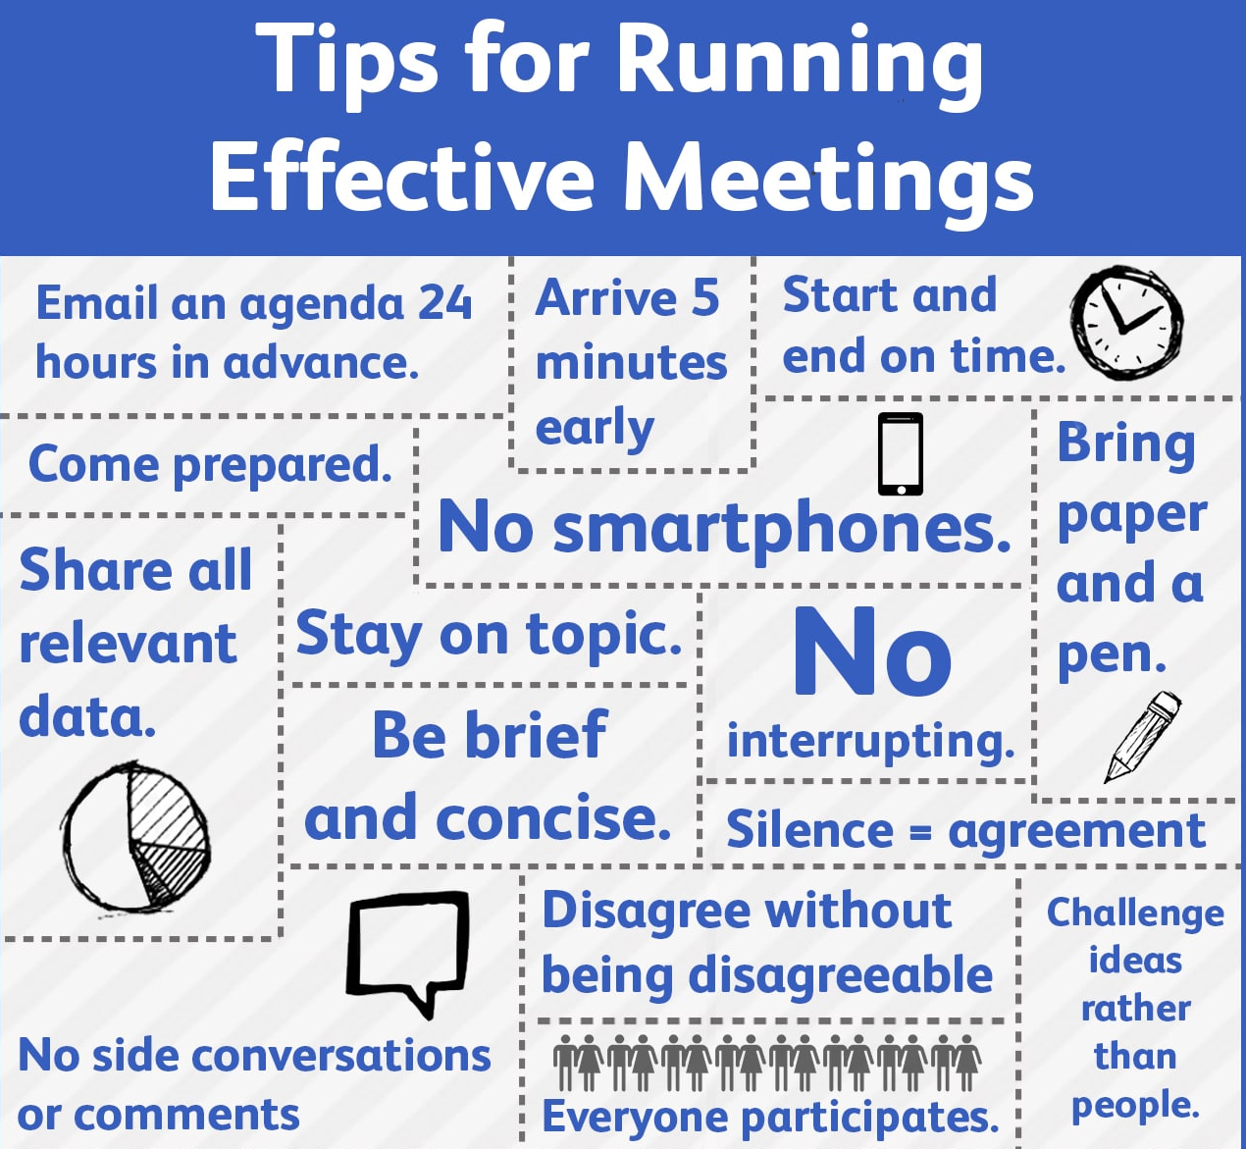

Slide 10
Robert’s Rules of Order is Your Friend
LESLIE FROST

