Slide 1

When conflict happens
I’d rather be…

Slide 2
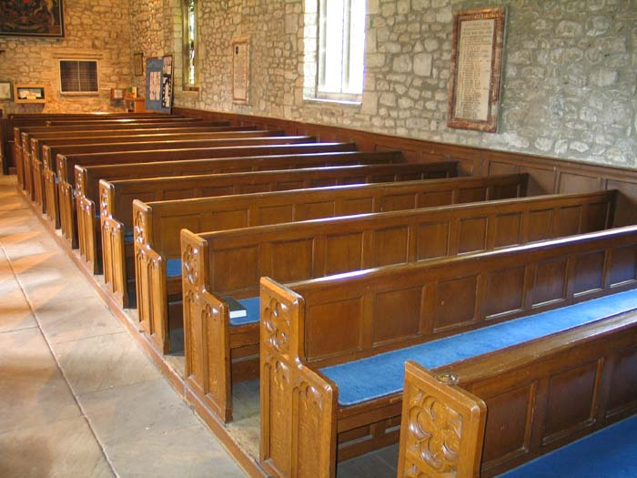
Our stories of conflict…

Slide 3
Initial responses to conflict…
How can this end well?
Who will get hurt?
Will I get pulled into the middle?
I don’t want to go there again?
Is this an opportunity for growth?
Is the Spirit at work here?

Slide 4

Finding a way forward…

Slide 5
What’s the goal?
Conflict Resolution
Conflict Management
Conflict Utilization
Conflict Transformation
Conflict Engagement
Conflict Avoidance

Slide 6
Staying engaged…
“To hold the whole congregation together for hard conversations, leaders need both courage and compassion: courage to face conflict squarely, and compassion to sidestep it at times, or slow it down, so everyone can stay involved. Each voice – wether it is conflict-friendly or conflict-averse – has wisdom to contribute. Wise leaders create safe space for all.” - Unconventional Wisdom: Is Conflict a Bad Thing? (www.alban.org)

Slide 7
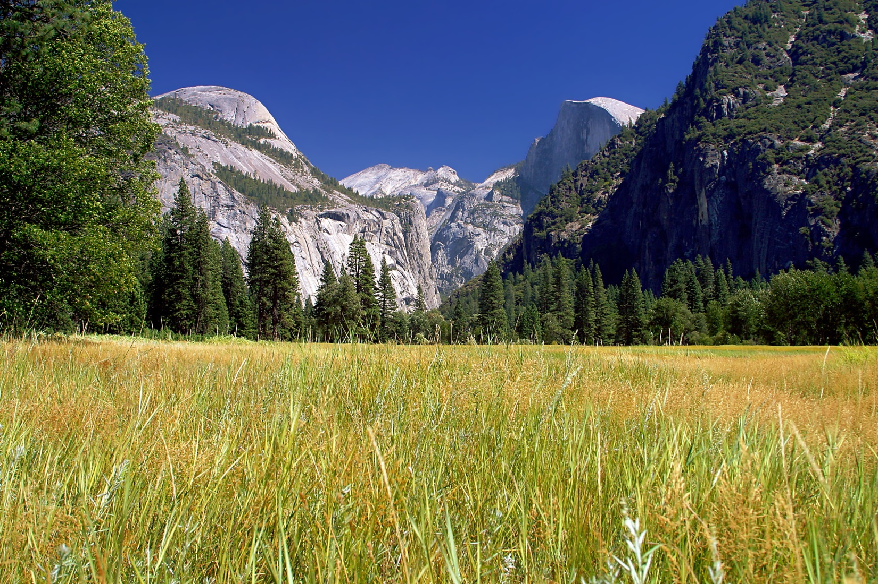
Finding hope…

Slide 8
Ways to engage conflict…
Connect your response to conflict with your spiritual growth.
Reflect upon the cost of avoiding.
Realize that change and conflict are linked and that both are inevitable in the development of a congregation as an organization.
Recognizing that engaging differences constructively is holy work on behalf of our culture at this time. - Embracing Conflict (www.alban.org)

