Slide 1
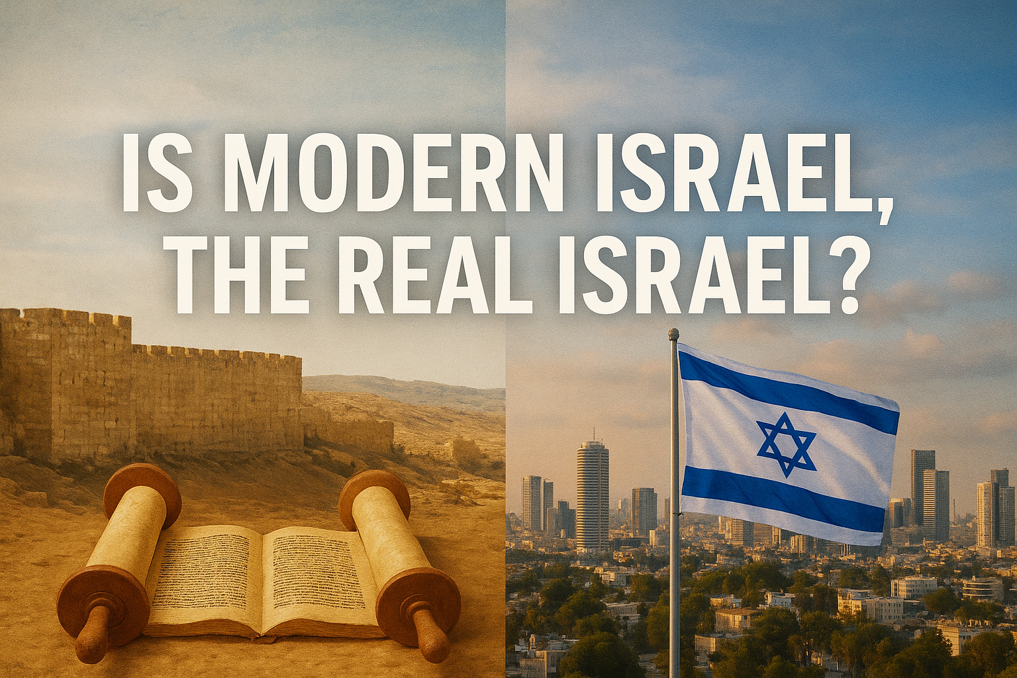


Slide 2
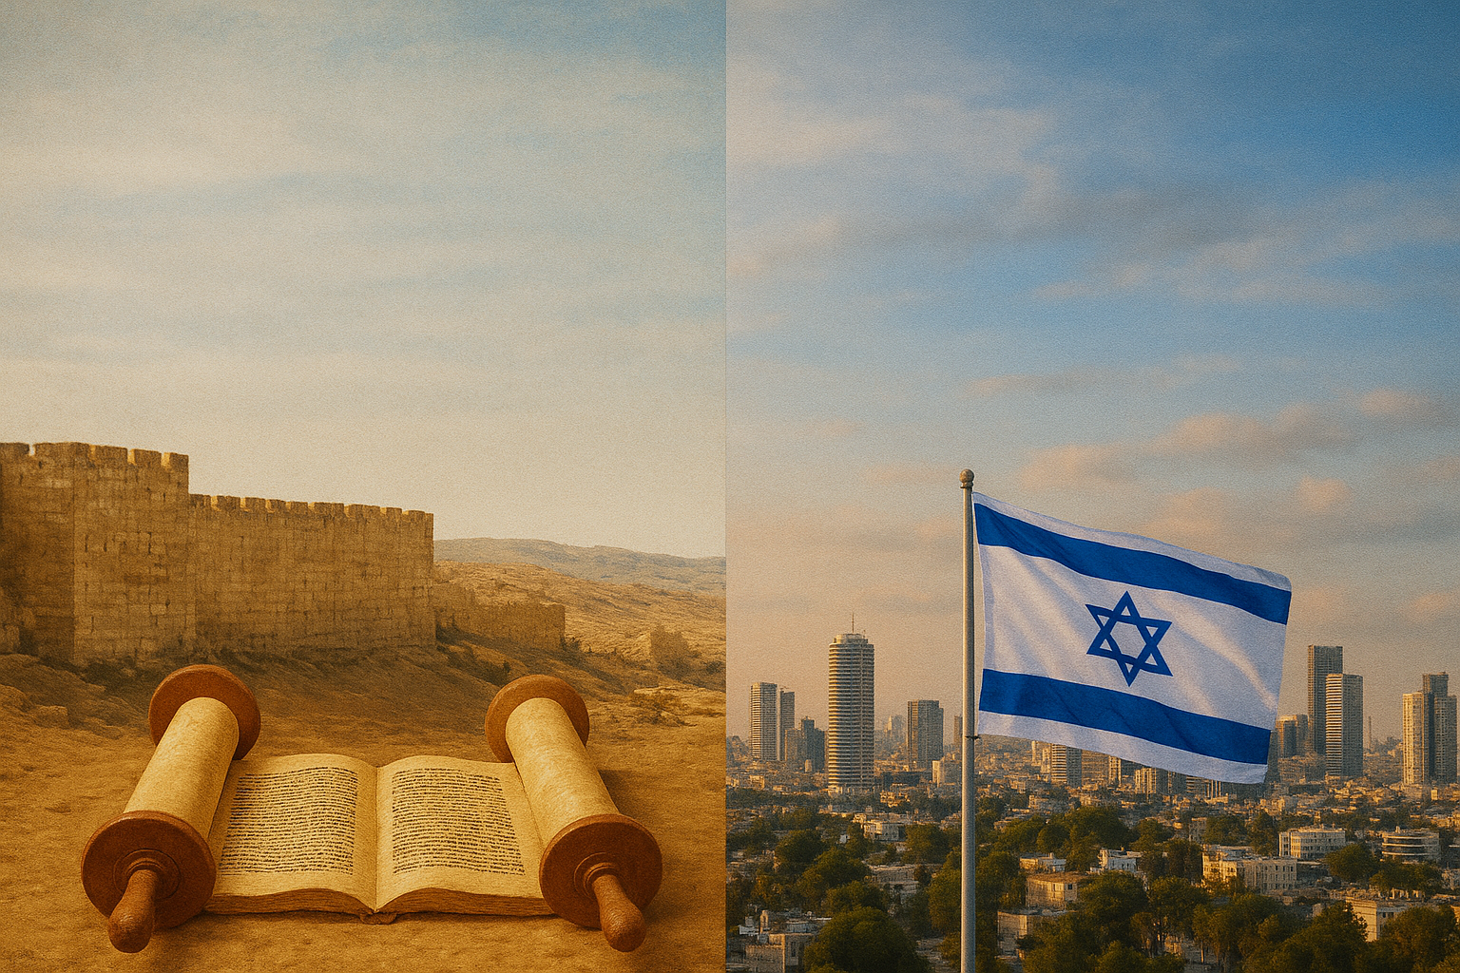
Genesis 12:2-3
“And I [God] will make you [Abraham] a great nation, & I will bless you, & make your name great; & so you shall be a blessing; & I will bless those who bless you, & the one who curses you I will curse. And in you all the families of the earth will be blessed.”

Slide 3
Genesis 22:18
“In your [singular] seed all the nations of the earth shall be blessed, because you have listened to My voice.”

Slide 4
Genesis 13:14-15
“Yahweh said to Abram, after Lot had separated from him, ‘Now lift up your eyes & look from the place where you are, northward & southward & eastward & westward; for all the land which you see, I will give it to you & to your seed forever.”

Slide 6
Is Modern Israel, The Real Israel?
Is the ancient Israeli nation prophesied to return in the Last Days? Yes

Slide 7
Numbers 14:33-34
“Your sons shall be shepherds for 40 years in the wilderness, & they will suffer for your unfaithfulness, until your corpses come to an end in the wilderness. According to the number of days which you spied out the land, 40 days, for every day you shall bear your guilt a year, even 40 years, & you will know My opposition.”

Slide 8
Matthew 24:15
“Therefore when you see the abomination of desolation which was spoken of through Daniel the prophet, standing in the holy place (let the reader understand)…”

Slide 9
Is Modern Israel, The Real Israel?
Is the ancient Israeli nation prophesied to return in the Last Days? Yes

Slide 10
Luke 19:41-42
“When He was come near, He beheld the city, & wept over it, saying, If thou hadst known, even thou, at least in this thy day, the things which belong unto thy peace! but now they are hid from thine eyes.”

Slide 11
Is Modern Israel, The Real Israel?
Is the ancient Israeli nation prophesied to return in the Last Days? Yes

Slide 12
II Thessalonians 2:3-4
“Let no one in any way deceive you, for it has not come unless the apostasy comes first, & the man of lawlessness is revealed, the son of destruction, who opposes & exalts himself above every so-called god or object of worship, so that he takes his seat in the sanctuary of God, exhibiting himself as being God.”

Slide 13
Is Modern Israel, The Real Israel?
Is the ancient Israeli nation prophesied to return in the Last Days? Yes
When is the Israeli nation prophesied to return in the Last Days? 1948

Slide 14
Jeremiah 25:11
“This whole land will be a waste place & an object of horror, & these nations will serve the king of Babylon seventy years.”

Slide 15
Jeremiah 29:10
“For thus says Yahweh, ‘When 70 years have been fulfilled for Babylon, I will visit you & establish My good word to you, to return you to this place.”

Slide 16
The Ezekiel 4 Prophecy
Jeremiah Predicts 70 year punishment
II Chronicles 36:21 says – Babylonian Captivity IS fulfillment of Jeremiah
Ezekiel Predicts 430 year punishment
70
430 years
536 BC
606 BC

Slide 17
Nehemiah 1:8
“Remember the word which You commanded Your servant Moses, saying, ‘If you are unfaithful, I will scatter you among the peoples.”

Slide 18
Nehemiah 13:17-18
“Then I contended with the nobles of Judah & said to them, “What is this evil thing you are doing, even profaning the sabbath day? Did not your fathers do the same, so our God brought on us & on this city all this calamity? Yet you are adding to His anger on Israel by profaning the sabbath.”

Slide 19
Malachi 2:2
“If you do not listen, & if you do not set it upon your heart to give honor to My name,” says Yahweh of hosts, “then I will send the curse upon you, & I will curse your blessings; & indeed, I have cursed them already because you are not setting it upon your heart.”

Slide 20
The Ezekiel 4 Prophecy
Jeremiah Predicts 70 year punishment
II Chronicles 36:21 says – Babylonian Captivity IS fulfillment of Jeremiah
Ezekiel Predicts 430 year punishment
70
430 years
536 BC Israel is still rebellious, therefore Leviticus 26 applies
536 BC
Convert to 365.25 day years & add 1 year (no year 0) May 14, 1948 AD
606 BC
Daniel & Nehemiah agree - Babylonian Captivity IS the curse of Lev 26
Remaining 360 years x 7 = 2520 years

Slide 21
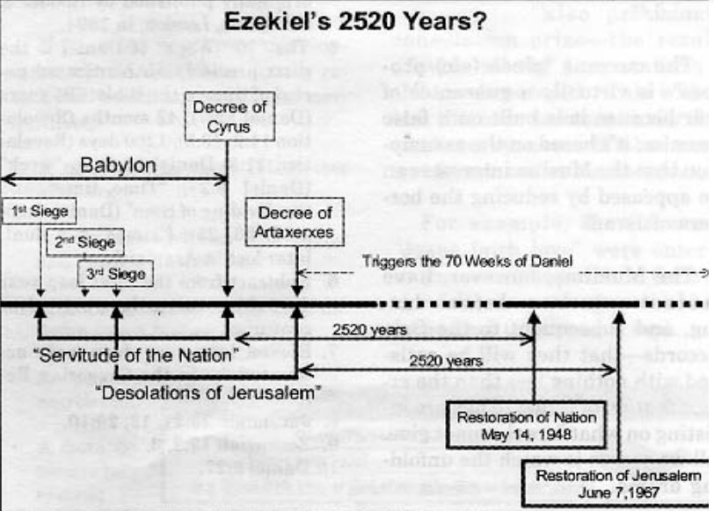
606 BC
538 BC
597 BC
445 BC
586 BC

Slide 22
Is Modern Israel, The Real Israel?
Is the ancient Israeli nation prophesied to return in the Last Days? Yes
When is the Israeli nation prophesied to return in the Last Days? 1948
Why is the Israeli nation prophesied to return in the Last Days? God promised

Slide 23
Ezekiel 36:22-23
“Therefore say to the house of Israel, ‘Thus says Lord Yahweh, ‘It is not for your sake, O house of Israel, that I am about to act, but for My holy name, which you have profaned among the nations, to which you have come… (cont)

Slide 24
Ezekiel 36:22-23
(cont) …I will prove the holiness of My great name which has been profaned among the nations, which you have profaned in their midst. Then the nations will know that I am Yahweh,” declares Lord Yahweh, when I prove Myself holy among you in their sight.”

Slide 25
Daniel 9:24b
“{This time is} to finish the transgression, to make an end of sin, to make atonement for iniquity, to bring in everlasting righteousness, to seal up vision and prophecy, and to anoint the Holy of Holies.”

Slide 26
Is Modern Israel, The Real Israel?
Is the ancient Israeli nation prophesied to return in the Last Days? Yes
When is the Israeli nation prophesied to return in the Last Days? 1948
Why is the Israeli nation prophesied to return in the Last Days? God promised

Slide 27
Romans 11:25-26
“For…a partial hardening has happened to Israel until the fullness of the Gentiles has come in; & so all Israel will be saved; just as it is written, ‘THE DELIVERER WILL COME FROM ZION, HE WILL REMOVE UNGODLINESS FROM JACOB.’”

Slide 28
Is Modern Israel, The Real Israel?
Is the ancient Israeli nation prophesied to return in the Last Days? Yes
When is the Israeli nation prophesied to return in the Last Days? 1948
Why is the Israeli nation prophesied to return in the Last Days? God promised

Slide 29
Special Topical Message | Sunday October 26 at 10:30 AM

