Slide 1
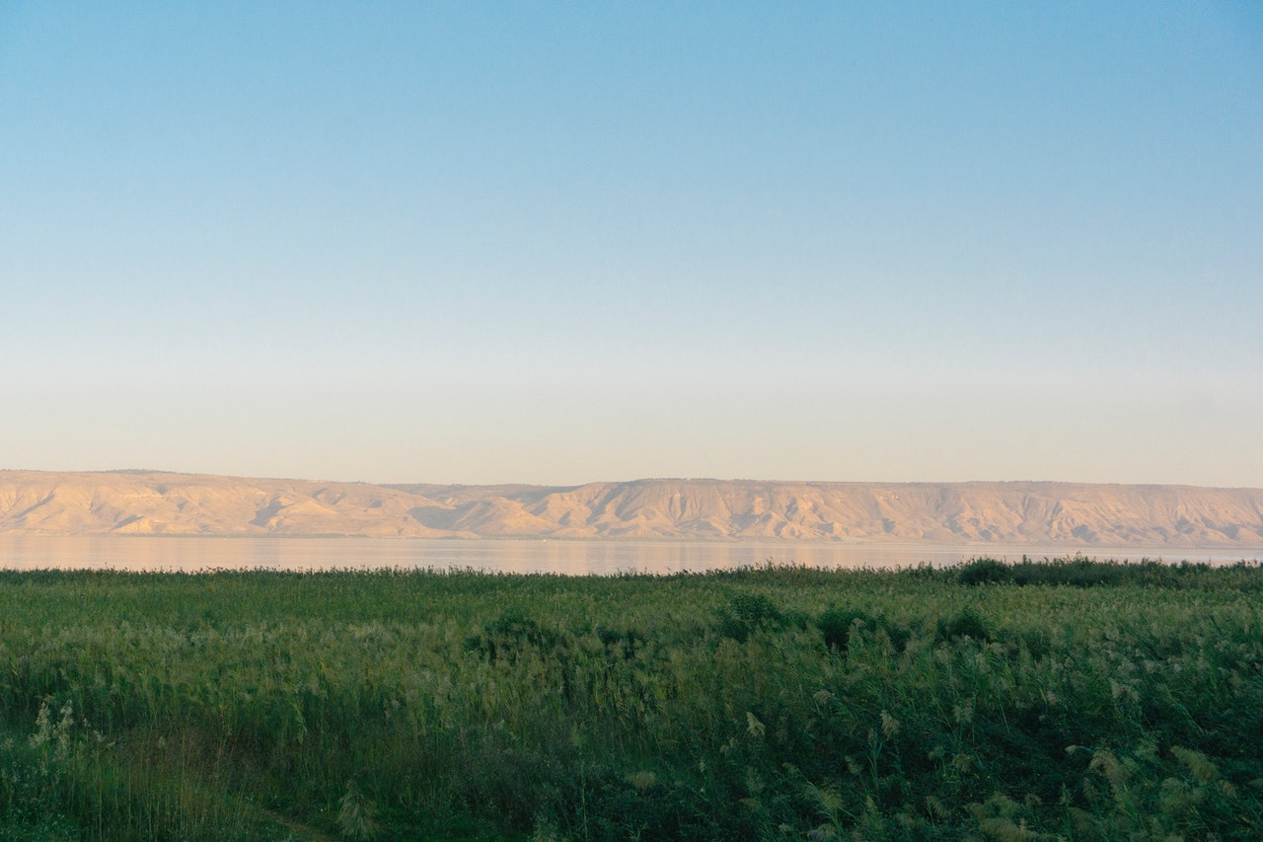
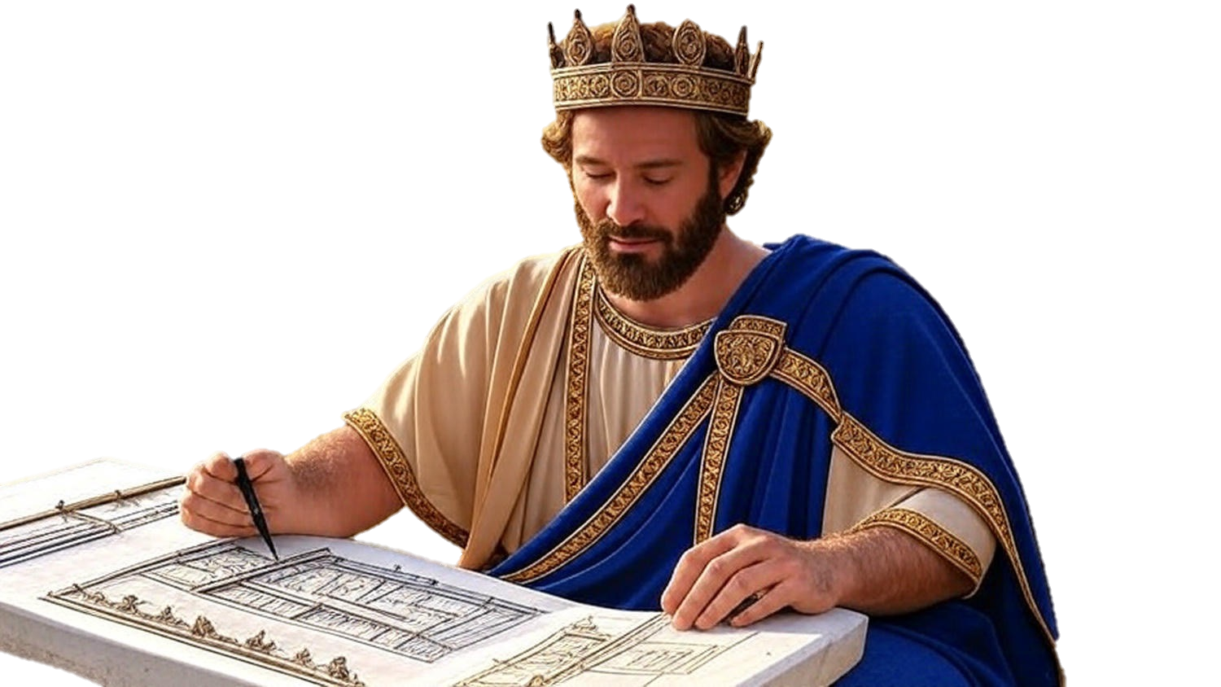

Chapters 32-33
2nd Chronicles
When Pride Reigns

Slide 2
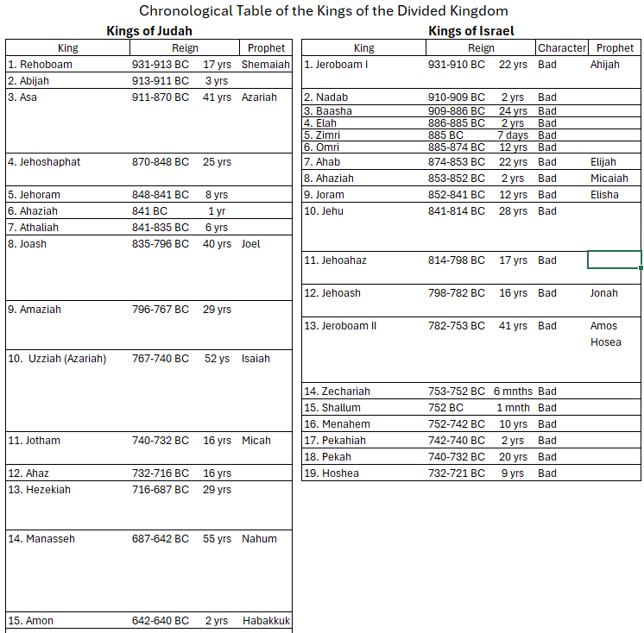

Slide 3
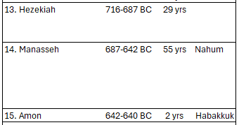

Slide 4
Chapters 32-33
2nd Chronicles
When Pride Reigns

Slide 5
What Pride Reigns
Hezekiah’s Enduring Faith
Watch out for pride at the end

Slide 6
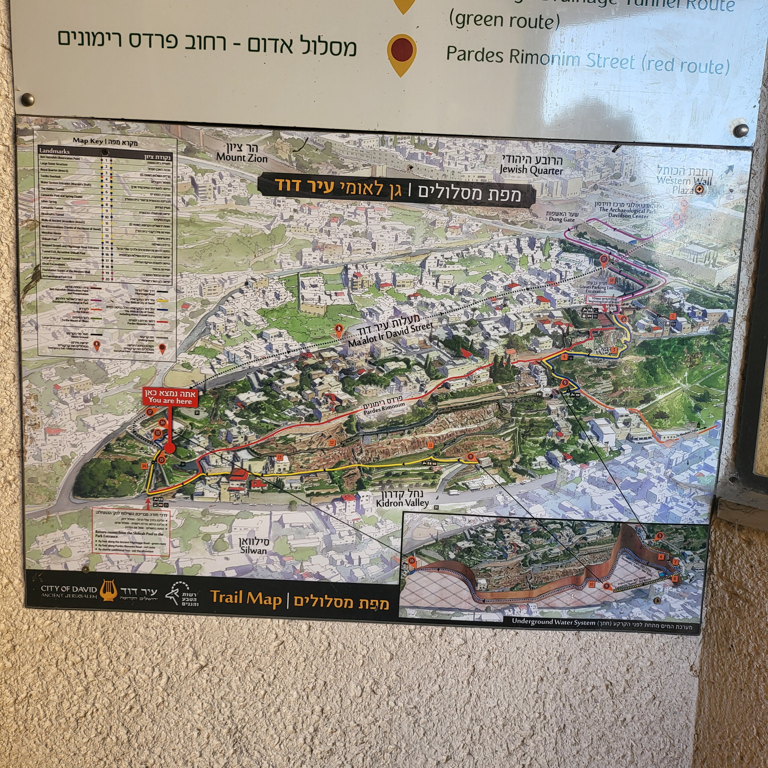
Jebusite & Hezekiah’s Tunnels

Slide 7
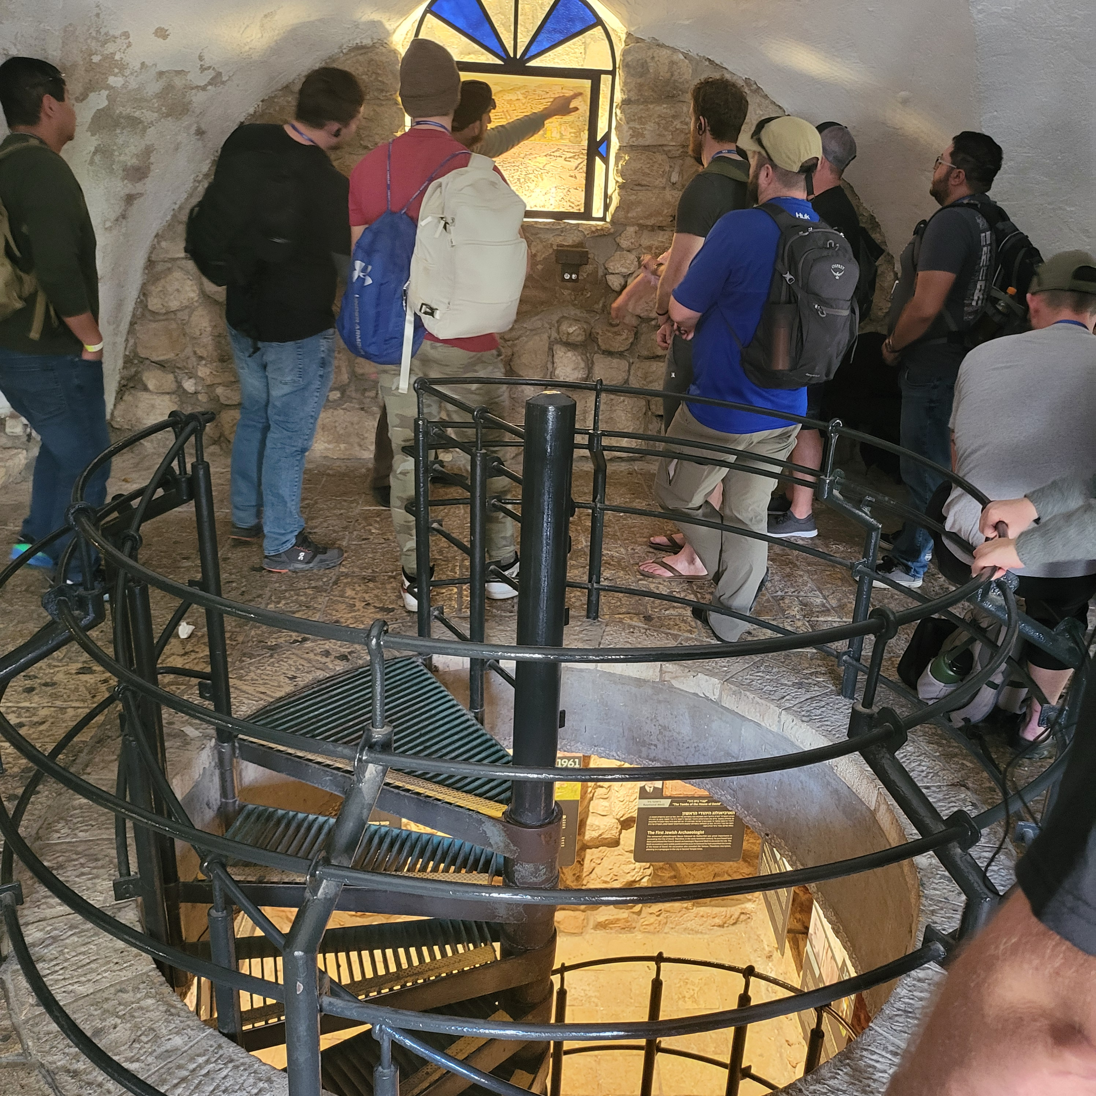
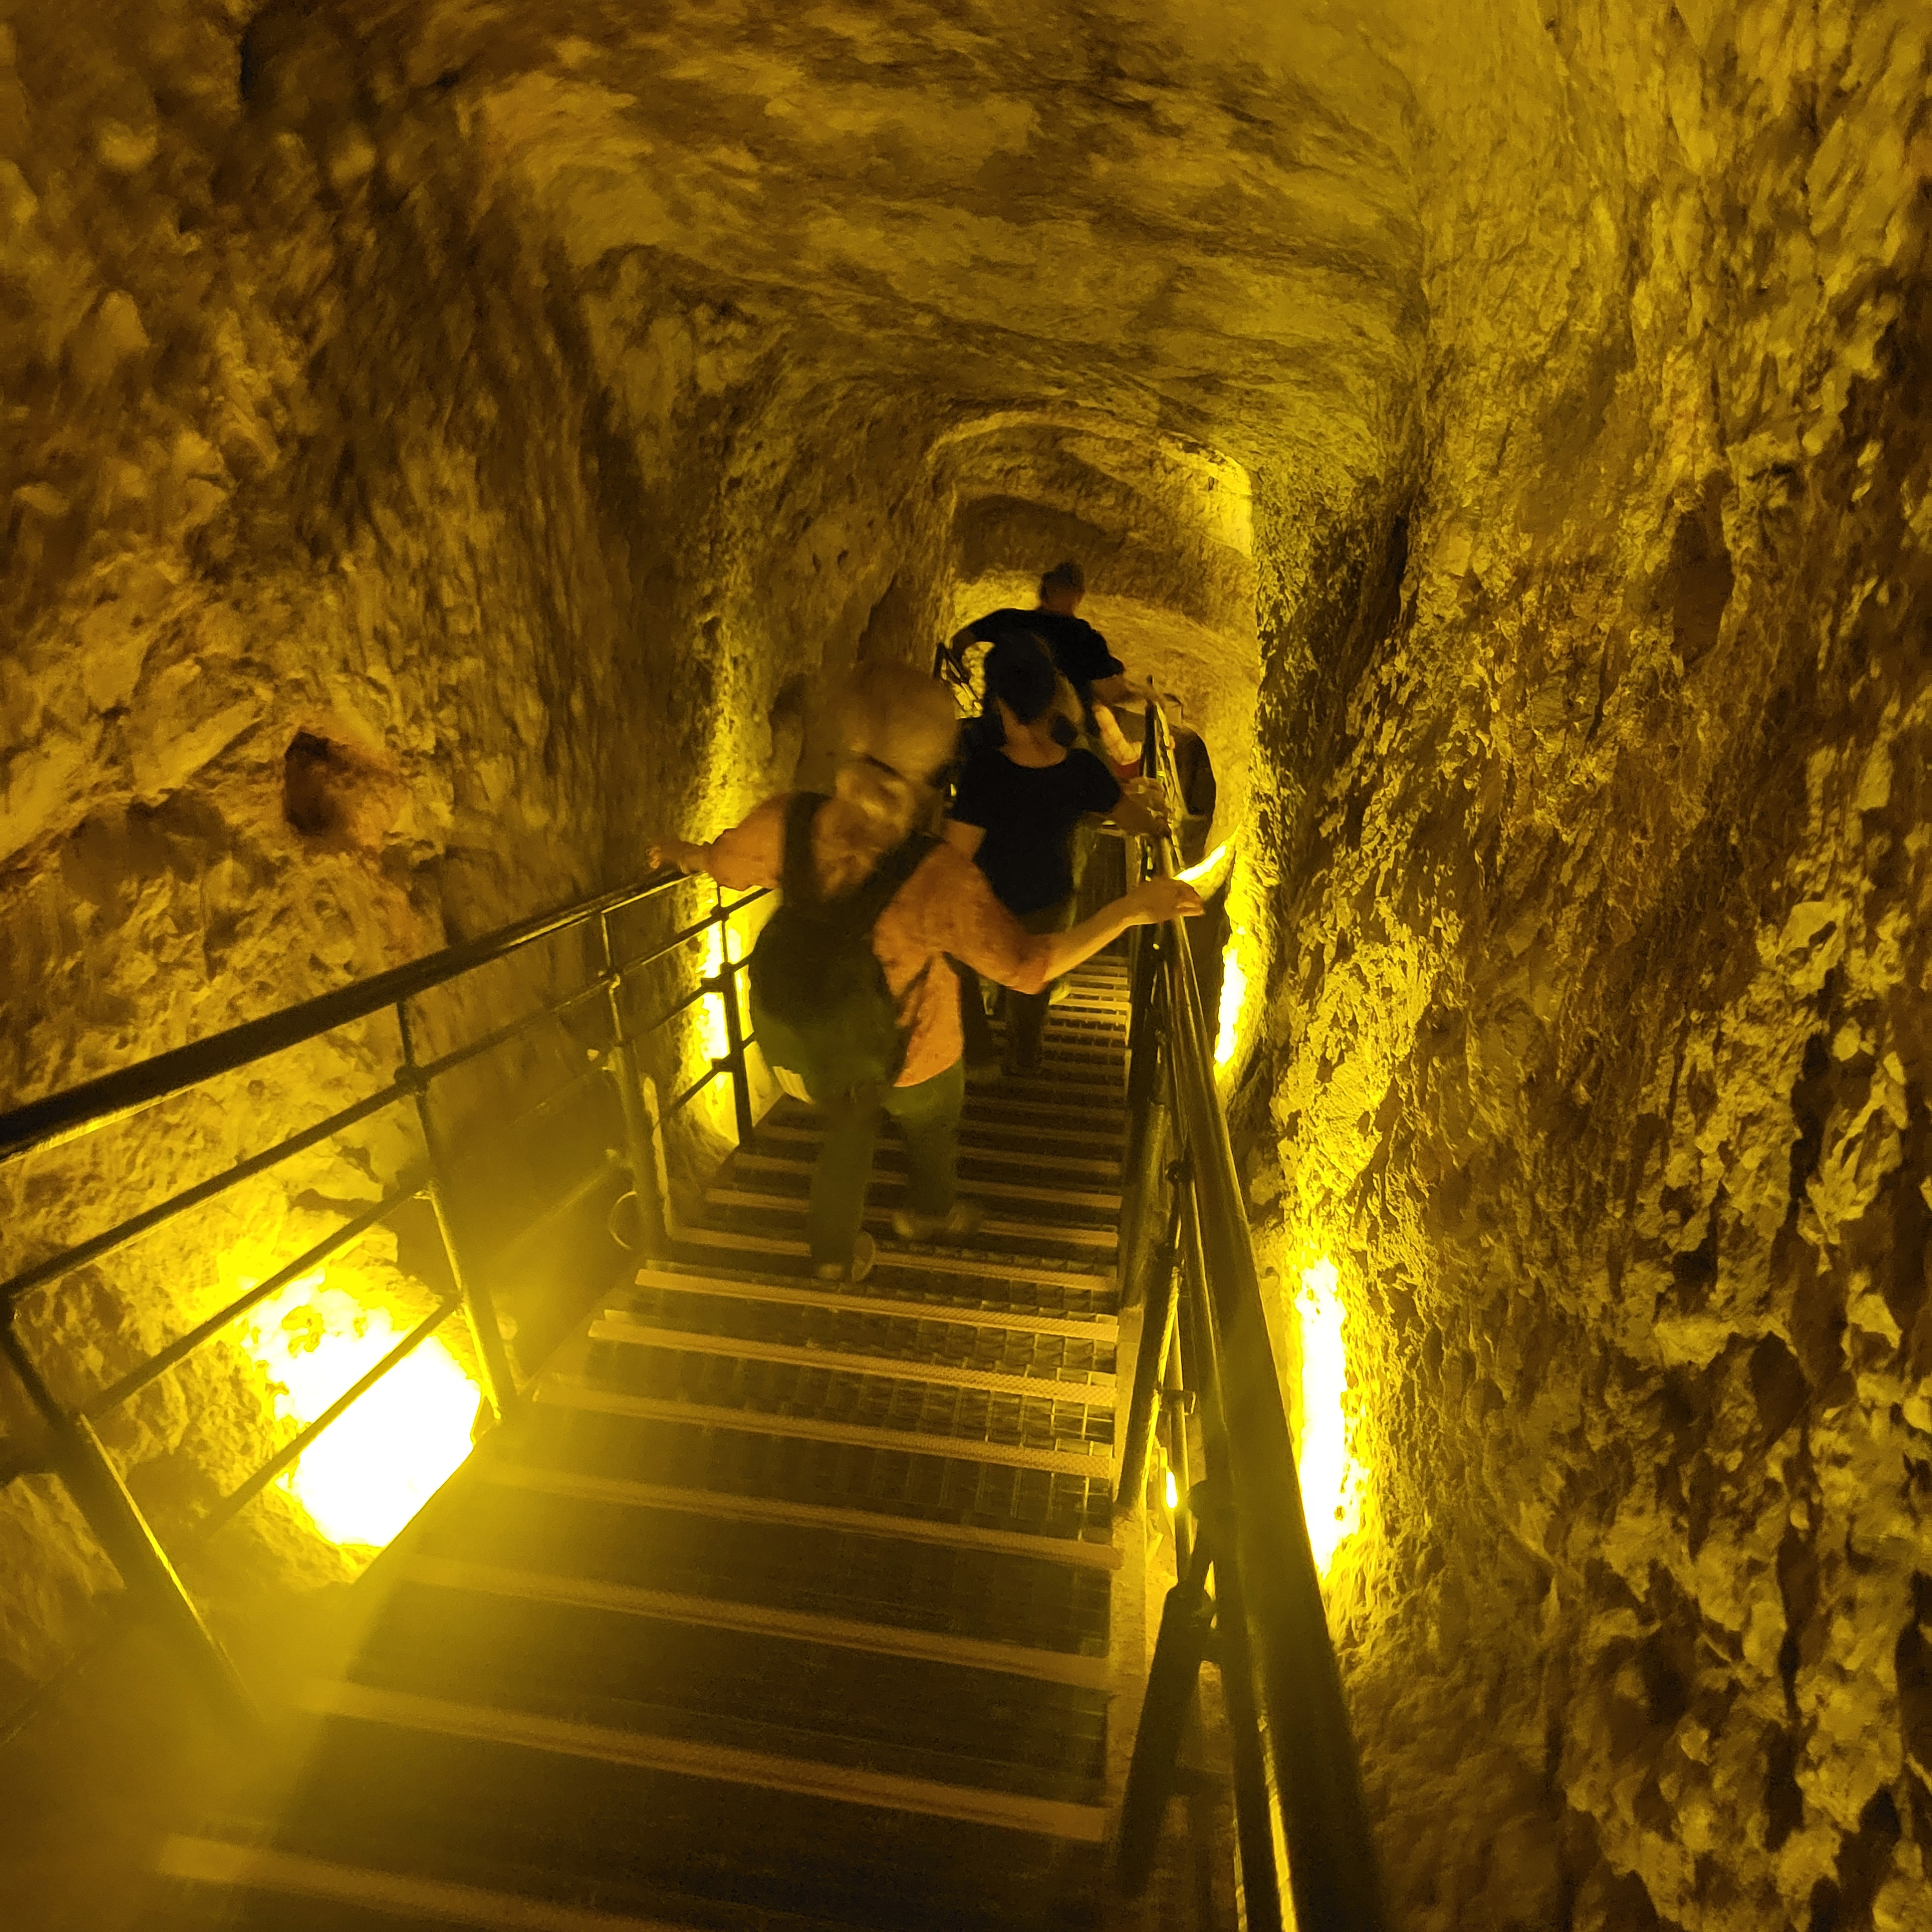

Slide 8
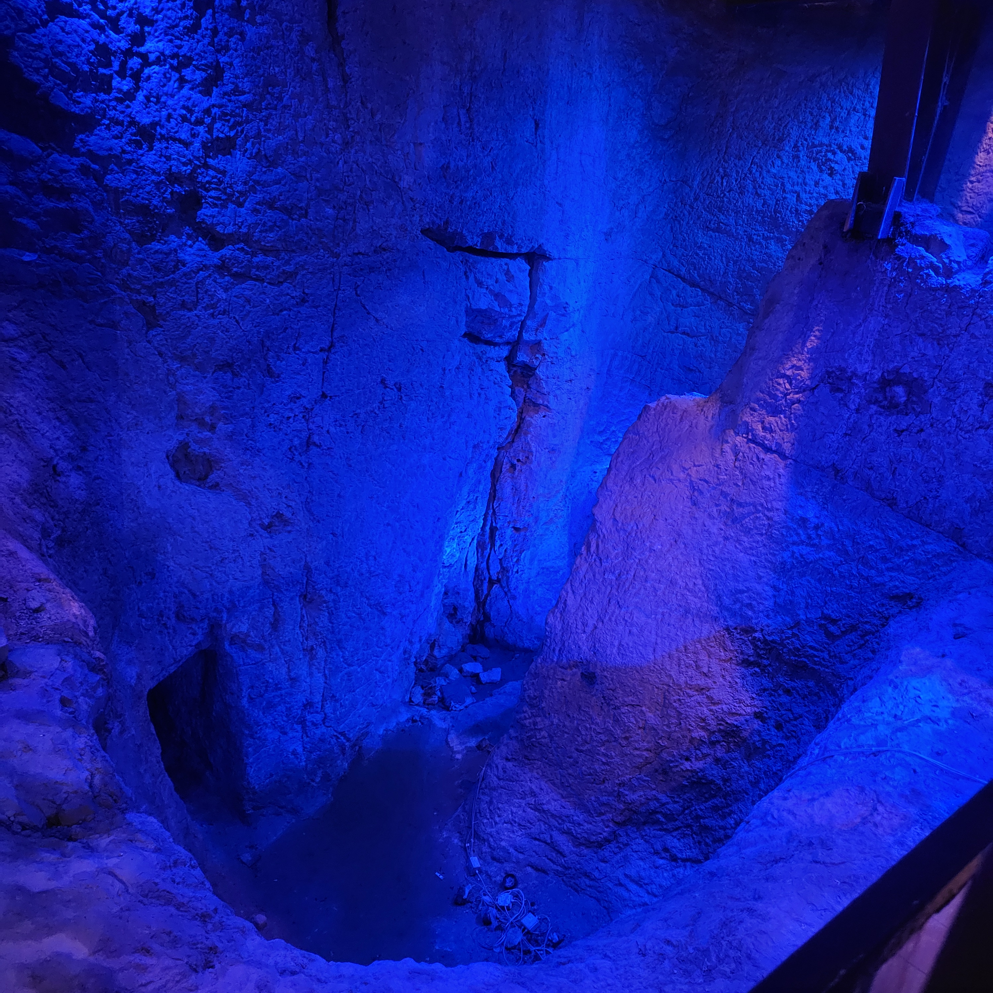
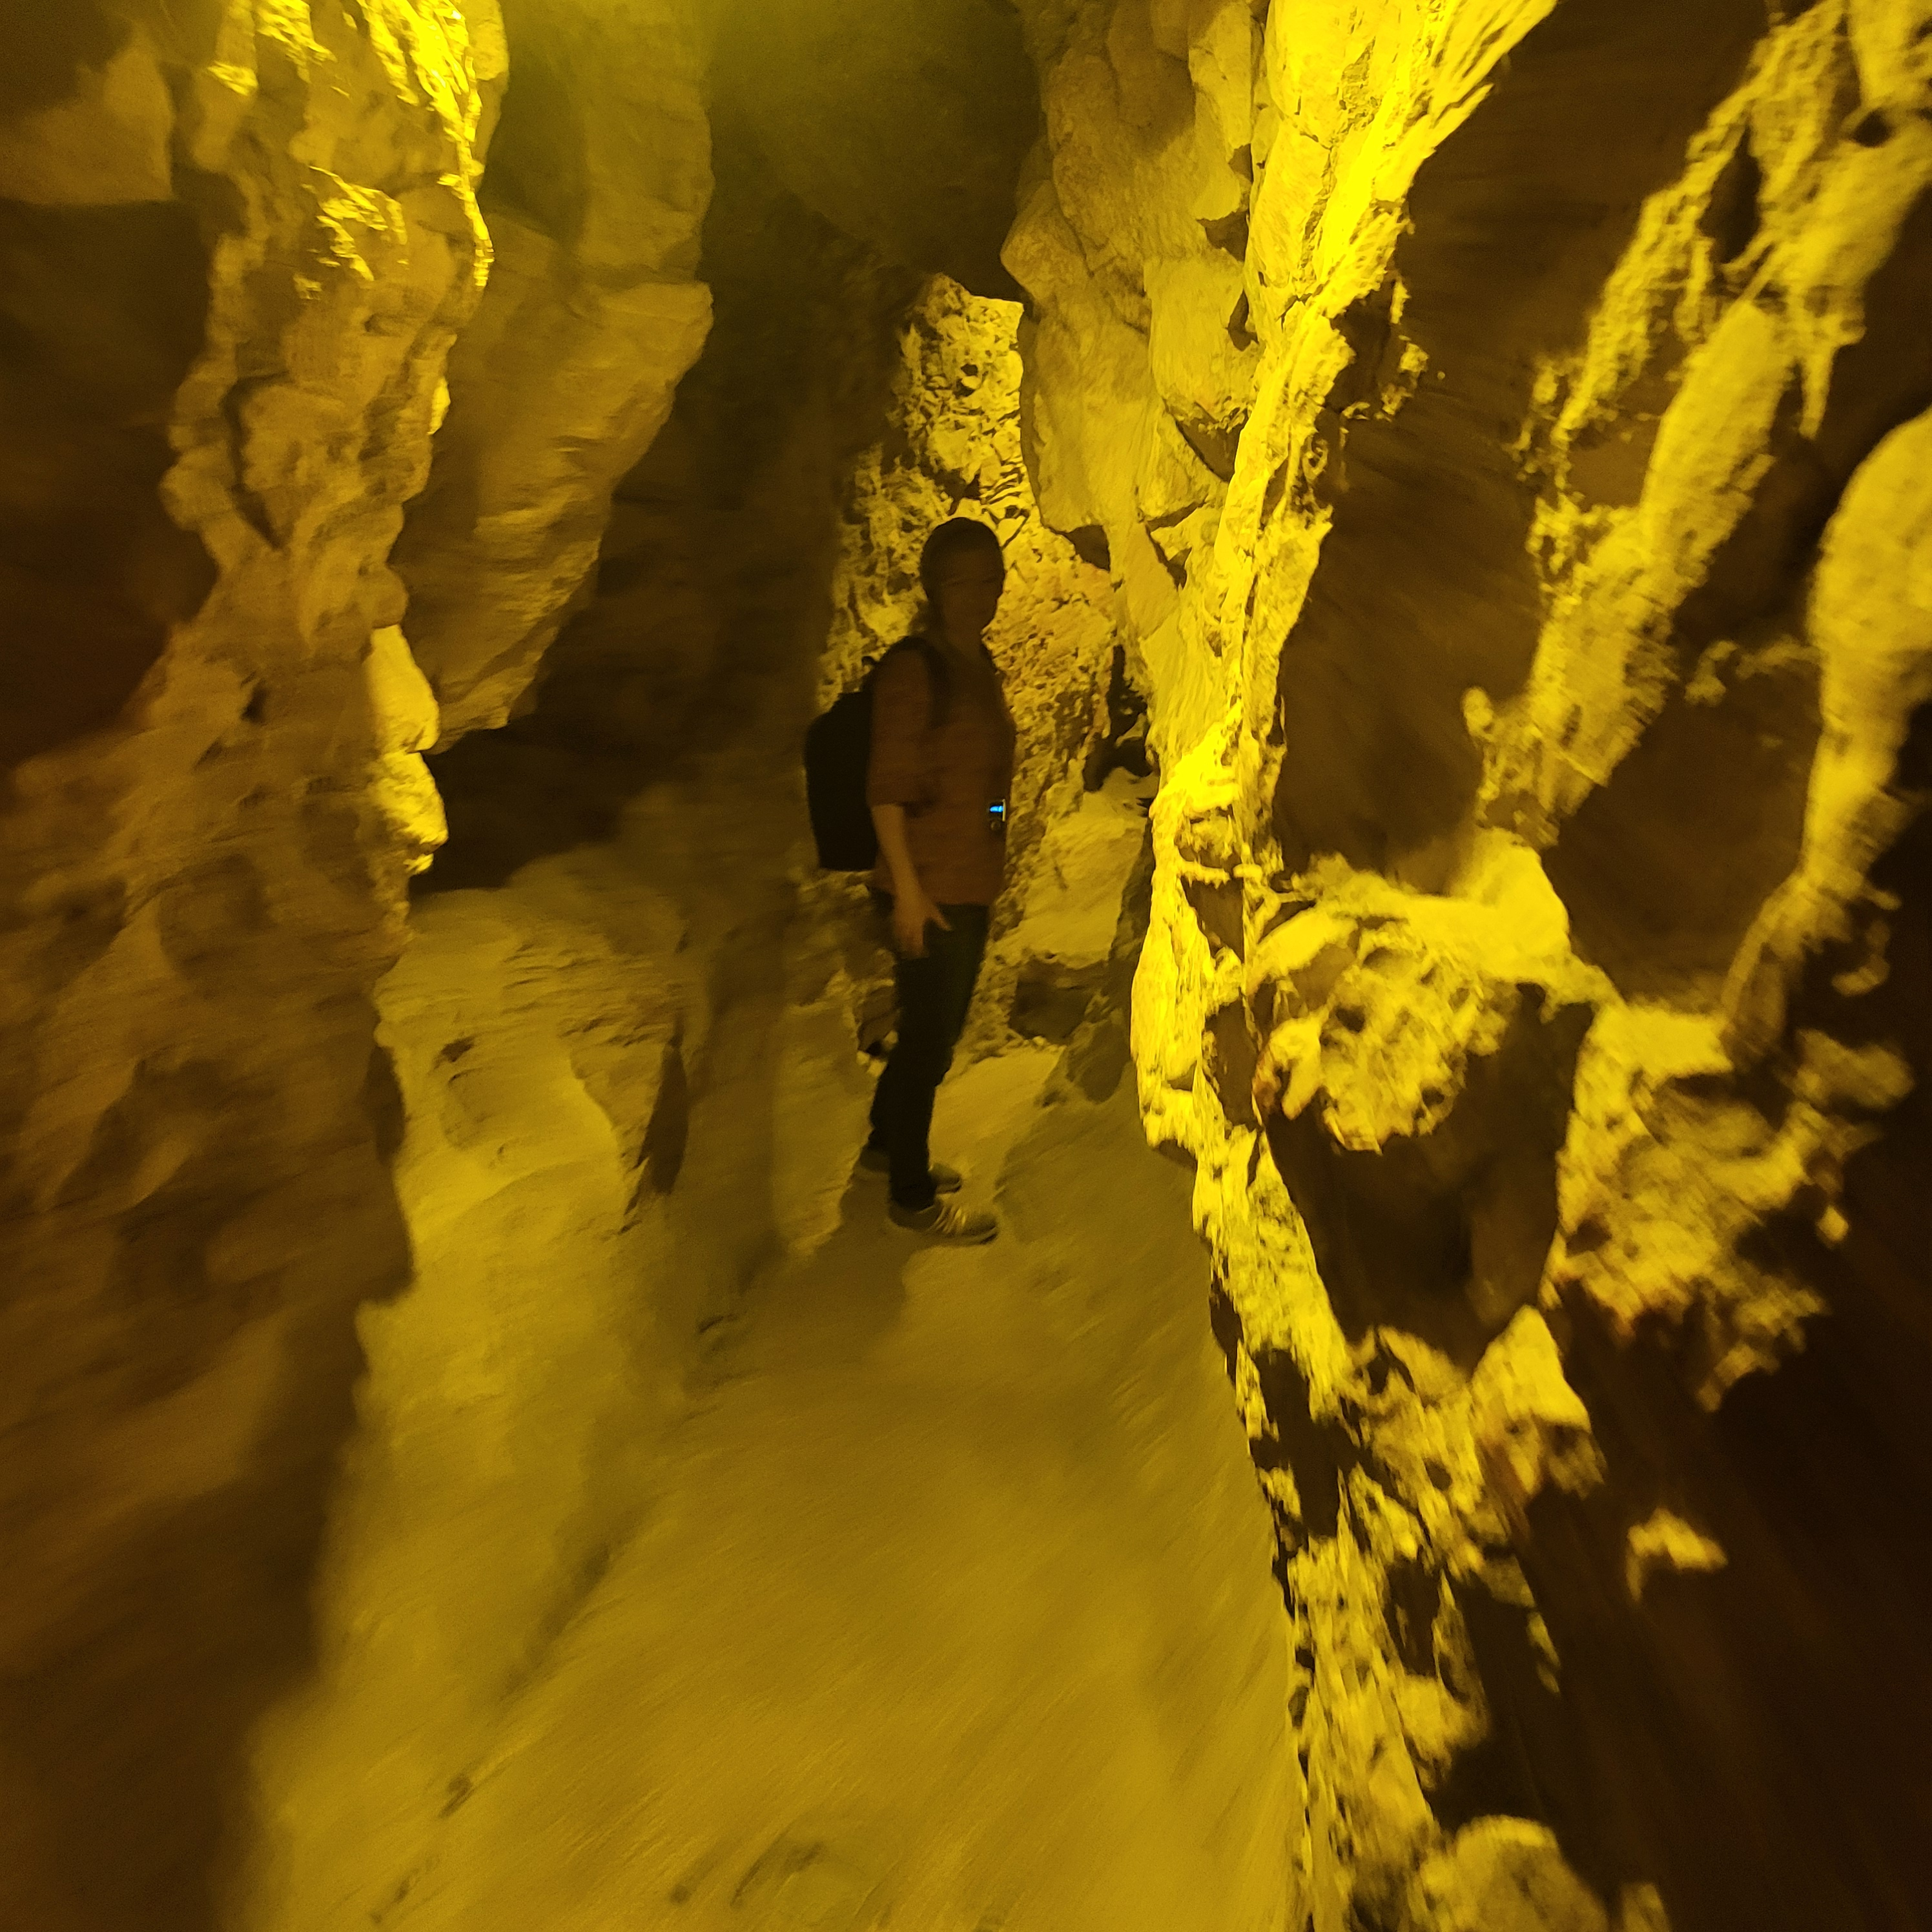

Slide 9
What Pride Reigns
Hezekiah’s Enduring Faith
Watch out for pride at the end
Watch out for pride at the start
Manasseh’s Repentant End
Watch out for pride all the time

