Slide 1
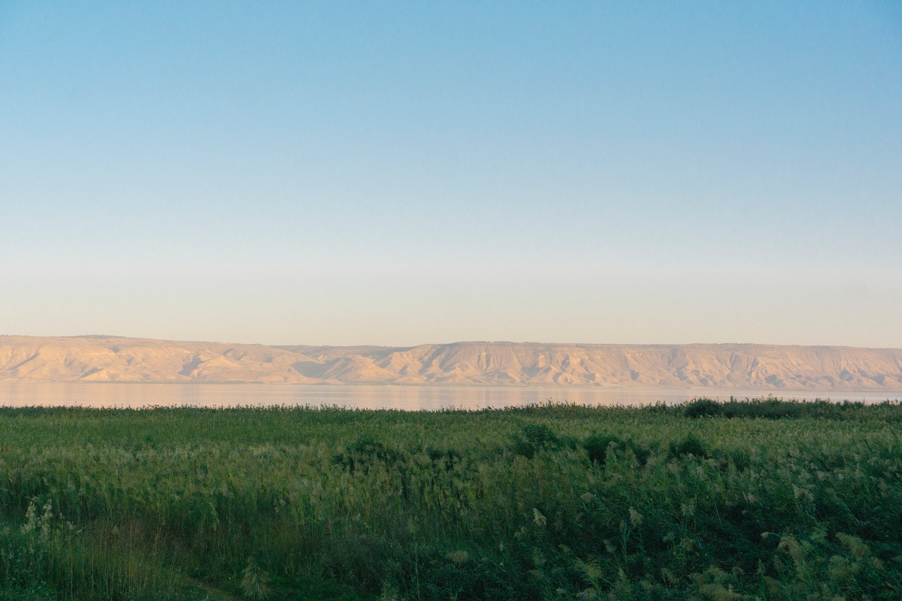
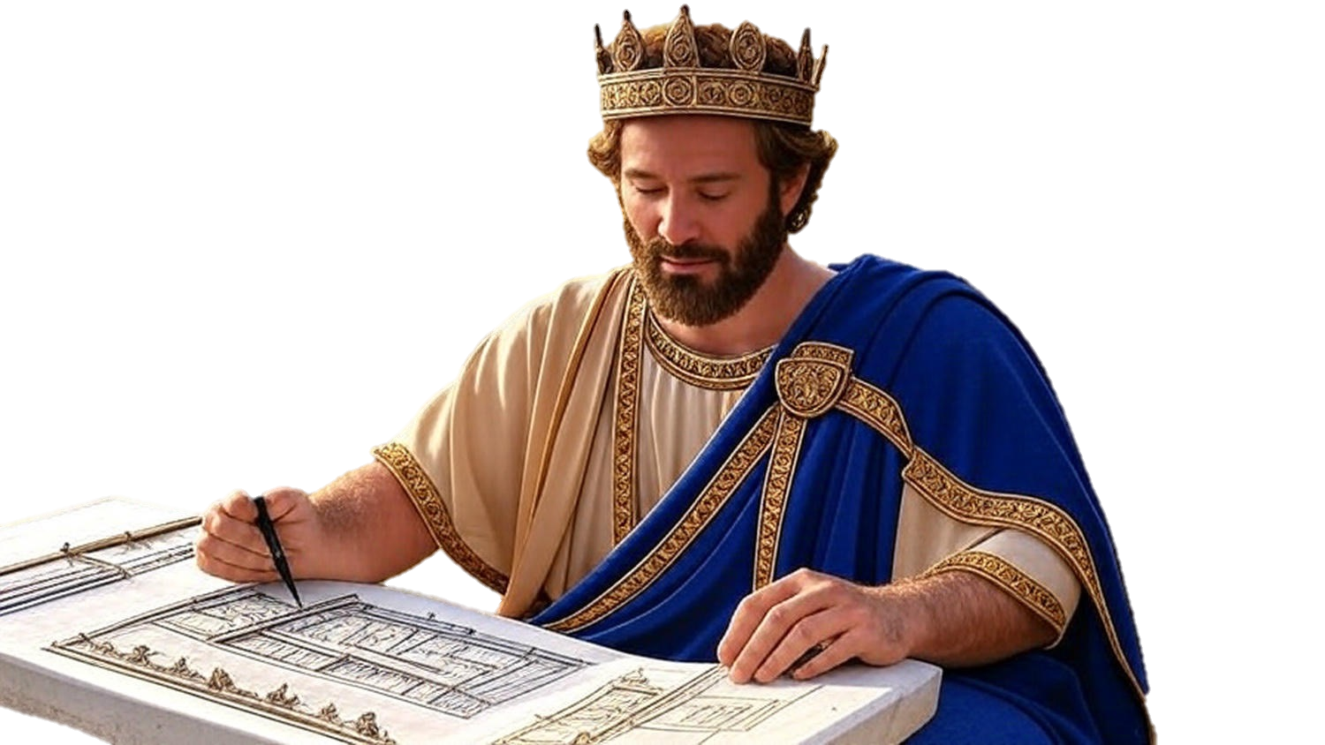

Chapters 29-31
2nd Chronicles
Even If You’re Late

Slide 2
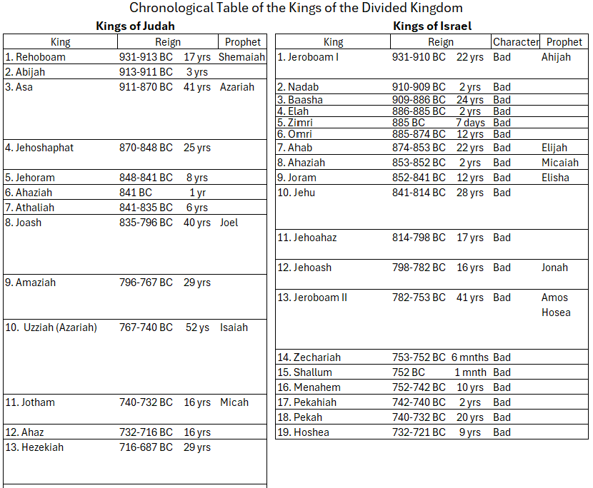

Slide 3
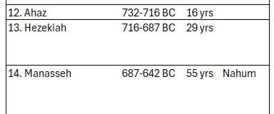

Slide 4
Chapters 29-31
2nd Chronicles
Even If You’re Late

Slide 5
Wonderful Things Can Still Be
Even if you’re late…Do the cleansing work

Slide 6
II Kings 18:5
“He trusted in Yahweh, the God of Israel; so that after him there was none like him among all the kings of Judah, nor among those who were before him.”

Slide 7
II Kings 18:4
“He took away the high places & shattered the sacred pillars & cut down the Asherah. He broke in pieces the bronze serpent that Moses had made, for until those days the sons of Israel were burning incense to it; & it was called Nehushtan.”

Slide 8
Wonderful Things Can Still Be
Even if you’re late…Do the cleansing work

Slide 9
Psalm 119:5
“Oh may my ways be established To keep Your statutes!”

Slide 10
Wonderful Things Can Still Be
Even if you’re late…Do the cleansing work
Even if you’re late…Bring your worship, heart & obedience

Slide 11
Numbers 9:9-10
“Then Yahweh spoke to Moses, saying, “Speak to the sons of Israel, saying, ‘If any one of you or of your generations becomes unclean because of a dead person, or is on a distant journey, he may, however, celebrate the Passover to Yahweh.”

Slide 12
Wonderful Things Can Still Be
Even if you’re late…Do the cleansing work
Even if you’re late…Bring your worship, heart & obedience
Even if you’re late…There can still be abundant blessing

Slide 13
Matthew 3:8-9
“Therefore bear fruit in keeping with repentance; & do not suppose that you can say to yourselves, ‘We have Abraham for our father’; for I say to you that from these stones God is able to raise up children to Abraham.”

Slide 14
Wonderful Things Can Still Be
Even if you’re late…Do the cleansing work
Even if you’re late…Bring your worship, heart & obedience
Even if you’re late…There can still be abundant blessing

