Slide 1
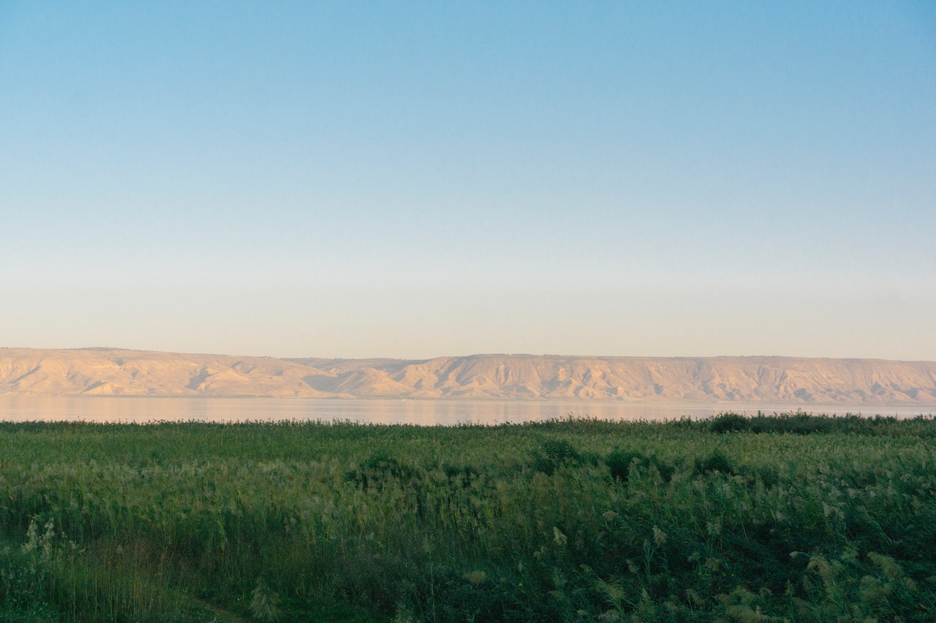
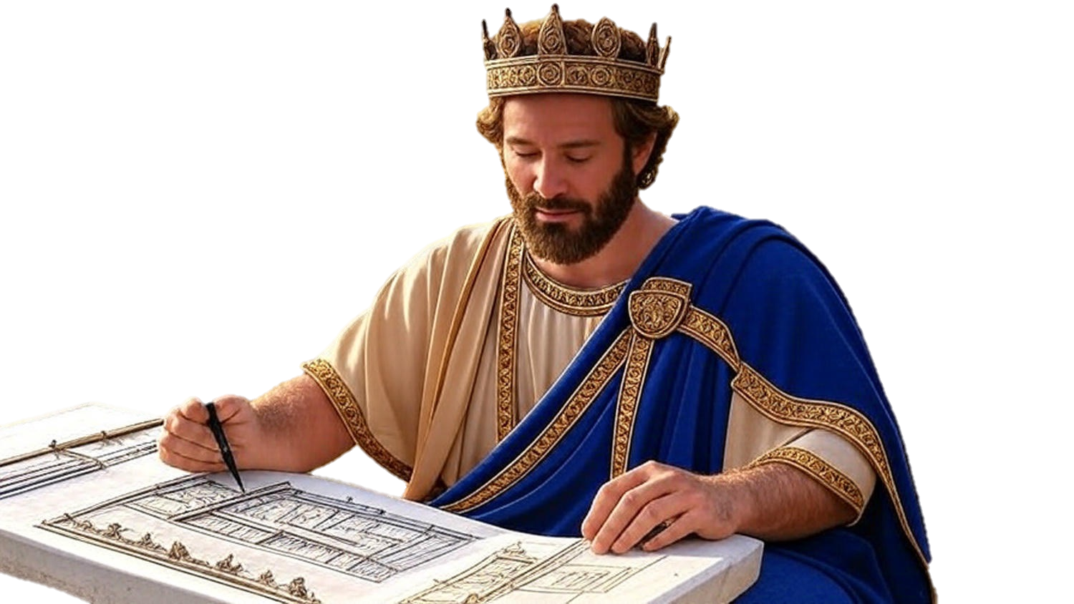

Chapters 26-28
2nd Chronicles
Simply Or Bravely, We Serve God

Slide 2
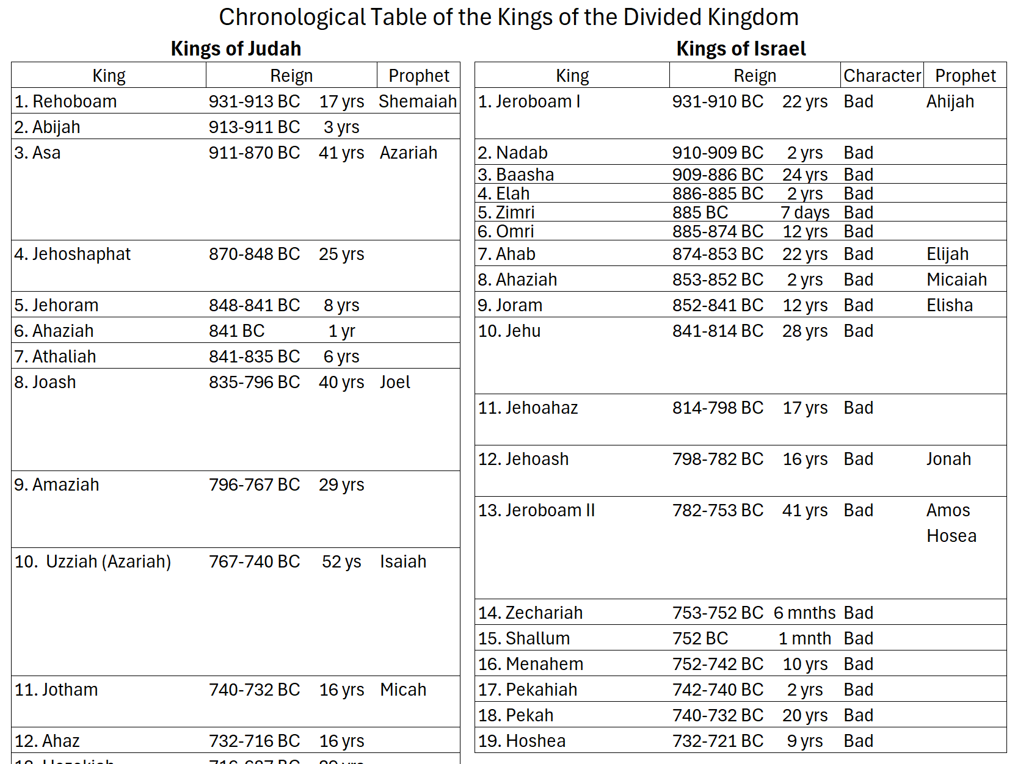

Slide 3
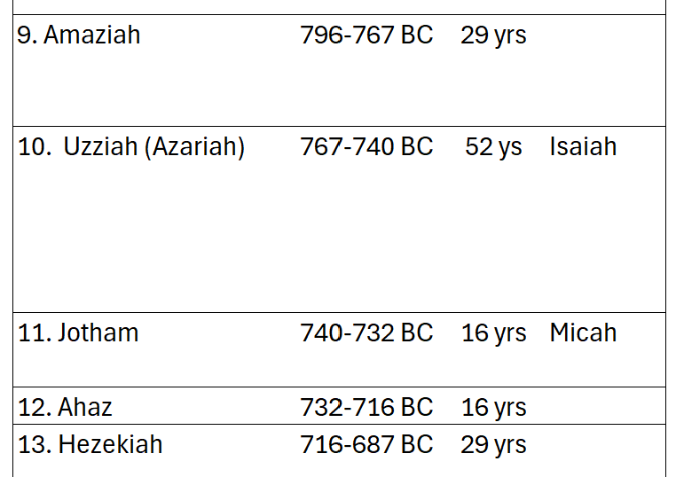

Slide 4
Chapters 26-28
2nd Chronicles
Simply Or Bravely, We Serve God

Slide 5
Honoring God W/ Our Lives
Uzziah: Love What God Loves

Slide 6
Numbers 16:8-9
“Then Moses said to Korah, “Hear now, you sons of Levi, is it not enough for you that the God of Israel has separated you from the rest of the congregation of Israel, to bring you near to Himself, to perform the service of the tabernacle of Yahweh, and to stand before the congregation to minister to them?”

Slide 7
Honoring God W/ Our Lives
Uzziah: Love What God Loves
Jotham: Live With Godly Simplicity
Oded (during the reign of Ahaz): Be Ready To Take Brave, Strong Action

