Slide 1
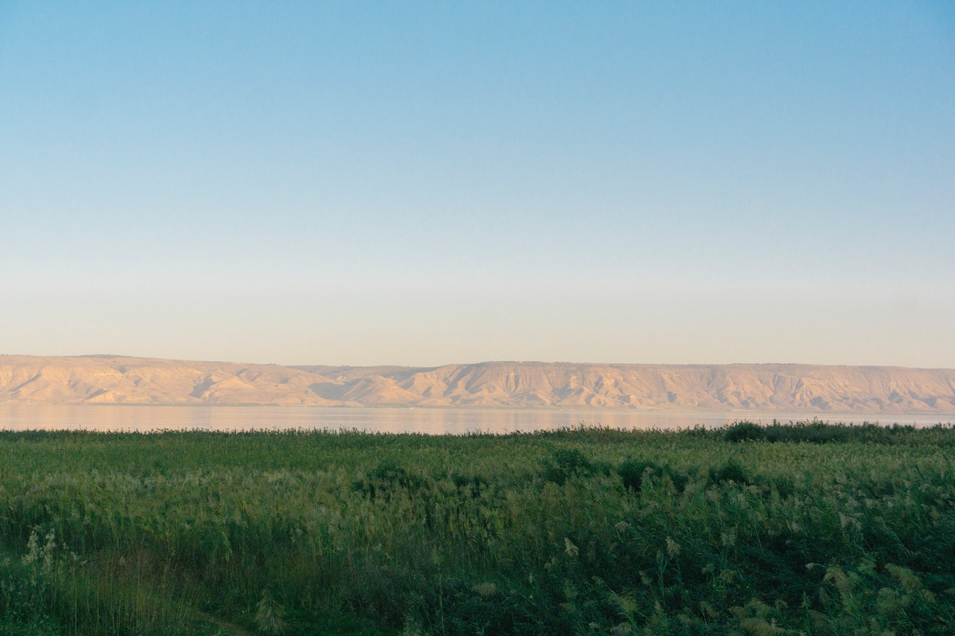
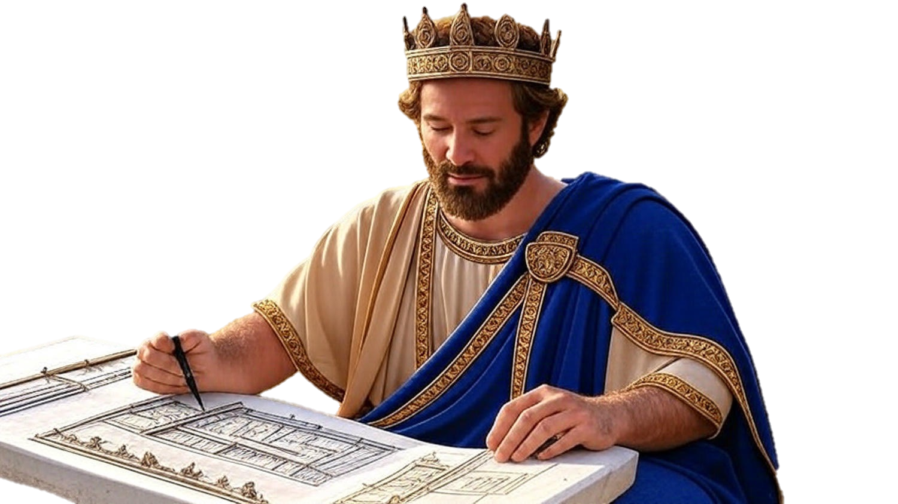

Chapters 24-25
2nd Chronicles
He Did What Was Right A.N.D….

Slide 2
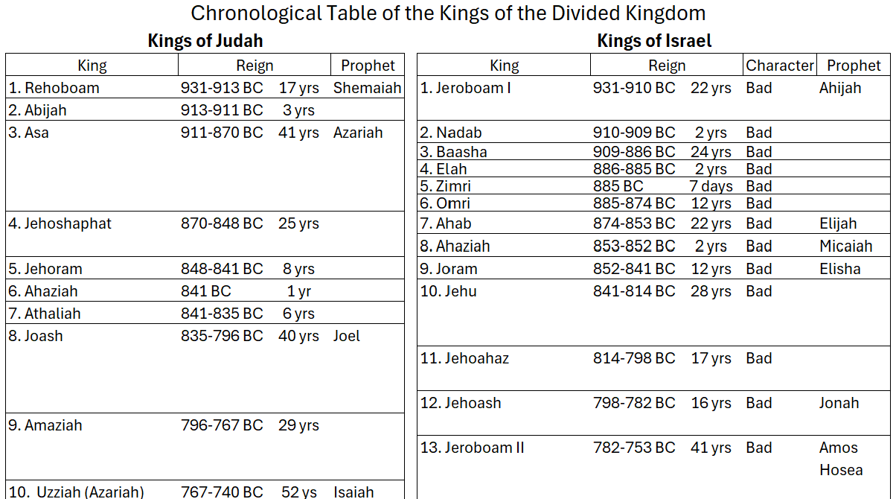
The Chronicles of the Kings

Slide 3
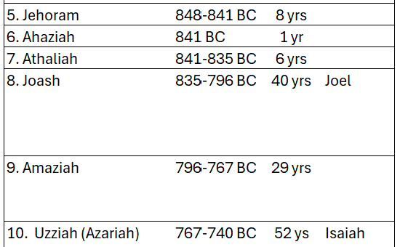
The Chronicles of the Kings

Slide 4
He Did What Was Right A.N.D….
Adultery - Narcissism - Defeat
Joash: It’s right to follow Godly people
Joash: His adultery, narcissism & defeat
Amaziah: It’s right to follow God’s Law
Amaziah: Adultery, narcissism & defeat

