Slide 1

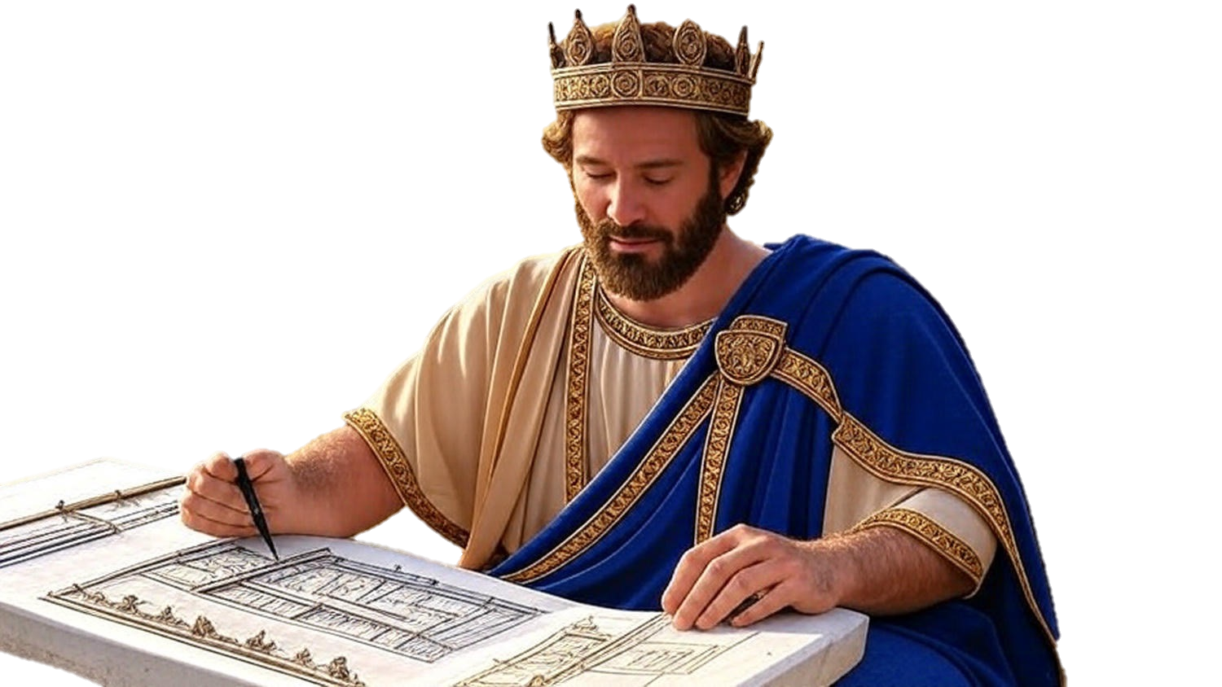

Chapters 21-23
2nd Chronicles
The Bold Defeat Of Sins

Slide 2
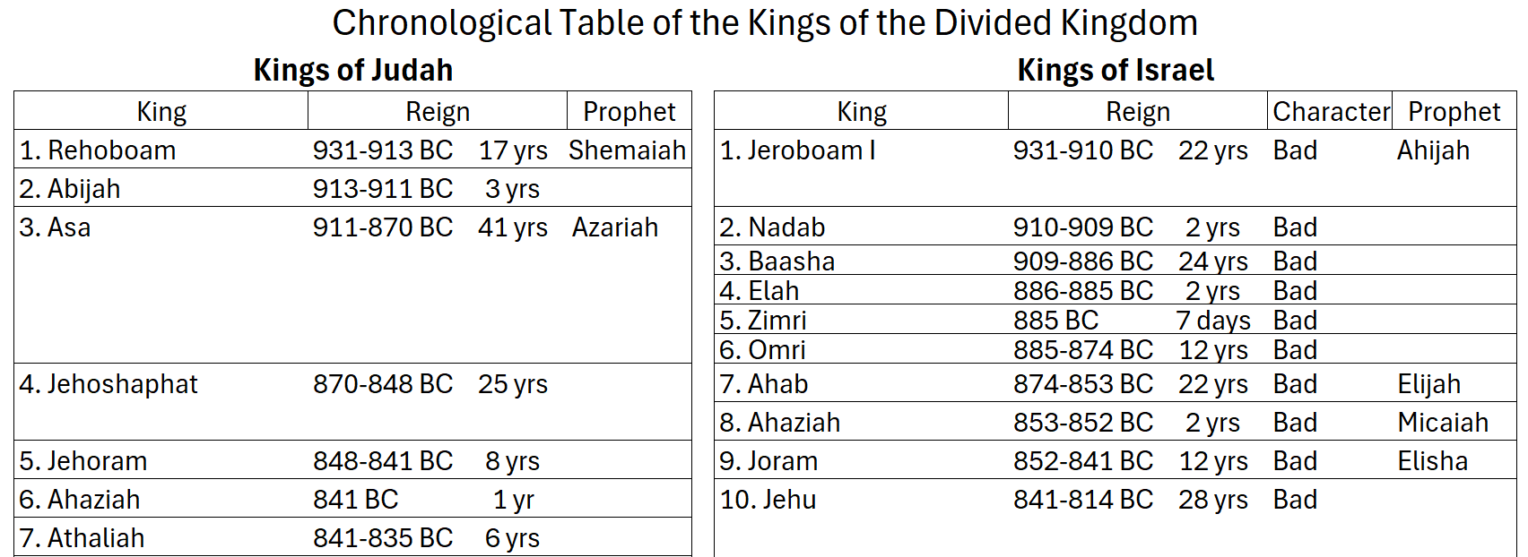
The Chronicles of the Kings

Slide 3
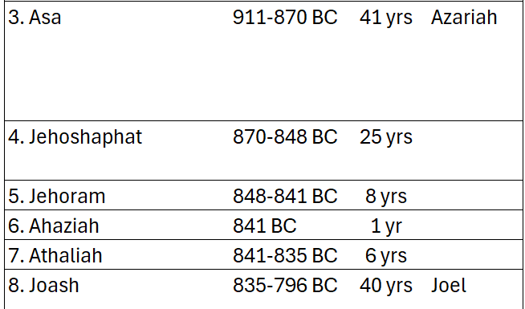
The Chronicles of the Kings

Slide 4
Sin’s Takeover & It’s Bold Defeat
Jehoram: Infiltration of sin by the selfish one

Slide 5
Romans 9:10-12
“There was Rebekah also, when she had conceived twins by one man, our father Isaac; for though the twins were not yet born & had not done anything good or bad, so that the purpose of God according to His choice would stand, not b/c of works but b/c of Him who calls, it was said to her, “The older shall serve the younger.”

Slide 6
Sin’s Takeover & It’s Bold Defeat
Jehoram: Infiltration of sin by the selfish one
Athaliah: Infestation of sin by the sinful one
Jehoiada: Incineration of sin by the selfless one

