Slide 1

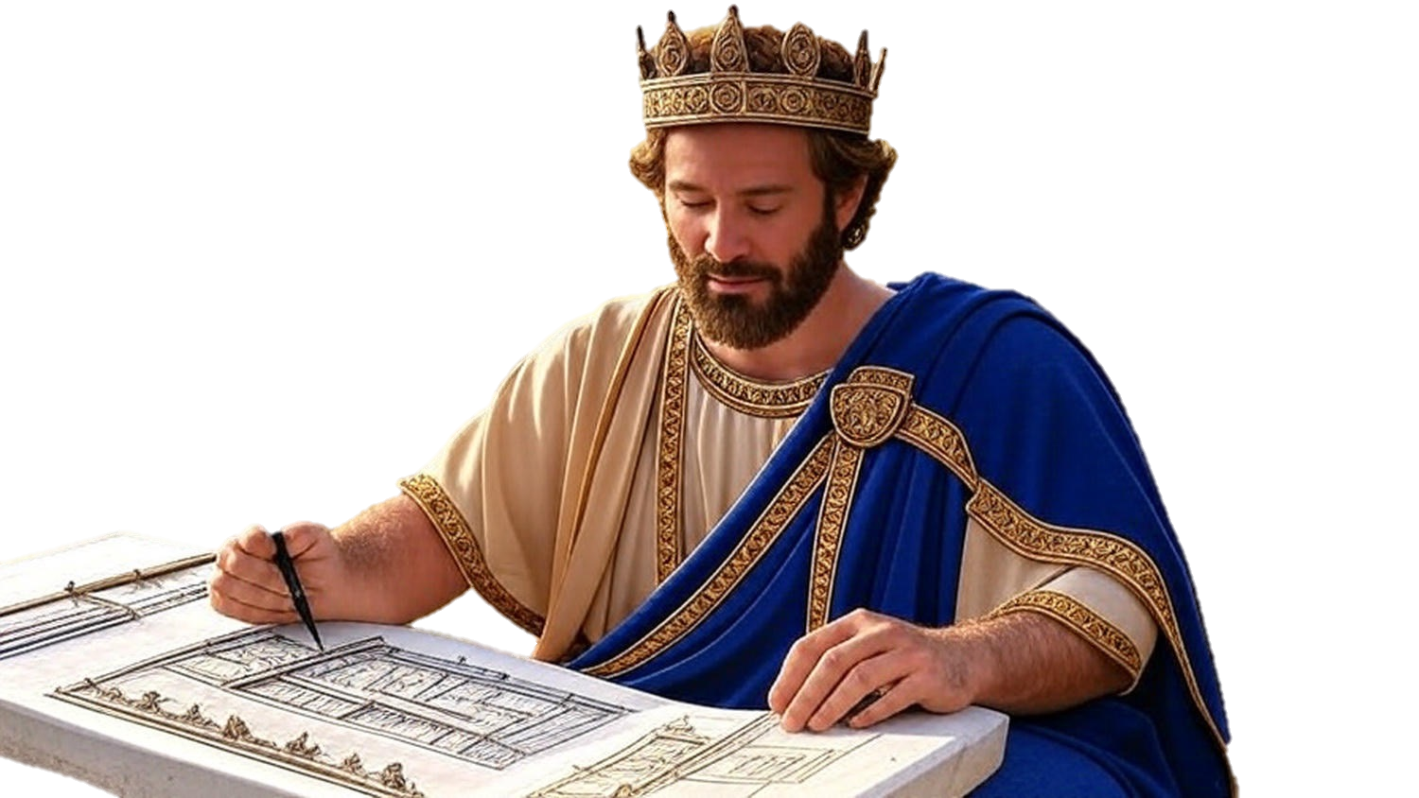

Chapters 17-20
2nd Chronicles
Jehoshaphat’s Pursuit Of God

Slide 2
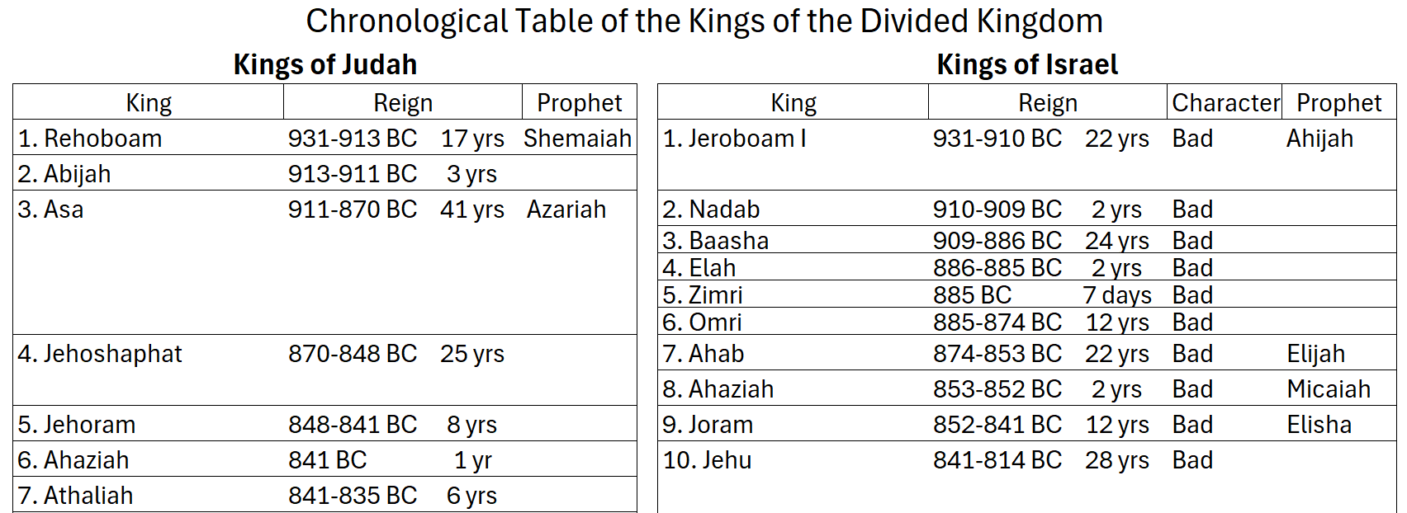
The Chronicles of the Kings

Slide 3
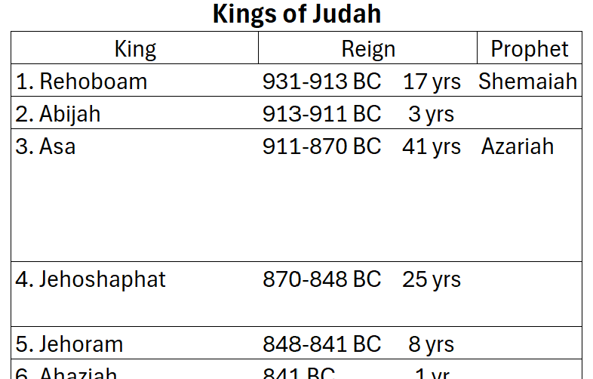
The Chronicles of the Kings

Slide 4
Habits That Show Pursuit of God
Teaching The Word To Everyone
Applying The Word That You Hear
Growing From Chastisement
Growing Thru The Trials Of Our Faith

