Slide 1
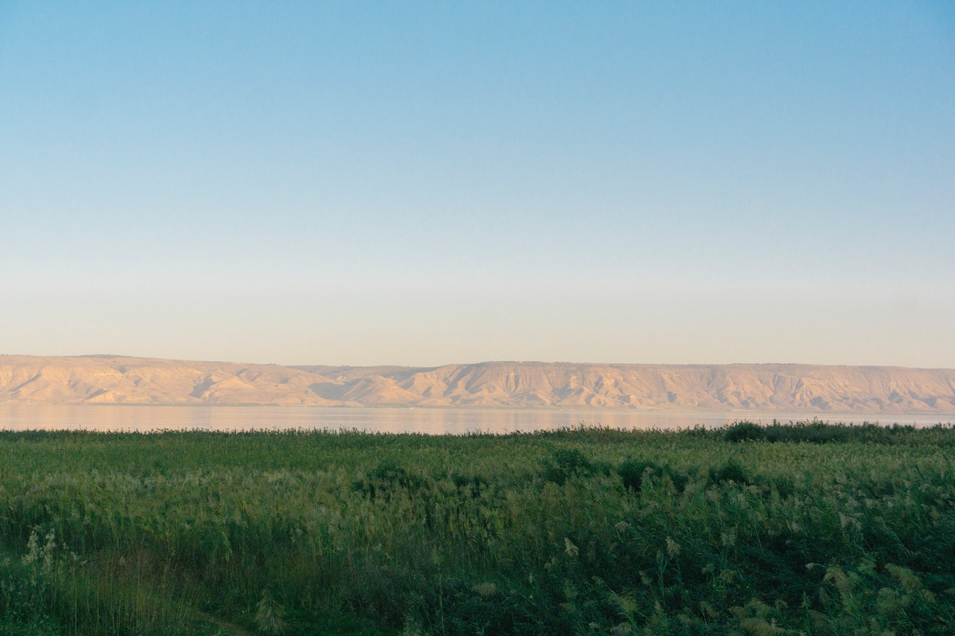
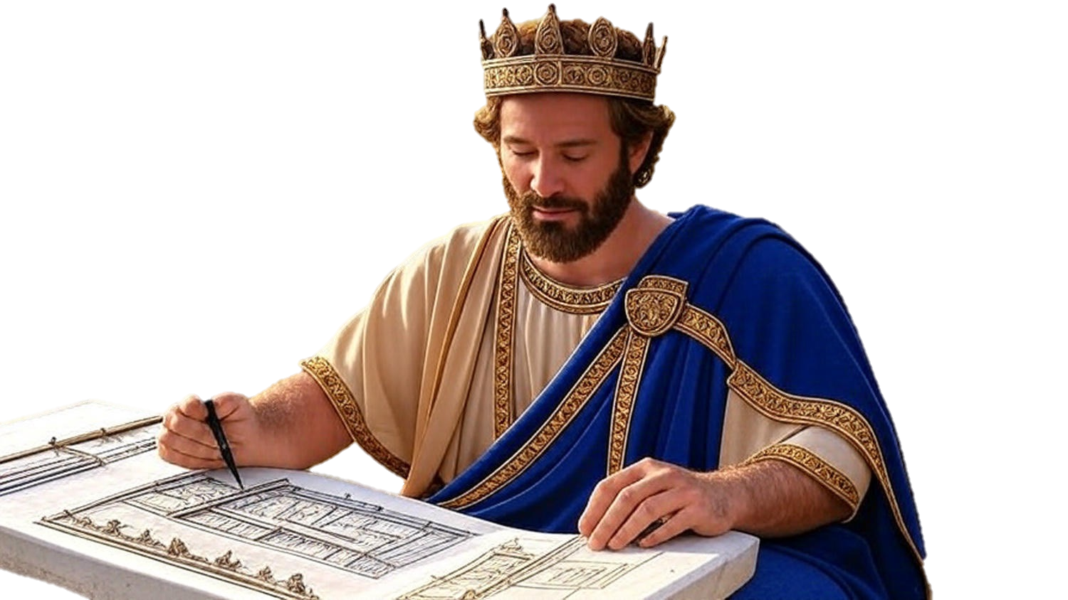

Chapters 13-16
2nd Chronicles
Is Your Faith P.U.R.E.

Slide 2
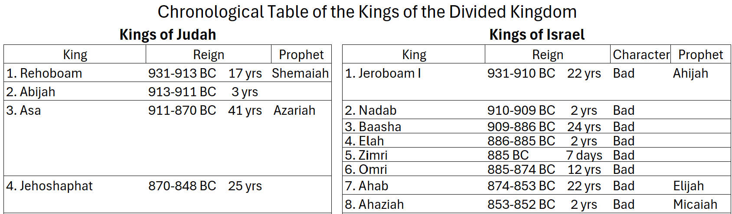
The Chronicles of the Kings

Slide 3
The Chronicles of the Kings

Slide 4
Is Your Faith P.U.R.E.?
Do we have Personal Faith or just a generic, national faith?
Do we have an Unchangeable Faith grounded in God’s Word?
Do we have a Robust Faith that removes sin & presses into new territory?
Do we have an Enduring Faith not overruled by the flesh?

