Slide 1
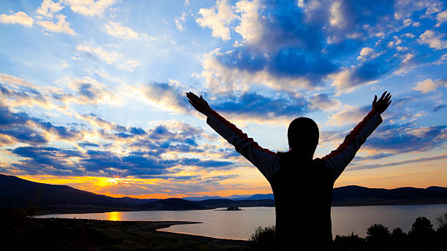

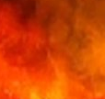
Psalms .
The
112-115
Faith On Display

Slide 2
Indicators of Genuine Faith
The faithful are fixed reverently on receiving righteousness from God

Slide 3
Hebrews 11:6
“And without faith it is impossible to please Him [God], for he who draws near to God must believe that He is and that He is a rewarder of those who seek Him.”

Slide 4
Psalm 1:1-2
“How blessed is the man who does not walk in the counsel of the wicked, nor stand in the way of sinners, nor sit in the seat of scoffers! But his delight is in the law of Yahweh, and in His law he meditates day and night.”

Slide 5
Indicators of Genuine Faith
The faithful are fixed reverently on receiving righteousness from God
The faithful exalt the One who came so low

Slide 6
Philippians 2:5-9
“Have this way of thinking in yourselves which was also in Christ Jesus, who, although existing in the form of God, did not regard equality with God a thing to be grasped, but emptied Himself, by taking the form of a slave, by being made in the likeness of men… (cont)

Slide 7
Philippians 2:5-9
(cont) …Being found in appearance as a man, He humbled Himself by becoming obedient to the point of death, even death on a cross. Therefore, God also highly exalted Him, and bestowed on Him the name which is above every name.”

Slide 8
Indicators of Genuine Faith
The faithful are fixed reverently on receiving righteousness from God
The faithful exalt the One who came so low
The faithful live their own experiences with God
The faithful are displaying God thru their lives

