Slide 1

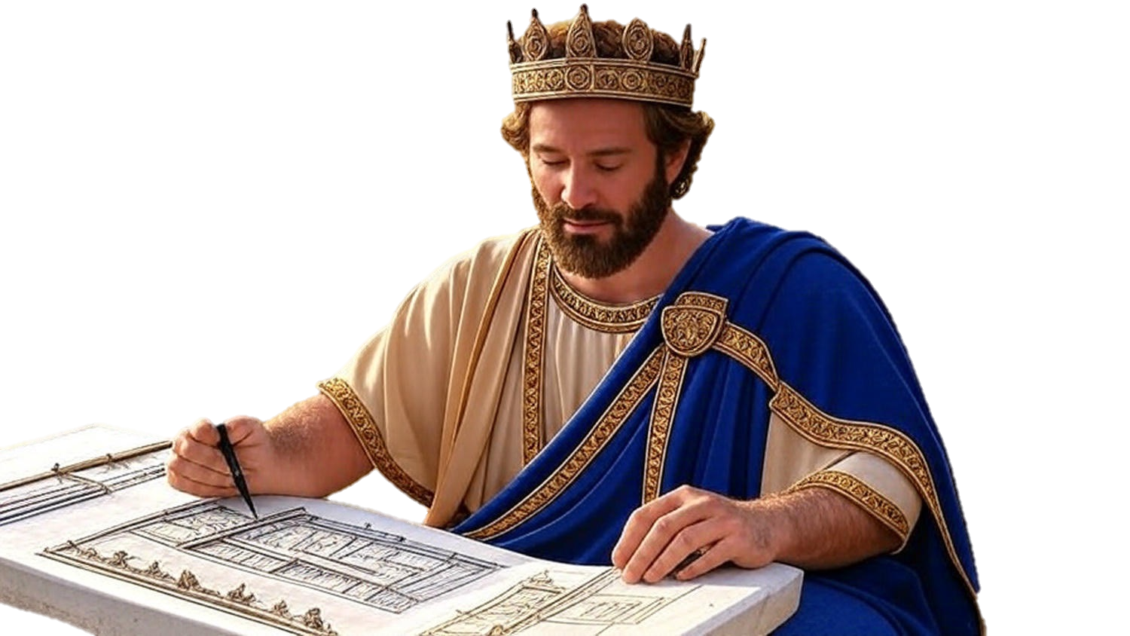

Chapters 10-12
2nd Chronicles
Rehoboam:
Divide Makes Everyone Decide

Slide 2
Divide Makes Everyone Decide
Dealing w/ Doubters: Will we listen to man’s counsel?

Slide 3
Mark 10:42-45
“And calling them to Himself, Jesus said to them, ‘You know that those who are recognized as rulers of the Gentiles lord it over them; & their great men exercise authority over them. ’But it is not this way among you, but whoever wishes to become great among you shall be your servant… (cont)

Slide 4
Mark 10:42-45
(cont) …and whoever wishes to be first among you shall be slave of all. For even the Son of Man did not come to be served, but to serve, & to give His life a ransom for many.”

Slide 5
Divide Makes Everyone Decide
Dealing w/ Doubters: Will we listen to man’s counsel?
Dealing w/ Disruptions: Will we listen to God’s counsel?
Dealing w/ Defeat: Will we live in worship or in idolatry?

