Slide 1
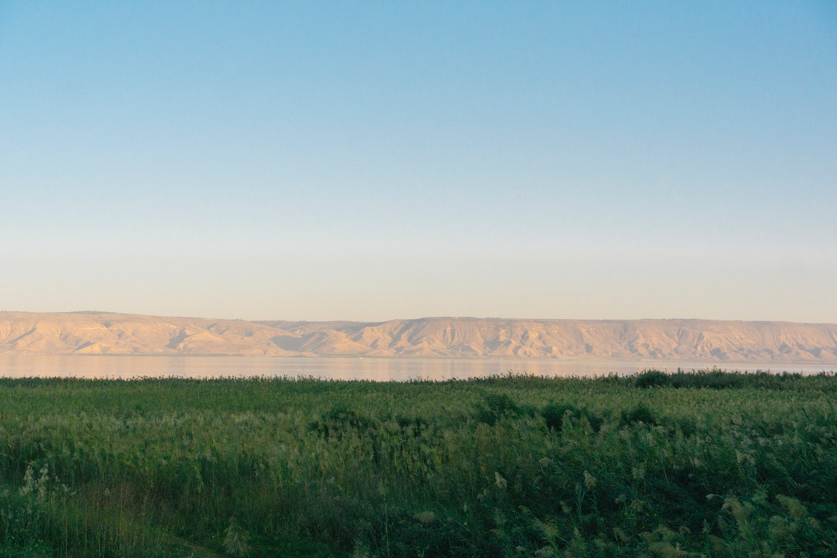
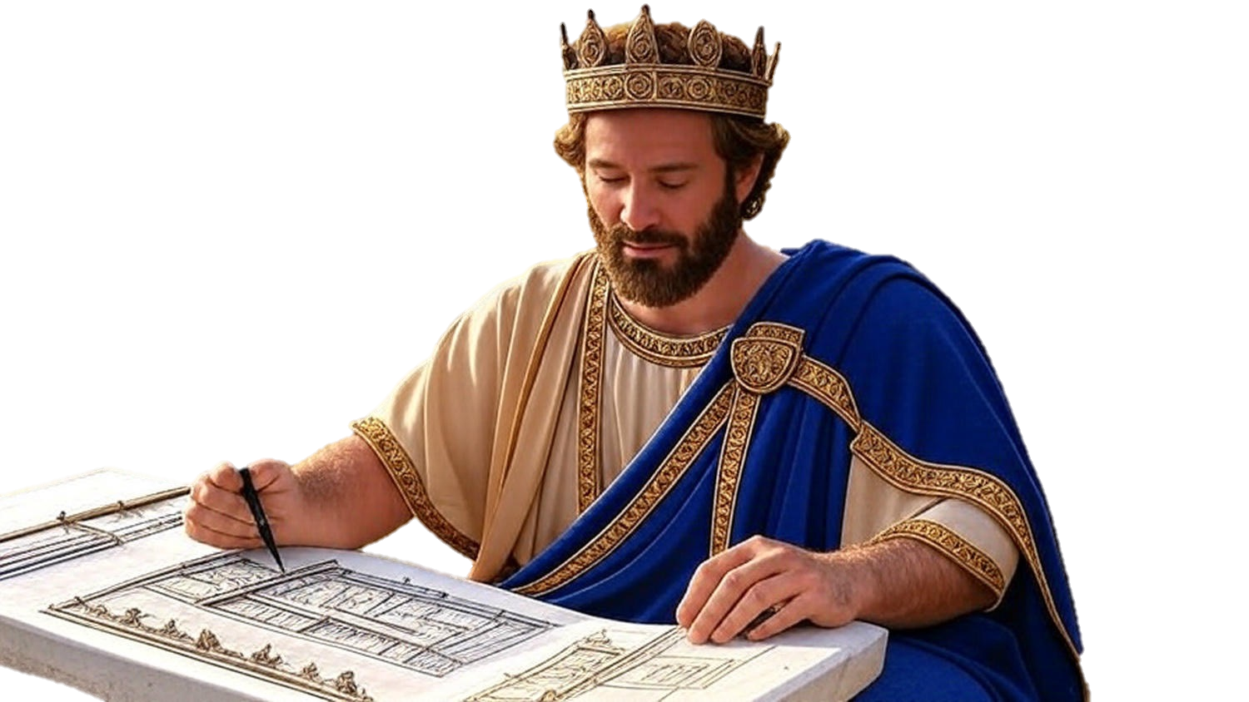

Chapters 8-9
2nd Chronicles
A Chance To Magnify God

Slide 2
A Chance To Magnify God
Purity Powers Progress
Questioning Quells Quarrels

Slide 3
Matthew 12:42
“The Queen of the South will rise up with this generation at the judgment & will condemn it, b/c she came from the ends of the earth to hear the wisdom of Solomon; & behold, something greater than Solomon is here.”

Slide 4
A Chance To Magnify God
Purity Powers Progress
Questioning Quells Quarrels
Prominence Provides Possibilities

Slide 5
Psalm 24:3-5
“Who may ascend into the mountain of Yahweh? Who may rise in His holy place? He who has innocent hands & a pure heart, who has not lifted up his soul to worthlessness & has not sworn deceitfully. He shall lift up a blessing from Yahweh & righteousness from the God of his salvation.”

Slide 6
A Chance To Magnify God
Purity Powers Progress
Questioning Quells Quarrels
Prominence Provides Possibilities

