Slide 1

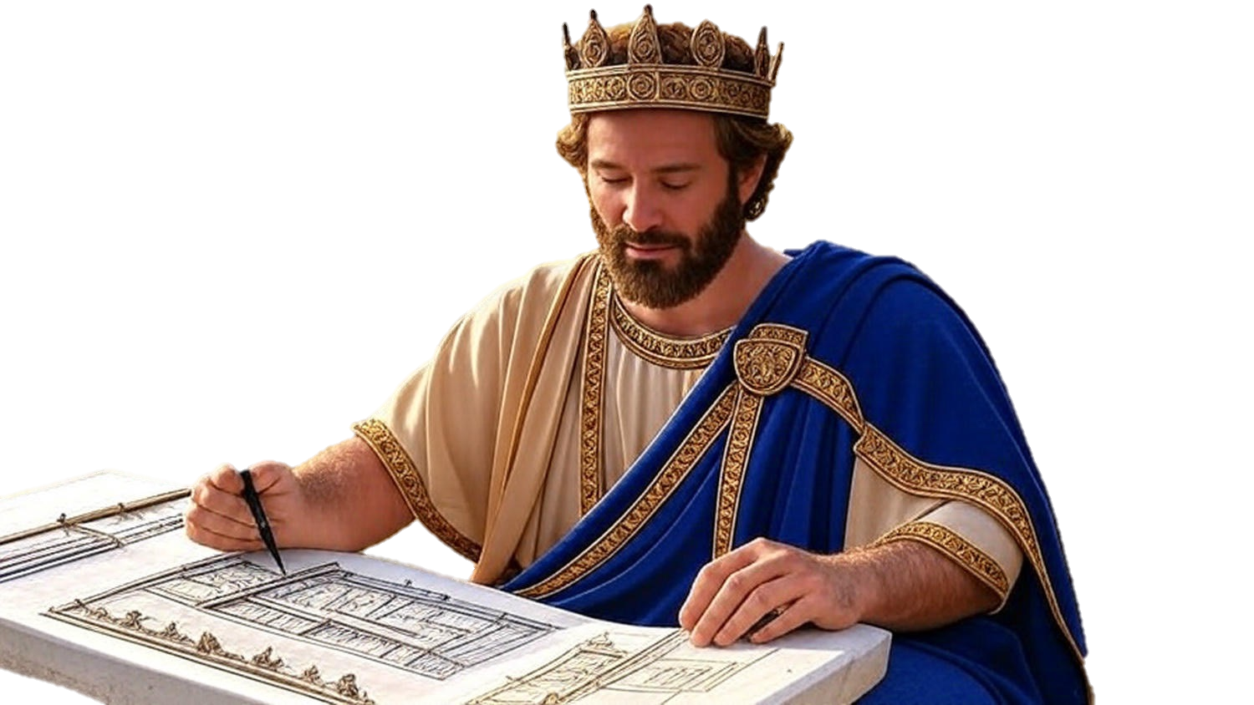

Chapters 5-7
2nd Chronicles
Doorway To Blessing

Slide 2
Doorway To Blessing
Install the physical centerpiece
God responds w/ His presence

Slide 3
Daniel 12:3
“And those who have insight will shine brightly like the brightness of the expanse of heaven, and those who lead the many to righteousness, like the stars forever and ever.”

Slide 4
Doorway To Blessing
Install the physical centerpiece
God responds w/ His presence
Install the mental centerpiece
God responds w/ His power
Install the spiritual centerpiece
God responds w/ His purpose

