Slide 1
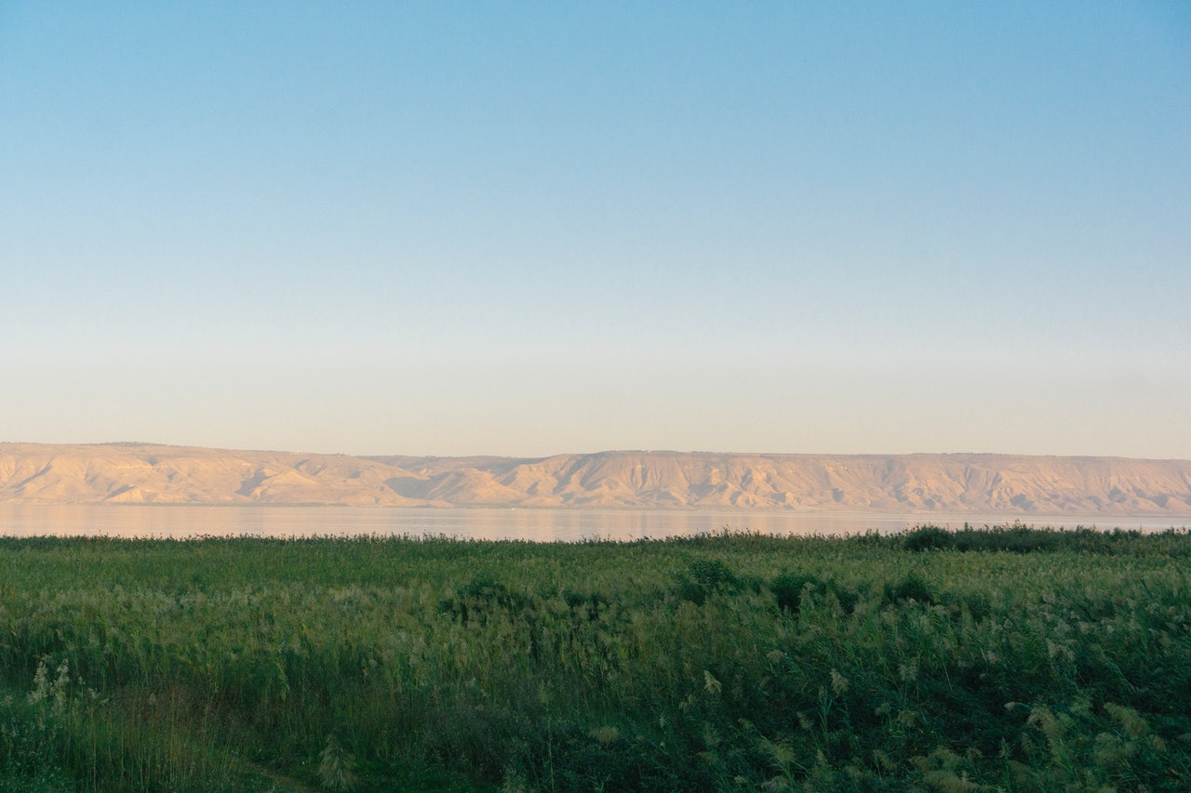
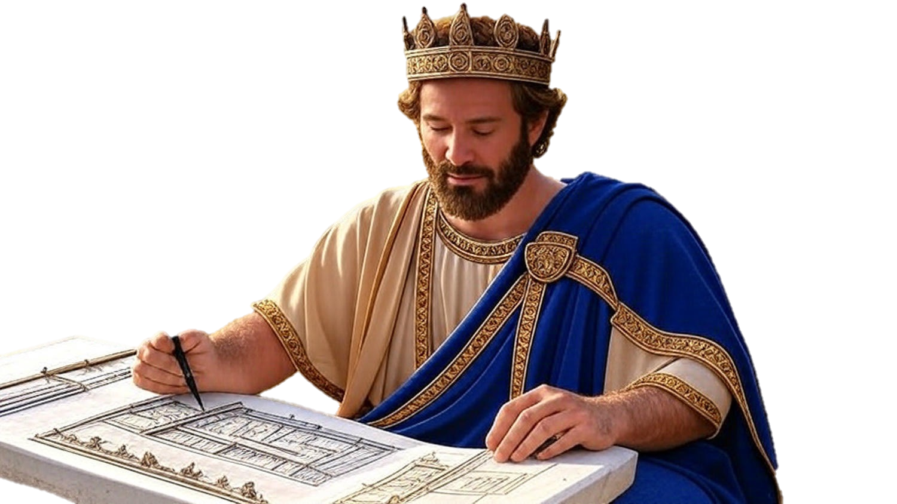

Chapters 1-4
2nd Chronicles
To Work God’s Will

Slide 2
To Work God’s Will
We need wisdom to do His will

Slide 3
Genesis 24:27
“And he said, ‘Blessed be Yahweh, the God of my master Abraham, who has not forsaken His lovingkindness & His truth toward my master; as for me, Yahweh has guided me in the way to the house of my master’s brothers.’”

Slide 4
Luke 11:11-13
“But what father among you, if his son asks for a fish, will give him a snake instead of a fish? Or, if his son asks for an egg, will give him a scorpion? If you then, being evil, know how to give good gifts to your children, how much more will your heavenly Father give the Holy Spirit to those who ask Him?”

Slide 5
James 4:3
“You ask and do not receive, because you ask with wrong motives, so that you may spend it on your pleasures.”

Slide 6
To Work God’s Will
We need wisdom to do His will

Slide 7
Matthew 6:33
“But seek first His kingdom and His righteousness, and all these things will be added to you.”

Slide 8
Deuteronomy 17:16-17
“Moreover, he [the king] shall not multiply horses for himself… Yahweh has said to you, ‘You shall never again return that way [to Egypt].’ And he shall not multiply wives for himself, or else his heart will turn away; nor shall he greatly increase silver & gold for himself.”

Slide 9
To Work God’s Will
We need wisdom to do His will
We need determination to do His will
We need focus to do His will

Slide 10
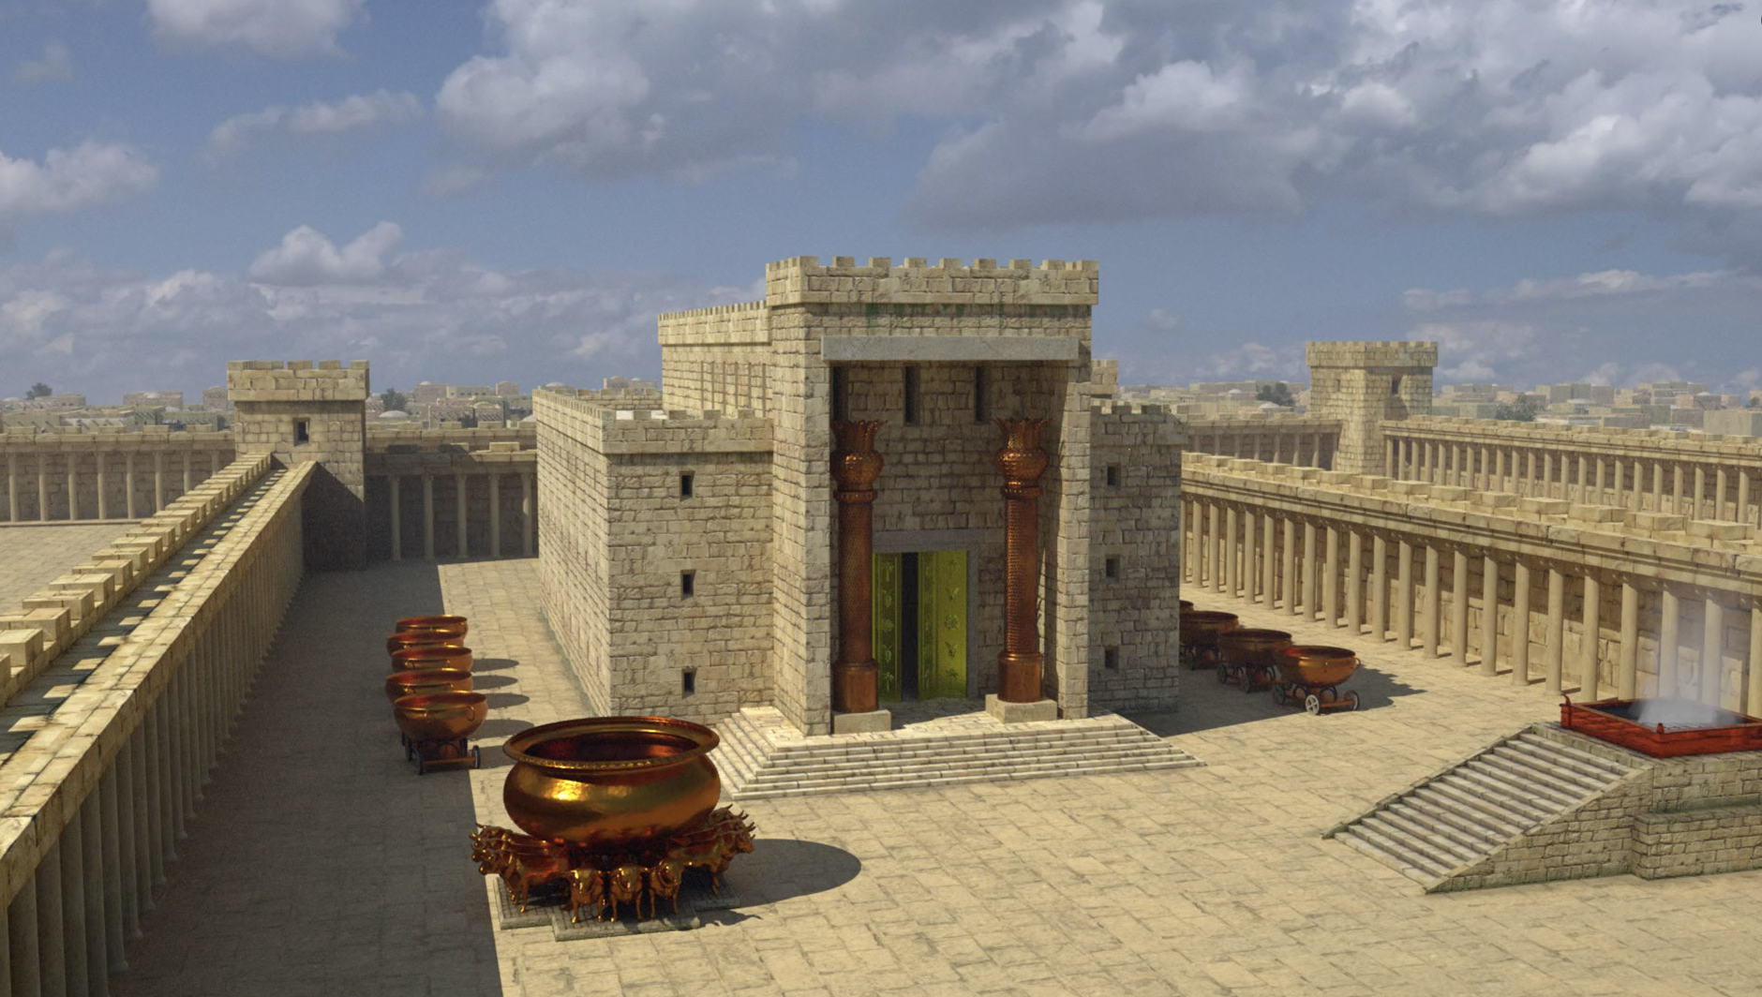
To Work God’s Will
We need wisdom to do His will
We need determination to do His will
We need focus to do His will

Slide 11
Hebrews 8:1-2
“We have such a high priest, who sat down at the right hand of the throne of the Majesty in the heavens, a minister in the holy places & in the true tabernacle, which the Lord pitched, not man.”

Slide 12
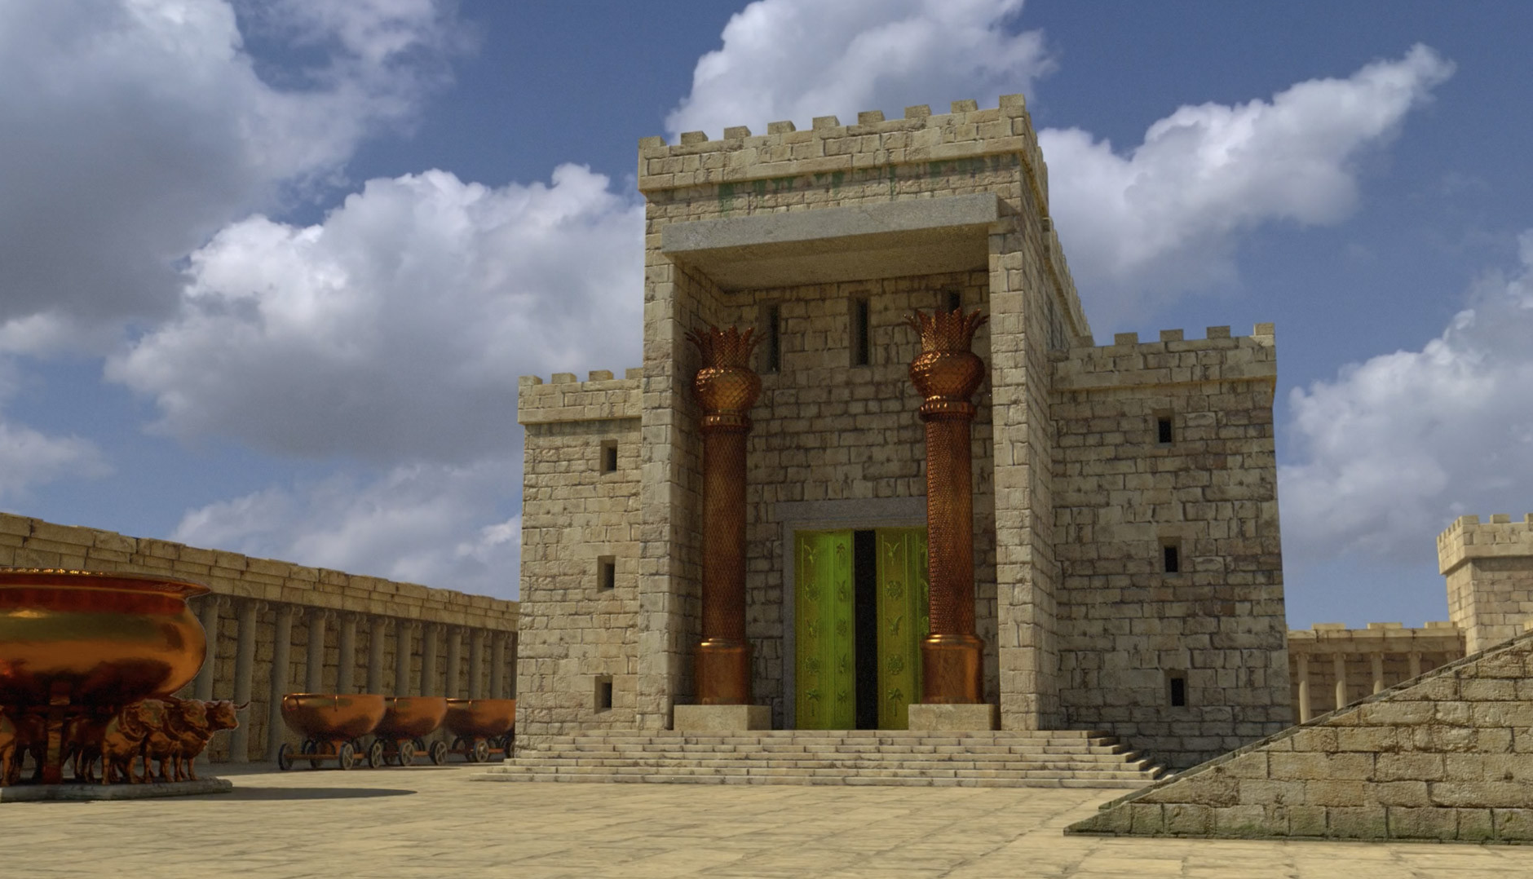
To Work God’s Will
We need wisdom to do His will
We need determination to do His will
We need focus to do His will

Slide 13
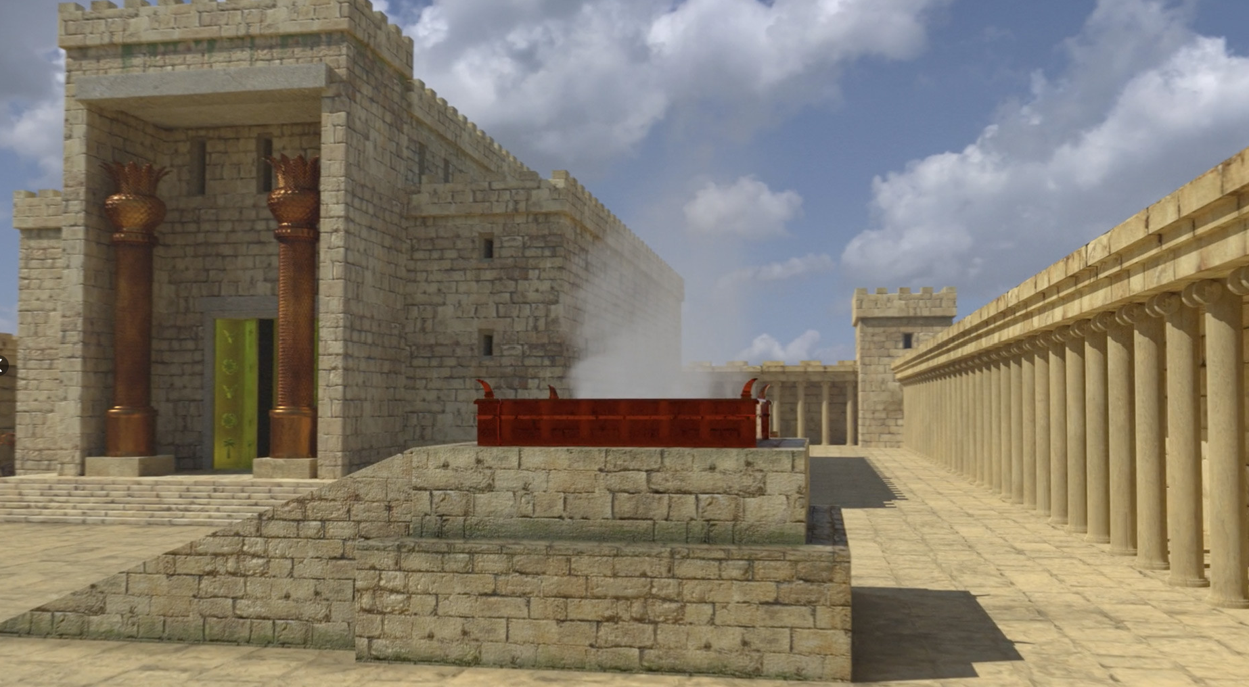
To Work God’s Will
We need wisdom to do His will
We need determination to do His will
We need focus to do His will

Slide 14
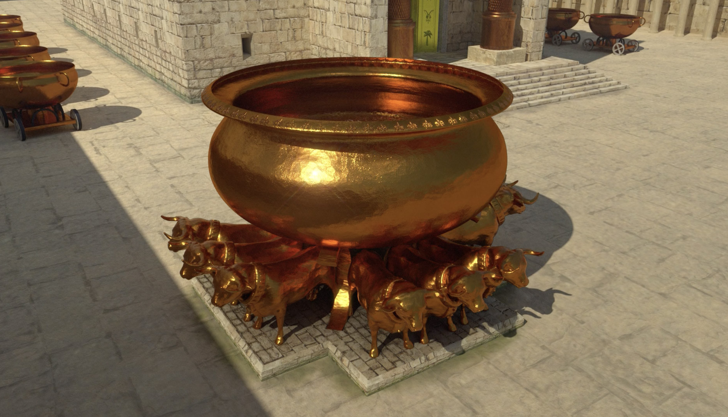
To Work God’s Will
We need wisdom to do His will
We need determination to do His will
We need focus to do His will

Slide 15
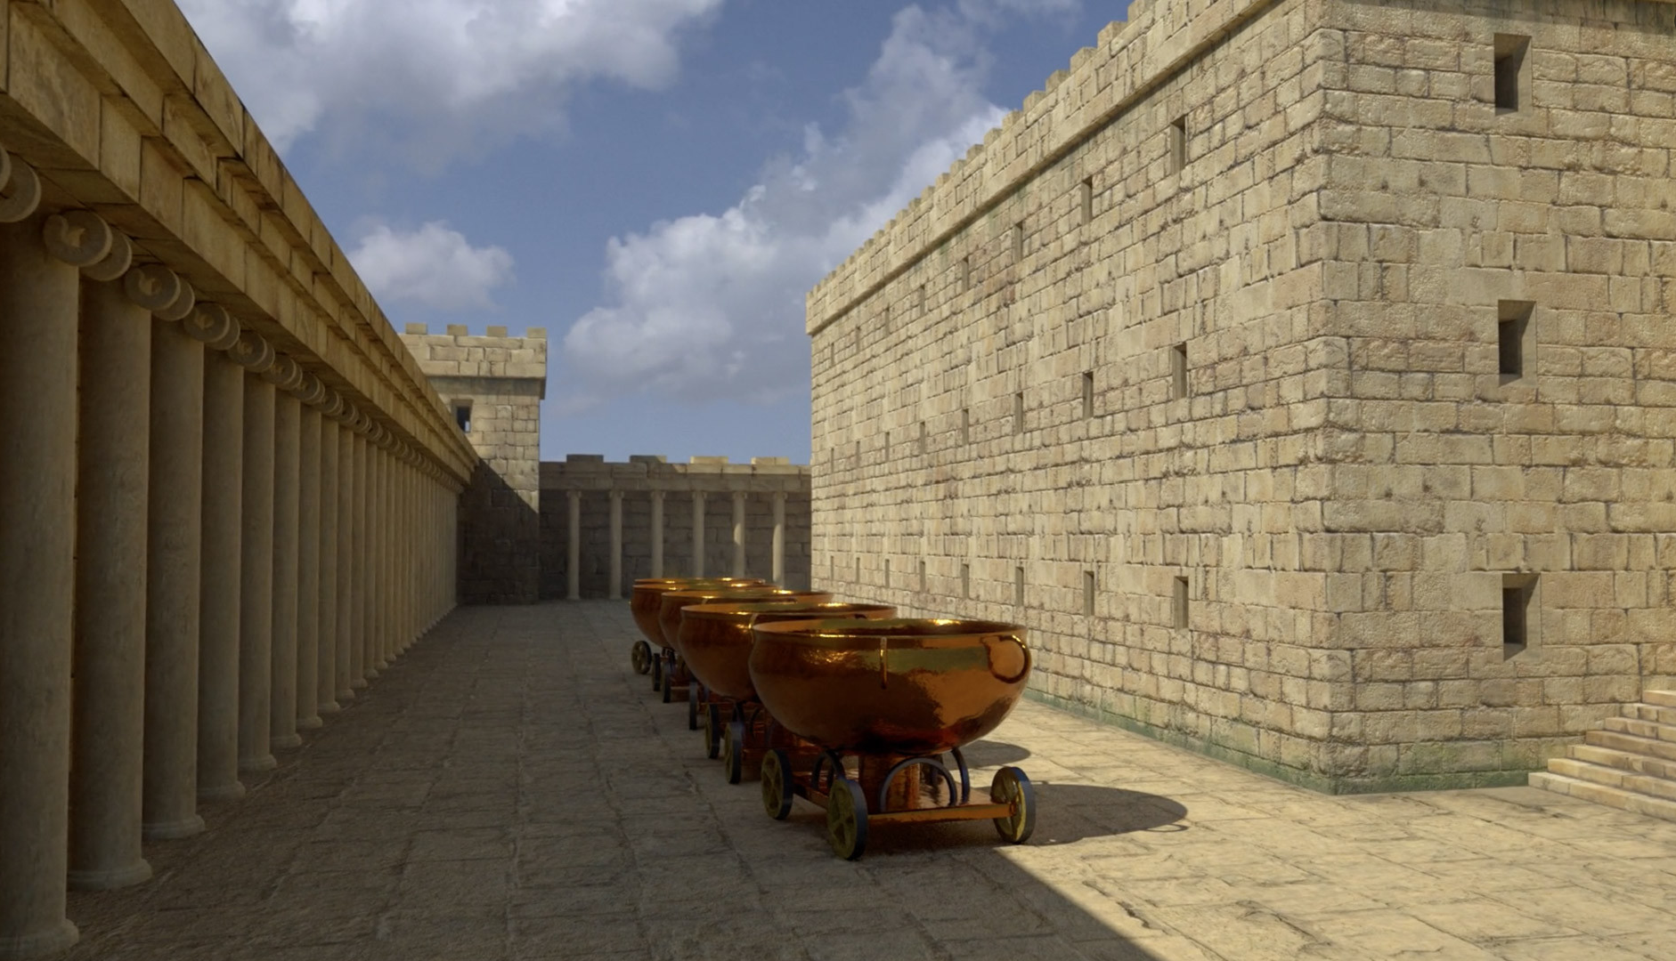
To Work God’s Will
We need wisdom to do His will
We need determination to do His will
We need focus to do His will

Slide 16
To Work God’s Will
We need wisdom to do His will
We need determination to do His will
We need focus to do His will

