Slide 1
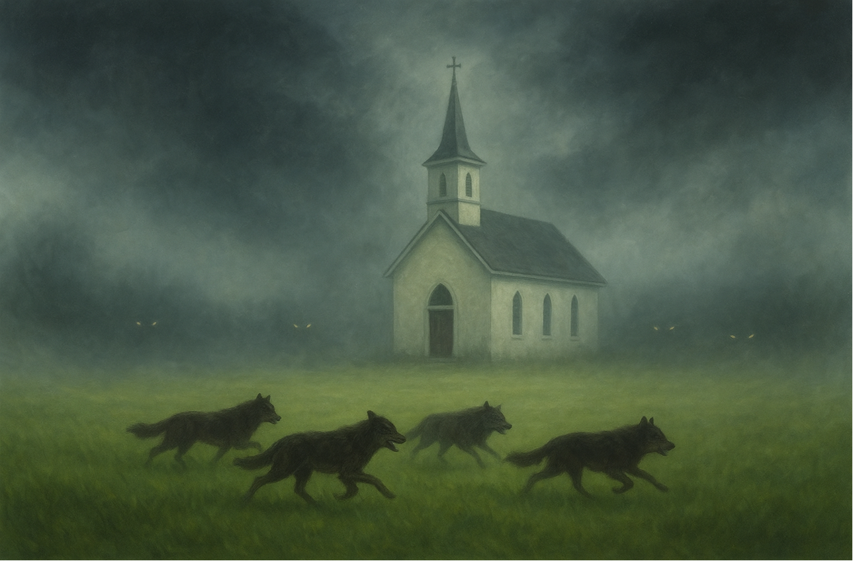

Jude
Earnestly Contend For The Faith
Part 2 of 2
BOOK OF
Verses 12-25

Slide 2
Earnestly Contending For The Faith
Don’t waste our resources on ourselves
Don’t war against authorities & powers
Don’t wear a false front as the hypocrite

Slide 3
II Timothy 3:5, 7-9
“[They’re] holding to a form of godliness, but having denied its power. Keep away from such men as these. [They’re] always learning and never able to come to the full knowledge of the truth…. (con’t)

Slide 4
II Timothy 3:5, 7-9
(con’t) …Just as Jannes & Jambres opposed Moses, so these men also oppose the truth, men of depraved mind, disqualified in regard to the faith. But they will not make further progress, for their folly will be obvious to all, just as theirs was also.”

Slide 5
Earnestly Contending For The Faith
Don’t waste our resources on ourselves
Don’t war against authorities & powers
Don’t wear a false front as the hypocrite

Slide 6
Isaiah 61:1-2
“The Spirit of Lord Yahweh is upon Me b/c Yahweh has anointed me To bring good news to the afflicted; He has sent Me to bind up the brokenhearted, to proclaim release to captives & freedom to prisoners, to proclaim the favorable year of Yahweh & the day of vengeance of our God, to comfort all who mourn…”

Slide 7
Earnestly Contending For The Faith
Don’t waste our resources on ourselves
Don’t war against authorities & powers
Don’t wear a false front as the hypocrite
We wist what we were taught

Slide 8
Acts 20:35
“In everything I showed you that by laboring in this manner you must help the weak & remember the words of the Lord Jesus, that He Himself said, ‘It is more blessed to give than to receive.’”

Slide 9
Luke 24:6-7
“He is not here, but He has risen. Remember how He spoke to you while He was still in Galilee, saying that the Son of Man must be delivered into the hands of sinful men, and be crucified, and the third day rise again.”

Slide 10
Isaiah 3:1-4
“For behold, the Lord, Yahweh of hosts, is going to remove from Jerusalem & Judah both supply & support, the whole supply of bread & the whole supply of water, the mighty man & the man of war, the judge & the prophet, the diviner & the elder… (con’t)

Slide 11
Isaiah 3:1-4
(con’t) …The commander of fifty & the highly respected man, the counselor & the wise craftsman, & the experienced enchanter. And I will make young men their princes, & capricious children will rule over them.”

Slide 12
Earnestly Contending For The Faith
Don’t waste our resources on ourselves
Don’t war against authorities & powers
Don’t wear a false front as the hypocrite
We wist what we were taught
We weave our lives together with God

Slide 13
Matthew 7:24-25
“Therefore everyone who hears these words of Mine & does them, may be compared to a wise man who built his house on the rock. The rain descended, & the rivers came, & the winds blew & fell against that house; & yet it did not fall, for it had been founded on the rock.”

Slide 14
Earnestly Contending For The Faith
Don’t waste our resources on ourselves
Don’t war against authorities & powers
Don’t wear a false front as the hypocrite
We wist what we were taught
We weave our lives together with God
We witness smartly to warn others

Slide 15
Lamentations 3:22
“The lovingkindnesses of Yahweh indeed never cease, for His compassions never fail.”

Slide 16
Ephesians 3:20-21
“Now to Him who is able to do far more abundantly beyond all that we ask or understand, according to the power that works within us, to Him be the glory in the church and in Christ Jesus to all generations forever and ever. Amen.”

Slide 17
Earnestly Contending For The Faith
Don’t waste our resources on ourselves
Don’t war against authorities & powers
Don’t wear a false front as the hypocrite
We wist what we were taught
We weave our lives together with God
We witness smartly to warn others

