Slide 1
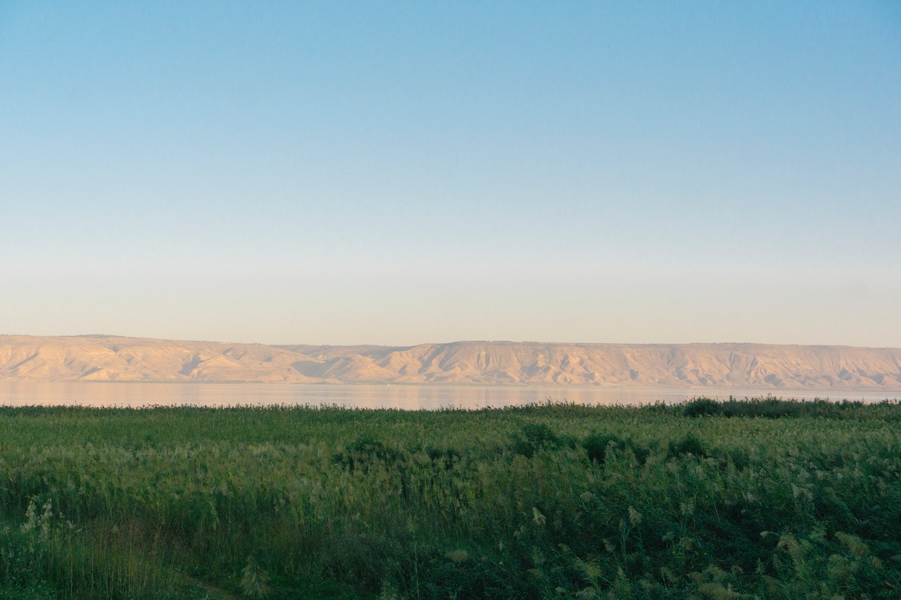
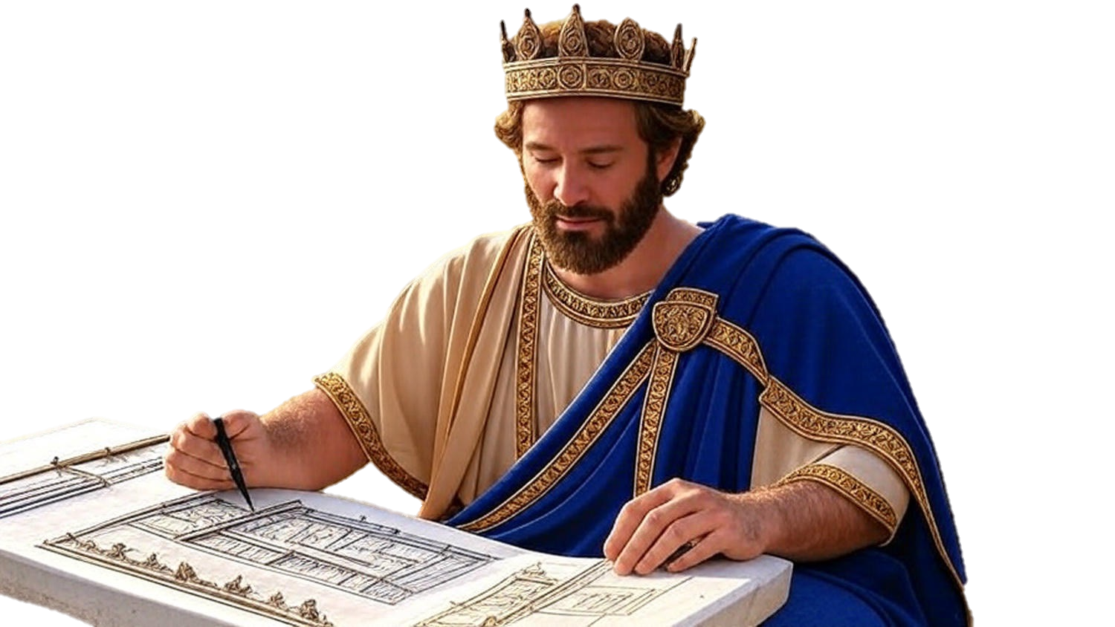

Chapters 23-29
1st Chronicles
You Can Lead A Horse To Water…

Slide 2
Setting Up The Kingdom For Success
He reorganizes the existing structure
He challenges them to public verbal commitment to use their resources on godliness
He challenges them to public tangible commitment to serve & worship God

