Slide 1
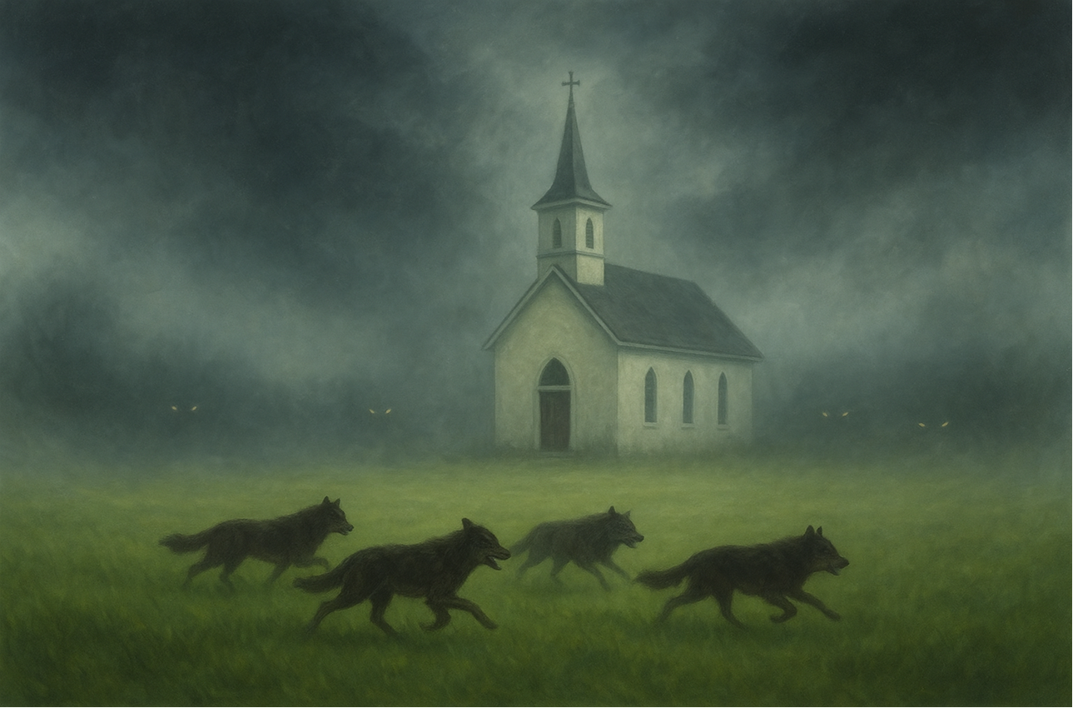

Jude
Earnestly Contend For The Faith
Part 1 of 2
BOOK OF
Verses 1-11

Slide 2
I Timothy 6:12
“Fight the good fight of faith. Take hold of the eternal life to which you were called, & you made the good confession in the presence of many witnesses.”

Slide 3
Jude
Earnestly Contend For The Faith
Part 1 of 2
BOOK OF
Verses 1-11

Slide 4
Earnestly Contending For The Faith
Don’t waste our resources on ourselves

Slide 5
Galatians 5:13-14
“For you were called to freedom, brothers; only do not turn your freedom into an opportunity for the flesh, but through love serve one another. For the whole Law is fulfilled in one word, in this: “You shall love your neighbor as yourself.”

Slide 6
Earnestly Contending For The Faith
Don’t waste our resources on ourselves

Slide 7
II Peter 2:9
“The Lord knows how to rescue the godly from trial, and to keep the unrighteous under punishment for the day of judgment.”

Slide 8
Earnestly Contending For The Faith
Don’t waste our resources on ourselves
Don’t war against authorities & powers

Slide 9
Ephesians 6:12-13
“For our struggle is not against flesh & blood, but against the rulers, against the authorities, against the world forces of this darkness, against the spiritual forces of wickedness in the heavenly places. Therefore, take up the full armor of God, so that you will be able to resist in the evil day, & having done everything, to stand firm.”

Slide 10
Earnestly Contending For The Faith
Don’t waste our resources on ourselves
Don’t war against authorities & powers

Slide 11
Job 38:2
“Who is this that darkens counsel By words without knowledge?”

Slide 12
Earnestly Contending For The Faith
Don’t waste our resources on ourselves
Don’t war against authorities & powers

Slide 13
Hebrews 11:4
“By faith Abel offered to God a better sacrifice than Cain, through which he was approved as being righteous—God approving his gifts—and through faith, though he is dead, he still speaks.”

Slide 14
Earnestly Contending For The Faith
Don’t waste our resources on ourselves
Don’t war against authorities & powers

