Slide 1

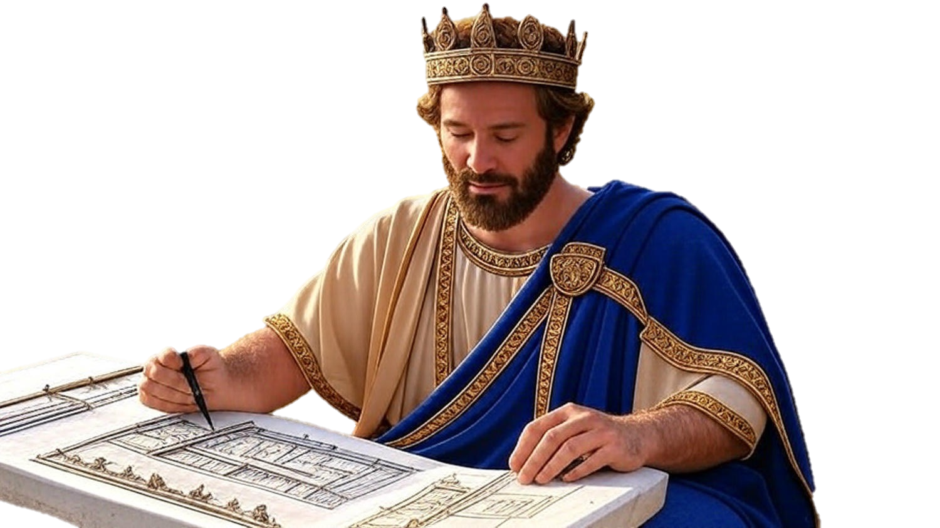

Chapters 21-22
1st Chronicles
Preparing What We’ll Never Use

Slide 2
Preparing What We’ll Never Use
Preparing Our Successors To Serve God
Wrong Way: Role-model self-dependence
Unplanned Way: Always repenting toward God’s plan

Slide 3
Luke 9:23
“He [Jesus] was saying to them all, ‘If anyone wishes to come after Me, let him deny himself, and take up his cross daily and follow Me.’”

Slide 4
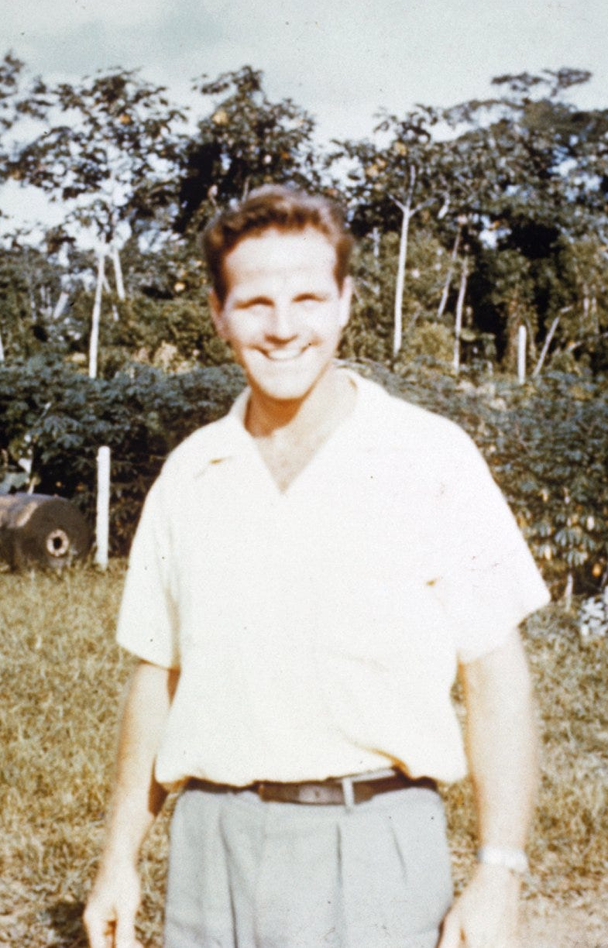
Jim Elliot
“He is no fool that gives up what he cannot keep, to gain what he cannot lose.”

Slide 5
Matthew 3:8
“Therefore bear fruit in keeping with repentance.”

Slide 6
Preparing What We’ll Never Use
Preparing Our Successors To Serve God
Wrong Way: Role-model self-dependence
Unplanned Way: Always repenting toward God’s plan
Right Way: Teaching others to depend on God

Slide 7
Deuteronomy 17:18-20
“Now it will be when he sits on the throne of his kingdom, that he shall write for himself a copy of this law on a scroll in the presence of the Levitical priests. And it shall be with him, & he shall read it all the days of his life, that he may learn to fear Yahweh his God, to carefully observe all the words of this law & these statutes… (cont)

Slide 8
Deuteronomy 17:18-20
(cont) …that his heart may not be lifted up above his brothers & that he may not turn aside from the commandment, to the right or the left, so that he may prolong his days in his kingdom, he & his sons in the midst of Israel.”

Slide 9
Preparing What We’ll Never Use
Preparing Our Successors To Serve God
Wrong Way: Role-model self-dependence
Unplanned Way: Always repenting toward God’s plan
Right Way: Teaching others to depend on God

