Slide 1

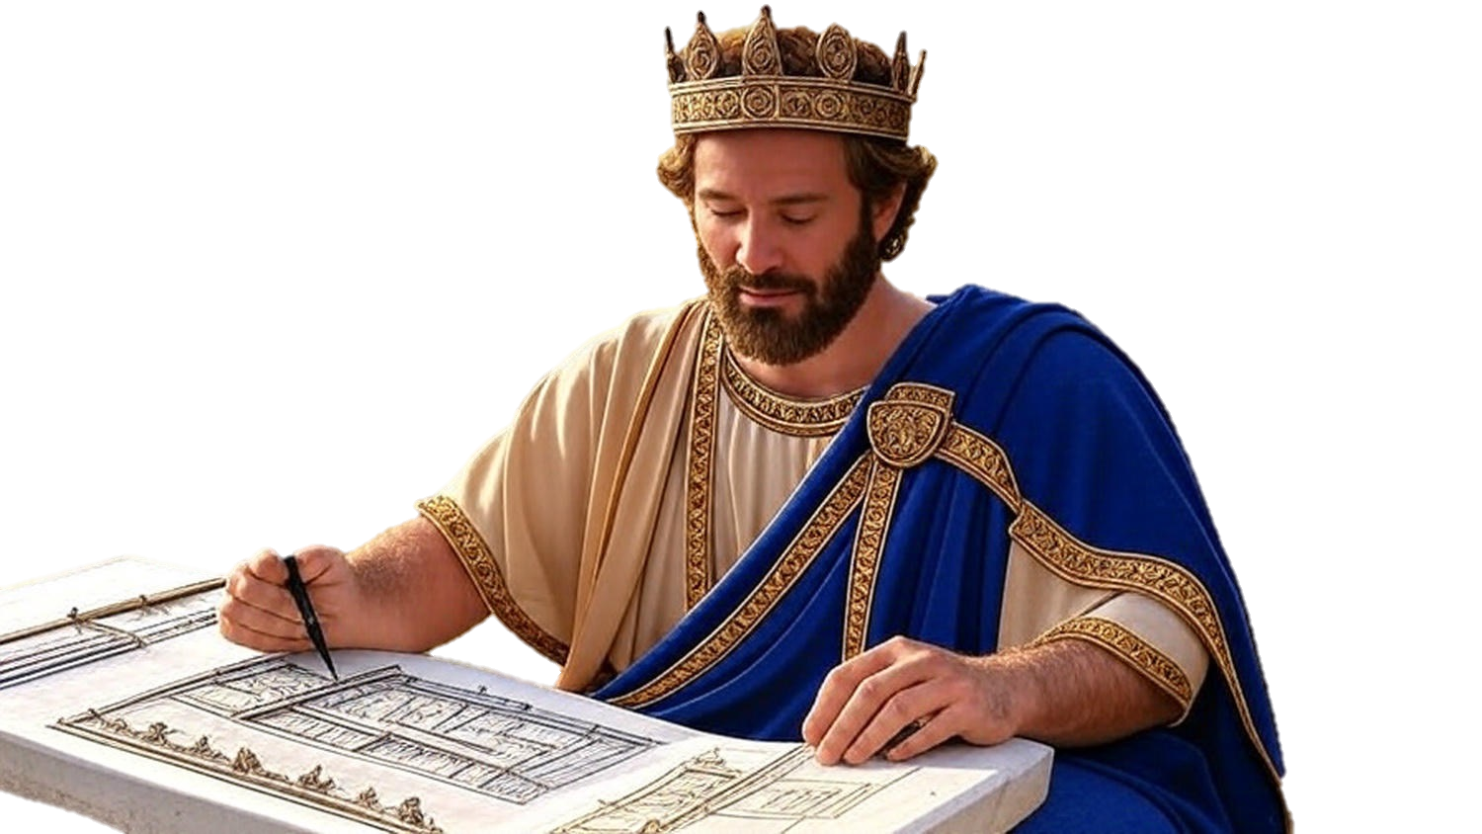

Chapters 18-20
1st Chronicles
Don’t Waste The Prosperity

Slide 2
Don’t Waste The Prosperity FULFILL YOUR GOD-GIVEN MISSION
Don’t focus inward, but press outwardly

Slide 3
Hebrews 4:1
“Therefore, let us fear, lest, while a promise remains of entering His rest, any one of you may seem to have fallen short of it.”

Slide 4
Don’t Waste The Prosperity FULFILL YOUR GOD-GIVEN MISSION
Don’t focus inward, but press outwardly
Don’t be shocked if your good is rewarded with evil

Slide 5
I Peter 3:10-11
“For, the one who desires life, to love & see good days, must keep his tongue from evil & his lips from speaking deceit. He must turn away from evil & do good; he must seek peace & pursue it.”

Slide 6
John 15:18
“If the world hates you, know that it has hated Me before it hated you.”

Slide 7
Don’t Waste The Prosperity FULFILL YOUR GOD-GIVEN MISSION
Don’t focus inward, but press outwardly
Don’t be shocked if your good is rewarded with evil
Don’t get lazy or lustful, but finish the job

Slide 8
II Samuel 12:26-29
“Then Joab fought against Rabbah of the sons of Ammon & captured the royal city. And Joab sent messengers to David & said, ‘I have fought against Rabbah, I have even captured the city of waters… (cont)

Slide 9
II Samuel 12:26-29
(cont) …So now, gather the rest of the people together & camp against the city & capture it, lest I capture the city myself & it be named after me. So David gathered all the people & went to Rabbah, fought against it & captured it.”

Slide 10
Don’t Waste The Prosperity FULFILL YOUR GOD-GIVEN MISSION
Don’t focus inward, but press outwardly
Don’t be shocked if your good is rewarded with evil
Don’t get lazy or lustful, but finish the job

