Slide 1
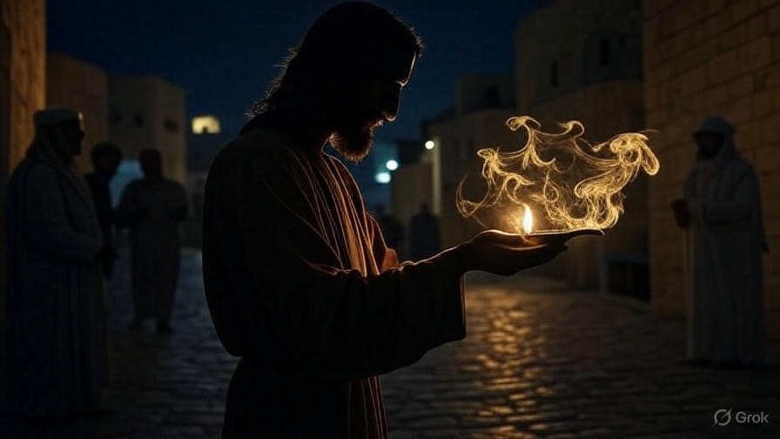

Connection Perfection
Second John

Slide 2
Authentic Christian Connection
It’s founded on the truth

Slide 3
“Therefore Pilate said to Him [Jesus], ‘So You are a king?’ Jesus answered, ‘You yourself said I am a king. For this I have been born, & for this I have come into the world, to bear witness to the truth. Everyone who is of the truth hears My voice.”
John 18:37

Slide 4
“Sanctify them by the truth; Your word is truth.”
John 17:17

Slide 5
“Heaven and earth will pass away, but My words will never pass away.”
Luke 21:33

Slide 6
Authentic Christian Connection
It’s founded on the truth
It’s covered in love

Slide 7
“Teach me Your way, O Yahweh; I will walk in Your truth; Unite my heart to fear Your name.”
Psalm 86:11

Slide 8
Authentic Christian Connection
It’s founded on the truth
It’s covered in love
It’ll be assailed by lies

Slide 9
“Therefore as you received Christ Jesus the Lord, so walk in Him, having been firmly rooted & being built up in Him, & having been established in your faith—just as you were instructed & abounding with thanksgiving… (cont)
Colossians 2:6-8

Slide 10
(cont) …See to it that no one takes you captive through philosophy & empty deception, according to the tradition of men, according to the elementary principles of the world, & not according to Christ.”
Colossians 2:6-8

Slide 11
Authentic Christian Connection
It’s founded on the truth
It’s covered in love
It’ll be assailed by lies
It desires to go deeper

