Slide 1
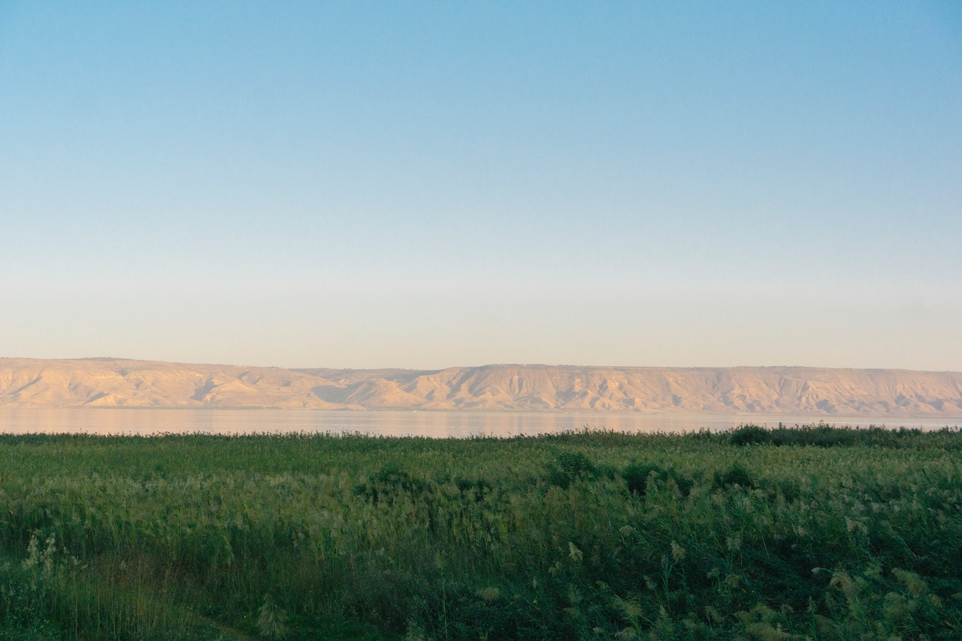
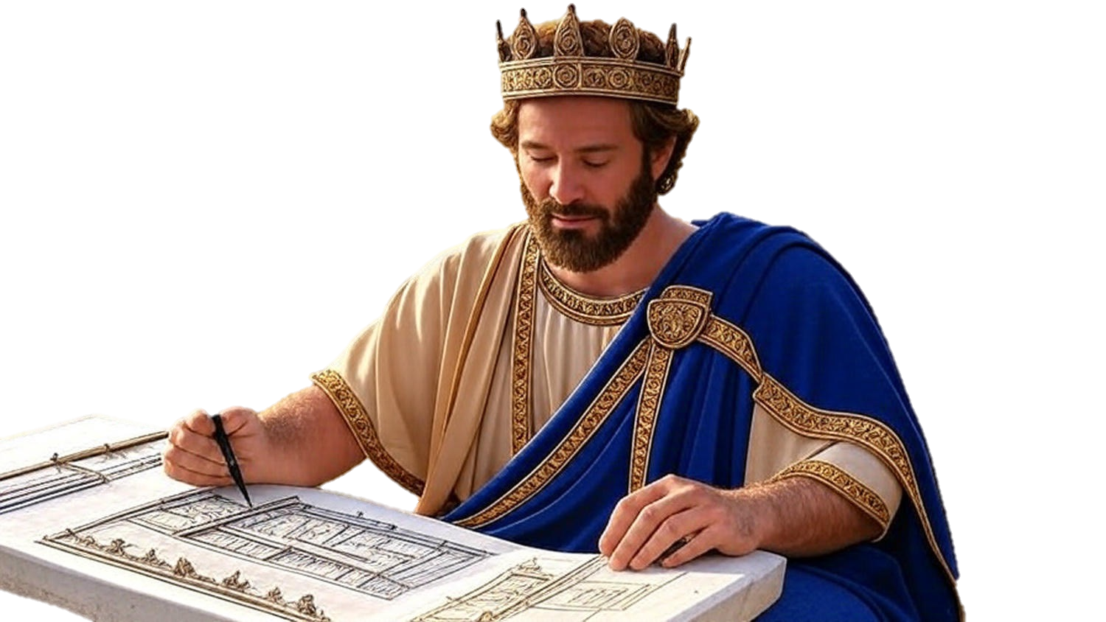

Chapters 16-17
1st Chronicles
The Verification Of Dedication

Slide 2
The Verification of
Dedication
It should be eventful: Hold special events

Slide 3
Revelation 4:8
“The four living creatures, each one of them having six wings, are full of eyes around & within, & day & night they do not cease to say, ‘Holy, holy, holy is the Lord God, the Almighty, Who was and Who is and Who is to come.”

Slide 4
The Verification of
Dedication
It should be eventful: Hold special events
It should be worshipful: Heart w/ actions

Slide 5
Genesis 35:5
“Then they journeyed on, & there was a terror from God upon the cities which were around them, & they did not pursue the sons of Jacob.”

Slide 6
Genesis 20:1-6
“And Abraham journeyed from there toward the land of the Negev & settled between Kadesh & Shur; then he sojourned in Gerar. Abraham said of Sarah his wife, ‘She is my sister.’ So Abimelech king of Gerar sent & took Sarah. But God came to Abimelech in a dream of the night & said to him, ‘Behold, you are a dead man b/c of the woman whom you have taken, for she is married… (cont)

Slide 7
Genesis 20:1-6
(cont) …(Now Abimelech had not come near her.) Then he said, ‘Lord, will You kill a nation, even though righteous? “Did he not himself say to me, ‘She is my sister’? And she herself also said, ‘He is my brother.’ In the integrity of my heart & the innocence of my hands I have done this.’ Then God said to him in the dream, ‘Indeed, I know that in the integrity of your heart you have done this, & I also held you back from sinning against Me; therefore I did not let you touch her.”

Slide 8
The Verification of
Dedication
It should be eventful: Hold special events
It should be worshipful: Heart w/ actions
It should be continuous: Daily life
It should be God-focused: His will not me

Slide 9
Haggai 1:2-6
“Thus says Yahweh of hosts, ‘This people says, ‘The time has not come, even the time for the house of Yahweh to be rebuilt.’ Then the word of Yahweh came by the hand of Haggai the prophet, saying, ‘Is it time for you yourselves to live in your paneled houses while this house lies waste?’ So now, thus says Yahweh of hosts, ‘Set your heart to consider your ways… (cont)

Slide 10
Haggai 1:2-6
(cont) …You have sown much, but bring in little; you eat, but there is not enough to be satisfied; you drink, but there is not enough to become drunk; you put on clothing, but no one is warm enough; & he who earns, earns wages to put into a bag with holes.”

Slide 11
The Verification of
Dedication
It should be eventful: Hold special events
It should be worshipful: Heart w/ actions
It should be continuous: Daily life
It should be God-focused: His will not me

