Slide 1
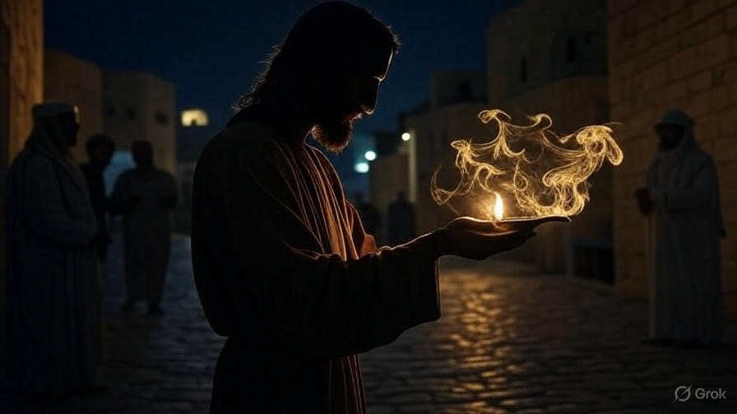

Our
Overcoming
Faith
First John
Chapter
5

Slide 2

. Our Overcoming Faith
We love & serve God & others; not as victims but as victors

Slide 3
“Slaves, in all things obey those who are your masters according to the flesh… Whatever you do, do your work heartily, as for the Lord rather than for men.”
. Colossians 3:22-23

Slide 4
. Our Overcoming Faith
We love & serve God & others; not as victims but as victors

Slide 5
“These things I have spoken to you, so that in Me [Jesus] you may have peace. In the world you have tribulation, but take courage; I have overcome the world.”
. John 16:33

Slide 6
“Come to Me [Jesus], all who are weary & heavy-laden, & I will give you rest. Take My yoke upon you & learn from Me, for I am gentle & humble in heart, & you will find rest for your souls. For My yoke is easy & My burden is light.”
. Matthew 11:28-30

Slide 7
. Our Overcoming Faith
We love & serve God & others; not as victims but as victors
We gain truth from God; not just from men

Slide 8
“When the Advocate comes, whom I will send to you from the Father, the Spirit of truth who proceeds from the Father, He will bear witness about Me.”
. John 15:26

Slide 9
“But the witness I [Jesus] have is greater than the witness of John; for the works which the Father has given Me to finish—the very works that I do—bear witness about Me, that the Father has sent Me… (cont)
. John 5:36-39

Slide 10
(cont) …And the Father who sent Me, He has borne witness about Me. You have neither heard His voice at any time nor seen His form. You do not have His word abiding in you, for you do not believe Him whom He sent… (cont)
. John 5:36-39

Slide 11
(cont) …You search the Scriptures because you think that in them you have eternal life; it is these that bear witness about Me.”
. John 5:36-39

Slide 12
“The Spirit Himself testifies with our spirit that we are children of God.”
. Romans 8:16

Slide 13
. Our Overcoming Faith
We love & serve God & others; not as victims but as victors
We gain truth from God; not just from men
We abide in life; not in sin & death

Slide 14
“Whoever eats the bread or drinks the cup of the Lord in an unworthy manner, shall be guilty of the body & the blood of the Lord. But a man must test himself, & in so doing he is to eat of the bread & drink of the cup. For he who eats & drinks, eats & drinks judgment to himself if he does not judge the body rightly. For this reason many among you are weak & sick, & a number sleep.”
. I Corinthians 1:27-30

Slide 15
“Brothers, even if anyone is caught in any transgression, you who are spiritual, restore such a one in a spirit of gentleness, each of you looking to yourself, so that you too will not be tempted.”
. Galatians 6:1

Slide 16
. Our Overcoming Faith
We love & serve God & others; not as victims but as victors
We gain truth from God; not just from men
We abide in life; not in sin & death
We know God Himself; no longer dead idols

Slide 17
. Our Overcoming Faith
We love & serve God & others; not as victims but as victors
We gain truth from God; not just from men
We abide in life; not in sin & death
We know God Himself; no longer dead idols
“[We] overcome him [Satan] by the blood of the Lamb, & by the word of [our] testimony; & [we] love not [our] lives unto the death.” –Rev 12:11

