Slide 1

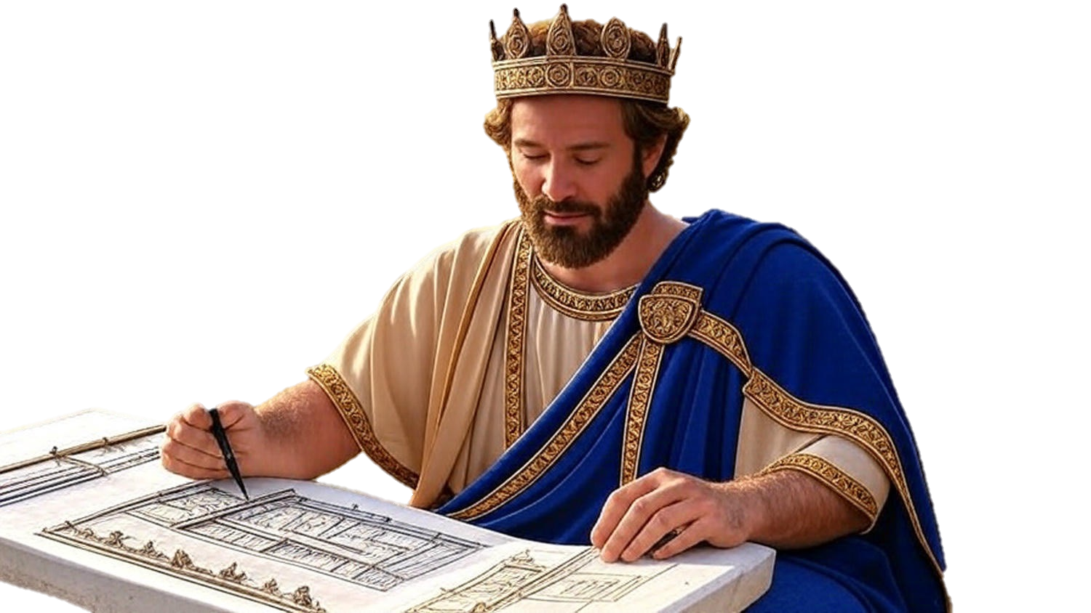

Chapters 13-15
1st Chronicles
Unrefined: The Need For Faith & Practice

Slide 2
Unrefined
The Need For Faith & Practice
The Ark & Uzza: Good desire, bad action

Slide 3
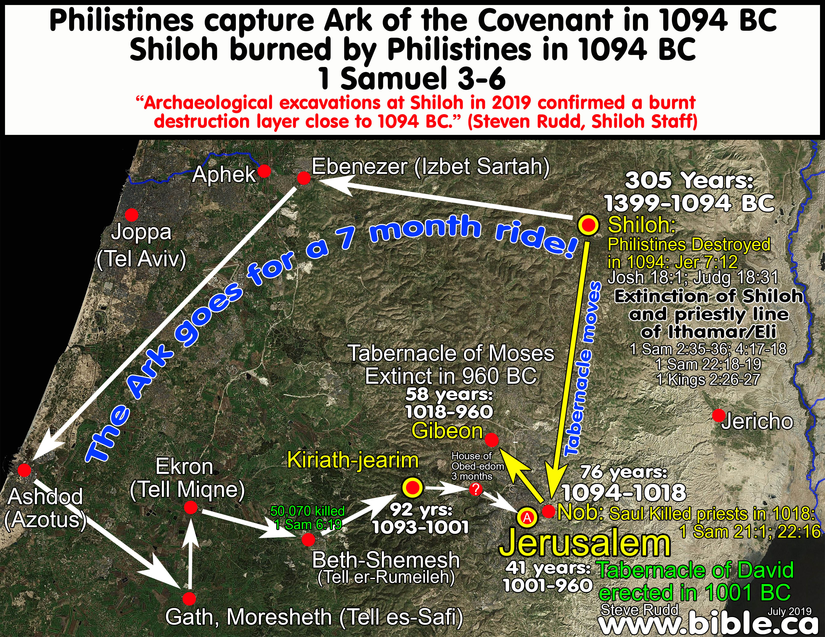

Slide 4
Unrefined
The Need For Faith & Practice
The Ark & Uzza: Good desire, bad action
Family Matters: Good desire, bad action

Slide 5
Deuteronomy 17:17
“And he [the king] shall not multiply wives for himself, or else his heart will turn away; nor shall he greatly increase silver & gold for himself.”

Slide 6
Unrefined
The Need For Faith & Practice
The Ark & Uzza: Good desire, bad action
Family Matters: Good desire, bad action
Foreign Affairs: Good desire & action
The Ark Comes Home: Good desire & action

