Slide 1
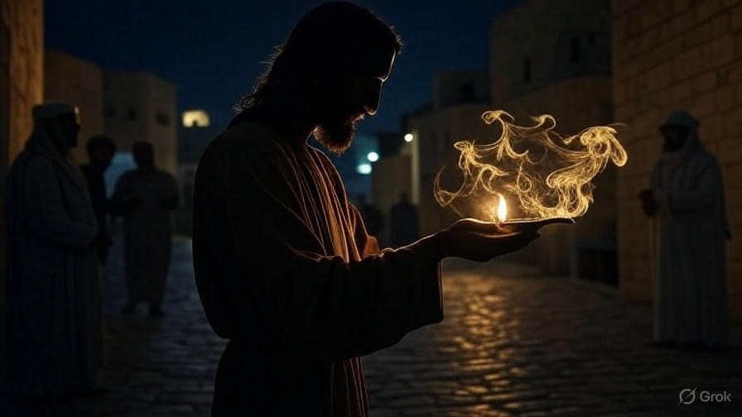

Using
God’s Love
First John
Chapter
4

Slide 2

. Using God’s Love
We prove teachers before we follow them

Slide 3
“But he who is spiritual examines all things, yet he himself is examined by no one. For who has known the mind of the Lord, that he will direct Him? But we have the mind of Christ.”
. I Corinthians 2:15-16

Slide 4
. Using God’s Love
We prove teachers before we follow them
We project God’s love onto others

Slide 5
“Behold, I stand at the door & knock. If anyone hears My voice & opens the door, I will come in to him & will dine with him, & he with Me.”
. Revelation 3:20

Slide 6
. Using God’s Love
We prove teachers before we follow them
We project God’s love onto others
We’re perfecting our love for God & others

