Slide 1
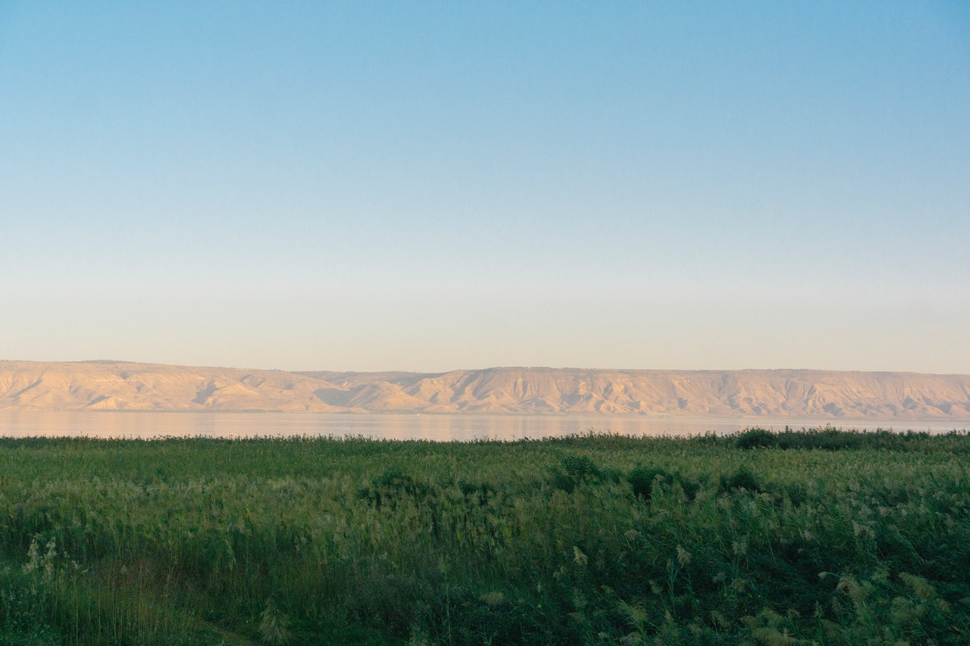
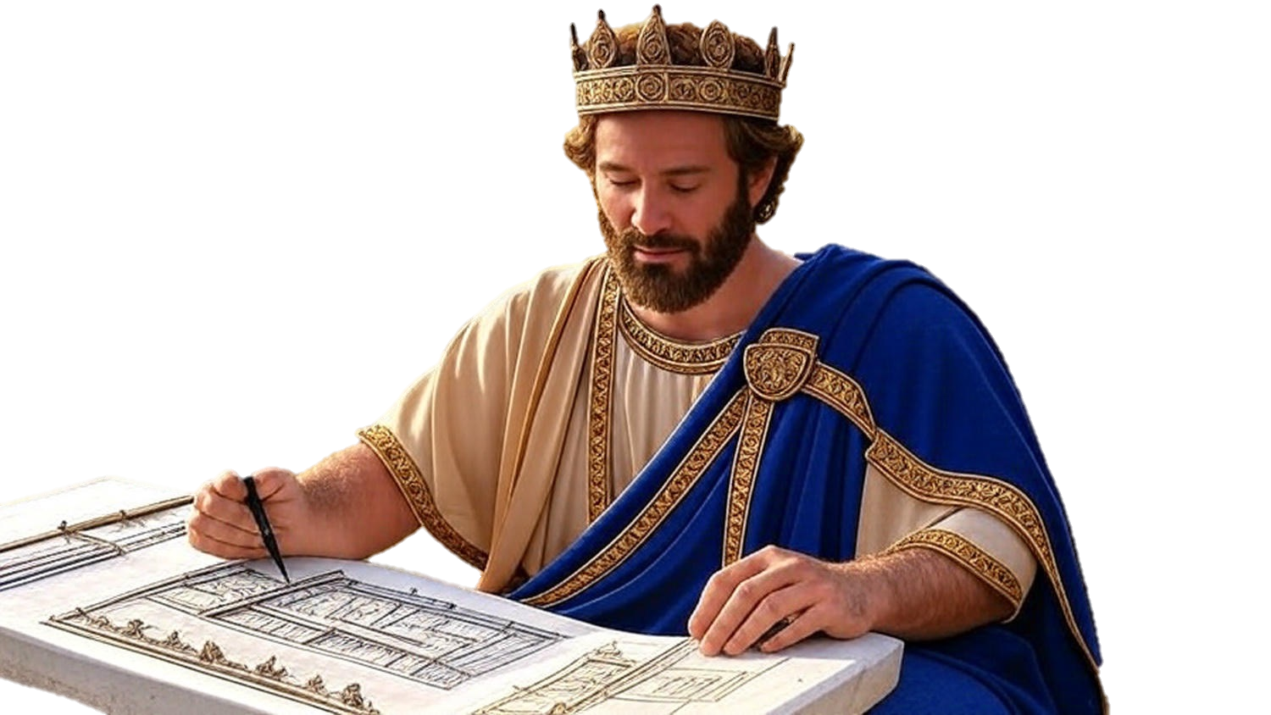

Chapters 10-12
1st Chronicles
Faith Rising

Slide 2
Faith Rising
The Results of our Actions Toward God’s Plan
Saul: Insubordinate Actions = Rejection
David: Incremental Actions = Reward
David’s Men: In-line Actions = Rejoicing

Slide 3
I Samuel 22:1-2
“So David departed from there and escaped to the cave of Adullam; and his brothers and all his father’s household heard of it and went down there to him… (cont)

Slide 4
I Samuel 22:1-2
(cont) …Then everyone who was in distress, & everyone who was in debt, & everyone who was bitter of soul, gathered to him; & he became a commander over them. Now there were about four hundred men with him.”

Slide 5
Faith Rising
The Results of our Actions Toward God’s Plan
Saul: Insubordinate Actions = Rejection
David: Incremental Actions = Reward
David’s Men: In-line Actions = Rejoicing

