Slide 1
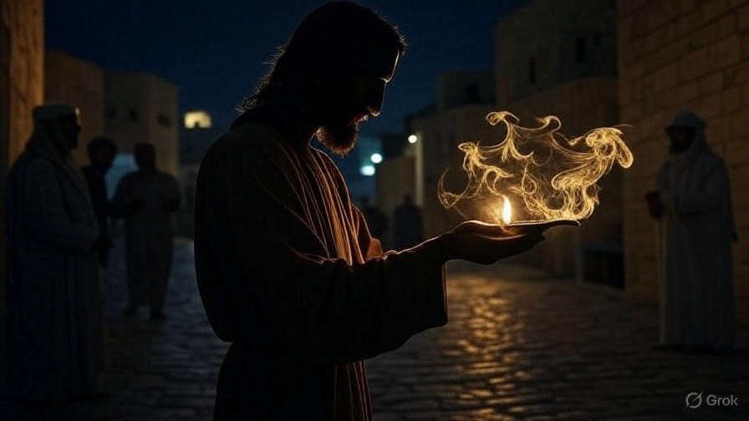

When Love & Hate Collide
First John
Chapter
3

Slide 2

. When Love & Hate Collide
Proofs that you are born again
You’re becoming like Jesus

Slide 3
“He came to what was His own, & those who were His own did not receive Him. But as many as received Him, to them He gave the right to become children of God, even to those who believe in His name, who were born, not of blood nor of the will of the flesh nor of the will of man, but of God.”
. John 1:11-13

Slide 4
“Do all things without grumbling or disputing, so that you will be blameless & innocent, children of God without blemish in the midst of a crooked & perverse generation, among whom you shine as lights in the world.”
. Philippians 2:14-15

Slide 5
“For the anxious longing of the creation eagerly waits for the revealing of the sons of God…For we know that the whole creation groans & suffers the pains of childbirth together until now… (cont)
. Romans 8:19, 22-23

Slide 6
(cont) …And not only this, but also we ourselves, having the first fruits of the Spirit, even we ourselves groan within ourselves, eagerly waiting for our adoption as sons, the redemption of our body.”
. Romans 8:19, 22-23

Slide 7
“But just as it is written, ‘things which eye has not seen & ear has not heard, & which have not entered the heart of man, all that God has prepared for those who love him.’ But to us God revealed them through the Spirit, for the Spirit searches all things, even the depths of God.”
. I Corinthians 2:9-10

Slide 8
. When Love & Hate Collide
Proofs that you are born again
You’re becoming like Jesus
You can’t tolerate habitual sin

Slide 9
“He made Him who knew no sin to be sin on our behalf, so that we might become the righteousness of God in Him.”
. II Corinthians 5:21

Slide 10
. When Love & Hate Collide
Proofs that you are born again
You’re becoming like Jesus
You can’t tolerate habitual sin
You experience the world’s hatred

Slide 11
“You have heard the ancients were told, ‘You shall not murder’ & ‘Whoever murders shall be guilty before the court.’ But I say to you that everyone who is angry with his brother shall be guilty before the court; & whoever says to his brother, ‘Raca,’ shall be guilty before the Sanhedrin; & whoever says, ‘You fool,’ shall be guilty enough to go into the fiery hell.”
. Matthew 5:21-22

Slide 12
. When Love & Hate Collide
Proofs that you are born again
You’re becoming like Jesus
You can’t tolerate habitual sin
You experience the world’s hatred
You give out love extravagantly

Slide 13
“What use is it, my brothers, if someone says he has faith but he has no works? Can that faith save him? If a brother or sister is without clothing & in need of daily food, & one of you says to them, ‘Go in peace, be warmed & be filled,’ & yet you do not give them what is necessary for their body, what use is that? Even so faith, if it has no works, is dead by itself.”
. James 2:14-17

Slide 14
. When Love & Hate Collide
Proofs that you are born again
You’re becoming like Jesus
You can’t tolerate habitual sin
You experience the world’s hatred
You give out love extravagantly

Slide 15
“Peace I [Jesus] leave with you; My peace I give to you; not as the world gives do I give to you. Do not let your heart be troubled, nor let it be fearful.”
. John 14:27

Slide 16
“And He was saying to them all, ‘If anyone wishes to come after Me [Jesus], let him deny himself, & take up his cross daily & follow Me.’”
. Luke 9:23

Slide 17
“Jesus answered and said to them, ‘This is the work of God, that you believe in Him whom He has sent.’”
. John 6:29

Slide 18
. When Love & Hate Collide
Proofs that you are born again
You’re becoming like Jesus
You can’t tolerate habitual sin
You experience the world’s hatred
You give out love extravagantly

