Slide 1
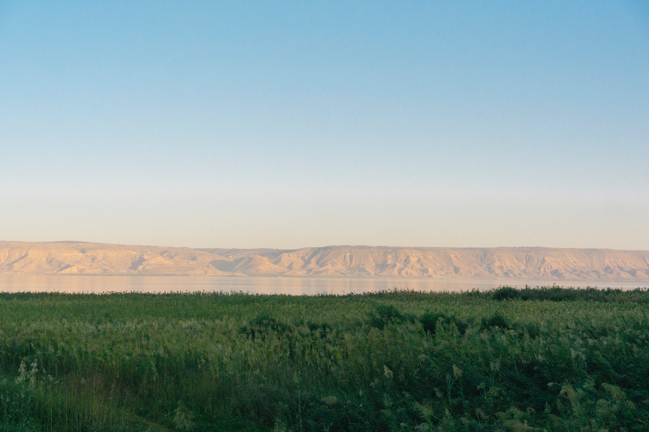
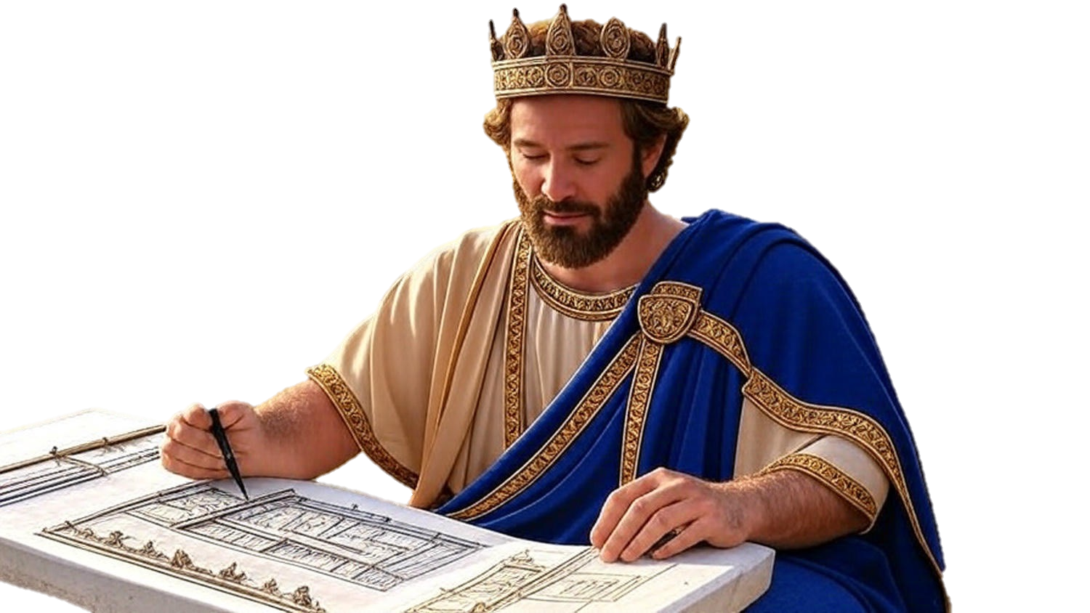

Chapters 1-9
1st Chronicles
Outlining Our Obligatory Orientation

Slide 2
Outlining Our Obligatory Orientation
Chapter 1 – From Adam to Israel
From Adam to Noah’s Father Lamech
Noah
Japheth
Ham
Shem

Slide 3
Outlining Our Obligatory Orientation
Chapter 1 – From Adam to Israel
From Noah’s Son Shem 5 generations down to Eber
Eber
Joktan
Peleg
Tower of Babel Timing
To Abraham

Slide 4
Outlining Our Obligatory Orientation
Chapter 1 – From Adam to Israel
From Abraham To His Grandsons
Abraham
Ishmael
Others
(w/ Keturah)
Isaac
Esau
Israel
(born Jacob)

Slide 5
Outlining Our Obligatory Orientation
Chapter 2 – From Israel thru Judah to David
From Judah To Grandson Hezron
Judah
Er
Onan
Shelah
Perez
Zerah
Hezron
Other

Slide 6
Outlining Our Obligatory Orientation
Chapter 2 – From Israel thru Judah to David
From Hezron To David
Hezron
Ram
Caleb
Jerahmeel
David
6 Generations Between Them

Slide 7
Outlining Our Obligatory Orientation
Chapter 3 – From David thru Kingly Lineage
From David to Mary & Joseph
David
Nathan
Solomon
Others
Mary
Joseph
Many Generations Between Them

Slide 8
Outlining Our Obligatory Orientation
Chapter 4-7 – Israel’s 13 Sons Families
Of Israel (Jacob) & His 13 Sons
Double Blessing Moved
Israel
Manasseh (of Joseph)
Simeon
Judah
Gad
Reuben
Levi
Birthright Moved
Asher
Benjamin
Issachar
Ephraim (of Joseph)
Naphtali
Dan
Zebulun
Daughters

Slide 9
Outlining Our Obligatory Orientation
3 Structures To Have Organized In Life
Re-establishing the Administrative Identity
Restoring the Religious Leadership
Reminding of God’s Faithfulness to those who are Faithful to Him

