Slide 1
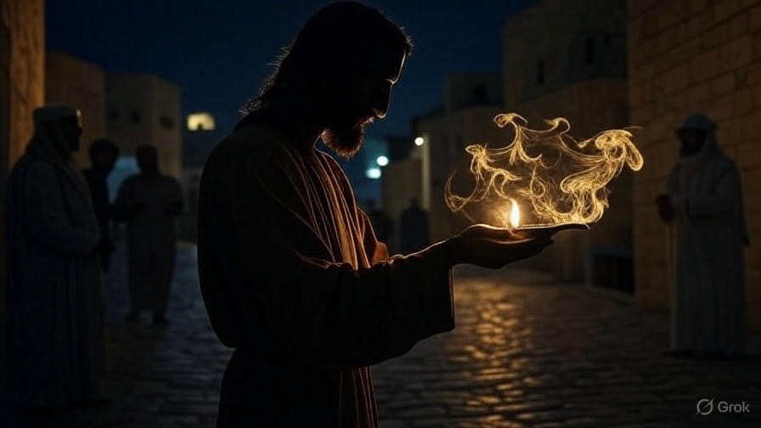

Anointed To Abide
First John
Chapter
2:15-29

Slide 2

. Anointed To Abide.
The Place of our Abiding: In the Lord, not in the world

Slide 3
“No servant can serve two masters; for either he will hate the one & love the other, or else he will be devoted to one & despise the other. You cannot serve God & wealth.”
. Luke 16:13

Slide 4
“…in which you formerly walked according to the course of this world, according to the ruler of the power of the air, the spirit that is now working in the sons of disobedience…”
. Ephesians 2:2

Slide 5
“Now those who belong to Christ Jesus crucified the flesh with its passions and desires.”
. Galatians 5:24

Slide 6
“Set your mind on the things above, not on the things that are on earth. For you died & your life has been hidden with Christ in God.”
. Colossians 3:2-3

Slide 7
. Anointed To Abide.
The Place of our Abiding: In the Lord, not in the world

Slide 8
“I have given them Your word; & the world has hated them, because they are not of the world, even as I am not of the world. I do not ask You to take them out of the world, but to keep them from the evil one. They are not of the world, even as I am not of the world. Sanctify them by the truth; Your word is truth. As You sent Me into the world, I also sent them into the world.”
. John 17:14-18

Slide 9
. Anointed To Abide.
The Place of our Abiding: In the Lord, not in the world
The Power of our Abiding: The Spirit of God, not the spirit of Anti-Christ

Slide 10
“For false christs & false prophets will arise & will show great signs & wonders, so as to deceive, if possible, even the elect.”
. Matthew 24:24

Slide 11
. Anointed To Abide.
The Place of our Abiding: In the Lord, not in the world
The Power of our Abiding: The Spirit of God, not the spirit of Anti-Christ

Slide 12
. What is Biblical Anointing?
Chrisma – Translated as ‘anointing’ – Holy Spirit’s empowering of all believers (I John 2:20 & II Cor 1:21)
Charisma – Translated as ‘gifts’ as thru Bible
Aleipho – Translated as ‘anointing’ – as in Mary anointing feet or anointing sick w/ oil

Slide 13
“But the Advocate, the Holy Spirit, whom the Father will send in My name, He will teach you all things, & bring to your remembrance all that I said to you.”
. John 14:26

Slide 14
. Anointed To Abide.
The Place of our Abiding: In the Lord, not in the world
The Power of our Abiding: The Spirit of God, not the spirit of Anti-Christ
The Purpose of our Abiding: Gaining eternal life and confidence

Slide 15
“And this is love, that we walk according to His commandments. This is the commandment, just as you have heard from the beginning, that you should walk in it.”
. II John 6

Slide 16
. Anointed To Abide.
The Place of our Abiding: In the Lord, not in the world
The Power of our Abiding: The Spirit of God, not the spirit of Anti-Christ
The Purpose of our Abiding: Gaining eternal life and confidence

