Slide 1
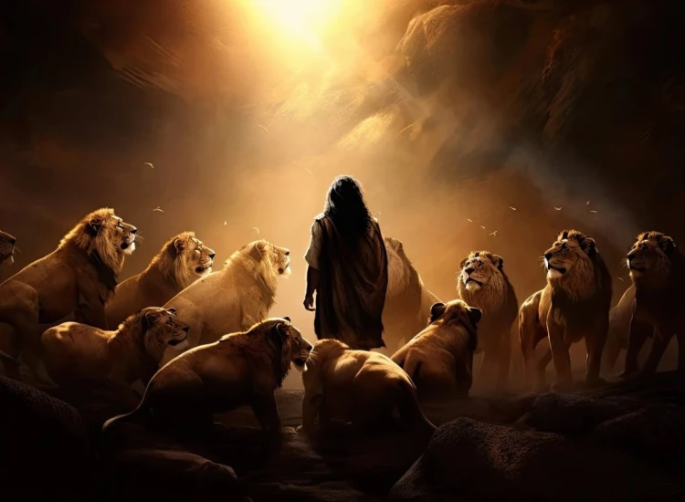


. Daniel . .
Chapter 11:36-12:13
Leading To The Substitute Episode 2 of 2

Slide 2

Leading To The Substitute
3 Final Last Days Themes
Anti-Christ’s Identification: He’s the culmination of man’s best efforts

Slide 3
Revelation 13:4-6
“They worshiped the dragon b/c he gave his authority to the beast, & they worshiped the beast, saying, ‘Who is like the beast, & who is able to wage war w/ him?’ There was given to him a mouth speaking great boasts & blasphemies, & authority to act for 42 months was given to him. He opened his mouth in blasphemies against God, to blaspheme His name & His tabernacle, that is, those who dwell in heaven.”

Slide 4
Leading To The Substitute
3 Final Last Days Themes
Anti-Christ’s Identification: He’s the culmination of man’s best efforts

Slide 5
II Thessalonians 2:4
“Who [Anti-Christ] opposes & exalts himself above every so-called god or object of worship, so that he takes his seat in the sanctuary of God, exhibiting himself as being God.”

Slide 6
Leading To The Substitute
3 Final Last Days Themes
Anti-Christ’s Identification: He’s the culmination of man’s best efforts

Slide 7
Revelation 16:12, 16, 19
“The 6th angel poured out his bowl on the great river, the Euphrates, & its water was dried up, so that the way would be prepared for the kings from the east…and they gathered them together to the place which in Hebrew is called Har-Magedon… And the great city was split into 3 parts, & the cities of the nations fell. Babylon the great was remembered before God, to give her the cup of the wine of the wrath of His rage.”

Slide 8
Zechariah 13:8-9
“It will be in all the land, declares Yahweh, that 2 parts in it will be cut off & breathe their last; but the 3rd will be left in it. And I will bring the 3rd part through the fire & refine them as silver is refined & test them as gold is tested. They will call on My name, & I will answer them; I will say, They are My people, & they will say, Yahweh is my God.”

Slide 9
Revelation 19:19-21
“Then I saw the beast & the kings of the earth & their armies assembled to make war w/ Him who sits on the horse & w/ His army. The beast was seized, & w/ him the false prophet …These 2 were thrown alive into the lake of fire which burns w/ brimstone. The rest were killed w/ the sword which came from the mouth of Him who sits on the horse, & all the birds were filled w/ their flesh.”

Slide 10
Leading To The Substitute
3 Final Last Days Themes
Anti-Christ’s Identification: He’s the culmination of man’s best efforts
Salvation & Glorification: God delivers & resurrects those that are His

Slide 11
Matthew 24:21-22
“For then there will be a great tribulation, such as has not occurred since the beginning of the world until now, nor ever will. And unless those days had been cut short, no life would have been saved; but for the sake of the elect those days will be cut short.”

Slide 12
Romans 11:25-26a
“For I do not want you, brothers, to be uninformed of this mystery - so that you will not be wise in your own estimation - that a partial hardening has happened to Israel until the fullness of the Gentiles has come in; & so all Israel will be saved.”

Slide 13
John 5:28-29
“Do not marvel at this; for an hour is coming, in which all who are in the tombs will hear His [Jesus] voice, & will come forth; those who did the good deeds to a resurrection of life, those who committed the evil deeds to a resurrection of judgment.”

Slide 14
Leading To The Substitute
3 Final Last Days Themes
Anti-Christ’s Identification: He’s the culmination of man’s best efforts
Salvation & Glorification: God delivers & resurrects those that are His

Slide 15
I Corinthians 15:41-42
“There is one glory of the sun, & another glory of the moon, & another glory of the stars; for star differs from star in glory. So also is the resurrection of the dead. It is sown a corruptible body, it is raised an incorruptible body.”

Slide 16
Leading To The Substitute
3 Final Last Days Themes
Anti-Christ’s Identification: He’s the culmination of man’s best efforts
Salvation & Glorification: God delivers & resurrects those that are His
Timing & Ramification: It’s about God not us

Slide 17
Revelation 22:11
“Let the one who does unrighteousness, still do unrighteousness; & the one who is filthy, still be filthy; & let the one who is righteous, still do righteousness; & the one who is holy, still keep himself holy.”

Slide 18
Leading To The Substitute
3 Final Last Days Themes
Anti-Christ’s Identification: He’s the culmination of man’s best efforts
Salvation & Glorification: God delivers & resurrects those that are His
Timing & Ramification: It’s about God not us

