Slide 1
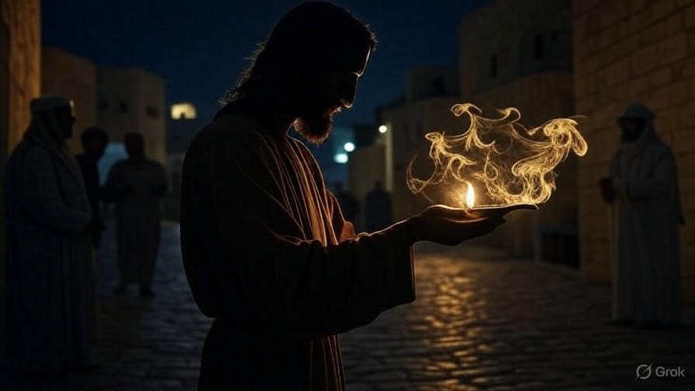

S.O.L.D. On Salvation
First John
Chapter
2:1-14

Slide 2

. S.O.L.D. On Salvation
Recognizing Full Assurance Of Salvation.
Savior: Jesus Himself is my means of attaining salvation

Slide 3
“Let us consider how to stimulate one another to love & good deeds, not forsaking our own assembling together, as is the habit of some, but encouraging one another, & all the more as you see the day drawing near.”
. Hebrews 10:24

Slide 4
. S.O.L.D. On Salvation
Recognizing Full Assurance Of Salvation.
Savior: Jesus Himself is my means of attaining salvation
Obedience: I serve Jesus

Slide 5
“If you love Me, you will keep My commandments.”
. John 14:15 .

Slide 6
“If you keep My commandments, you will abide in My love; just as I have kept My Father’s commandments & abide in His love.”
. John 15:10 .

Slide 7
. S.O.L.D. On Salvation
Recognizing Full Assurance Of Salvation.
Savior: Jesus Himself is my means of attaining salvation
Obedience: I serve Jesus

Slide 8
“And have put on the new man who is being renewed to a full knowledge according to the image of the One who created him… (con’t)
. Colossians 3:10, 16-17

Slide 9
(con’t) …Let the word of Christ dwell in you richly, with all wisdom teaching and admonishing one another… & whatever you do in word or deed, do all in the name of the Lord Jesus, giving thanks to God the Father through Him.”
. Colossians 3:10, 16-17

Slide 10
“I am the vine, you are the branches; he who abides in Me & I in him, he bears much fruit, for apart from Me you can do nothing.”
. John 15:5 .

Slide 11
. S.O.L.D. On Salvation
Recognizing Full Assurance Of Salvation.
Savior: Jesus Himself is my means of attaining salvation
Obedience: I serve Jesus
Loving: I’m motivated by love

Slide 12
“Teacher, which is the great commandment in the Law? And He said to him, ‘You shall love the Lord your God w/ all your heart, & w/ all your soul, & w/ all your mind.’ This is the great & foremost commandment. And the second is like it, ‘You shall love your neighbor as yourself.’ On these two commandments hang the whole Law & the Prophets.”
. Matthew 22:36-40

Slide 13
“A new commandment I give to you, that you love one another, even as I have loved you, that you also love one another.”
. John 13:34 .

Slide 14
. S.O.L.D. On Salvation
Recognizing Full Assurance Of Salvation.
Savior: Jesus Himself is my means of attaining salvation
Obedience: I serve Jesus
Loving: I’m motivated by love

Slide 15
“A new commandment I give to you, that you love one another, even as I have loved you, that you also love one another. By this all will know that you are My disciples, if you have love for one another.”
. John 13:34-35 .

Slide 16
. S.O.L.D. On Salvation
Recognizing Full Assurance Of Salvation.
Savior: Jesus Himself is my means of attaining salvation
Obedience: I serve Jesus
Loving: I’m motivated by love
Develop: I’m becoming like Jesus

Slide 17
“But in all these things we overwhelmingly conquer through Him who loved us.”
. Romans 8:37.

Slide 18
. S.O.L.D. On Salvation
Recognizing Full Assurance Of Salvation.
Savior: Jesus Himself is my means of attaining salvation
Obedience: I serve Jesus
Loving: I’m motivated by love
Develop: I’m becoming like Jesus

Slide 19
“That I may know Him & the power of His resurrection & the fellowship of His sufferings, being conformed to His death, in order that I may attain to the resurrection from the dead.”
. Philippians 3:10-11.

Slide 20
“How can a young man keep his way pure? By keeping it according to Your word.”
. Psalms 119:9.

Slide 21
. S.O.L.D. On Salvation
Recognizing Full Assurance Of Salvation.
Savior: Jesus Himself is my means of attaining salvation
Obedience: I serve Jesus
Loving: I’m motivated by love
Develop: I’m becoming like Jesus

