Slide 1
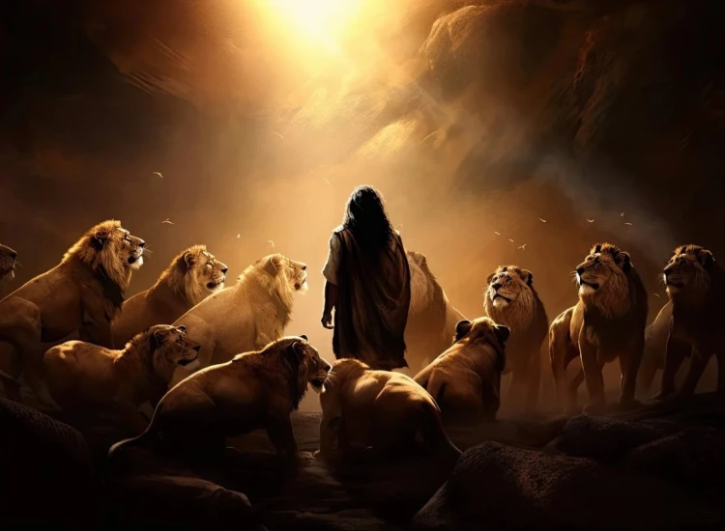


. Daniel . .
Chapter 11:1-35
Leading To The Substitute Episode 1 of 2

Slide 2

Leading To The Substitute
Anti-Christ Rising
From Present Persian Rule To Future Greek Rule

Slide 3
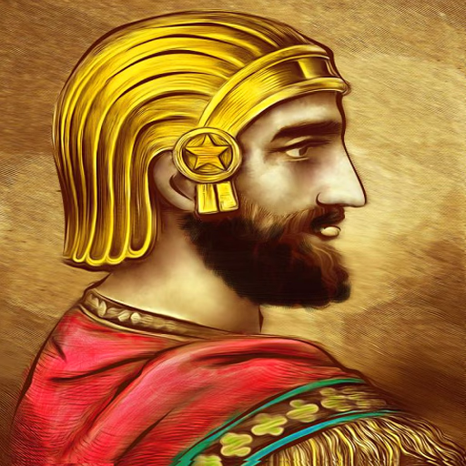
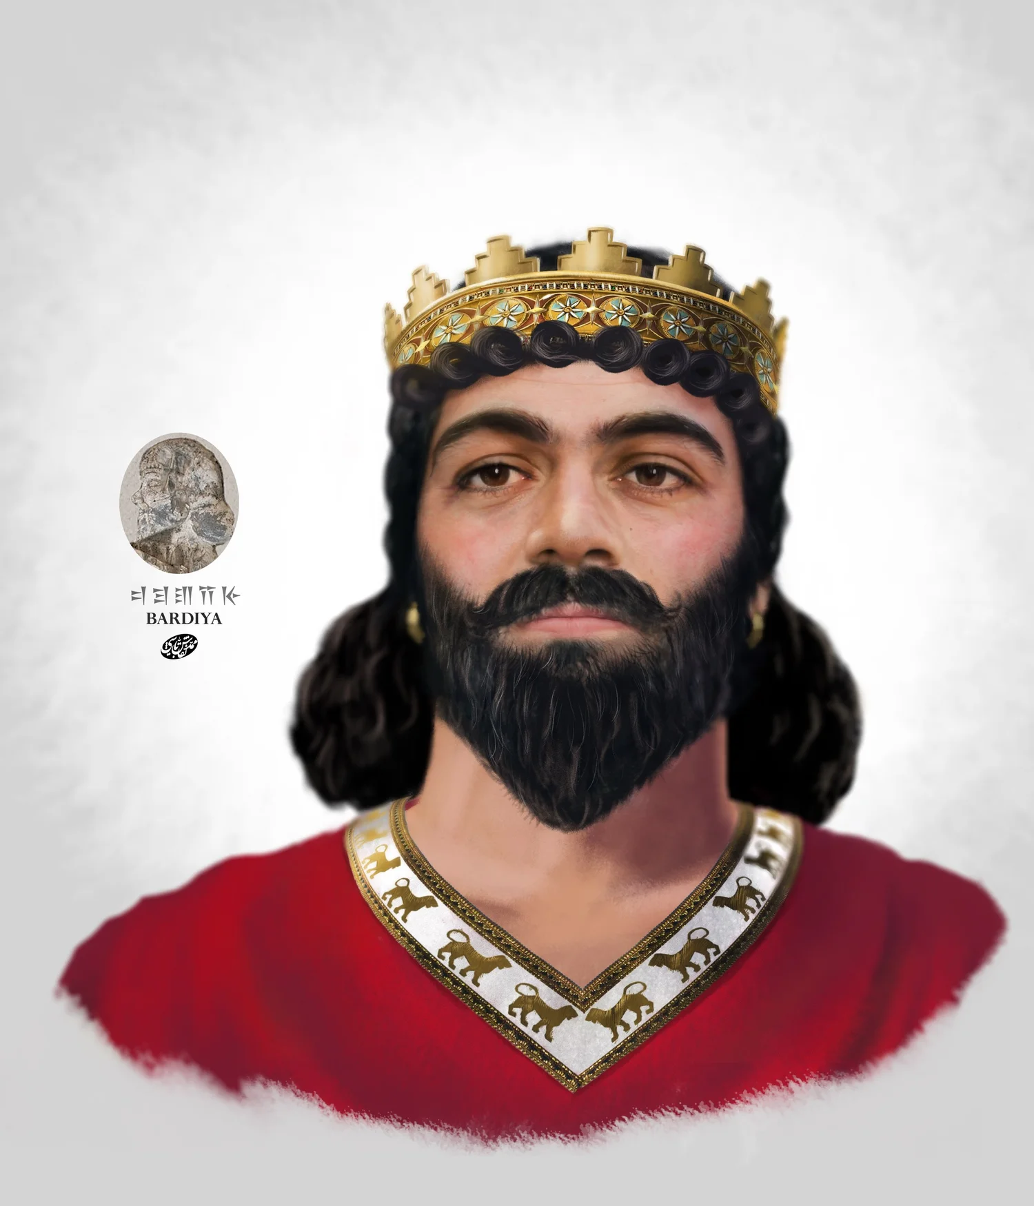
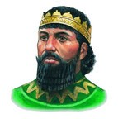
Persian Rule
Turning the tide to the Greeks
Cyrus the Great
559-530 BC
(Daniel 9-12)
(Ezra 1-3)
Cambyses Ahasuerus
530-522 BC
(Ezra 4)
Smerdis Bardiya
522 BC
(No Biblical Reference)
Darius Hystaspes
522-486 BC
(Hag & Zec)
(Ezra 5-6)
Xerxes Ahasuerus
486-465 BC
(Esther)

Slide 4
Leading To The Substitute
Anti-Christ Rising
From Present Persian Rule To Future Greek Rule
From A General Greek Rule To A Specific Greek Rule

Slide 5
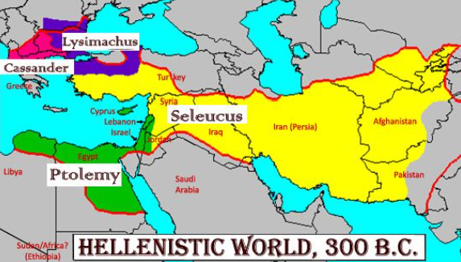
Leading To The Substitute
Anti-Christ Rising
From Present Persian Rule To Future Greek Rule
From A General Greek Rule To A Specific Greek Rule
King of the North
King of the South

Slide 6
Leading To The Substitute
Anti-Christ Rising
From Present Persian Rule To Future Greek Rule
From A General Greek Rule To A Specific Greek Rule
Antiochus Epiphanes Rises w/ Intrigue

Slide 7
Applying Daniel 11
God in His infinite foreknowledge tells the end from the beginning - trust Him
Man in his limited power comes like grass & fades in a day - can’t trust him
Bible isn’t about me - it’s about God’s infinite plan to draw people to Himself

