Slide 1
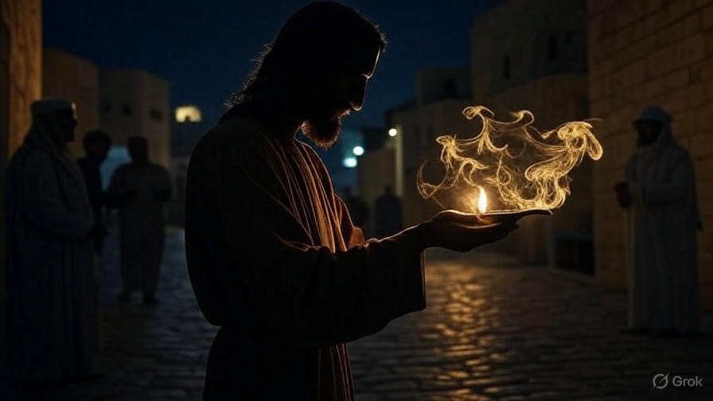

Devoted To The Authentic Jesus
First John
Chapter
1

Slide 2

. Devoted To The Authentic Jesus .
Be immersed in Jesus (The Life)

Slide 3
“In the beginning was the Word, & the Word was with God, & the Word was God.”
John 1:1

Slide 4
“He appeared to Cephas, then to the twelve. After that He appeared to more than 500 brothers at one time, most of whom remain until now, but some have fallen asleep. After that, He appeared to James, then to all the apostles, & last of all, as to one untimely born, He appeared to me also.”
I Cor 15:5-8

Slide 5
. Devoted To The Authentic Jesus .
Be immersed in Jesus (The Life)

Slide 6
“I am the door; if anyone enters through Me, he will be saved, & will go in & out & find pasture. The thief comes only to steal & kill & destroy; I came that they may have life, & have it abundantly.”
. John 10:9-10 .

Slide 7
“Jesus said to her, ‘I am the resurrection & the life; he who believes in Me will live even if he dies, & everyone who lives & believes in Me will never die—ever. Do you believe this?”
. John 11:25-26 .

Slide 8
. Devoted To The Authentic Jesus .
Be immersed in Jesus (The Life)

Slide 9
“If you keep My commandments, you will abide in My love; just as I have kept My Father’s commandments & abide in His love. These things I have spoken to you so that My joy may be in you, & that your joy may be complete.”
. John 15:10-11 .

Slide 10
. Devoted To The Authentic Jesus .
Be immersed in Jesus (The Life)
Walk in His ways (The Light)

Slide 11
“Then Jesus again spoke to them, saying, ‘I am the Light of the world; he who follows Me will never walk in the darkness, but will have the Light of life.’”
. John 8:12

Slide 12
“Every good thing given & every perfect gift is from above, coming down from the Father of lights, with whom there is no variation or shifting shadow.”
. James 1:17 .

Slide 13
. Devoted To The Authentic Jesus .
Be immersed in Jesus (The Life)
Walk in His ways (The Light)

Slide 14
“But become doers of the word, & not merely hearers who delude themselves.”
. James 1:22 .

Slide 15
“I have come as Light into the world, so that everyone who believes in Me will not remain in darkness.”
. John 12:46 .

Slide 16
. Devoted To The Authentic Jesus .
Be immersed in Jesus (The Life)
Walk in His ways (The Light)
Confess sin honestly (The Lament)

Slide 17
“The heart is more deceitful than all else & is desperately sick; Who can know it?”
. Jeremiah 17:9 .

Slide 18
. Devoted To The Authentic Jesus .
Be immersed in Jesus (The Life)
Walk in His ways (The Light)
Confess sin honestly (The Lament)

Slide 19
“Come now, & let us reason together, Says Yahweh, though your sins are as scarlet, they will be as white as snow; though they are red like crimson, they will be like wool.”
. Isaiah 1:18 .

Slide 20
“Create in me a clean heart, O God, & renew a steadfast spirit within me. Do not cast me away from Your presence & do not take Your Holy Spirit from me. Restore to me the joy of Your salvation & sustain me with a willing spirit.”
. Psalm 51:10-12 .

Slide 21
. Devoted To The Authentic Jesus .
Be immersed in Jesus (The Life)
Walk in His ways (The Light)
Confess sin honestly (The Lament)

Slide 22
“Be immersed in Jesus”
. John 1:1 .

