Slide 1
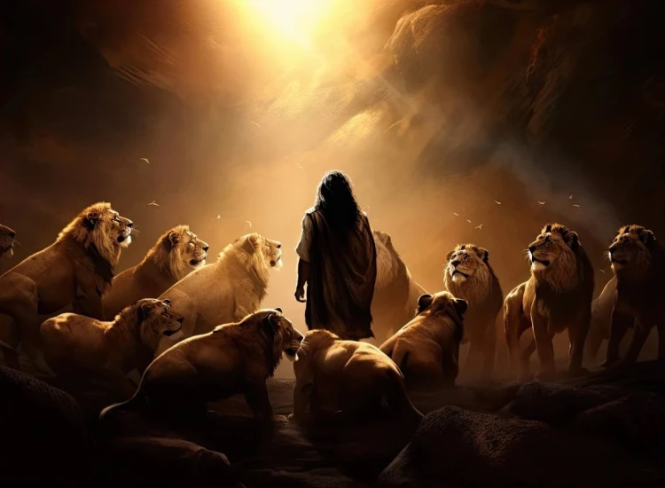


. Daniel . .
Chapter 10
Heard In Heaven

Slide 2

Heard In Heaven
Checking in on our devotion to God
Is our mind desiring God’s will for others?
Is our will persevering thru the unknown?

Slide 3
Psalm 34:15
“The eyes of Yahweh are toward the righteous & His ears are open to their cry for help.”

Slide 4
Isaiah 65:24
“And it will be that before they call, I will answer, and while they are still speaking, I will hear.”

Slide 5
Heard In Heaven
Checking in on our devotion to God
Is our mind desiring God’s will for others?
Is our will persevering thru the unknown?

Slide 6
Ephesians 6:12
“For our struggle is not against flesh & blood, but against the rulers, against the authorities, against the world forces of this darkness, against the spiritual forces of wickedness in the heavenly places.”

Slide 7
II Corinthians 10:3-4
“For though we walk in the flesh, we do not war according to the flesh, for the weapons of our warfare are not of the flesh, but divinely powerful for the tearing down of strongholds.”

Slide 8
II Kings 20:19
“Then Hezekiah said to Isaiah, ‘The word of Yahweh which you have spoken is good.’ For he said, ‘Will it not be good, if there will be peace and truth in my days?’”

Slide 9
Heard In Heaven
Checking in on our devotion to God
Is our mind desiring God’s will for others?
Is our will persevering thru the unknown?
Is our attitude portraying we’re helpless but loved?

Slide 10
Luke 5:4-8
“When He had finished speaking, he said to Simon, ‘Put out into the deep water & let down your nets for a catch.’ Simon answered & said, ‘Master, we labored all night & caught nothing, but at Your word, I will let down the nets.’ And when they had done this, they enclosed a great quantity of fish & their nets began to break… (cont)

Slide 11
Luke 5:4-8
(cont) …so they signaled to their partners in the other boat for them to come & help them. And they came & filled both of the boats, so that they began to sink. But when Simon Peter saw this, he fell down at Jesus’ knees, saying, ‘Go away from me Lord, for I am a sinful man!’”

Slide 12
Isaiah 6:5-7
“Then I said, “Woe is me, for I am ruined! For I am a man of unclean lips, & I live among a people of unclean lips; for my eyes have seen the King, Yahweh of hosts… (cont)

Slide 13
Isaiah 6:5-7
(cont) …Then one of the seraphim flew to me with a burning coal in his hand, which he had taken from the altar with tongs & he touched my mouth with it & said, ‘Behold, this has touched your lips; & your iniquity is taken away, & your sin is atoned for.”

Slide 14
Heard In Heaven
Checking in on our devotion to God
Is our mind desiring God’s will for others?
Is our will persevering thru the unknown?
Is our attitude portraying we’re helpless but loved?

