Slide 1
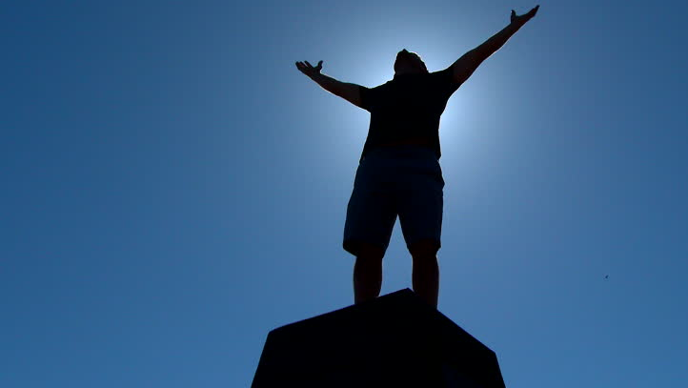

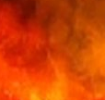
The
Utterly Helpless, But God
Psalms .
106

Slide 2
Romans 7:22-8:1
“For I joyfully concur w/ the law of God in the inner man, but I see a different law in my members, waging war against the law of my mind & making me a captive to the law of sin which is in my members. Wretched man that I am! Who will deliver me from the body of this death?... (cont)

Slide 3
Romans 7:22-8:1
(cont) …Thanks be to God through Jesus Christ our Lord! So then, on the one hand I myself with my mind am serving the law of God, but on the other, with my flesh the law of sin.”

Slide 4
The
Utterly Helpless, But God
Psalms .
106

Slide 5
Utterly Helpless, But God
Our Desired Direction:
The Wise Want To Do Well
Our Deep Delinquency:
We Witness Our Worthlessness

Slide 6
John 20:27-29
“Then He said to Thomas, ‘Bring your finger here, & see My hands; & bring your hand here & put it into My side; & do not be unbelieving, but believing.’ Thomas answered & said to Him, ‘My Lord & my God!’ Jesus said to him, ‘B/c you have seen Me, have you believed? Blessed are those who did not see, & yet believed.’”

Slide 7
Romans 10:17
“So faith comes from hearing, and hearing by the word of Christ.”

Slide 8
Utterly Helpless, But God
Our Desired Direction:
The Wise Want To Do Well
Our Deep Delinquency:
We Witness Our Worthlessness
Our Devoted Deliverer:
Our Worthy God Welcomes Us

Slide 9
II Corinthians 5:21
“He [the Father] made Him [Jesus] who knew no sin to be sin on our behalf, so that we might become the righteousness of God in Him.”

Slide 10
Utterly Helpless, But God
Our Desired Direction:
The Wise Want To Do Well
Our Deep Delinquency:
We Witness Our Worthlessness
Our Devoted Deliverer:
Our Worthy God Welcomes Us

