Slide 1
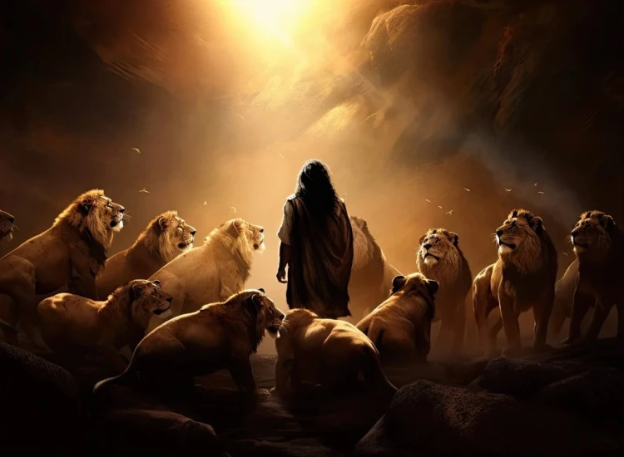


. Daniel . .
Chapter 9
Discerning The Times

Slide 2

Discerning The Times
We grow in understanding thru…
His Word

Slide 3
I Chronicles 12:32
“Of the sons of Issachar, men who knew how to discern the times, to know what Israel should do, their chiefs were 200; & all their relatives were at their command.”

Slide 4
Jeremiah 25:11-13
“This whole land will be a waste place & an object of horror, & these nations will serve the king of Babylon 70 years. Then it will be when 70 years are fulfilled, that I will punish the king of Babylon & that nation, declares Yahweh, for their iniquity, even the land of the Chaldeans; & I will make it an everlasting desolation. I will bring upon that land all My words which I have spoken against it, all that is written in this book which Jeremiah has prophesied against all the nations.”

Slide 5
Jeremiah 29:10
“For thus says Yahweh, ‘When 70 years have been fulfilled for Babylon, I will visit you & establish My good word to you, to return you to this place.”

Slide 6
Discerning The Times
We grow in understanding thru…
His Word
Prayer
Godly Fellowship

Slide 7
James 1:5
“But if any of you lacks wisdom, let him ask of God, who gives to all generously & without reproach, & it will be given to him.”

Slide 8
Discerning The Times
We grow in understanding thru…
His Word
Prayer
Godly Fellowship

Slide 9
Luke 8:9-10
“His disciples began questioning Him as to what this parable meant. And He said, To you it has been granted to know the mysteries of the kingdom of God, but to the rest it is in parables, so that seeing they may not see, & hearing they may not understand.”

Slide 10
Discerning The Times
We grow in understanding thru…
His Word
Prayer
Godly Fellowship

Slide 11
Number 14:33-34
“Your sons shall be shepherds for 40 years in the wilderness, & they will suffer for your unfaithfulness, until your corpses come to an end in the wilderness. According to the number of days which you spied out the land, 40 days, for every day you shall bear your guilt a year, even 40 years, & you will know My opposition.”

Slide 12
Ezekiel 4:6
“You shall complete these, & you shall lie down a second time, but on your right side & bear the iniquity of the house of Judah; I have set it for you for 40 days, a day for each year.”

Slide 13
Matthew 24:15
“Therefore when you see the abomination of desolation which was spoken of through Daniel the prophet, standing in the holy place (let the reader understand)…”

Slide 14
Discerning The Times
We grow in understanding thru…
His Word
Prayer
Godly Fellowship

Slide 15
Psalm 32:1-2
“How blessed is he whose transgression is forgiven, whose sin is covered! How blessed is the man whose iniquity Yahweh will not take into account, & in whose spirit there is no deceit!”

Slide 16
Hebrews 1:1-2a
“God, having spoken long ago to the fathers in the prophets in many portions & in many ways, in these last days spoke to us in His Son…”

Slide 17
Acts 2:16-17
“But this is what was spoken through the prophet Joel: & it shall be in the last days, God says, that I will pour out My Spirit on all mankind; & your sons & your daughters shall prophesy, & your young men shall see visions, & your old men shall dream dreams.”

Slide 18
Discerning The Times
We grow in understanding thru…
His Word
Prayer
Godly Fellowship

Slide 19
Luke 19:41-42
“When He was come near, He beheld the city, & wept over it, saying, If thou hadst known, even thou, at least in this thy day, the things which belong unto thy peace! but now they are hid from thine eyes.”

Slide 20
Discerning The Times
We grow in understanding thru…
His Word
Prayer
Godly Fellowship

Slide 21
II Thessalonians 2:3-4
“Let no one in any way deceive you, for it has not come unless the apostasy comes first, & the man of lawlessness is revealed, the son of destruction, who opposes & exalts himself above every so-called god or object of worship, so that he takes his seat in the sanctuary of God, exhibiting himself as being God.”

Slide 22
Discerning The Times
We grow in understanding thru…
His Word
Prayer
Godly Fellowship

