Slide 1
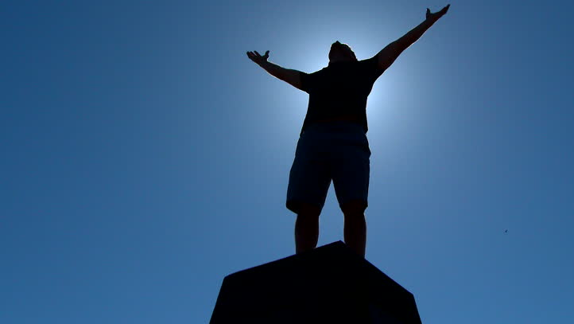

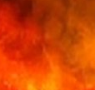
The
Made With Promise, Molded To Secure Them
Psalms .
104-105

Slide 2
Made With Promise, Molded To Secure Them
We’ve been intricately created with an abundant environment

Slide 3
Romans 1:20
“For since the creation of the world His invisible attributes, both His eternal power & divine nature, have been clearly seen, being understood through what has been made, so that they are without excuse.”

Slide 4
Psalm 19:1
“The heavens are telling of the glory of God; & the expanse is declaring the work of His hands.”

Slide 5
Made With Promise, Molded To Secure Them
We’ve been intricately created with an abundant environment

Slide 6
Genesis 1:14
“Then God said, “Let there be lights in the expanse of the heavens to separate the day from the night, & let them be for signs & for seasons & for days & years.”

Slide 7
Made With Promise, Molded To Secure Them
We’ve been intricately created with an abundant environment
We’re allowed difficult experiences to produce greater results

Slide 8
Genesis 35:5
“Then they journeyed on, & there was a terror from God upon the cities which were around them, & they did not pursue the sons of Jacob.”

Slide 9
Genesis 20:2-6
“Abraham said of Sarah his wife, ‘She is my sister.’ So Abimelech king of Gerar sent & took Sarah. But God came to Abimelech in a dream of the night & said to him, ‘Behold, you are a dead man b/c of the woman whom you have taken, for she is married… (cont)

Slide 10
Genesis 20:2-6
(cont) …(Now Abimelech had not come near her.) Then he said, ‘Lord, will You kill a nation, even though righteous? Did he not himself say to me, ‘She is my sister’? And she herself also said, ‘He is my brother.’ In the integrity of my heart & the innocence of my hands I have done this.’… (c0nt)

Slide 11
Genesis 20:2-6
(cont) …Then God said to him in the dream, ‘Indeed, I know that in the integrity of your heart you have done this, & I also held you back from sinning against Me; therefore I did not let you touch her.”

Slide 12
Made With Promise, Molded To Secure Them
We’ve been intricately created with an abundant environment
We’re allowed difficult experiences to produce greater results

Slide 13
Genesis 50:20
“As for you, you meant evil against me, but God meant it for good in order to do what has happened on this day, to keep many people alive.”

Slide 14
Made With Promise, Molded To Secure Them
We’ve been intricately created with an abundant environment
We’re allowed difficult experiences to produce greater results

Slide 15
II Corinthians 4:17
“For our momentary, light affliction is working out for us an eternal weight of glory far beyond all comparison.”

Slide 16
Made With Promise, Molded To Secure Them
We’ve been intricately created with an abundant environment
We’re allowed difficult experiences to produce greater results

